Slide 1
Sample PowerPoint File
St. Cloud Technical College

Slide 2
This is a Sample Slide
You can print out PPT files as handouts using the PRINT > PRINT WHAT > HANDOUTS option
Here is an outline of bulleted points

Slide 3
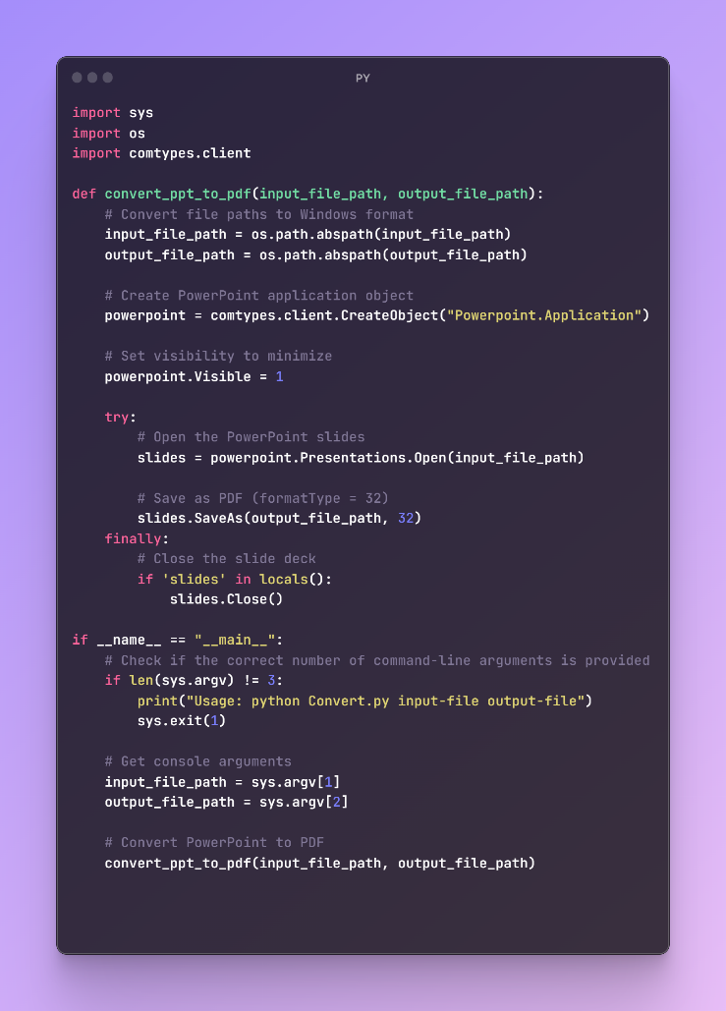
My IMAGE with code

