Slide 1
This is a Sample Slide
You can print out PPT files as handouts using the PRINT > PRINT WHAT > HANDOUTS option
Here is an outline of bulleted points

Slide 2
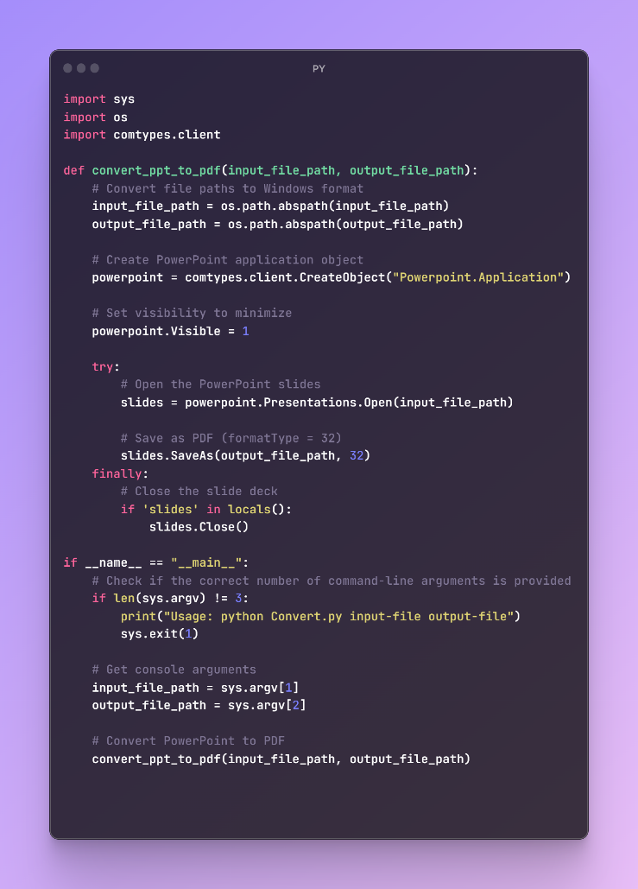
My IMAGE with code

