Slide 1
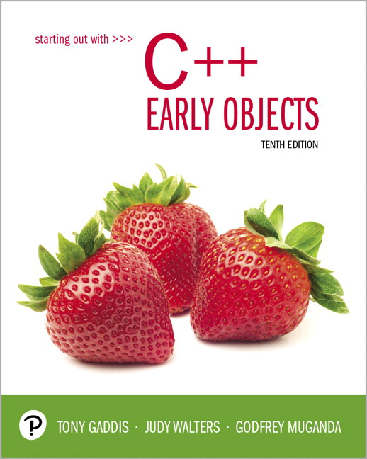
Starting Out with C++ Early Objects
Tenth Edition
Chapter 8
Arrays and Vectors

Slide 2
8.1 Arrays Hold Multiple Values
Array: a variable that can store multiple values of the same data type
The values are stored in consecutive memory locations
It is declared using [] operator
const int ISIZE = 5;
int tests[ISIZE];

Slide 3
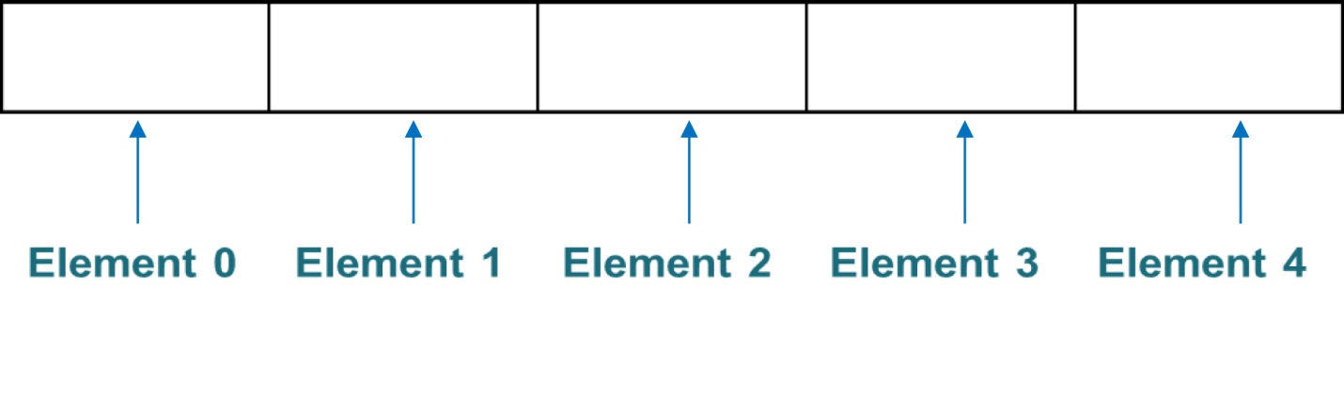
Array Storage in Memory
The definition
int tests[ISIZE]; // ISIZE is 5
allocates the following memory elements

Slide 4
Array Terminology
In the definition int tests[ISIZE];
int is the data type of the array elements
tests is the name of the array
ISIZE, in [ISIZE], is the size declarator. It shows the number of elements in the array.
The size of an array is the number of bytes allocated for it
(number of elements) * (bytes needed for each element)

Slide 5
Array Examples
Examples:
Assumes int uses 4 bytes and double uses 8 bytes
const int ISIZE = 5, DSIZE = 10;
int tests[ISIZE]; // holds 5 ints, array
// occupies 20 bytes
double volumes[DSIZE];// holds 10 doubles,
// array occupies
// 80 bytes

Slide 6
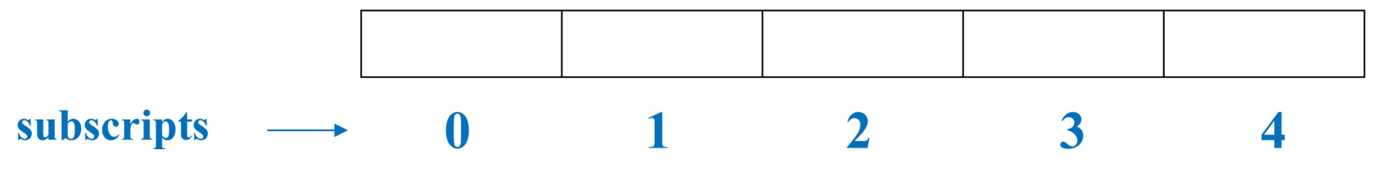
8.2 Accessing Array Elements 1 of 2
Each array element has a subscript, used to access the element.
Subscripts start at 0

Slide 7
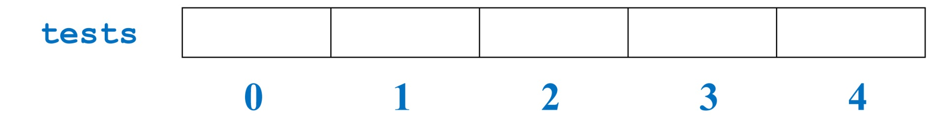
Accessing Array Elements 2 of 2
Array elements (accessed by array name and subscript) can be used as regular variables
tests[0] = 79;
cout << tests[0];
cin >> tests[1];
tests[4] = tests[0] + tests[1];
cout << tests; // illegal due to
// missing subscript

Slide 8
8.3 Inputting and Displaying Array Contents
cout and cin can be used to display values from and store values into an array
const int ISIZE = 5;
int tests[ISIZE]; // Define 5-elt. array
cout << "Enter first test score ";
cin >> tests[0];
Notes:
See pr8-01.cpp

Slide 9
Array Subscripts
Array subscript can be an integer constant, integer variable, or integer expression
Examples: Subscript is
cin >> tests[3]; int constant
cout << tests[i]; int variable
cout << tests[i+j]; int expression

Slide 10
Array Subscripts
const int ISIZE = 5;
int tests[ISIZE]; // Define 5-elt. array
cout << "Enter first test score ";
cin >> tests[0];
cout << "Enter second test score ";
cin >> tests[1];
cout << "Enter third test score ";
cin >> tests[2];
cout << "Enter fourth test score ";
cin >> tests[3];
cout << "Enter fifth test score ";
cin >> tests[4];
Notes:
See pr8-01.cpp

Slide 11
Accessing All Array Elements
To access each element of an array
Use a loop
Use the loop control variable as the array subscript
A different array element will be referenced each time through the loop
for (i = 0; i < 5; i++)
cout << tests[i] << endl;
Notes:
See pr8-02.cpp

Slide 12
Getting Array Data from a File
const int ISIZE = 5;
int sales[ISIZE];
ifstream dataFile;
dataFile.open("sales.dat");
if (!dataFile)
cout << "Error opening data file\n";
else // Input daily sales
{ for (int day = 0; day < ISIZE; day++)
dataFile >> sales[day];
dataFile.close();
}
Notes:
See pr8-03.cpp

Slide 13
Sending Array Data to a File
Open the file using an ofstream object
Use a loop to write each array element to the file
Close the file

Slide 14
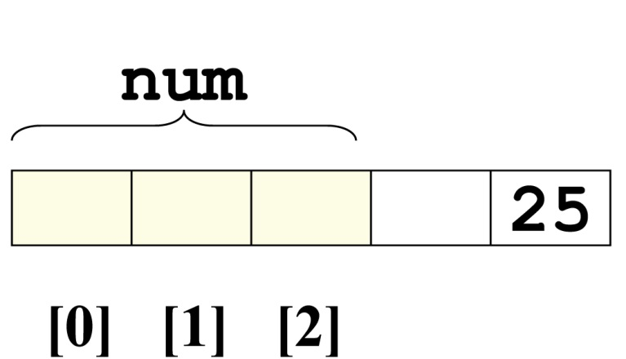
No Bounds Checking
There are no checks in C++ that an array subscript is in range
An invalid array subscript can cause the program to overwrite other memory
Example:
const int ISIZE = 3;
int i = 4;
int num[ISIZE];
num[i] = 25;
Notes:
See pr8-04.cpp

Slide 15
Off-By-One Errors
These most often occur when a program accesses data one position beyond the end of an array, or misses the first or last element of an array.
If an array has size n, then the range of the subscripts is from 0 to n-1

Slide 16
Start at element 0 or 1?
You may choose to declare arrays to be one larger than needed. This allows you to use the element with subscript 1 as the ‘first’ element, etc., and may minimize off-by-one errors.
The element with subscript 0 is not used.
This is most often done when working with ordered data that logically begins with 1, e.g., months of the year or days of the week
Notes:
See pr8-05B.cpp and pr8-06B.cpp

Slide 17
8.4 Array Initialization
An array can be initialized during program execution with assignment statements
tests[0] = 79;
tests[1] = 82; // etc.
It can be initialized at array definition with an initialization list
const int ISIZE = 5;
int tests[ISIZE] = {79,82,91,77,84};
Notes:
See pr8-05.cpp and pr8-06.cpp

Slide 18
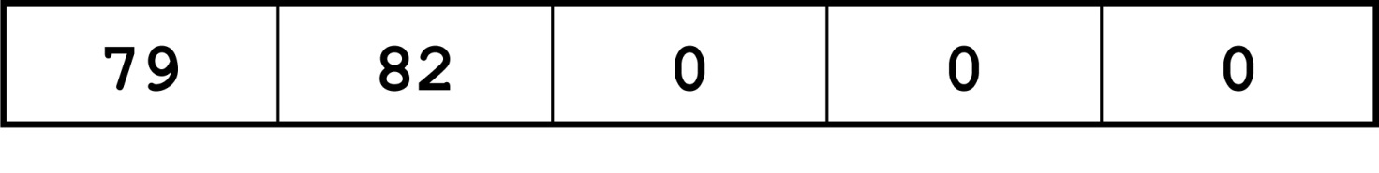
Partial Array Initialization
If an array is initialized at definition with fewer values than the array was declared to be, the remaining elements will be set to 0 or the empty string
int tests[ISIZE] = {79, 82};
Initial values are used in order; you cannot skip over elements to initialize a noncontiguous range
You cannot have more values in the initialization list than the declared size of the array
Notes:
See pr8-07.cpp

Slide 19
Implicit Array Sizing
C++ can determine the array size by the size of the initialization list
short quizzes[]={12,17,15,11};
You must use either an array size declarator or an initialization list when the array is defined

Slide 20
Alternate Ways to Initialize Variables
You can initialize a variable at definition time using a functional notation
int length(12); // same result as
// int length = 12;
In C++ 11 and higher, you can also do this:
int length{12};
The second approach checks the argument to ensure that it matches the data type of the variable, and will generate a compiler error if not

Slide 21
8.5 The Range-Based for Loop
Uses a variable that will hold a different array element for each iteration
Format:
for (data_type var : array)
statement;
data_type : the type of the variable
var: the variable
statement; : the loop body
Introduced in C++ 11

Slide 22
Range-Based for Loop - Details
data_type must be the type of the array elements, or a type that the array elements can be automatically converted to
var will hold the value of successive array elements as the loop iterates. Each array element is processed in the loop
statement; can be a single statement or a block of statements enclosed in { }

Slide 23
Range-Based for Loop – Example 1
// sum the elements of an array
int grades[] = {68,84,75};
int sum = 0;
for (int score : grades)
sum += score;
Notes:
See pr8-08.cpp and pr8.09.cpp

Slide 24
Range-Based for Loop – Example 2
// modify the contents of an array
const int ISIZE = 3;
int grades[ISIZE];
for (int &score : grades)
{
cout << "Enter a score: ";
cin >> score;
}

Slide 25
Comparison: Range-Based for Loop vs. Regular for Loop
The range-based for loop provides a simple notation to use to process all of the elements of an array.
However, it does not give you access to the subscripts of the array elements.
If you need to know the element locations as well as the element values, then use a regular for loop.

Slide 26
8.6 Processing Array Contents
Array elements can be
treated as ordinary variables of the same type as the array
used in arithmetic operations, in relational expressions, etc.
Example:
if (principalAmt[3] >= 10000)
interest = principalAmt[3] * intRate1;
else
interest = principalAmt[3] * intRate2;
Notes:
See pr8-10.cpp

Slide 27
Using Increment and Decrement Operators with Array Elements
When using ++ and -- operators, don’t
confuse the element with the subscript
tests[i]++; // adds 1 to tests[i]
tests[i++]; // increments i, but has
// no effect on tests

Slide 28
Copying One Array to Another
You cannot copy with an assignment statement:
tests2 = tests; //won’t work
You must instead use a loop to copy element-by-element:
for (int indx=0; indx < ISIZE; indx++)
tests2[indx] = tests[indx];
Notes:
See arrayCopy.cpp

Slide 29
Are Two Arrays Equal?
Like copying, you cannot compare two arrays in a single expression:
if (tests2 == tests)
You can use a while loop with a bool variable:
bool areEqual=true;
int indx=0;
while (areEqual && indx < ISIZE)
{
if(tests[indx] != tests2[indx]
areEqual = false;
indx++;
}
Notes:
See arrayCompare.cpp

Slide 30
Find the Sum, Average of Array Elements
Use a simple loop to add together array elements
float average, sum = 0;
for (int tnum=0; tnum< ISIZE; tnum++)
sum += tests[tnum];
Or use C++ 11 range-based for loop:
for (int num : tests)
sum += num;
Once summed, average can be computed
average = sum/ISIZE;

Slide 31
Find the Largest Array Element
Use a loop to examine each element and find the largest element (i.e., one with the largest value)
int largest = tests[0];
for (int tnum = 1; tnum < ISIZE; tnum++)
{ if (tests[tnum] > largest)
largest = tests[tnum];
}
cout << "Highest score is " << largest;
A similar algorithm exists to find the smallest element
Notes:
See pr8-11.cpp

Slide 32
Using Arrays vs. Using Simple Variables
An array is probably not needed if the input data is only processed once:
Find the sum or average of a set of numbers
Find the largest or smallest of a set of values
If the input data must be processed more than once, an array is probably a good idea:
Calculate the average, then determine and display which values are above the average, at the average, and below the average

Slide 33
Partially-Filled Arrays
The exact amount of data (and, therefore, the array size) may not be known when a program is written.
The programmer makes a best estimate for the maximum amount of data, then sizes arrays accordingly. A sentinel value can be used to indicate end-of-data.
The programmer must also keep track of how many array elements are actually used
Notes:
See pr8-12.cpp

Slide 34
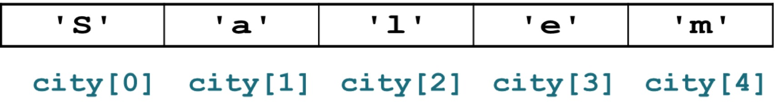
C-Strings and string Objects
They can be processed using the string name
Entire string at once, or
One element at a time by using a subscript
string city;
cout << "Enter city name: ";
cin >> city;
Notes:
See pr8-13.cpp and pr8-14.cpp

Slide 35
8.7 Using Parallel Arrays
Parallel arrays: two or more arrays that contain related data
The subscript is used to relate the arrays
elements at the same subscript are related
The arrays do not have to hold data of the same type

Slide 36
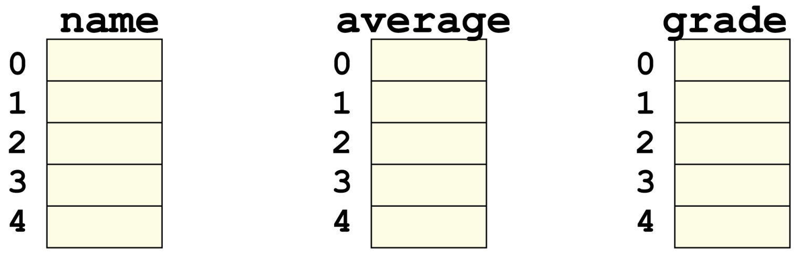
Parallel Array Example
const int ISIZE = 5;
string name[ISIZE]; // student name
float average[ISIZE]; // course average
char grade[ISIZE]; // course grade

Slide 37
Parallel Array Processing
const int ISIZE = 5;
string name[ISIZE]; // student name
float average[ISIZE]; // course average
char grade[ISIZE]; // course grade
...
for (int i = 0; i < ISIZE; i++)
{
cout << “Enter Student Name: “;
cin >> name[i];
cout << “Enter the Student Average: “;
cin >> average[i];
cout << “Enter the Student Grade: “;
cin >> grade[i];
}
Notes:
See pr8-15.cpp

Slide 38
Parallel Array Example
const int ISIZE = 5;
string name[ISIZE]; // student name
float average[ISIZE]; // course average
char grade[ISIZE]; // course grade
name average grade
0
1
2
3
4
Ben
0
1
2
3
4
94.8
0
1
2
3
4
A
Mary
78.1
C
John
90.9
A
Anna
81.4
B
Mark
85.2
B

Slide 39
Parallel Array Processing
const int ISIZE = 5;
string name[ISIZE]; // student name
float average[ISIZE]; // course average
char grade[ISIZE]; // course grade
...
for (int i = 0; i < ISIZE; i++)
cout << " Student: " << name[i]
<< " Average: " << average[i]
<< " Grade: " << grade[i]
<< endl;
Notes:
See pr8-15.cpp

Slide 40
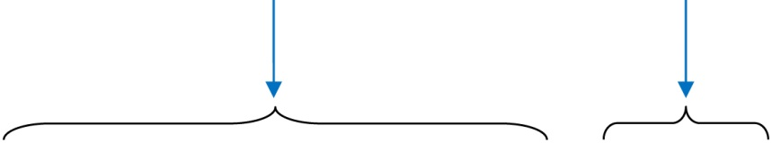
8.8 The typedef Statement
Creates an alias for a simple or structured data type
Format:
typedef existingType newName;
Example:
typedef unsigned int Uint;
Uint tests[ISIZE]; // array of
// unsigned ints

Slide 41
Uses of typedef
It can be used to make code more readable
Can be used to create an alias for an array of a particular type
// Define yearArray as a data type
// that is an array of 12 ints
typedef int yearArray[MONTHS];
// Create two of these arrays
yearArray highTemps, lowTemps;

Slide 42
8.9 Arrays as Function Arguments
Passing a single array element to a function is no different than passing a regular variable of that data type
The function does not need to know that the value it receives is coming from an array
displayValue(score[i]); // call
void displayValue(int item) // header
{ cout << item << endl;
}
Notes:
See pr8-16.cpp

Slide 43
Passing an Entire Array 1 of 2
To define a function that has an array parameter, use empty [] to indicate the array in the prototype and header
To pass an array to a function, just use the array name
// Function prototype
void showScores(int []);
// Function call
showScores(tests);
// Function header
void showScores(int tests[])

Slide 44
Passing an Entire Array 2 of 2
Use the array name, without any brackets, as the argument
You can also pass the array size as a separate parameter so the function knows how many elements to process
void showScores(int[], int); // prototype
showScores(tests, 5); // call
void showScores(int A[],int size) // header
Notes:
See pr8-17.cpp and pr8-19.cpp

Slide 45
Modifying Arrays in Functions
Array parameters in functions are similar to reference variables
Changes made to an array passed to a function are made to the actual array in the calling function
The programmer must be careful that an array is not inadvertently changed by a function
The const keyword can be used in the prototype and header to prevent changes
Notes:
See pr8-19.cpp and pr8-20.cpp

Slide 46
8.10 Two-Dimensional Arrays
You can define one array for multiple sets of data
It is like a table in a spreadsheet
Use two size declarators in the definition
int exams[4][3];
Number of rows
Number of cols

Slide 47
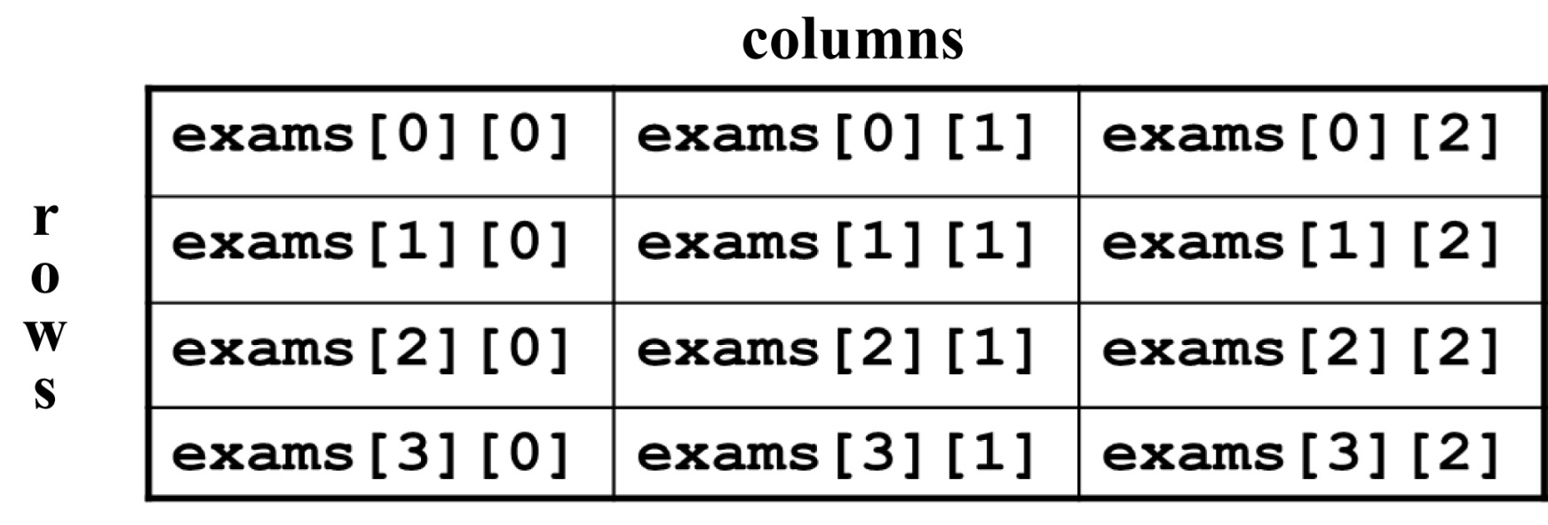
Two-Dimensional Array Representation
int exams[4][3];
Use two subscripts to access an element
exams[2][1] = 86;
Notes:
See pr8-21.cpp

Slide 48
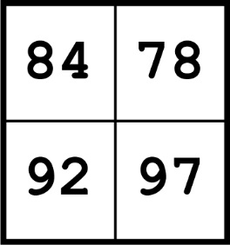
Initialization at Definition
Two-dimensional arrays are initialized row-by-row
int exams[2][2] = { {84, 78},
{92, 97} };
The inner { } in the initialization improve readability but are not required
The inner { } can be used to initialize some but not all elements of a two-dimensional array

Slide 49
Two-Dimensional Array Traversal
Use nested loops, one for the row and one for the column, to access each array element.
Accumulators can be used to calculate the sum of the elements row-by-row, column-by-column, or over the entire array.

Slide 50
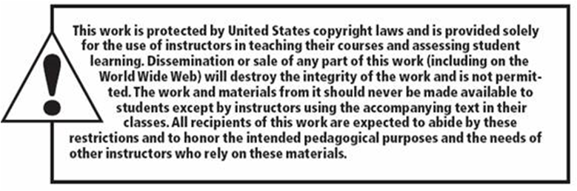
Copyright

