Slide 1
ERPC
Essential remote pc control

Slide 2
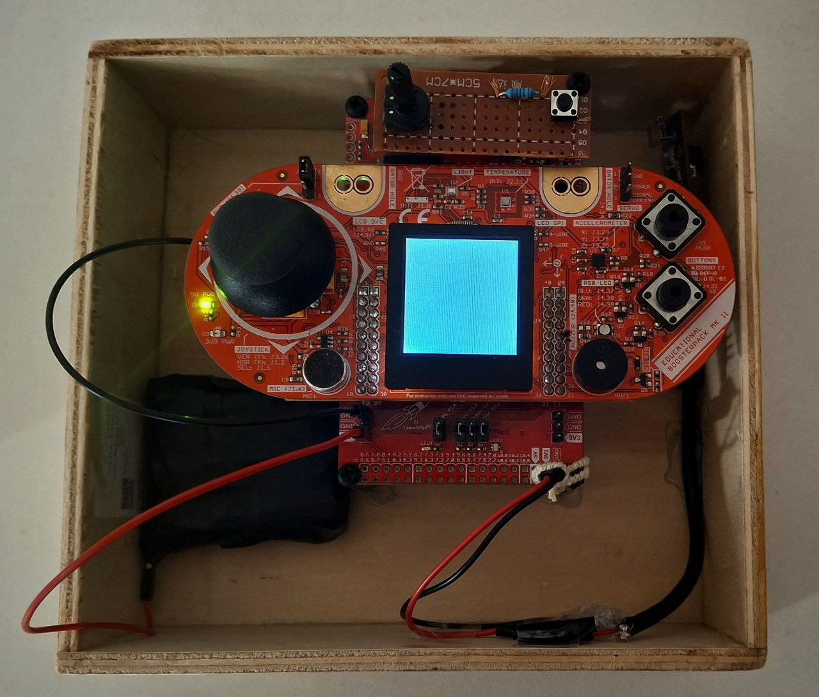
Introduction
Features:
Right and left buttons
Cursor movement
Volume control
ESC button
Virtual keyboard open button

Slide 3
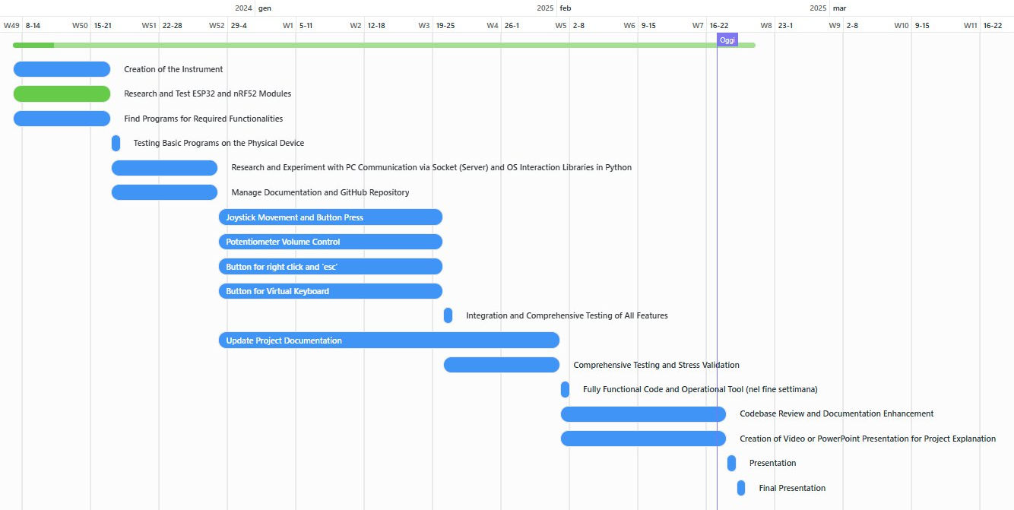
Gantt diagram

Slide 4
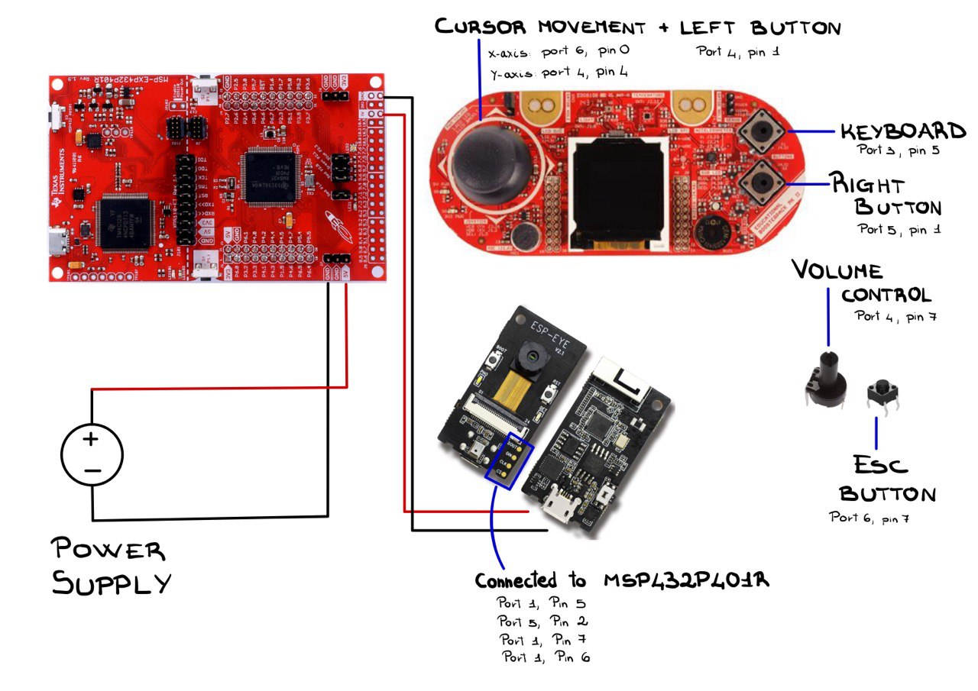
Software-hardware interaction

Slide 5
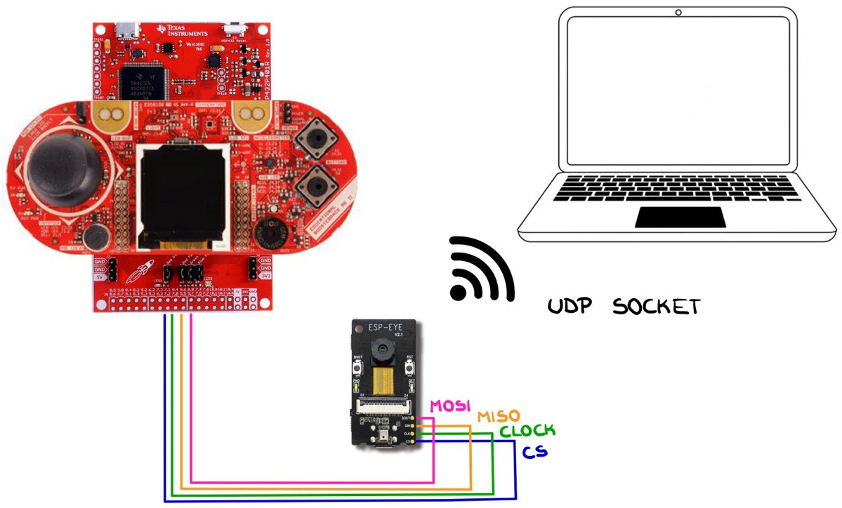
COMMUNICATION BETWEEN DEVICES

Slide 6
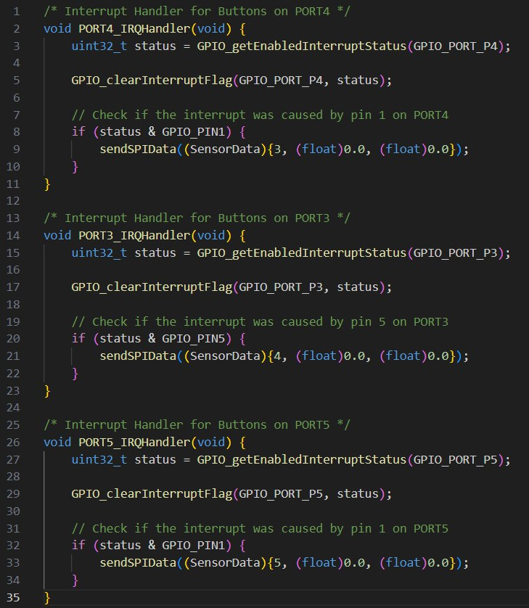
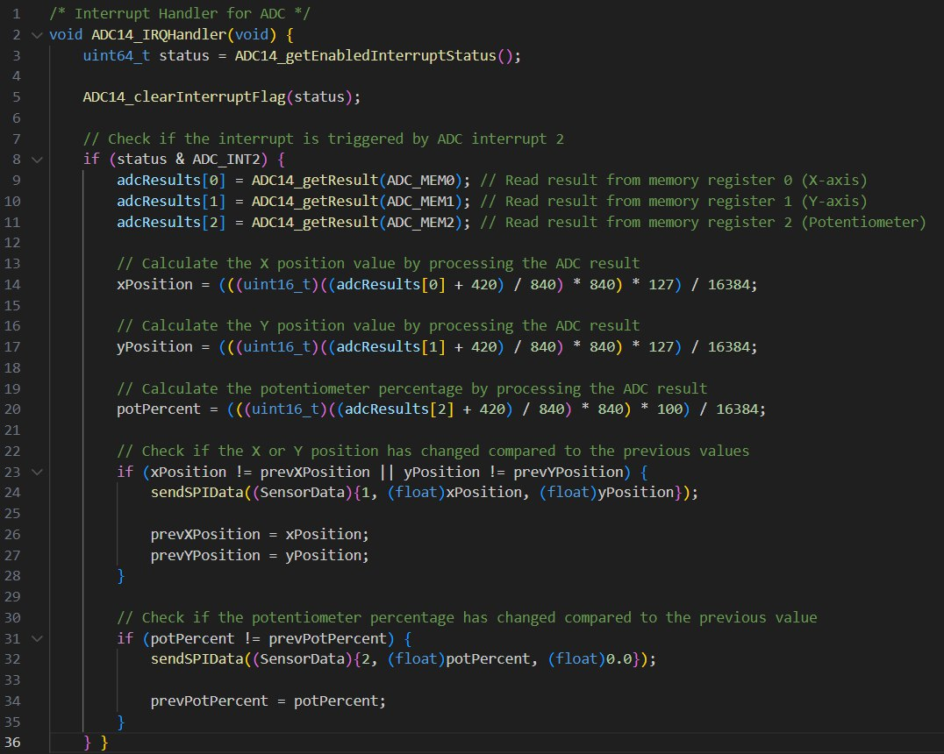
Relevant code

Slide 7
Testing & debugging
IMPROVEMENTS
No documentation for pin settings
Measurement frequency too high
Security
Bluetooth connection
External devices:
Display
Microphone
Touch screen

