Slide 1
PLANNING OUR LAYOUT

Slide 2
WIREFRAME
A wireframe is a layout of a web page that demonstrates what interface elements will exist on key pages

Slide 3
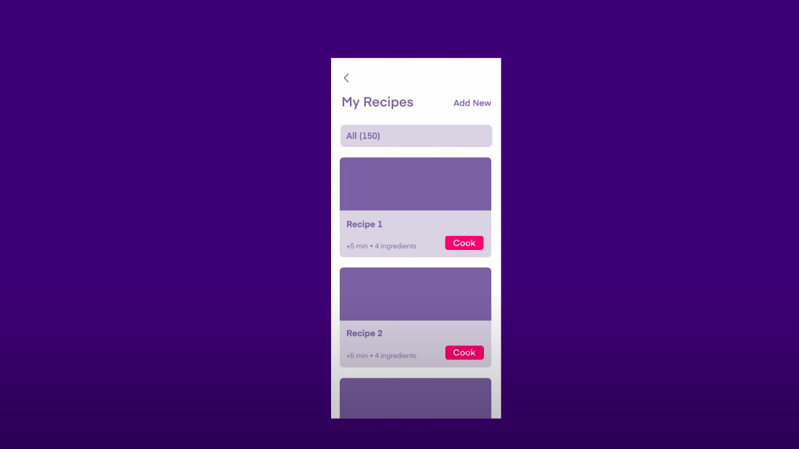

Slide 4
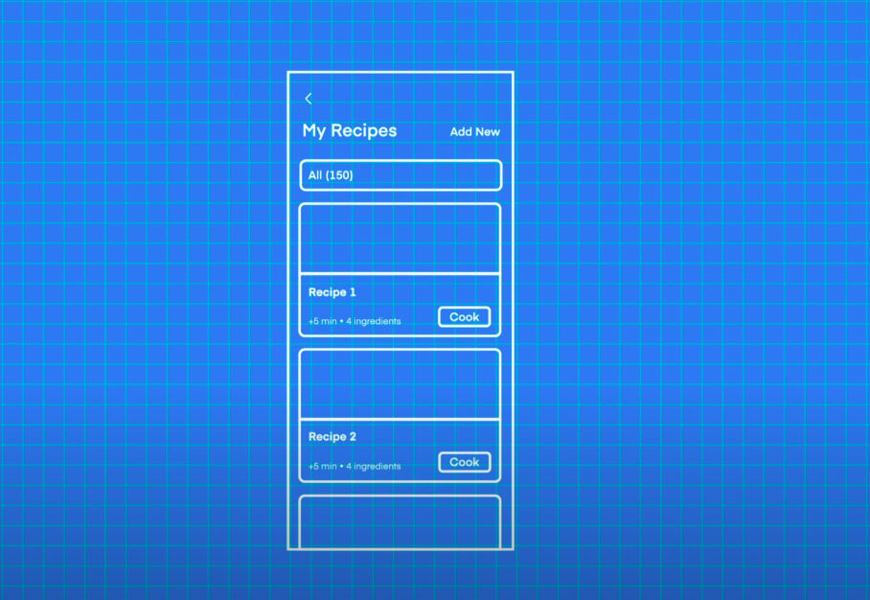

Slide 5
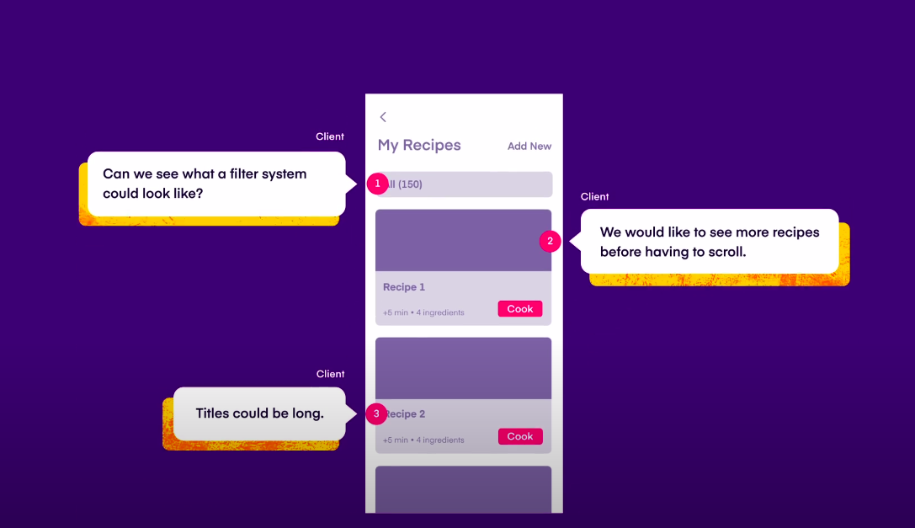

Slide 6
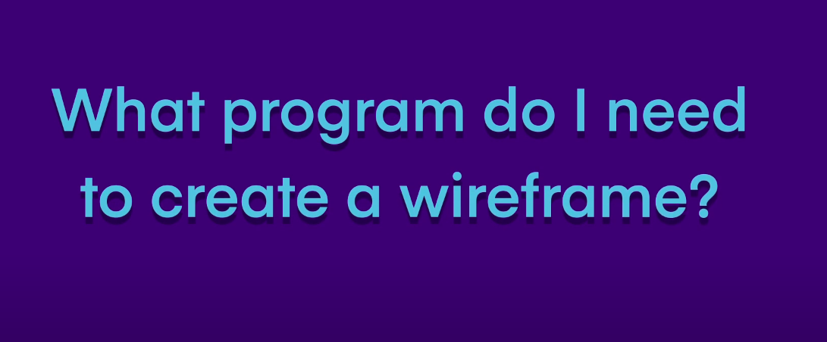

Slide 7


Slide 8
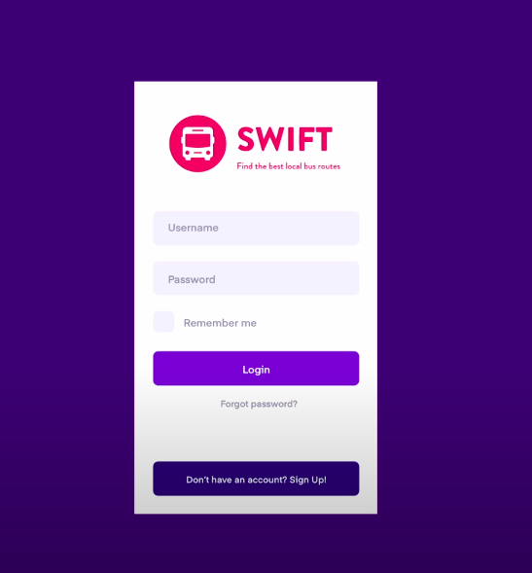

Slide 9
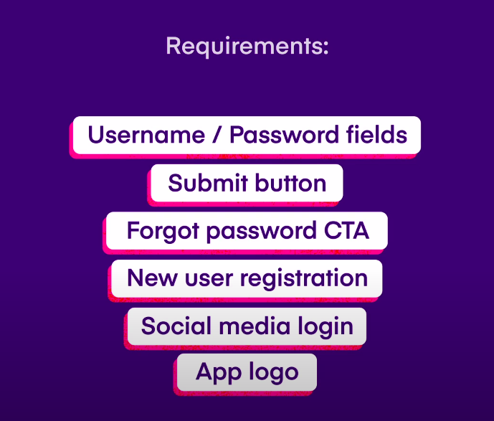

Slide 10


