Slide 1
JavaScript
An Introduction and Getting Started!

Slide 2
Content
Introduction to JavaScript
Working with Node
Variables in JavaScript

Slide 3
Introduction to JavaScript
JavaScript is a programming language for the web.
It is one of the three core technologies of the web, along with HTML and CSS.
A programming language is a formal language, which comprises a set of instructions and algorithms that can produce various kinds of outputs.

Slide 4
Introduction to JavaScript
We can use JavaScript to update and change both HTML and CSS. Moreover, we can calculate, manipulate and validate data using JavaScript.

Slide 5
Introduction to JavaScript
HTML: Hypertext Markup Language is a markup language for creating web pages and web applications.
CSS: Cascading Style Sheets is a style sheet language used for describing the presentation of a document.
While HTML and CSS are markup languages, JavaScript is a programming language.
Markup languages are used to describe and define elements within a document.
Programming languages are used to communicate instructions to a machine. They can be used to control the behavior of a machine and express algorithms.

Slide 6
History of JavaScript
JavaScript was created by Brendan Eich in 1995 while working at Netscape Communications. JavaScript was initially made for the Netscape browser.

Slide 7
History of JavaScript
When Netscape’s main competitor, Microsoft, started becoming popular, Netscape began the standardisation of JavaScript to avoid Microsoft gaining control of the JavaScript language. Netscape also began a partnership with Sun.

Slide 8
History of JavaScript
Microsoft’s internet explorer dominated the market.
Before Netscape went down, they set a standard which would guide JavaScript, named ECMAScript. This guides scripting language specifications. It dictates rules and conventions which everyone agrees upon.

Slide 9
History of JavaScript
JavaScript was created by Brendan Eich in 1995 for the web browser Netscape.
Mocha => LiveScript => JavaScript
Microsoft’s Internet Explorer took JavaScript and started making its own implementations like JScript.
Soon Internet Explorer dominated the market and Netscape project shut down.
Before Netscape went down, they decided to start a standard that would guide the path of JavaScript, named ECMAScript.

Slide 10
History of JavaScript
Standard is set of rules and conventions which everybody agrees upon.
Ecma International: an organization that creates standards for technologies.
ECMA-262: a standard published by Ecma International.
ECMAScript is a scripting-language specification standardized by Ecma International in ECMA-262.

Slide 11
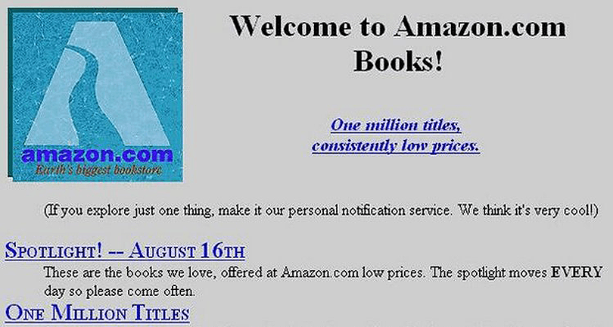
This is how websites looked like in the 90s

Slide 12
A Note on Marketing
Java was created in 1990, and in 1995 there was a lot of hype around the programming language.
JavaScript got its name because the creator and a partnering company wanted JavaScript to benefit from the Java hype. The name is only a marketing ploy. JavaScript has nothing to do with Java!
JavaScript is as related to Java as Carnival is to Car.
Kyle Simpson

