Slide 1
node.js
Node.js is an open-source, cross-platform JavaScript run-time environment that executes JavaScript code outside of a browser.

Slide 2
Working with node
JavaScript applications do not need to run in the browser. We can run applications that run in the terminal. The most common way to do this is with Node.js (or node for short).

Slide 3
Why Node?
Throughout this module, we are going to be teaching programming basics, logical thinking, pattern recognition, etc. So, for now, the focus should be on the programming language to form a solid basis in the fundamentals!

Slide 4
console.log()
This method outputs a message to the web console (or to the terminal we’re working in).
It is logging a message to the console. This method is EXTREMELY important for debugging.
When in doubt, console.log()!

Slide 5
Let’s create our first JavaScript file!
Create a file named “hello.js”
We’re going to run our first console.log console.log(‘Hello, world’)

Slide 6
Terminal
You can open the terminal right in Visual Studio Code. The keyboard shortcut is ctrl+`

Slide 7
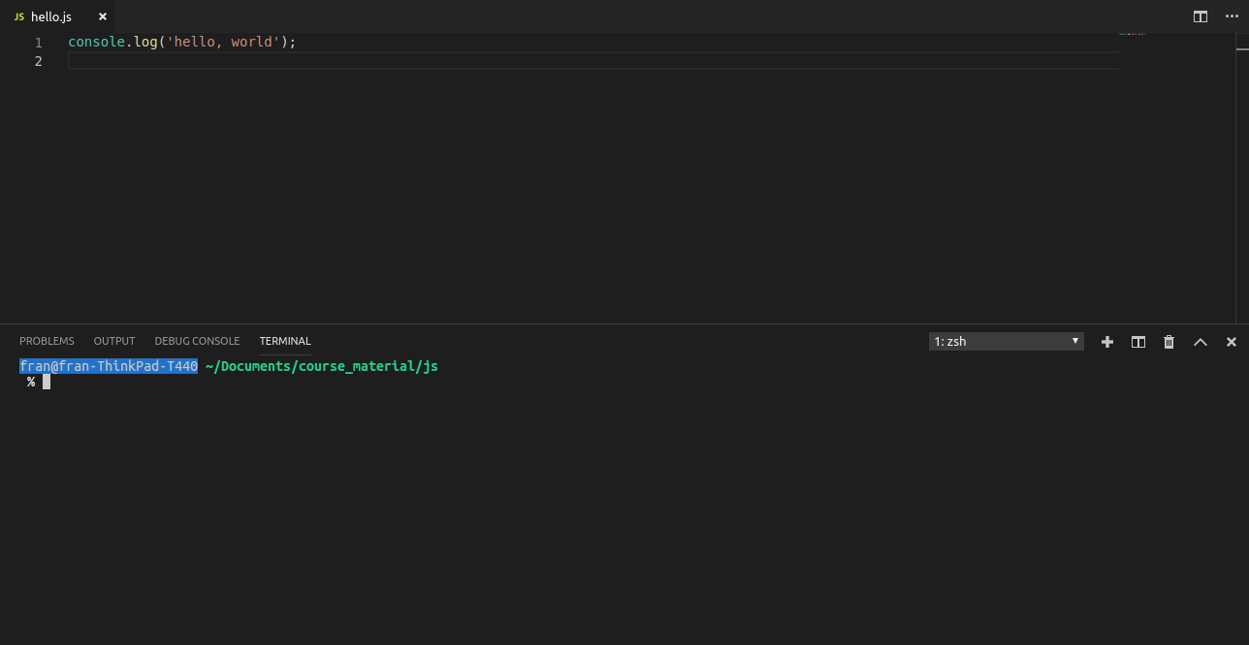

Slide 8
Once you’ve opened the terminal, you can run your script with the command: node filename node hello.js

Slide 9
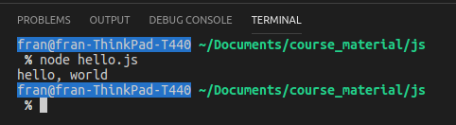
Once you run your script, you should see the message that you console logged right in the terminal.

