Slide 1
Strings
Strings in JavaScript represent textual data. Eg. let str = “This is a string”.
Writing Strings
Double quotes: "Hello".
Single quotes: 'Hello'.
Backticks: `Hello`.

Slide 2
Strings
Note: there is no character type in JavaScript as there is in some languages.
Each element in the String occupies a position in the String.
The first element is at index 0, the next at index 1, and so on. The length of a String is the number of elements in it.

Slide 3
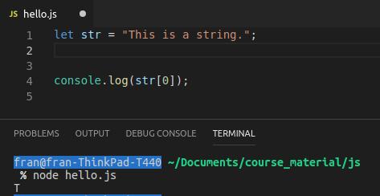
Strings
We can access an element in a String by using square brackets as well as the index.
e.g. str[0].
Note: JavaScript is case sensitive!!

