Slide 1
objects
A JavaScript object is a collection of properties. These properties are stored in key/value pairs. Properties can reference any type of data, including objects and/or primitive values.
Objects are variables too.
But objects can contain many values.
var obj = {
key1: 'value',
key2: 'value',
key3: true,
key4: 32,
key5: {}
}

Slide 2
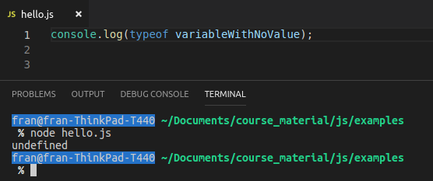
typeof
You can check the data type of something with the typeof operator.
This returns the data type of a given value.
What is the type of a variable with no value?

Slide 3
typeof

