Slide 1
EXECUTIVE STORYLINE · FY2024 10-K · CONFIDENTIAL
Amazon.com, Inc.
AMZN
AWS-led growth is reaccelerating — but capex is consuming all of it, leaving FCF at $7.7B.
A five-act readout for the leadership team.
Prepared for the executive team
April 2026
Notes:
Open with the contradiction in one breath: Amazon is having one of its best years in a decade — earnings up, AWS reaccelerating — and yet free cash flow just collapsed 77%. That tension IS the deck.
Frame the deck: I'll walk through the same five questions the board will ask — what's happening, what's driving it, what's the issue, why it matters, and what we should track.
Tone: confident, operator-grade. Don't apologize for the capex. Just be clear-eyed about the trade-off.

Slide 2
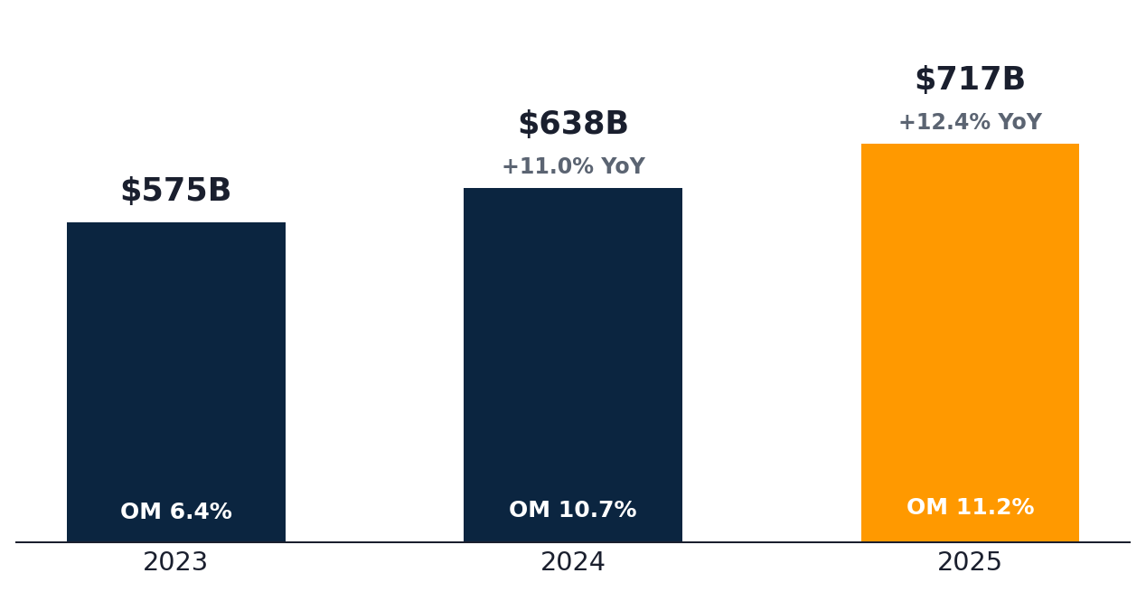
ACT I · WHAT'S HAPPENING
Amazon posted +12.4% revenue growth, lifting the topline to $716.9B with op margin near 11%
REVENUE
OPERATING MARGIN
NET MARGIN
$716.9B
11.2%
10.8%
+12.4% YoY
+40 bps YoY
+150 bps YoY
WHAT THE NUMBERS TELL US
REVENUE & OPERATING MARGIN
DURABLE Top-line growth holds in low-teens for the second straight year — re-acceleration is real.
LEVERAGE Operating margin nearly doubled in two years (6.4% → 11.2%) on AWS mix and retail efficiency.
QUALITY Net income up 31% on $79B operating profit — first true earnings inflection since 2018.
Source: Amazon.com, Inc. 10-K, FY2024 · Equity research view
2 / 7
Notes:
Anchor in the strength first. Three numbers: revenue $716.9B (+12%), op margin 11.2%, net income $77.7B. These are real.
Operating margin nearly doubling in two years is the under-told story — most analysts still think of Amazon as a low-margin retailer.
Closing line: 'On every income-statement metric, this is the best year Amazon has had as a public company. Hold that — because the cash-flow picture changes the conversation.'

Slide 3
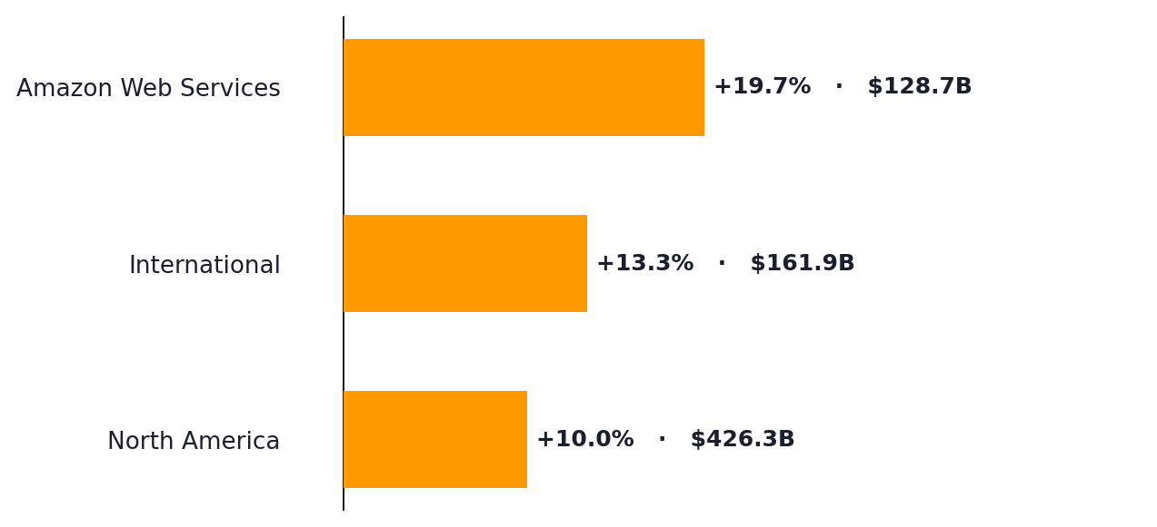
ACT II · WHAT'S DRIVING IT
AWS (+19.6%) is the single-largest profit engine — $45.6B operating income at 35% margin
SEGMENT REVENUE — YoY GROWTH AND CURRENT-YEAR SCALE
AWS REVENUE GROWTH
+19.6%
vs +13.3% prior year — clear reacceleration
AWS contributes 18% of revenue but 57% of segment OI
ENGINE AWS posted $45.6B in operating profit at 35.4% margin — more than NA + International combined.
BREADTH International (+13.3%) and North America (+10.0%) confirm growth is not AWS-only.
AI Bedrock + Trainium + Anthropic partnership are now driving measurable enterprise consumption.
Source: Amazon.com, Inc. 10-K, FY2024 · Equity research view
3 / 7
Notes:
AWS is not just the largest segment by profit — it's the sole reason consolidated margins look the way they do.
+19.6% AWS growth on a $108B base is the most significant data point. That's worth pausing on. Compare to Azure +34%, GCP +30% — Amazon is still in the race.
Land the implication: 'When AWS reaccelerates AND capex jumps 59%, the question is whether one is paying for the other. That's the next slide.'

Slide 4
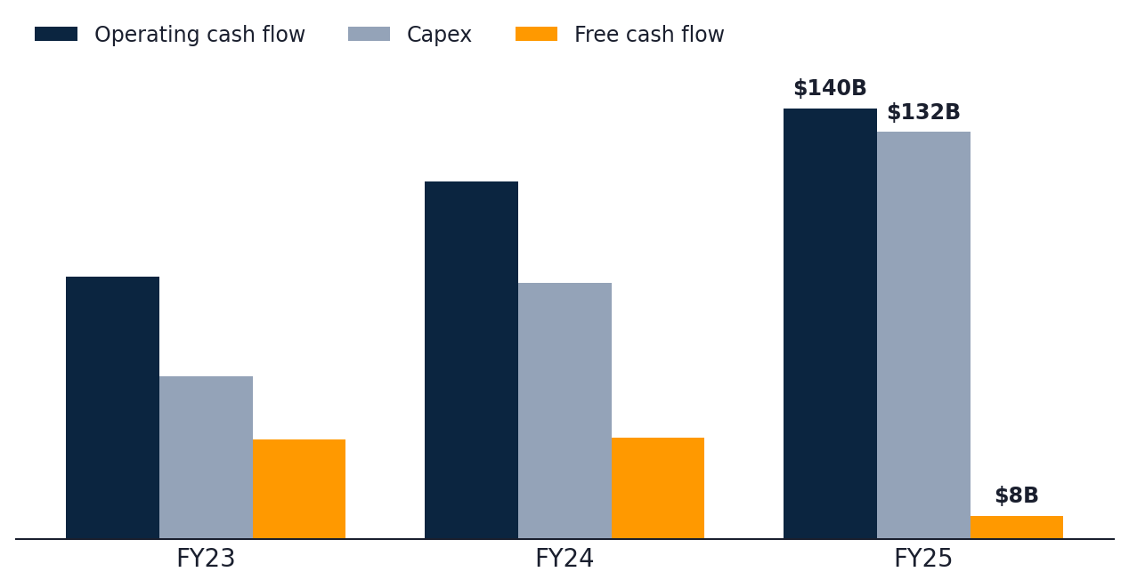
ACT III · WHAT'S THE ISSUE
Capex (+59% YoY) is now consuming nearly all operating cash flow — FCF collapsed 77%
OPERATING CASH FLOW vs. CAPEX vs. FREE CASH FLOW ($B)
CAPEX FY24
$131.8B
▲ +58.8% YoY
vs FCF $7.7B (▼ –76.6% YoY)
WHY THE CASH STORY HAS CHANGED
STRUCTURAL Capex/OCF ratio jumped from 72% (FY23) to 95% (FY24) — almost every dollar of cash is being reinvested.
SEVERE FCF collapsed from $32.9B to $7.7B in one year — a 77% decline despite $79B of operating income.
INTENSITY Capex is now 18.4% of revenue, up from 9.2% three years ago — a doubling of capital intensity.
Source: Amazon.com, Inc. 10-K, FY2024 · Equity research view
4 / 7
Notes:
This is the turning point of the deck. Slow down. The $7.7B FCF number is the headline; everything before this slide was setup.
Lead with the contradiction: Revenue grew $79B. FCF dropped $25B. The cash went into PP&E — Trainium chips, data centers, leases.
Don't editorialize on whether the spend is 'right.' The spend may be entirely warranted. But the cash-flow profile of the company has fundamentally changed.

Slide 5
ACT IV · WHY IT MATTERS
Sustainability hinges on AWS holding above 18% growth while capex peaks in 2025
TWO SCENARIOS — AND WHAT TIPS US INTO EACH
BASE CASE · AWS HOLDS, CAPEX PEAKS FY25
BEAR CASE · AWS DECELERATES, CAPEX STAYS HOT
FCF REBUILD
FCF STALL
FCF re-accelerates to $40–55B by FY26 as capex moderates to ~14% of revenue.
FCF stuck below $20B if AWS slips below 15% while capex stays above $130B.
MARGIN
MARGIN REVERSAL
Operating margin expands toward 13% on AWS mix and retail leverage.
Depreciation step-up alone could compress retail OI back to break-even.
MULTIPLE
DE-RATING
Re-rating as compounding FCF returns and AI ROIC become visible.
Multiple compression on a thesis that AI capex isn't earning its cost of capital.
THE CRITICAL VARIABLE
Whether AWS workloads can monetize at the rate capex is being deployed — by FY26, not later.
Source: Amazon.com, Inc. 10-K, FY2024 · Equity research view
5 / 7
Notes:
Frame as a fork in the road. Two scenarios. The next 18 months will tell us which one we're in.
Use clean transition language: 'In the base case... in the bear case...' Avoid emotional words.
End on the critical variable — AI workload monetization rate. That's THE metric. Everything else is downstream.

Slide 6
ACT V · BOTTOM LINE
Track three metrics that will tell us — within 12 months — which scenario is unfolding
THE THREE-METRIC EARLY-WARNING DASHBOARD
01
AWS constant-currency growth
Watch for >18% — anything below 15% would meaningfully break the AI-monetization thesis.
QUARTERLY · AWS SEGMENT RELEASE
02
Capex/OCF ratio
Should peak by FY25 and trend toward 75% in FY26. Above 95% = structural cash strain.
MONTHLY · TREASURY CASH FORECAST
03
AWS operating margin
Watch for >32% — compression below 30% would signal pricing pressure or AI mix-shift drag.
QUARTERLY · SEGMENT DISCLOSURE
RECOMMENDATION
Stay constructive on the franchise; gate further conviction on Q2 capex moderation and AWS reacceleration.
Source: Amazon.com, Inc. 10-K, FY2024 · Equity research view
6 / 7
Notes:
Land on a single, decisive recommendation. Don't hedge.
Watch list: three metrics, one quarter at a time. Make it sound operational — these are things the team CAN monitor.
Closing line: 'We don't need to bet now. We need to be paying attention. The AWS growth print and the capex/OCF ratio will tell us everything.'

Slide 7
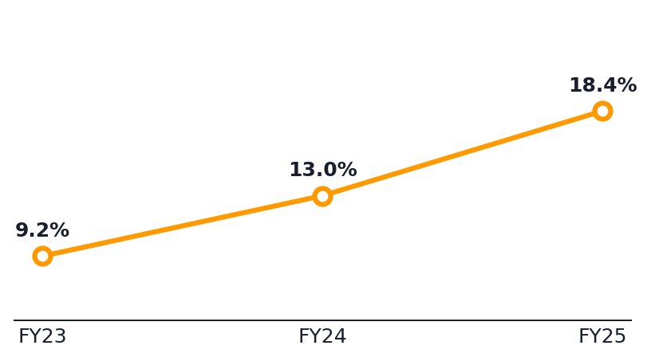
APPENDIX
Three-year P&L, segment, and cash-flow reference
INCOME STATEMENT · $B EXCEPT %
CASH FLOW · $B
SEGMENTS · FY24 REVENUE
FY22
FY23
FY24
FY22
FY23
FY24
FY24
YoY
OM%
Revenue
$574.8
$638.0
$716.9
Operating cash flow
$84.9
$115.9
$139.5
North America
$426.3
+10.0%
6.9%
Gross profit
$269.3
$311.7
$360.5
Capex
$52.7
$83.0
$131.8
International
$161.9
+13.3%
2.9%
Operating income
$36.9
$68.6
$80.0
Free cash flow
$32.2
$32.9
$7.7
AWS
$128.7
+19.6%
35.4%
Net income
$30.4
$59.2
$77.7
SBC
$24.0
$22.0
$19.5
R&D
$85.6
$88.5
$108.5
D&A
$48.7
$52.8
$65.8
CAPEX INTENSITY · CAPEX/REVENUE %
Gross margin
46.9%
48.9%
50.3%
Buybacks
$0.0
$0.0
$0.0
Operating margin
6.4%
10.8%
11.2%
Dividends
$0.0
$0.0
$0.0
Net margin
5.3%
9.3%
10.8%
Capex/OCF
62%
72%
95%
Source: Amazon.com, Inc. 10-K, FY2024 · Equity research view
7 / 7
Notes:
Don't read this slide. Use it to take Q&A.
If asked, highlight one stat: Capex/OCF moved from 72% to 95% in one year — that's the single number that summarizes the entire story.
Have AWS economics ready as a deeper question: 35.4% op margin on $128.7B in revenue.

