Slide 1
EXECUTIVE STORYLINE · FY2024 10-K · CONFIDENTIAL
Apple Inc.
AAPL
Topline growth has slowed to mid-single digits — premium margins and capital return remain the equity story.
A five-act readout for the leadership team.
Prepared for the executive team
April 2026
Notes:
Apple is a different story from peers. Frame it: revenue growth is the slowest of the four mega-caps, but margin expansion + capital return is sustaining the equity story.
The deck answers: is the Services + AI engine large enough to offset hardware deceleration and China weakness?
Tone: measured. Don't oversell. Don't undersell. Apple is the most premium, lowest-volatility name in this peer group.

Slide 2
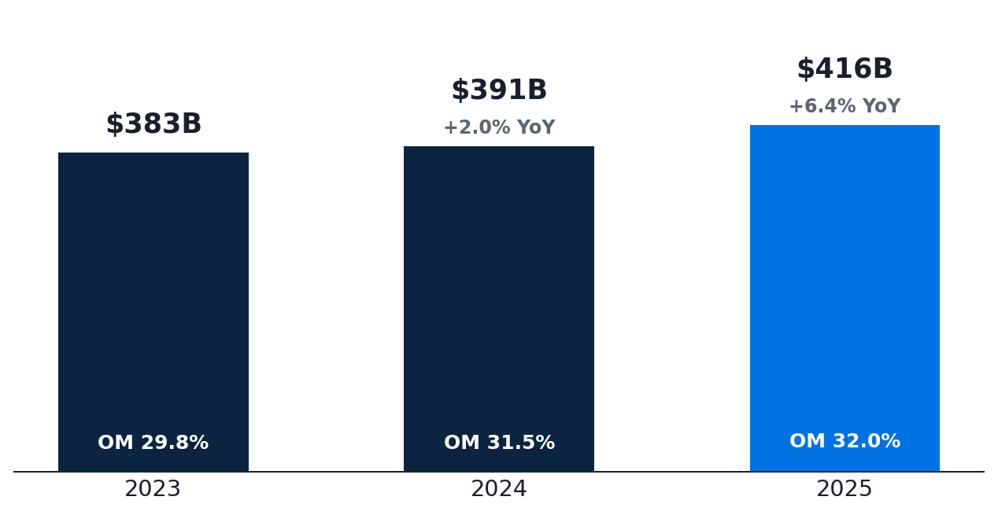
ACT I · WHAT'S HAPPENING
Apple posted +6.4% revenue growth — modest top-line, but margins are the highest in five years
REVENUE
OPERATING MARGIN
NET MARGIN
$416.2B
32.0%
26.9%
+6.4% YoY
+50 bps YoY
+290 bps YoY
WHAT THE NUMBERS TELL US
REVENUE & OPERATING MARGIN
STABILIZING Revenue back in growth after a flat FY24, but pace is roughly half of Microsoft and a third of Meta.
MARGIN Gross margin near 47% — highest level since FY21 — driven by Services mix shift.
QUALITY Net income $112B (+19%); $90.7B returned via buybacks. EPS leverage from share count alone is meaningful.
Source: Apple Inc. 10-K, FY2024 · Equity research view
2 / 7
Notes:
Three numbers: revenue $416B (+6%), op margin 32% — yes, this is normal for Apple.
Net margin expansion 290 bps is meaningful — that's the buyback compounding showing up in per-share economics.
Closing: 'The income statement is fine. The narrative complexity is in the geographic mix and the cash-deployment choices.'

Slide 3
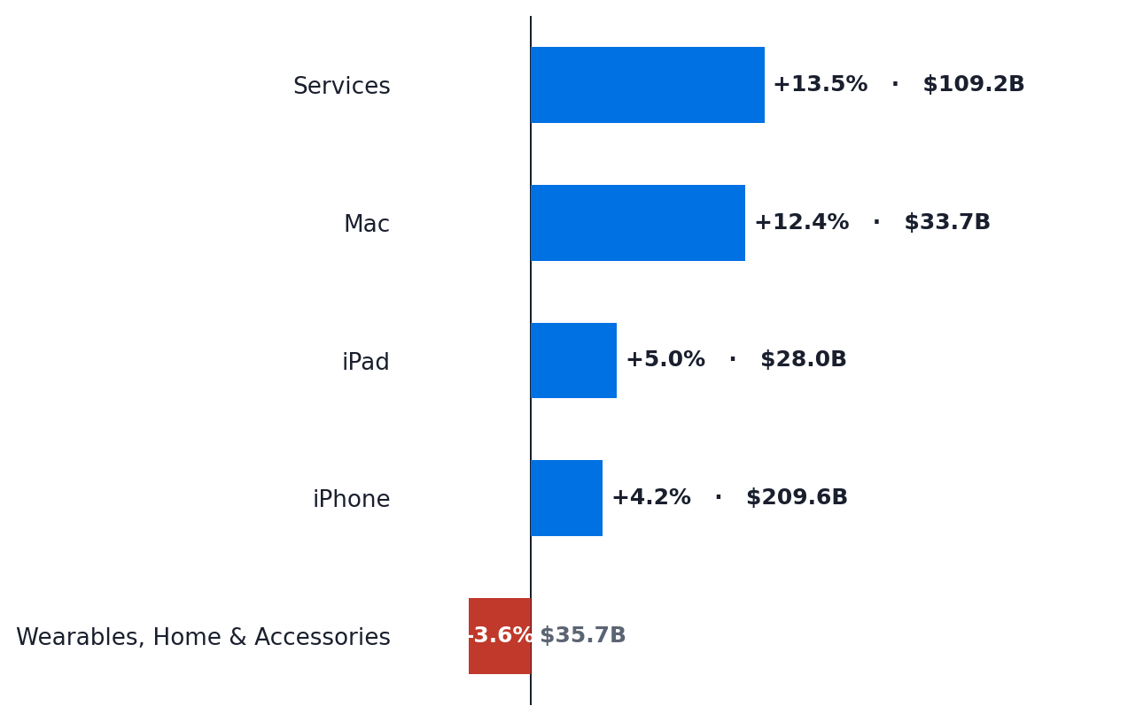
ACT II · WHAT'S DRIVING IT
Greater China (–4%) is the single largest drag — but Services growth and margin expansion offset
SEGMENT REVENUE — YoY GROWTH AND CURRENT-YEAR SCALE
GREATER CHINA REVENUE
–4%
vs –2% prior year — second straight year of decline
Now 15% of revenue, down from 19% three years ago
OFFSET Japan (+15%) and Rest of Asia Pacific (+10%) more than compensate for the China softness.
MIX Americas now 43% of revenue — concentration in a single region is itself a strategic question.
SERVICES Services revenue growing double-digits at ~74% gross margin is the underlying margin engine.
Source: Apple Inc. 10-K, FY2024 · Equity research view
3 / 7
Notes:
China is the slide. Don't bury it. Two consecutive years of decline matter.
Counter-balance is Services + Japan + RoAP — but Services data isn't broken out the way investors want.
Land: 'Apple is becoming an America + Services story. That's defensible — but it's a different equity than the global hardware franchise of 2018.'

Slide 4
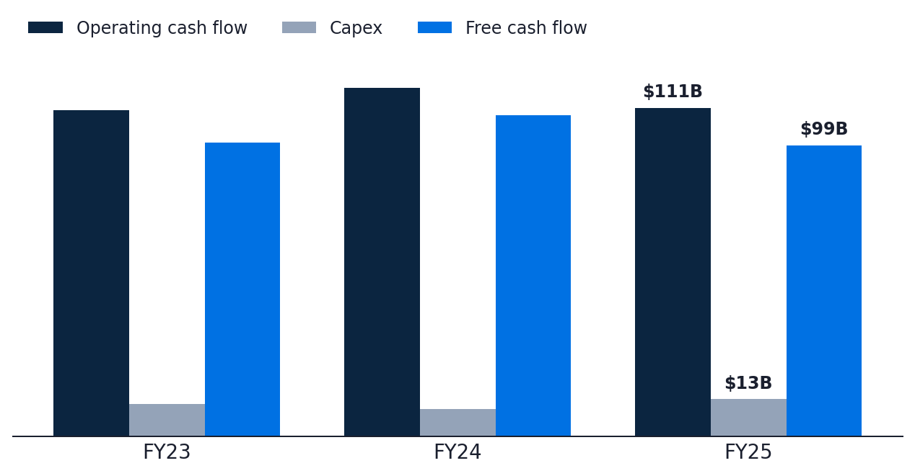
ACT III · WHAT'S THE ISSUE
Free cash flow declined 9% as buybacks consumed 92% of FCF — capital flexibility is narrowing
OPERATING CASH FLOW vs. CAPEX vs. FREE CASH FLOW ($B)
FCF FY24
$98.8B
▼ –9.2% YoY
Buybacks $90.7B = 92% of FCF
WHY THE CASH STORY MATTERS
CONCENTRATION Buybacks ($90.7B) + dividends ($15.4B) = $106B returned, larger than this year's FCF of $98.8B.
FLEX Net cash position falling — limits room for a major acquisition or unforeseen capex pivot.
CHINA-RISK If Greater China declines another 5–10%, FCF compresses materially before buybacks can adjust.
Source: Apple Inc. 10-K, FY2024 · Equity research view
4 / 7
Notes:
This is where Apple's story diverges from peers. The 'issue' isn't capex — it's capital flexibility narrowing as buybacks consume nearly all FCF.
Note: $106B returned vs. $98.8B FCF — net cash is being drawn down to fund the program.
Don't moralize. State it: this is a CHOICE the company is making. Investors should be aware of the trade-off.

Slide 5
ACT IV · WHY IT MATTERS
Sustainability hinges on Services holding above 12% growth while China stabilizes by FY26
TWO SCENARIOS — AND WHAT TIPS US INTO EACH
BASE CASE · SERVICES HOLDS, CHINA FLATTENS
BEAR CASE · SERVICES SLOWS, CHINA SOFTENS
REVENUE PATH
REVENUE STALL
Mid-to-high single-digit growth on Services + iPhone refresh + AI features.
Revenue back below 5% if Services dips below 10% and China drops another 5%+.
MARGIN
MARGIN COMPRESSION
Operating margin holds 32–33% on Services mix and supply-chain discipline.
Hardware deflation + ASP pressure could compress op margin toward 30%.
MULTIPLE
DE-RATING
Premium multiple defensible at 28–30× as buybacks compound EPS.
Multiple compression to 22–24× as the structural growth story weakens.
THE CRITICAL VARIABLE
Whether Services growth + AI-feature monetization can sustain double-digit pace by FY26.
Source: Apple Inc. 10-K, FY2024 · Equity research view
5 / 7
Notes:
Two scenarios, similar to how we frame other names — but the decisive variable is Services growth + China.
Base case is most likely. Bear case is real and more probable than for Microsoft or Meta.
Land on the critical variable: AI feature monetization. Apple Intelligence will need to be a real revenue line by FY27.

Slide 6
ACT V · BOTTOM LINE
Track three metrics that will tell us — within 12 months — which scenario is unfolding
THE THREE-METRIC EARLY-WARNING DASHBOARD
01
Services revenue growth
Watch for >12% — anything below 10% would break the high-margin growth narrative.
QUARTERLY · SERVICES LINE ITEM
02
Greater China revenue
Stabilization or growth needed; another 5%+ decline would meaningfully compress estimates.
QUARTERLY · GEOGRAPHIC SEGMENT DISCLOSURE
03
Apple Intelligence adoption
Look for explicit feature monetization commentary; Vision Pro learnings may apply.
QUARTERLY · EARNINGS CALL COMMENTARY
RECOMMENDATION
Premium-quality holding; conviction depends on Services trajectory and China stabilization.
Source: Apple Inc. 10-K, FY2024 · Equity research view
6 / 7
Notes:
Single recommendation. Premium holding — but not a high-conviction add at current multiple.
Watch list: Services growth, China revenue, AI adoption commentary. These three will move the multiple.
Closing: 'Apple is the lowest-beta name in the group. Hold for quality; don't expect the +30% upside that Microsoft or Meta could deliver.'

Slide 7
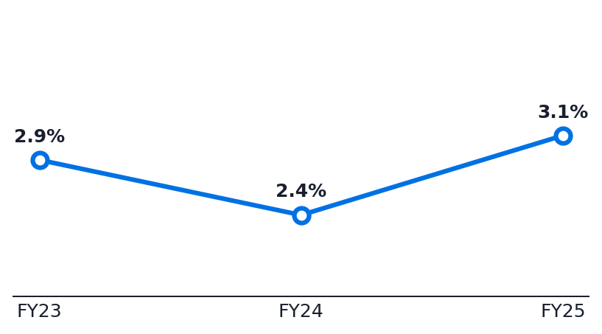
APPENDIX
Three-year P&L, segment, and cash-flow reference
INCOME STATEMENT · $B EXCEPT %
CASH FLOW · $B
GEOGRAPHIC SEGMENTS · FY24 REVENUE
FY22
FY23
FY24
FY22
FY23
FY24
FY24
YoY
Mix
Revenue
$383.3
$391.0
$416.2
Operating cash flow
$110.5
$118.3
$111.5
Americas
$178.4
+7%
43%
Gross profit
$169.1
$180.7
$195.2
Capex
$11.0
$9.4
$12.7
Europe
$111.0
+10%
27%
Operating income
$114.3
$123.2
$133.1
Free cash flow
$99.6
$108.8
$98.8
Greater China
$64.4
–4%
15%
Net income
$97.0
$93.7
$112.0
SBC
$10.8
$11.7
$12.9
R&D
$29.9
$31.4
$34.6
D&A
$11.5
$11.4
$11.7
CAPEX INTENSITY · CAPEX/REVENUE %
Gross margin
44.1%
46.2%
46.9%
Buybacks
$77.6
$94.9
$90.7
Operating margin
29.8%
31.5%
32.0%
Dividends
$15.0
$15.2
$15.4
Net margin
25.3%
24.0%
26.9%
Capex/OCF
10%
8%
11%
Source: Apple Inc. 10-K, FY2024 · Equity research view
7 / 7
Notes:
Reference page. Use for Q&A.
If asked one number: net margin expansion 290 bps. That's the buyback math.
Service revenue growth will dominate any deeper question — have the Q4 print ready.

