Slide 1
EXECUTIVE STORYLINE · FY2024 10-K · CONFIDENTIAL
Meta Platforms, Inc.
META
Ad business is humming — but Reality Labs lost $19B and AI capex is up 87%, compressing FCF.
A five-act readout for the leadership team.
Prepared for the executive team
April 2026
Notes:
Headline: Meta is having one of its best operating years ever — and FCF still went down. That contradiction is the deck.
Frame: five questions. What's happening, what's driving it, what's the issue, why it matters, what to track.
Tone: clear-eyed. The bull case on Meta is strong. The bear case is real. We're going to draw both lines.

Slide 2
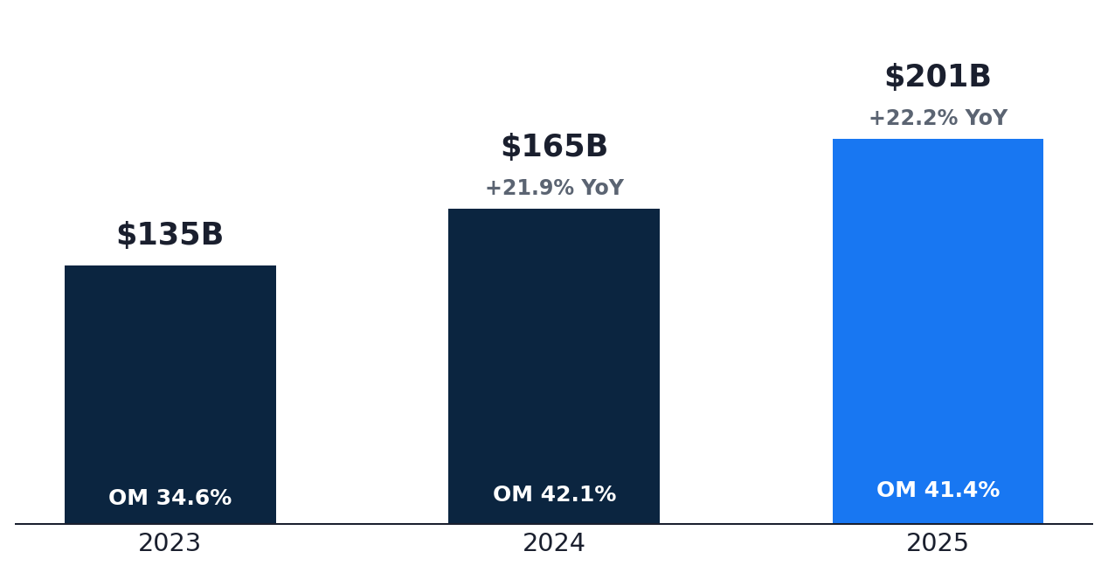
ACT I · WHAT'S HAPPENING
Meta posted +22.1% revenue growth — best top-line in three years, but FCF declined 16%
REVENUE
OPERATING MARGIN
NET MARGIN
$201.0B
41.4%
30.1%
+22.1% YoY
–80 bps YoY
–780 bps YoY
WHAT THE NUMBERS TELL US
REVENUE & OPERATING MARGIN
ACCELERATING +22% growth is the fastest since FY21 — AI-recommended content is driving real engagement.
LEVERAGE-LIMITED Operating margin DECLINED slightly — 41% is still elite, but Reality Labs + AI capex are starting to weigh.
QUALITY-WATCH Net margin compressed 780 bps as RL losses and tax rate normalize — earnings quality is the open question.
Source: Meta Platforms, Inc. 10-K, FY2024 · Equity research view
2 / 7
Notes:
Three numbers: $201B revenue (+22%), op margin 41%, net margin 30%.
Note the asymmetry: top-line is best-in-class, but margins are flat-to-down. That's the AI capex showing up.
Closing: 'Meta is the rare case where the income statement and the cash flow statement tell different stories. We need to read both.'

Slide 3
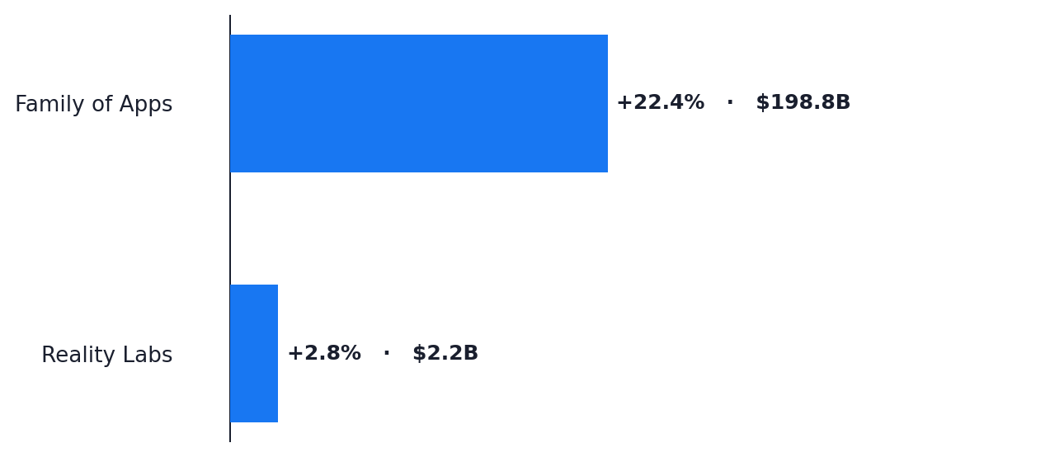
ACT II · WHAT'S DRIVING IT
Family of Apps (+18%) is the entire profit engine — Reality Labs lost $19B at –870% margin
SEGMENT REVENUE — YoY GROWTH AND CURRENT-YEAR SCALE
FAMILY OF APPS REVENUE GROWTH
+18%
Operating margin 51.6% — highest in company history
AI-driven recommendation system is the underlying lever
ENGINE FoA generated $102B in operating profit — a profitability inflection driven by AI ranking + ads efficiency.
AI-WORKING Engagement up across Reels + Threads; advertiser ROI improving without CPM compression.
RL-DRAG Reality Labs lost $19B on $2B revenue — cumulative ~$60B since 2020 with no margin path in sight.
Source: Meta Platforms, Inc. 10-K, FY2024 · Equity research view
3 / 7
Notes:
FoA at 51.6% operating margin is the most under-told stat in tech. Pause on it.
Then pivot hard: Reality Labs lost $19B on $2.2B revenue. That's a 870% operating loss margin. Sit with that for a moment.
Land: 'Two segments. One is the most profitable advertising business in history. The other is among the worst-margin businesses in any industry. The deck is about whether the first can carry the second.'

Slide 4
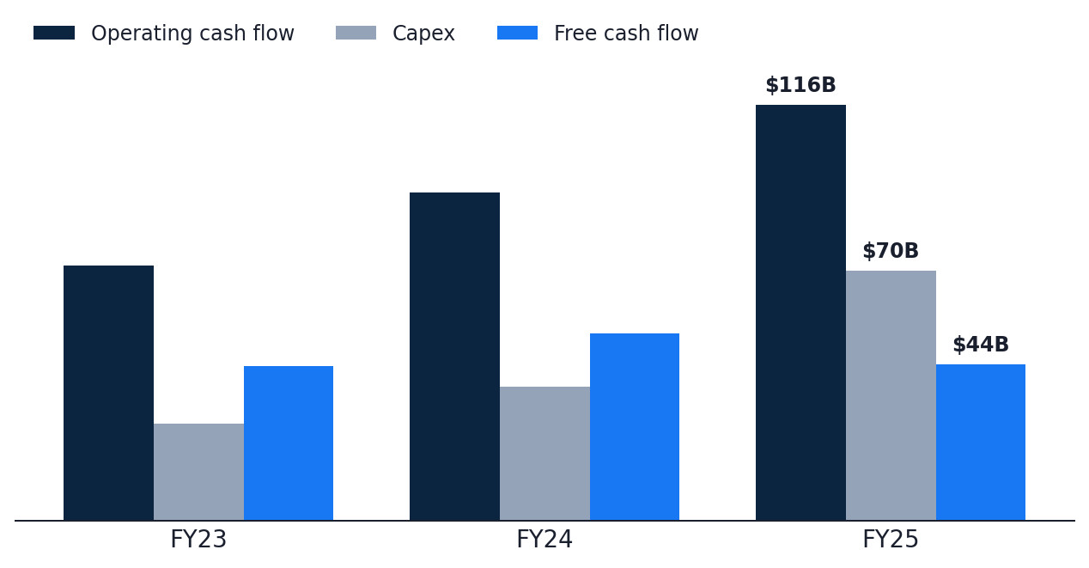
ACT III · WHAT'S THE ISSUE
Capex (+87% YoY) is doubling on AI infrastructure — FCF declined 16% despite +22% revenue
OPERATING CASH FLOW vs. CAPEX vs. FREE CASH FLOW ($B)
CAPEX FY24
$69.7B
▲ +87.1% YoY
vs FCF $43.6B (▼ –16.4% YoY)
WHY THE CASH STORY HAS CHANGED
AI-CAPEX Capex jumped from $37B to $70B in one year — bigger than total Reality Labs revenue history.
RL-COST Reality Labs operating loss of $19B is structural — capped revenue, growing R&D, no clear monetization path.
FCF-COMPRESS FCF dropped from $52B to $44B even as revenue grew $36B — every dollar of growth went to infrastructure.
Source: Meta Platforms, Inc. 10-K, FY2024 · Equity research view
4 / 7
Notes:
Turning point. Capex jumped from $37B to $70B — that's bigger than Meta's entire R&D budget two years ago.
FCF declined despite revenue +$36B. Where did the cash go? PP&E for AI infrastructure.
Don't editorialize on RL — but be clear: at $19B/year, it's a structural cost line, not an experiment.

Slide 5
ACT IV · WHY IT MATTERS
Sustainability hinges on FoA holding 18%+ growth while RL losses cap and AI capex peaks
TWO SCENARIOS — AND WHAT TIPS US INTO EACH
BASE CASE · FoA HOLDS, AI ROIC EMERGES
BEAR CASE · FoA DECELERATES, RL WIDENS
FCF REBUILD
FCF SQUEEZE
FCF re-accelerates to $60–75B by FY26 as capex moderates and AI features monetize.
FCF compressed below $30B if FoA dips below 12% while capex stays >$80B.
MARGIN
MARGIN REVERSAL
Op margin holds 41–43% on FoA mix; RL contained at –$20B/year cap.
Depreciation step-up + RL widening could push op margin toward 35%.
MULTIPLE
DE-RATING
Re-rating to 25–28× as AI commerce + ads ROI compounds visibly.
Multiple compression to 18–20× as the AI-payback narrative breaks.
THE CRITICAL VARIABLE
Whether AI-driven engagement gains translate into ad revenue at the rate capex is being deployed.
Source: Meta Platforms, Inc. 10-K, FY2024 · Equity research view
5 / 7
Notes:
Frame as fork in the road. FoA is the variable; RL is the constraint.
Base case: FoA holds 18%+, RL caps at $20B, capex peaks 2025 → FCF rebuilds.
Bear case: FoA decelerates AND RL widens AND capex stays elevated → multiple compresses fast.
Critical variable: AI engagement → ad revenue conversion.

Slide 6
ACT V · BOTTOM LINE
Track three metrics that will tell us — within 12 months — which scenario is unfolding
THE THREE-METRIC EARLY-WARNING DASHBOARD
01
Family of Apps revenue growth
Watch for >18% — anything below 12% would meaningfully break the AI engagement thesis.
QUARTERLY · FOA SEGMENT RELEASE
02
Reality Labs operating loss
Should cap at –$20B/year by FY26. Widening above –$25B = strategic-cost spiral.
QUARTERLY · RL SEGMENT DISCLOSURE
03
Capex/FoA-revenue ratio
Should peak by FY25 and trend below 30% in FY26. Above 40% = structural cash strain.
QUARTERLY · CFO COMMENTARY
RECOMMENDATION
Constructive on FoA; gate further conviction on Q2 RL containment and AI capex moderation.
Source: Meta Platforms, Inc. 10-K, FY2024 · Equity research view
6 / 7
Notes:
Single recommendation: constructive, gated.
Three metrics. FoA growth, RL loss, capex/FoA ratio. Make it operational.
Closing: 'Meta is the highest-upside name in this peer group — and the highest-tail-risk. The next four quarters resolve which one wins.'

Slide 7
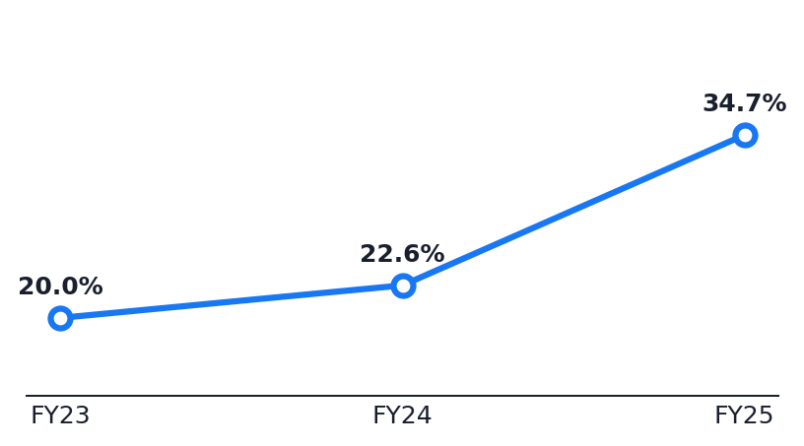
APPENDIX
Three-year P&L, segment, and cash-flow reference
INCOME STATEMENT · $B EXCEPT %
CASH FLOW · $B
SEGMENTS · FY24 REVENUE & MARGIN
FY22
FY23
FY24
FY22
FY23
FY24
FY24
YoY
OM%
Revenue
$134.9
$164.5
$201.0
Operating cash flow
$71.1
$91.3
$115.8
Family of Apps
$198.8
+18.0%
51.6%
Gross profit
$108.9
$134.3
$164.8
Capex
$27.0
$37.3
$69.7
Reality Labs
$2.2
+2.8%
–870%
Operating income
$46.8
$69.4
$83.3
Free cash flow
$43.0
$52.1
$43.6
Total
$201.0
+22.1%
41.4%
Net income
$39.1
$62.4
$60.5
SBC
$14.0
$16.7
$20.4
R&D
$38.5
$43.9
$57.4
D&A
$11.2
$15.5
$18.6
CAPEX INTENSITY · CAPEX/REVENUE %
Gross margin
80.7%
81.7%
82.0%
Buybacks
$19.8
$29.8
$26.2
Operating margin
34.6%
42.2%
41.4%
Dividends
$0.0
$5.1
$5.3
Net margin
29.0%
37.9%
30.1%
Capex/OCF
38%
41%
60%
Source: Meta Platforms, Inc. 10-K, FY2024 · Equity research view
7 / 7
Notes:
Reference. Don't read it.
One stat for Q&A: Reality Labs cumulative loss is approaching $60B. That's the number that defines the strategic question.
Capex intensity chart on the right: 13% → 19% → 35% in three years. Hold it up if challenged on whether the issue is structural.

