Slide 1
EXECUTIVE STORYLINE · FY2025 10-K · CONFIDENTIAL
Microsoft Corporation
MSFT
AI-driven revenue growth is strong — but heavy capex is now compressing free cash flow.
A five-act readout for the leadership team.
Prepared for the executive team
April 2026
Notes:
Open with the headline tension in one breath: Microsoft is growing fast — and yet free cash flow is going down. That contradiction is the entire story.
Frame the deck: I'll walk through the same five questions the board will ask — what's happening, what's driving it, what's the issue, why it matters, and what we should track.
Tone: confident, measured. Don't apologize for the numbers — they're strong. Just be clear about the trade-off.

Slide 2
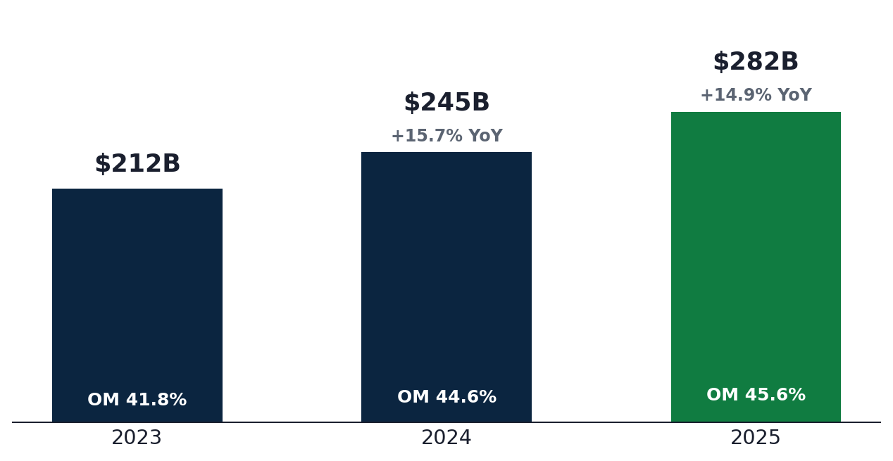
ACT I · WHAT'S HAPPENING
Microsoft posted +14.9% revenue growth, lifting the topline to $281.7B
REVENUE
OPERATING MARGIN
NET MARGIN
$281.7B
45.6%
36.1%
+14.9% YoY
+90 bps YoY
+10 bps YoY
WHAT THE NUMBERS TELL US
REVENUE & OPERATING MARGIN
ACCELERATING Top-line growth holds in the mid-teens for the second straight year — durable, not a one-off.
LEVERAGE Operating margin up 380 bps over two years to 45.6% — best-in-class among hyperscalers.
QUALITY Net margin held at 36% despite stepped-up R&D, signaling the franchise still scales.
Source: Microsoft Corporation 10-K, FY2025 · Equity research view
2 / 7
Notes:
Anchor the audience in the growth story BEFORE we pivot to the issue. They need to feel the strength of the franchise first.
Three stats matter: revenue $281.7B, op margin 45.6%, net margin 36%. Read them deliberately. Pause after each one.
Closing line: 'On every traditional measure, this is one of the best years Microsoft has had. Hold that thought — because the next chart tells a different story.'

Slide 3
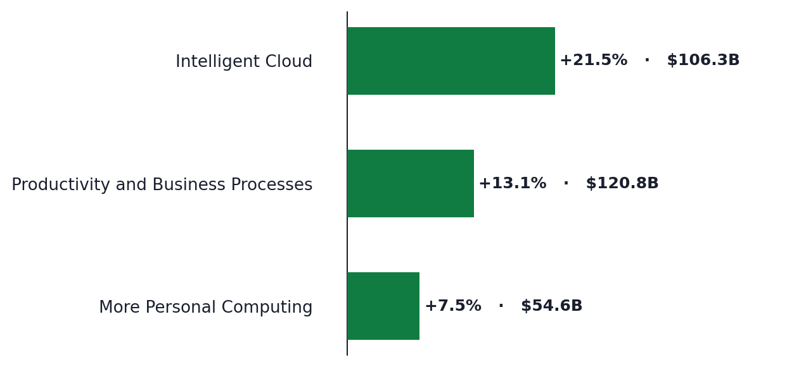
ACT II · WHAT'S DRIVING IT
Intelligent Cloud (+21.5%) is the single-largest growth driver — Azure alone grew +34%
SEGMENT REVENUE — YoY GROWTH AND CURRENT-YEAR SCALE
AZURE GROWTH
+34%
vs +30% prior year — a 4-point reacceleration
AI-powered consumption is now a measurable workload
SCALE Intelligent Cloud added $18.8B in FY25 — more than P&BP and MPC combined.
MIX Cloud is now 38% of Microsoft revenue, up from 35% the prior year.
MOAT Activision integration adds $23B+ in gaming; Xbox content +16% offsets hardware decline.
Source: Microsoft Corporation 10-K, FY2025 · Equity research view
3 / 7
Notes:
Pivot from 'what' to 'why.' The room needs to understand that this isn't generic growth — it's concentrated, and that concentration matters.
The +34% Azure number is the single most important data point in the deck. Say it slowly. Compare it to AWS at ~20% and Google Cloud at ~30% to give context.
Land the implication: 'When one segment grows this much faster than the rest, it changes the whole company's economics. That's the setup for the next slide.'

Slide 4
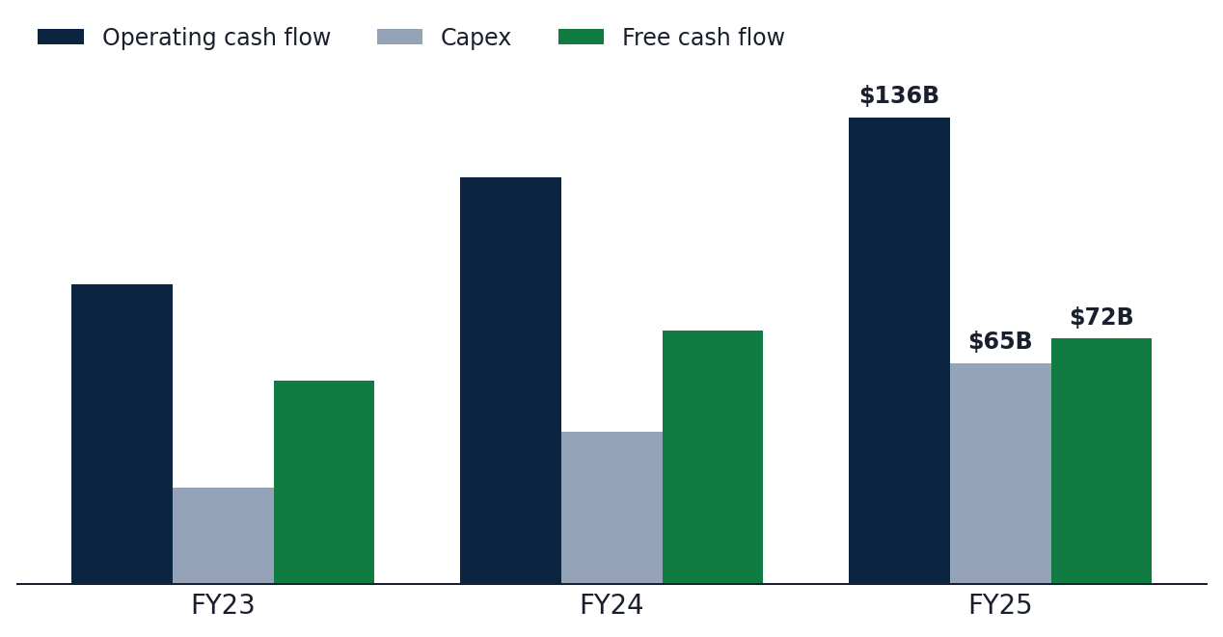
ACT III · WHAT'S THE ISSUE
Capex (+45% YoY) is now outrunning operating cash flow — FCF declined 3.3% on +14.9% revenue
OPERATING CASH FLOW vs. CAPEX vs. FREE CASH FLOW ($B)
CAPEX FY25
$64.6B
▲ +45.1% YoY
vs FCF $71.6B (▼ –3.3% YoY)
WHY THE NUMBERS DON'T COMPOUND
STRUCTURAL Capex/OCF ratio jumped from 32% (FY23) to 47% (FY25) — every incremental dollar of cash is going into AI infrastructure.
UNUSUAL FCF declined for the first time in four years despite revenue growing $36.6B.
INTENSITY Capex is now 22.9% of revenue, up from 13.3% two years ago — a structural step-change.
Source: Microsoft Corporation 10-K, FY2025 · Equity research view
4 / 7
Notes:
This is the turning point of the deck. Slow down. The audience needs to feel the contrast between the prior two slides and this one.
Lead with the contradiction: Revenue grew $36.6B. FCF went DOWN $2.5B. Where did the cash go? Capex jumped $20B in one year.
Don't editorialize yet — let the numbers carry the weight. The investment thesis here isn't necessarily wrong, but the cash-flow profile of the company has fundamentally changed.

Slide 5
ACT IV · WHY IT MATTERS
Sustainability hinges on Azure holding above 30% growth while capex moderates by FY27
TWO SCENARIOS — AND WHAT TIPS US INTO EACH
BASE CASE · AZURE HOLDS, CAPEX PEAKS FY26
BEAR CASE · AZURE DECELERATES, CAPEX STAYS HOT
FCF INFLECTION
FCF SQUEEZE
FCF re-accelerates to $90–100B by FY27 as capex moderates to 18% of revenue.
FCF could turn negative on a TTM basis if Azure dips below 25% while capex stays >$60B.
MARGIN
MARGIN REVERSAL
Operating margin holds 45–47% on Cloud mix and SaaS leverage.
Depreciation step-up alone would compress operating margin 200–300 bps.
MULTIPLE
DE-RATING
Re-rating to 32× forward earnings as AI ROIC compounds visibly.
Compression to 22–24× forward earnings as the AI-payback narrative breaks.
THE CRITICAL VARIABLE
Whether AI workloads can monetize at the rate capex is being deployed — by FY27, not later.
Source: Microsoft Corporation 10-K, FY2025 · Equity research view
5 / 7
Notes:
Don't moralize about whether the capex is 'right' or 'wrong.' Frame it as a fork in the road: there are two scenarios, and the next 18 months will tell us which one we're in.
Use clean transition language: 'In the base case... in the bear case...' Avoid emotionally loaded words like 'risk' or 'danger' — keep it analytical.
End the slide on the critical variable: AI monetization rate. That's the metric to track. Everything else is downstream of it.

Slide 6
ACT V · BOTTOM LINE
Track three metrics that will tell us — within 12 months — which scenario is unfolding
THE THREE-METRIC EARLY-WARNING DASHBOARD
01
Azure constant-currency growth
Watch for >30% — anything below 25% breaks the AI-monetization thesis.
QUARTERLY · CLOUD & AI SEGMENT RELEASE
02
Capex/OCF ratio
Should peak by FY26 and trend below 40% in FY27. Above 50% = structural risk.
MONTHLY · TREASURY CASH FORECAST
03
AI revenue disclosure
Look for explicit Copilot, Azure AI, and Foundry revenue lines — opacity is itself a signal.
QUARTERLY · EARNINGS CALL COMMENTARY
RECOMMENDATION
Stay constructive on the franchise; gate further conviction on Q2 capex/Azure data.
Source: Microsoft Corporation 10-K, FY2025 · Equity research view
6 / 7
Notes:
Land the deck on a single, decisive recommendation. Don't hedge.
Drive home the watch list: three metrics, one quarter at a time. Make it sound operational — these are things this team can actually monitor.
Closing line: 'We don't need to bet now. We need to be paying attention. The signals will be unambiguous.'

Slide 7
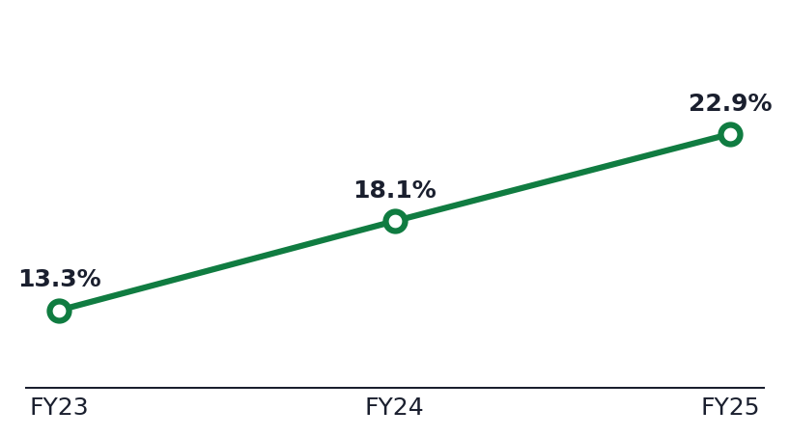
APPENDIX
Three-year P&L, segment, and cash-flow reference
INCOME STATEMENT · $B EXCEPT %
CASH FLOW · $B
SEGMENTS · FY25 REVENUE
FY23
FY24
FY25
FY23
FY24
FY25
FY25
YoY
OM%
Revenue
$211.9
$245.1
$281.7
Operating cash flow
$87.6
$118.5
$136.2
Productivity & Business
$120.8
+13.0%
57.8%
Gross profit
$146.1
$171.0
$193.9
Capex
$28.1
$44.5
$64.6
Intelligent Cloud
$106.3
+21.5%
41.9%
Operating income
$88.5
$109.4
$128.5
Free cash flow
$59.5
$74.1
$71.6
More Personal Computing
$54.6
+7.5%
25.9%
Net income
$72.4
$88.1
$101.8
SBC
$9.6
$10.7
$12.0
R&D
$27.2
$29.5
$32.5
D&A
$13.9
$22.3
$34.2
CAPEX INTENSITY · CAPEX/REVENUE %
Gross margin
68.8%
69.8%
68.9%
Buybacks
$22.2
$12.0
$13.0
Operating margin
41.8%
44.7%
45.6%
Dividends
$19.8
$21.8
$24.1
Net margin
34.1%
36.0%
36.1%
Capex/OCF
32%
37%
47%
Source: Microsoft Corporation 10-K, FY2025 · Equity research view
7 / 7
Notes:
This slide is a reference layer — don't read it. Just say: 'Full three-year P&L, cash flow, and segment data is here. We can come back to any line if questions arise.'
Highlight one number for context if asked: Capex/OCF moved from 32% to 47% in two years — that's the ratio that summarizes everything we just discussed.
Use this page to take Q&A. Not to present from.

