Slide 1

Fake News Classification with Machine Learning
Francesca Brodu (70/83/65329)
Caterina Mereu (70/83/65485)
GitHub Repo:
ML Project - Brodu, Mereu

Slide 2
Introduction and Objectives
Automatically classify news articles as “Fake”or “Real”
Scikit-learn models [2]
SVM linear
k-NN
MLP
Hyperparameter tuning with GridSearchCV
Evaluation using ShuffleSplit cross-validation
SVM RBF
Dataset: Fake and Real News Dataset, from Kaggle [1]

Slide 3
The Dataset
2 CSV: Fake.csv e True.csv
Each row contains
Title
Text
Subject
Date
Around 44.000 articles
Binary Classification
Combined title and text for input
0 = Fake
1 = Real

Slide 4
Preprocessing: Text Cleaning and Feature Extraction
Initially, we performed preprocessing [3,4] on the text data. In particular, punctuation, numbers, and special characters were removed, and the text was converted to lowercase.
Subsequently, a numerical transformation was applied using TF-IDF (Term Frequency - Inverse Document Frequency).
We also set thresholds for the minimum and maximum document frequency in order to reduce noise and redundancy.

Slide 5
Normalization and Dimensionality Reduction
The features were scaled using MinMaxScaler to standardize distributions and facilitate model convergence.
In addition, to reduce the number of features, we applied dimensionality reduction through PCA (Principal Component Analysis), retaining the top 50 components.
This approach helps preserve important information while removing noise.

Slide 6
Selected Classifiers and Parameter Optimization
SVM with linear kernel
C: 0.01, 0.1, 1, 10, 100
SVM with RBF kernel
C: 0.01, 0.1, 1, 10, 100
K-Nearest Neighbors
Number of neighbors (k): 3, 5, 7, 9
Multi-layer Perceptron
Hidden layer: (50,), (100,), (50, 50)
Gamma: 0.01, 0.1, 1, 10
Activation: Relu, Tanh
Alpha: 0.0001, 0.001

Slide 7
Selected Classifiers and Parameter Optimization
For each classifier, we used GridSearchCV to find the best hyperparameters, applying 3-fold cross-validation.
Then, to evaluate the models, we used ShuffleSplit with 5 folds, allocating 70% of the data for training and 30% for testing. The selection of hyperparameters was based on the best average accuracy score on the training set.

Slide 8
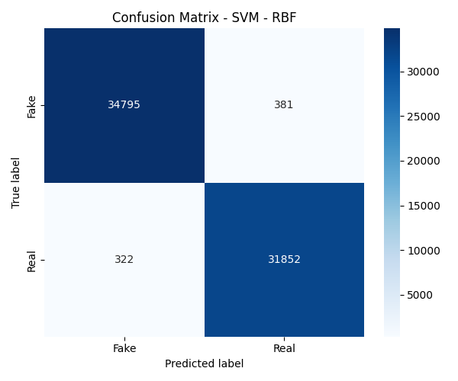
Model Evaluation
To evaluate the reliability of the model, we used accuracy, computing both the mean and the standard deviation. In addition, we calculated further metrics such as precision, recall, and F1-score, both using the macro average (unweighted mean across classes) and the weighted average (weighted by class support).
Finally, we generated confusion matrices to analyze false positives and false negatives, which are essential for assessing model quality in real-world applications.

Slide 9
Quantitative Results
The SVM with RBF kernel stood out as the best-performing classifier, achieving an average accuracy of 98.9% and both macro and weighted F1-score equal to 0.98, demonstrating an excellent generalization capability.
The MLP achieved comparable performance, confirming the effectiveness of feedforward neural networks even on TF-IDF vectorized textual data.
The linear SVM also showed good results, while k-NN exhibited slightly lower performance, likely due to the high-dimensional nature of the dataset.

Slide 10
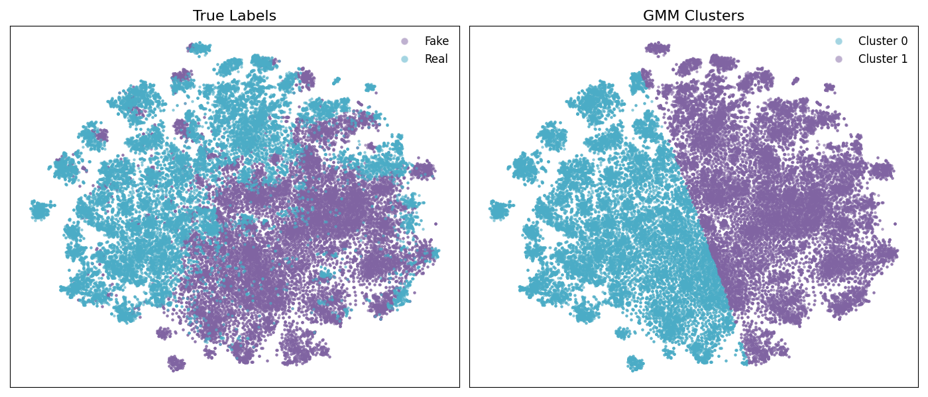
Visual Analysis with t-SNE
To visualize the separability of the data, we applied t-SNE on the data previously reduced using PCA, projecting it into a three-dimensional space and applying a Gaussian Mixture Model (GMM).
The t-SNE algorithm preserves the local structure of the dataset, clearly showing partial class separation, with some overlapping regions that explain classification errors. This qualitative visualization confirms the effectiveness of the preprocessing and dimensionality reduction steps.

Slide 11
Conclusions
In conclusion, our approach to data preparation, feature selection, and model optimization led to highly effective classifiers, with the SVM with RBF kernel emerging as the best-performing model.
The combination of TF-IDF, feature scaling, and dimensionality reduction with PCA proved to be essential for achieving strong performance on high-dimensional text data.

Slide 12
Thank you for your attention

Slide 13
References
[1] Kaggle – Fake and Real News Dataset
[2] Scikit-learn: Machine Learning in Python
[3] A. Agarwal and A. Dixit, “Fake News Detection: An Ensemble Learning Approach,” in Proc. 2020 4th Int. Conf. Intell. Comput. Control Syst. (ICICCS), Madurai, India, May 2020, pp. 124–129.
[4] H. Saleh, A. Alharbi, and S. H. Alsamhi, “OPCNN-FAKE: Optimized Convolutional Neural Network for Fake News Detection,” IEEE Access, vol. 9, pp. 129471–129489, Sep. 2021.

