Slide 1

FACE MASK DETECTION :
University of batna 2
Faculty of mathematics and computer science
Department of comuter science
Speciality artificial intelligence and multimedia
Module RDF
Submitted by:
REFIS FOUAD CHAOUKI
SMAIL RAED ABD-RAHIME
Supervised by:
MELLKMI KAMEL EDDINE
November 2023

Slide 2
introduction:
In this project we will build MASK VS NO MASK classifier using CNN and ML it will detect wherther a person is wearing a mask or not using database with/without mask.
A Convolutional Neural Network (CNN) is a type of Artificial Neural network designed to process pixel data. They are used explicitly in Image Processing and Image Recognition.

Slide 3
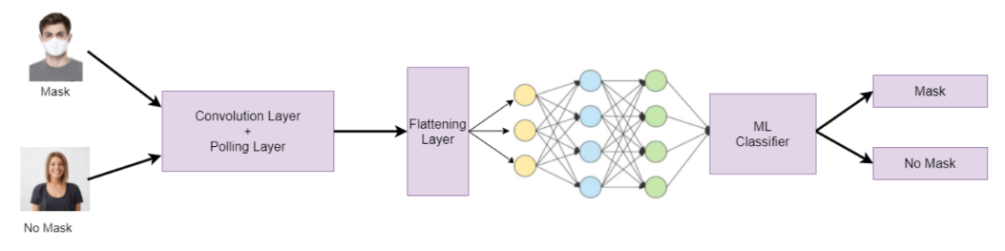
CNN MODEL PIPELINE:
First, we will input the RGB images of size 224×224 pixels. Then these images will go into a CNN model that will extract 128 relevant feature vectors from them. Then we will use these feature vectors to train our various machine learning classifiers, like Logistic Regression, Random Forest, etc., to classify whether the person in that image is wearing a mask or not. You can refer to the below diagram for a better understanding.

Slide 4
Loading and Preprocessing of Dataset:
With Mask | Witout Mask
1411(54,42%) | 1182(45,58%)
-this dataset contains more than 2500+ images of different people wearing a face mask or not. After loading the dataset, we will preprocess it. It involves splitting into train and test datasets, converting pixel values between 0 to 1, and converting the labels into one-hot encoded labels.
-In the below code, we will first read all the images from the folder and then store them in an array by resizing them into 224×224 pixels. After that, we will label these images. Images with masks have a label 0, and images without masks have a label 1. Finally, we will split this dataset into training and testing using the sklearn function named train test split

Slide 5
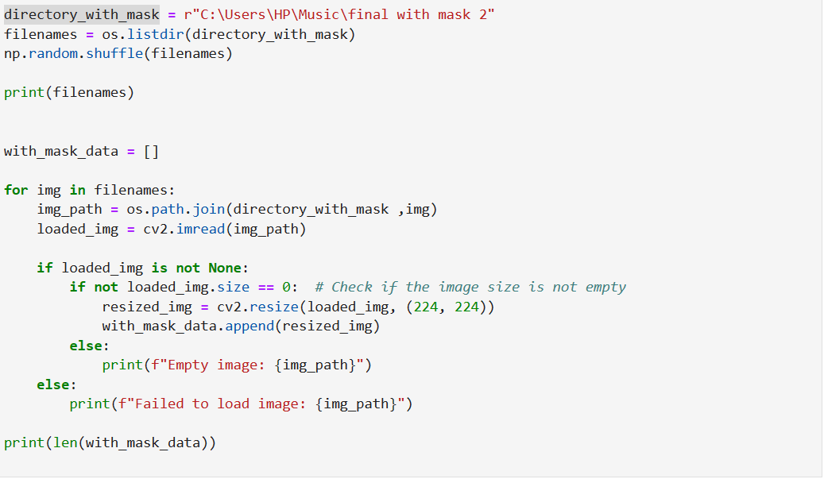
Load ‘with Mask’ images resize them and print their file names:

Slide 6
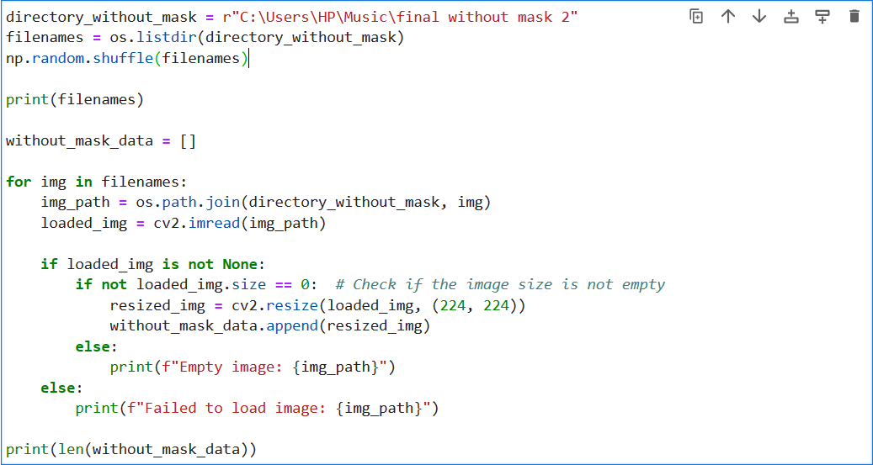
Load ‘without Mask’ images resize them and print their file names:

Slide 7
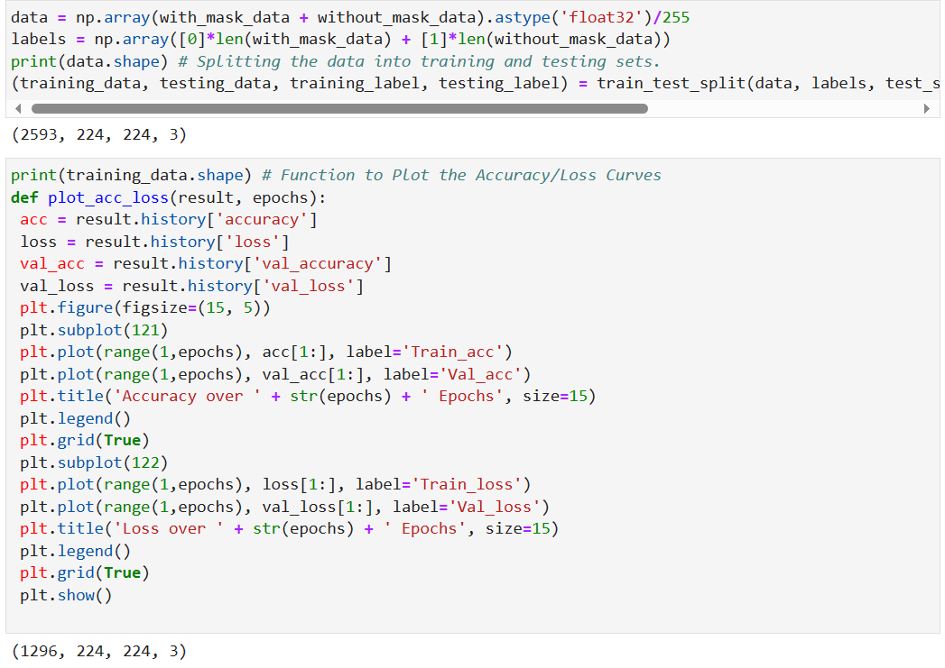
Normalization and converting into single array:
We have combined both arrays to make a single array, converting each pixel value between 0 and 1 by dividing them by 255.

Slide 8
Building The Convolutional Neural Network (CNN):
Next, we'll construct our Convolutional Neural Network (CNN). To augment our dataset, an image data generator has been employed, generating additional images by applying operations such as clockwise or anti-clockwise rotation, contrast adjustments, zooming in or out, and more, to the existing images.
Subsequently, we'll utilize the MobileNetV2 architecture, a pre-trained model, for training. This approach, known as transfer learning, involves leveraging the knowledge gained by pre-existing models to train new deep learning models. Following transfer learning, a flattening layer will be applied to convert the 2D matrix into a 1D array. Then, dense and dropout layers will be incorporated for classification purposes.
Ultimately, the model will be trained using a batch size of 32 and 25 epochs. Feel free to adjust these values based on your computational capabilities.

Slide 9
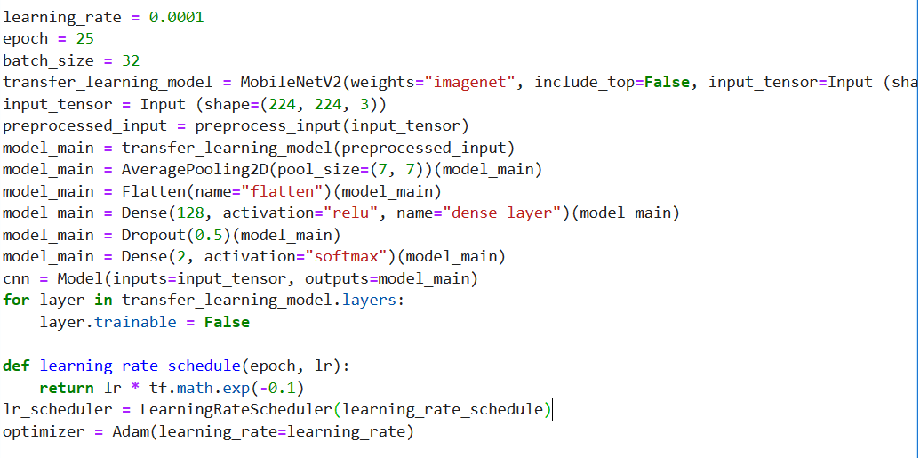
train the model and check its accuracy on the
test set:

Slide 10
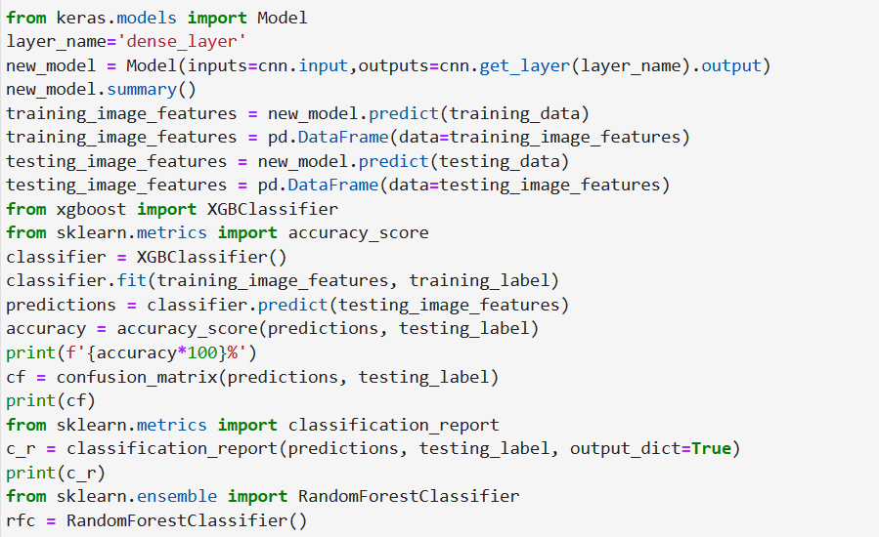
ML Classifiers:

Slide 11
We will extract 128 relevant feature vectors from our previously trained CNN model and apply them to different machine learning classifiers. The following classifiers will be used:
Xtreme Gradient Boosting (XGBoost): Xtreme Gradient Boosting (XGBoost) is an open-source library that efficiently implements the gradient boosting algorithm. Begin by importing the necessary libraries, then define the classifier as XGBClassifier. After fitting it, obtain predictions and accuracy scores. The output includes accuracy, confusion matrix, and classification report, with an achieved accuracy of 98.98%.
Random Forest Classifier: The Random Forest Classifier comprises multiple decision trees on various subsets of the dataset, averaging predictions to enhance accuracy. Import required libraries, define the classifier as RandomForestClassifier, fit it, and retrieve predictions and accuracy scores. The output includes accuracy, confusion matrix, and classification report, with an impressive accuracy of 99.41%, surpassing XGBoost.

Slide 12
Logistic Regression: Logistic regression, a supervised learning classification algorithm, predicts the probability of a dichotomous target variable. Achieving an accuracy of 99.70%, Logistic Regression outperforms XGBoost but slightly trails behind Random Forest. Importantly, it is effective for binary classification tasks.
Gaussian Distribution: Representing a symmetric probability distribution around the mean, the Gaussian distribution (normal distribution) highlights the frequency of data close to the mean. This distribution is visualized as a bell curve on a graph, emphasizing that data near the mean occurs more frequently.

Slide 13
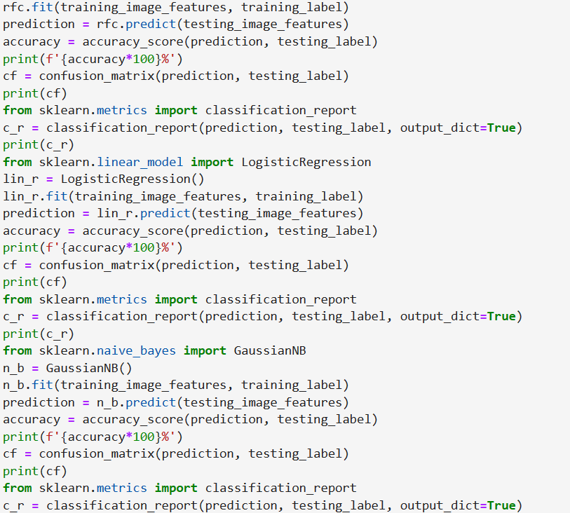
Accuracy, prcision, F1 Score :

Slide 14
Methd | XGB Classifier | Random Forest | Logistic regression | Gaussian NB
Accuracy | 90% | 90% | 79% | 57%
precision | 90% | 90% | 79% | 25%
F1 Score | 91% | 90% | 77% | 38%
Recall | 92% | 90% | 81% | 87%

Slide 15
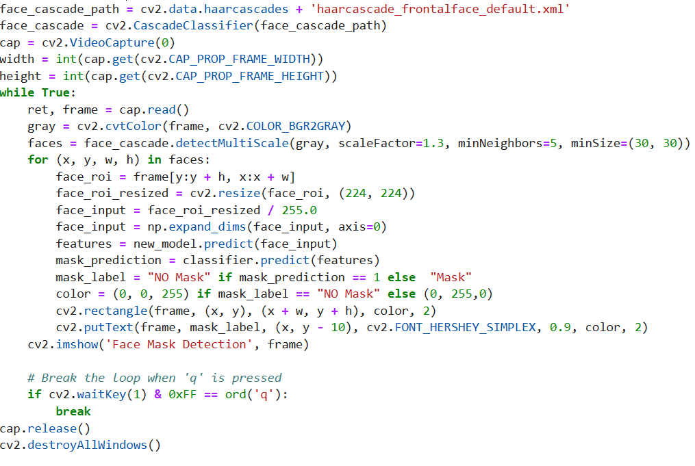
Real time Mask detection :

