Slide 1
Reality Marketing For The Startup

Slide 2
Agenda
Where Startups Go Wrong
What are the 5 things that Really Matter

Slide 3
The Balance
You don’t yet know what you don’t know
The clock is ticking…
Time-to-market
Completeness
_{The} _{Right} _{Balance}
Risks
Foregone conclusions
Kool-aid reality
Risks
Analysis paralysis
Petri-dish reality

Slide 4
5
There are
Things That Really Matter

Slide 5
Market Validation – the 5 filters
Unmet
Need
Big
Opportunity
Sustainable
Competitive
Positioning
Scalable
Business
Why us?
Why now?
1
2
3
4
5

Slide 6
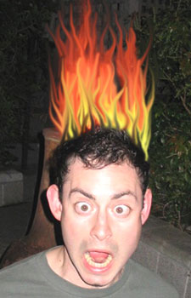
Unmet Need
Who has “hair-on-fire”?
Segment of market that absolutely needs your product
Unmet
Need
1

Slide 7
Find A Big Opportunity
Is there an opportunity?
Will it be big?
Big
Opportunity
2

Slide 8
Size The Market
Build a tops down and bottoms-up model
Total Market
Analyst data
Proxy modeling
Total Addressable Market
Your Projected Share
Empirical
Qualitative research
Your revenue and unit forecast

Slide 9
Billion Dollar Market?
Stratio
Total Address-able Market
Served market
Initial Target Segment
Base-camp
Semiconductor substrate material, $34.1B
Optical semiconductor substrates, $3.75B
Optical silicon photonics market, $1B + growing at 75%

Slide 10
What is the Category?
New
Market
Existing
Market
A new invention for a new category
A better, faster, cheaper alternative for today’s category
Expanded Market
Re-segment
Market
Niche Market
A specialized solution for a niche category

Slide 11
Sustainable Competitive Positioning
Who is the competition?
Why are you better?
What is your unfair advantage?
Can you sustain this advantage?
Sustainable
Competitive
Positioning
3

Slide 12
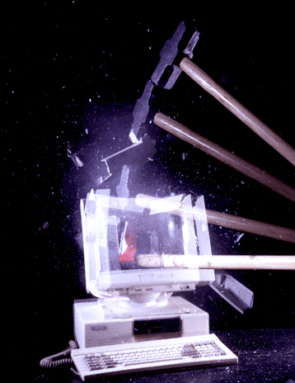
Be Different
Better, faster, cheaper.
Is there an existing context that needs to be smashed?

Slide 13
Defendable Differentiated Position
Clear, Concise, Consistent
Market Definition
Executive Summary
For (target customer)
Who (statement of the need or opportunity)
The (product name) is a (product category)
Opportunity Need
Corporate Presentation
Value/Compelling reason to buy
Elevator Pitch
That (statement of key benefit – the compelling reason to buy)
Unlike ( competitive advantage)
Our product (statement of primary differentiation)
Competitive analysis
Web site,
collateral
Differentiated
position
Tagline

Slide 14
Scalable Business Model
Can you sell more with minimal additional resources?
Minimal customization for other market segments?
Where do you go next?
Scalable
Business
4
Notes:
Motiv design is highly scalable because the boards remain the same, we use more or less, then make minor changes to the software

Slide 15
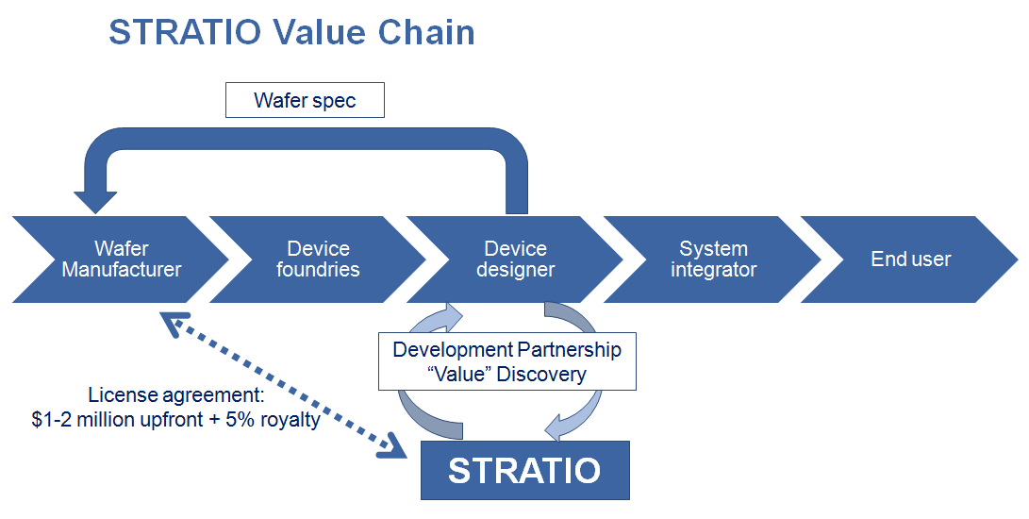
Business Model – Draw a Diagram
Notes:
Internet/enterprise – block diagram business model/value chain

Slide 16
Why us? Why now?
Do you have the right team with the right domain knowledge?
Is there some discontinuity in the market for your business?
Why us?
Why now?
5

Slide 17
Eco-System Alignment
Your Idea
Behavioral changes
Market Discontinuity
Regulatory / other Changes
Product Innovation

Slide 18
Market Validation – the 5 filters
Unmet
Need
Big
Opportunity
Sustainable
Competitive
Positioning
Scalable
Business
Why us?
Why now?
1
2
3
4
5

Slide 19

Your Marketing Strategy is…
The DNA
of your company
Notes:
Keep! Put at the end

Slide 20
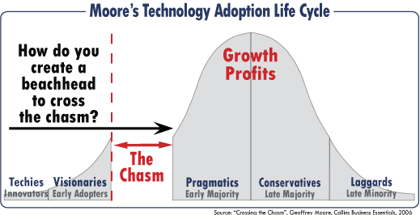

Product Market Fit
Geoffrey Moore: “Crossing the Chasm”

Slide 21

Unmet Need
Who has “hair-on-fire”?
Segment of market that absolutely needs your product
Burning Need
Burning Need

Slide 22
Customer Discovery – Overarching Principles
Identify most important items to demonstrate
Common pitfalls to overcome
Important success factors to deliver
“In companies such as this one….”
80/20 vs. 70/5
Develop a plan to prove to yourselves; you’ll then be able to prove to others
Use voice of the customer to answer difficult questions

Slide 23
Types of Discovery
LOI / MOU
Referenceable Customers
Quotations
Revenue/Orders
Execution-
Users/Stats
Proxies
Industry reports
Anecdotes
Public sources
“We believe”
Surveys
Public research
Traditional quantitative research methods
Credibility
Statistical Significance

Slide 24
“70-5” – Better Than “80-20”
Assumption | Important Driver of Success | Risk to Overcome | Common Belief
TAM | √ |  | √
Target segment(s) | √
Burning need? | √
Customer behavior |  | √
Willingness to pay / value prop |  | √
Customer acquisition model | √
Business model |  |  | √
Partnerships |  |  | √
Environment (dependencies)

Slide 25
Make a Plan For Addressing Each Important Item
Example: Customer behavior:
What behavioral pattern are you trying to change?
How will you determine whether you have demonstrated the possibility of change (metrics)?
What sources will you tap into (discuss)? Who will do what, when – Gantt chart with clear deliverables?
How well will you be able to answer the tough investor question?

Slide 26
Execution Beats Hypotheses
How will I respond to those difficult questions…
Google AdWords
Landing page
Analytics regarding customer behavior - users
Actual $ changing hands
MOU/LOI
Build your product or service and get reactions and statistics
Screen-shots, (fake) demos, make-a-little….

Slide 27
Hierarchy of Product Execution
Product release
User validation
Beta
Alpha
Prototype
Mock-up
Screen shots

Slide 28
Hierarchy of Sales Execution
$
Users
LOI / MOU for Beta customers
Potential customers who can be contacted as references
Written references from potential customers
Names of customers

Slide 29
How do I Get to Talk With Folks?
LinkedIn
Social networks
Alumni networks
Relentless pursuit – “name names”
Salesperson’s approach
Associations – Directory of Associations
Email lists

Slide 30
Example Source of Information: Interviews – Overcome the Fear
Prepare
Target interviewees
Land meetings / phone calls
Develop interview guide
Execute
2-on-1 for important face-to-face meetings?
Good experience for interviewee
Achieve goals of interview – different for different stages
Follow Up
Thank you
Future meetings
Other targets

Slide 31
Interviews – Pacing
1st Stage:
Open-ended
Broad
Wide net
Listen to their motivations / needs
2nd Stage:
React to product
Validate specific need
Determine target market and value proposition
Modify specs
3rd Stage:
LOI / MOU
Intent to purchase
Purchase order

Slide 32
Interview Process Considerations
Target interviewees
Interview notes
How to “learn” and iterate
Combine insights with other data
Set stage for future discussions / business meetings / Board of Advisors

Slide 33
Survey Considerations
Survey development process
Sample considerations (size, bias)
Method of surveying
Level of detail
Quantitative vs. qualitiative
Sources of survey information
How to present / report

Slide 34
Other Sources of Information
Competitors’ websites
Census data
10Ks, S-1s
Conferences – rich for intelligence and interviews
Industry reports
Trade publications
Stanford network
Input from instructor team and guests: all 50 of us – sort it out

Slide 35
Parting Thoughts
Customer Discovery - Why
Answer in the voice of the customer
Speak with credibility and authority
Validate your target and business model

Slide 36
Parting Thoughts
Customer Discovery - How
Analytical AND intuitive
Scrappy – be creative
Tailored to YOUR business “70/5”

Slide 37
Parting Thoughts
Customer Discovery - When
NOW
Always
As much as you can stand

Slide 38

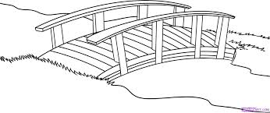
Market Meets Product/Service
Market
Meets
Product/Service
What do you sell?
Burning Need?
Size of market?
Willingness to pay?
Sustainability?
What do you sell?
Unique differentiation?
Difficulty/ Capital required?
Cost of product/ service
Sustainable differentiation
Partners

Slide 39
Gate I: Questions for CMO (I/II)
What do you sell – be specific?
What is the burning need for your product/service? Who needs you most (describe your ideal customer)?
What is it about your product/service that uniquely satisfies that customer?
How does that offering differ from other offerings (current and future)?
What is the size of market – TAM and size of initial target segment (also describe the segment)?
How do you plan to attract customers (be as specific as you can)?

Slide 40
Gate I: Questions for CMO (II/II)
Have You Talked to Any Potential customers yet?
How much will customers be willing to pay for the product or service?
What is your GTM approach (draw scematic), and what part of your go-to-market approach do you plan to execute before the end of the quarter?
What novel approaches are you using as you take your product/service to market?
How do those novel approaches provide a sustainable advantage to your company?
What partnerships do you need in order to be successful in selling and marketing your product/service?

Slide 41
Gate I: Questions for CTO (I/II)
What do you sell – define your product or service as explicitly as possible?
Provide a schematic (or architecture diagram) for your product or service
What unique technology are you applying to your product or service?
What is the current state of this technology?
What development has already taken place?
Who owns the rights to the technology?
Are technology partnerships required?

Slide 42
Gate I: Questions for CTO (II/II)
What state of development do you expect it to be by the end of the quarter? What technical developments will you achieve in the next 6 weeks?
What are the important milestones for the technology over the next 12 – 24 months? Consider providing a table, showing the significant milestones, timing, and resources required
How does that technology provide a sustainable advantage to your company? How is the technology different from other technologies that exist or are in development by other companies?
How well do the capabilities of your technology match the needs of your target market?

Slide 43
Additional Questions for CMO or CTO
What is the most compelling, novel aspect of your business?
What are the most important things that must be validated about your product and/or market to have the best chance of success?
What will you do over the next few weeks to validate those things?

Slide 44
TA Announcements
Thanks for submitting the assignments on time and correctly!
The TAs will be giving you feedback throughout the week
(Red Light, Yellow Light, Green Light)
If your idea changes significantly, resubmit the Team Concept
Wednesday: Special Session on Market Research (Optional)
With Konstantin Guericke (Co-founder of LinkedIn)
Nano-232 at 5:30pm
Friday: Teaching Team/Mentor Concept/Product Sign-Off
Due by 5:00pm
Elevator pitch video (1-5 minutes)
Each individual teammate should submit a private note on Piazza giving a star rating of their current idea (1-4 stars)
A teaching team member and your mentor will also rate

Slide 45
TA Announcements
Signup for Gate 1 via Google Doc (instructions will be emailed)
1 Presentation Slot
1 Observation Slot
12 min presentation + 12 min Q&A
Sign up for office hours via Google Doc (instructions will be emailed)
Team name
One slot per team per week (until the day before)
Assignment 2 Due Monday 10/6 11:59PM
Posted Midnight tonight
Customer Research & add a positioning statement

