Slide 1
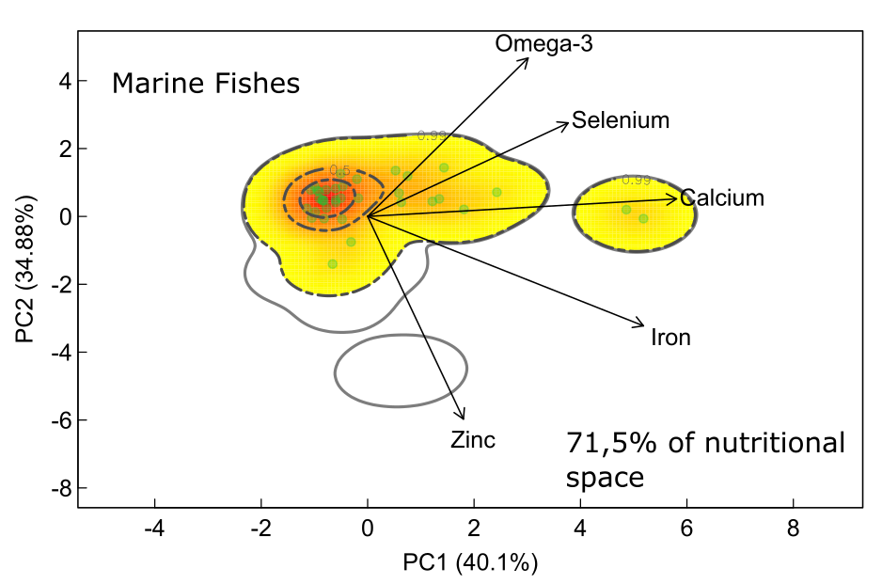
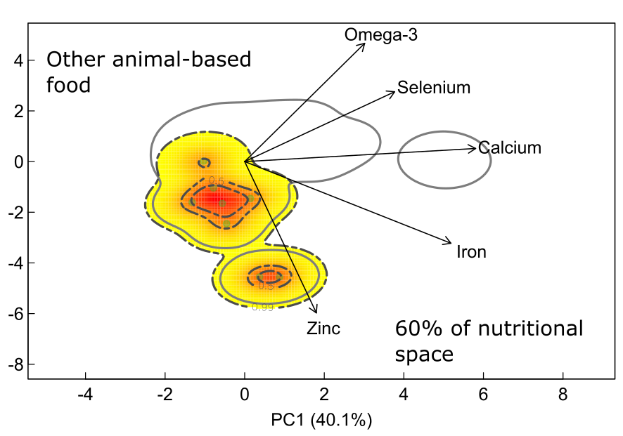
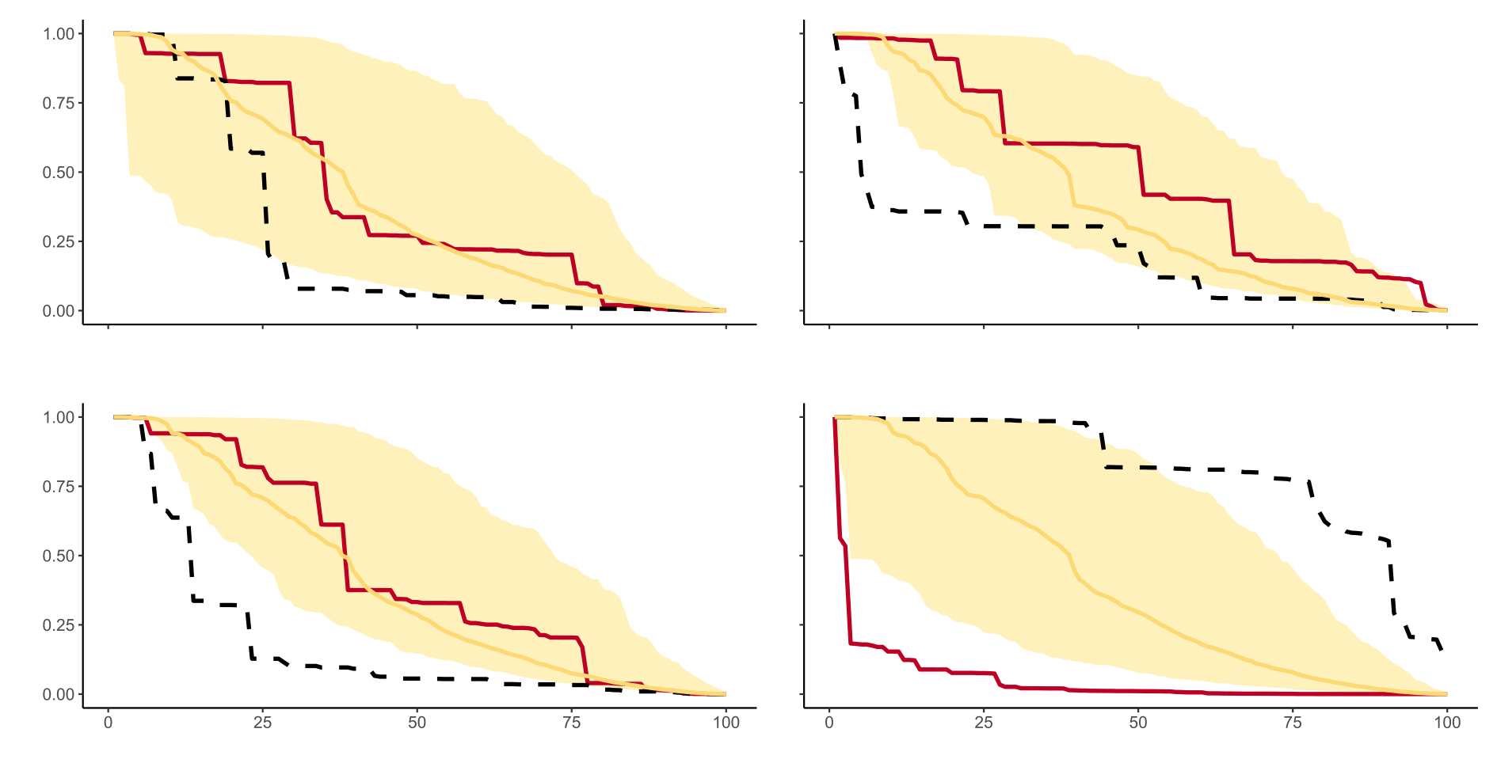
A)
B)
C) Body length
D) Trophic level
Scenario
Higher to lower
Lower to higher
Random
NRic
E) Vulnerability
F) Nutrient density
Species erosion (%)

