Slide 1
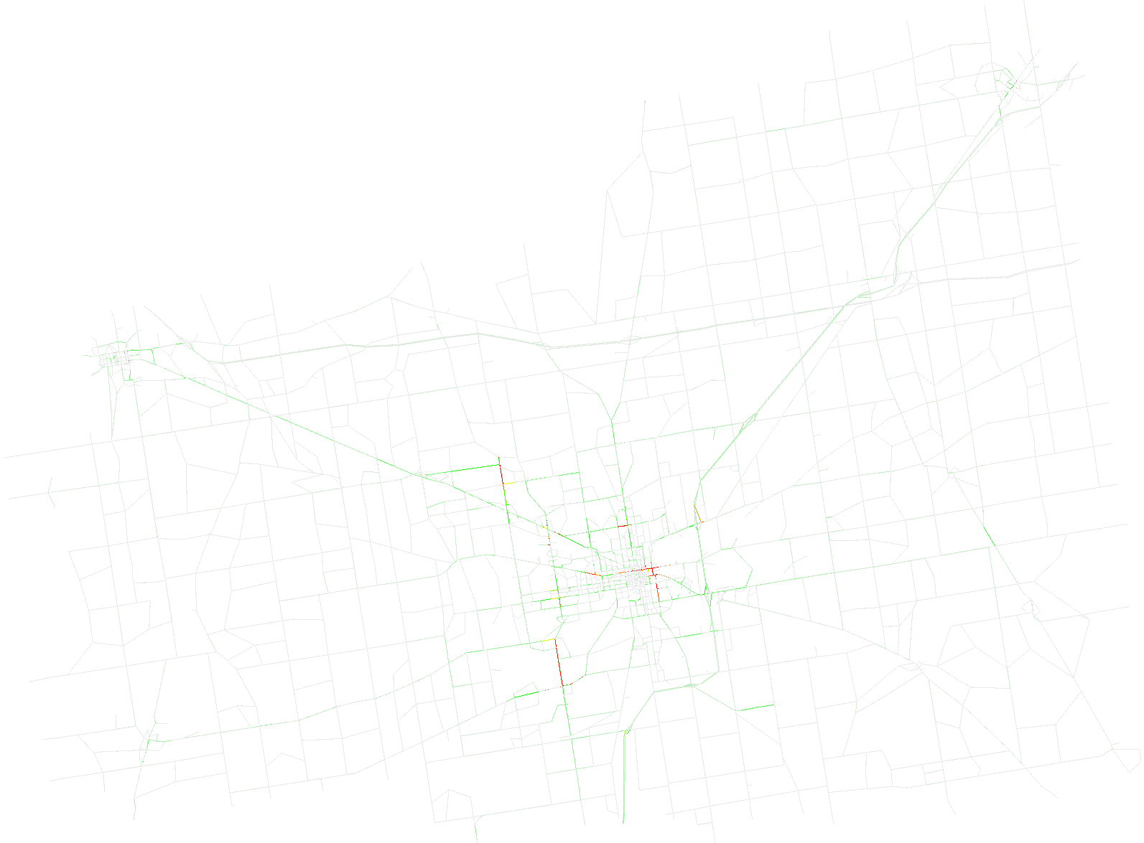
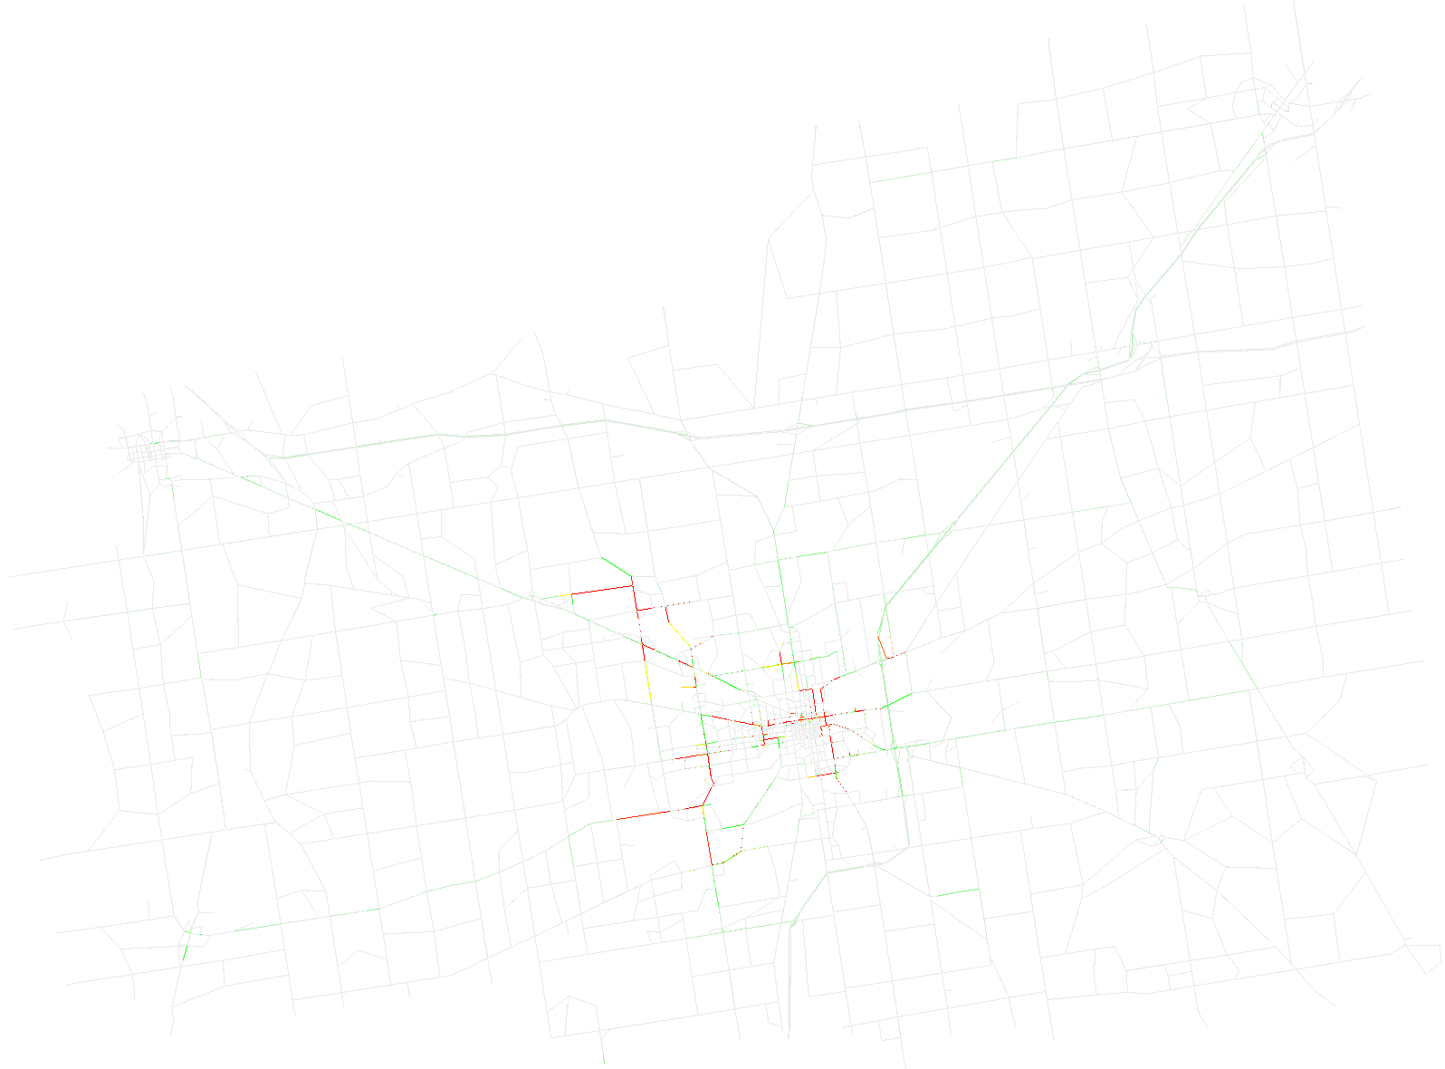
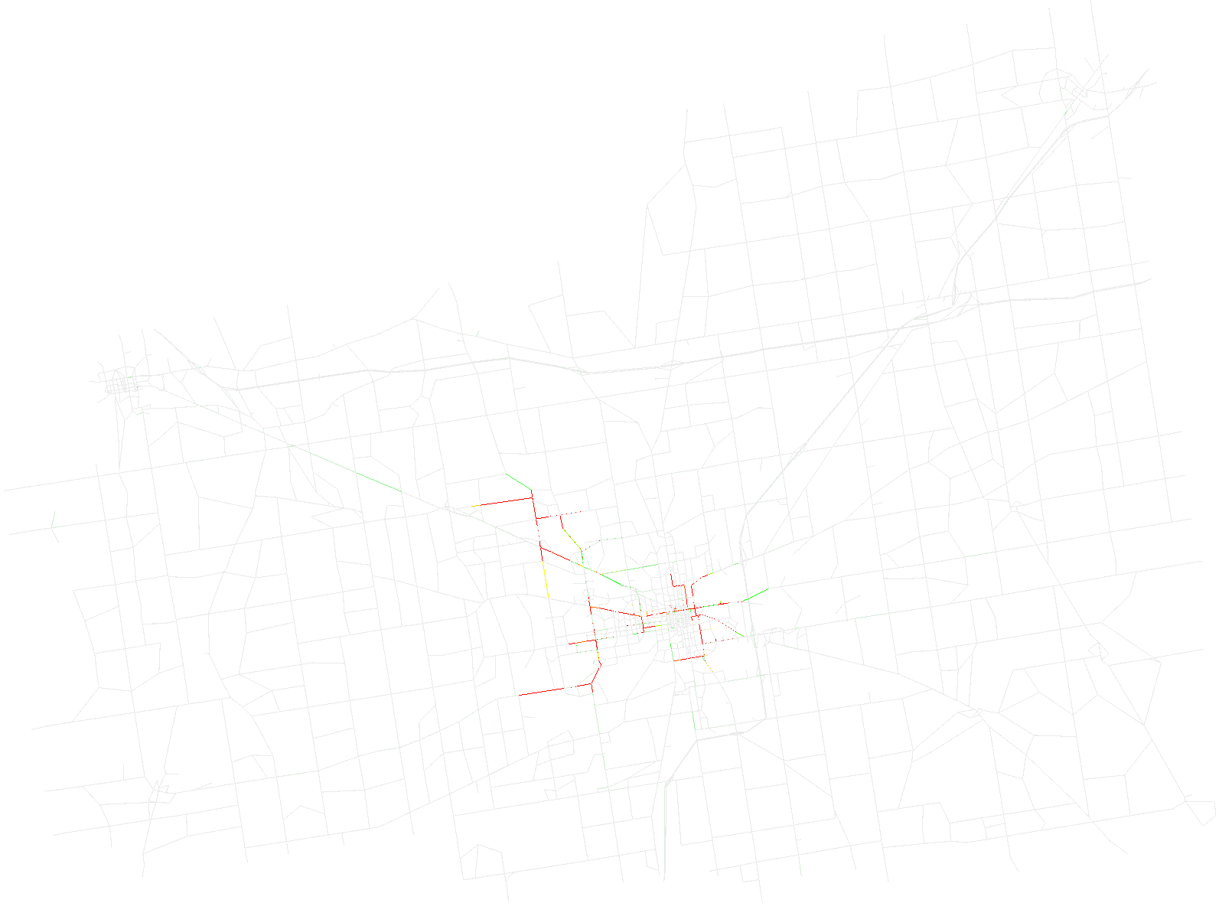

Time step 2000
Time step 4000
Time step 6000
Time step 8000

Slide 2
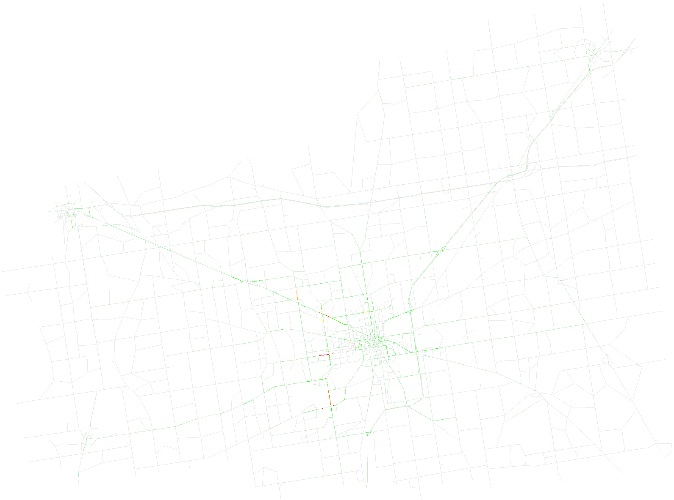
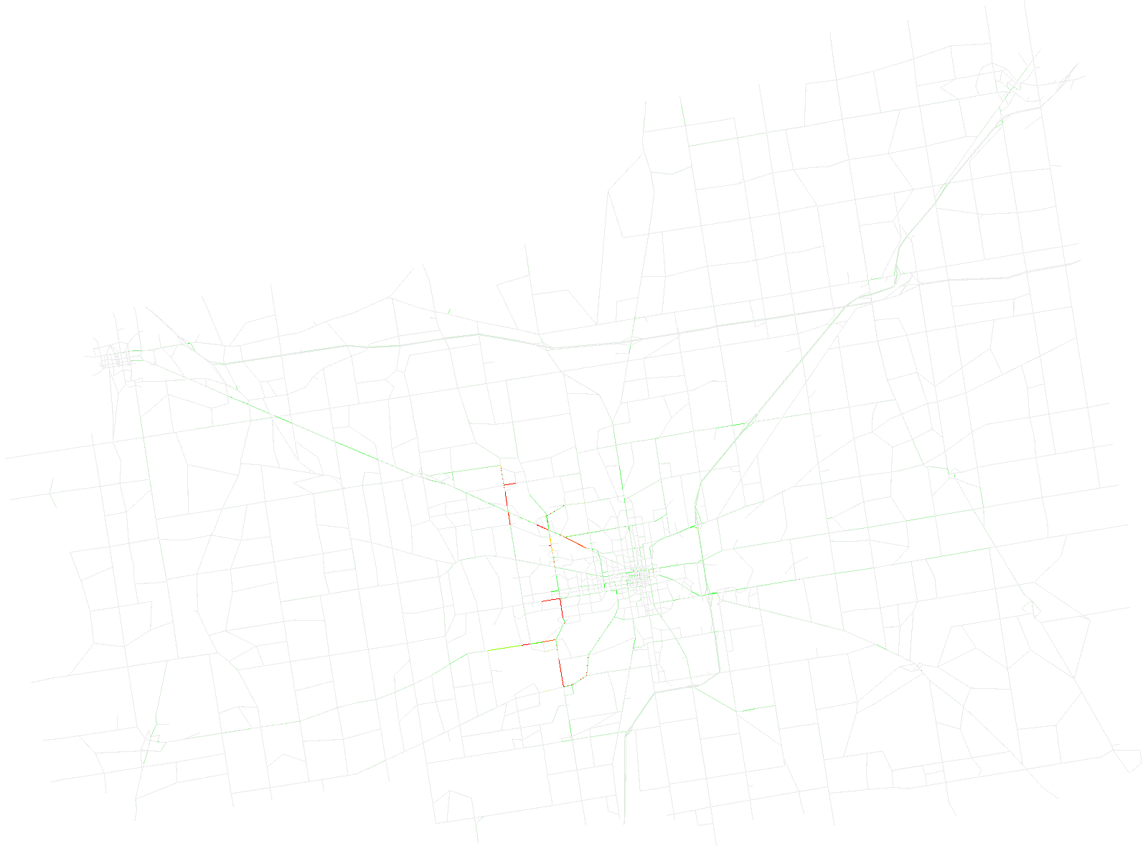
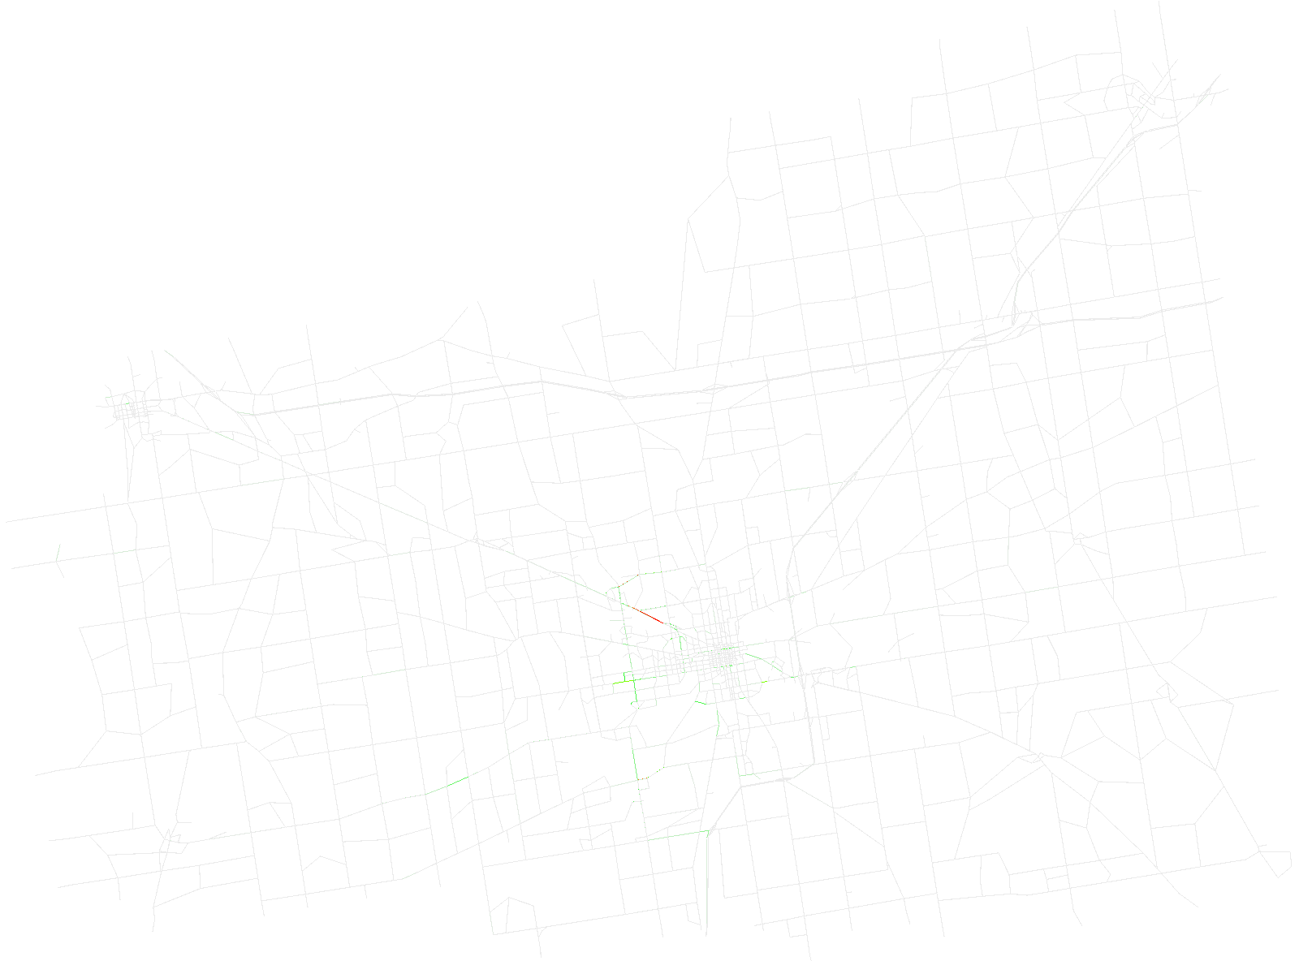

Time step 2000
Time step 4000
Time step 6000
Time step 8000

Slide 3


t
y
$$t_{1}$$
$$t_{0}$$
x

