Slide 1






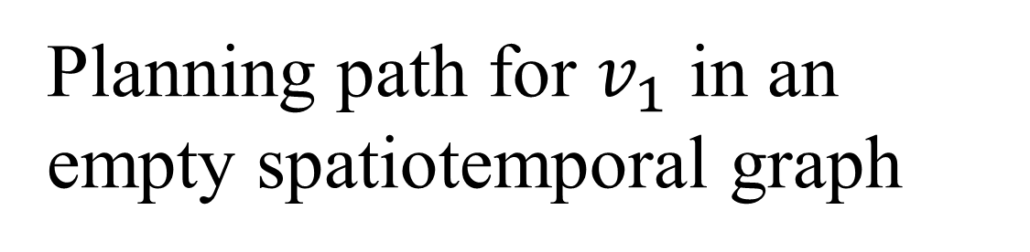

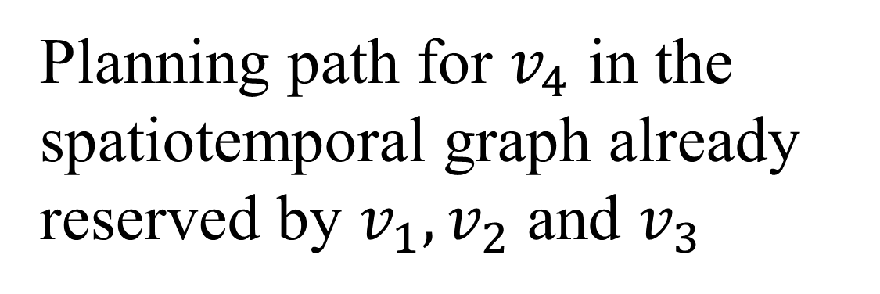
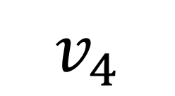
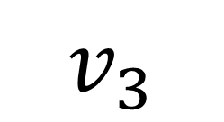
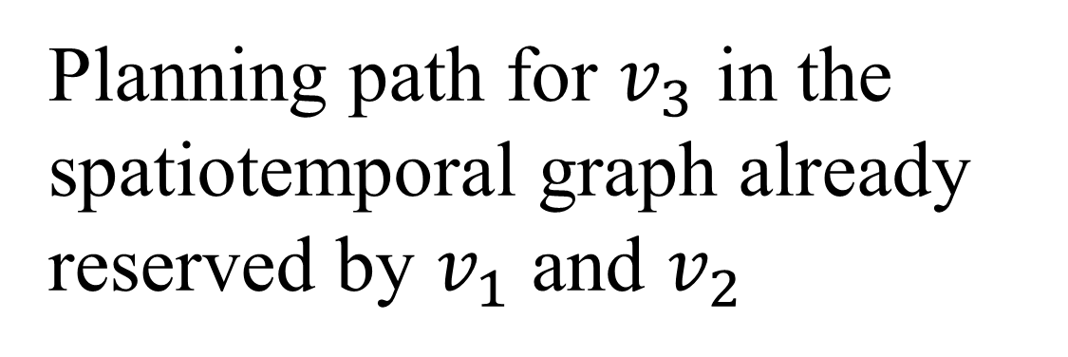

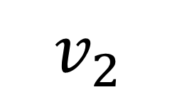

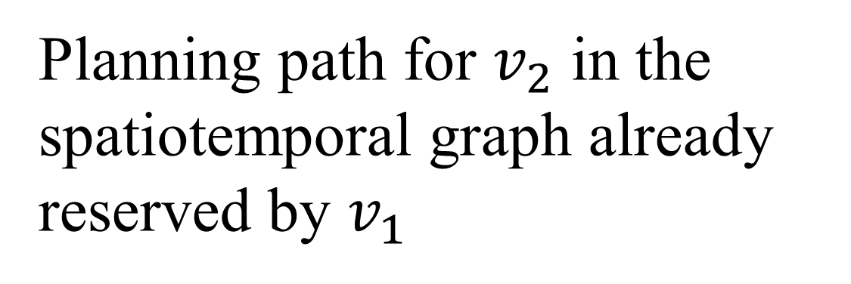

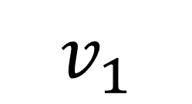
Planning path for $v_{1}$ in an empty spatiotemporal graph
$$v_{1}$$
$${OC}_{T}^{v_{1}}$$
$$v_{2}$$
Planning path for $v_{2}$ in the spatiotemporal graph already reserved by $v_{1}$
$${OC}_{T}^{v_{12}}$$
Planning path for $v_{3}$ in the spatiotemporal graph already reserved by $v_{1}$ and $v_{2}$
$$v_{3}$$
$${OC}_{T}^{v_{123}}$$
Planning path for $v_{4}$ in the spatiotemporal graph already reserved by $v_{1}, v_{2}$ and $v_{3}$
$$v_{4}$$
Vehicles
$${OC}_{T}^{v_{1234}}={OC}_{T}^{V}$$

