Slide 1




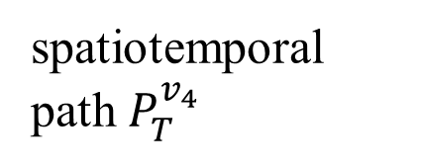

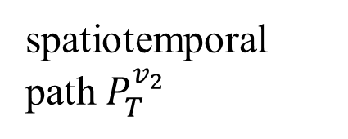
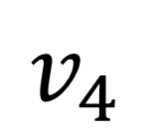
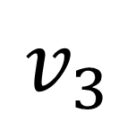
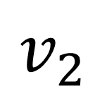
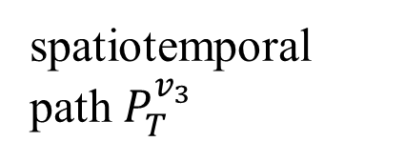

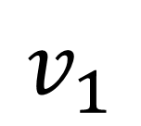
$$v_{1}$$
spatiotemporal path $P_{T}^{v_{1}}$
$$v_{2}$$
spatiotemporal path $P_{T}^{v_{2}}$
$$v_{3}$$
$${OC}_{T}^{V}$$
spatiotemporal path $P_{T}^{v_{3}}$
$$v_{4}$$
spatiotemporal path $P_{T}^{v_{4}}$
Vehicles

