Slide 1
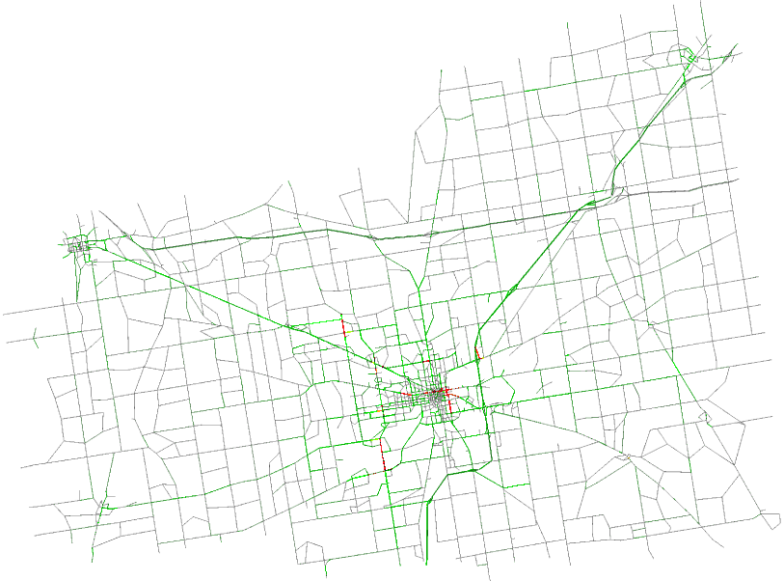
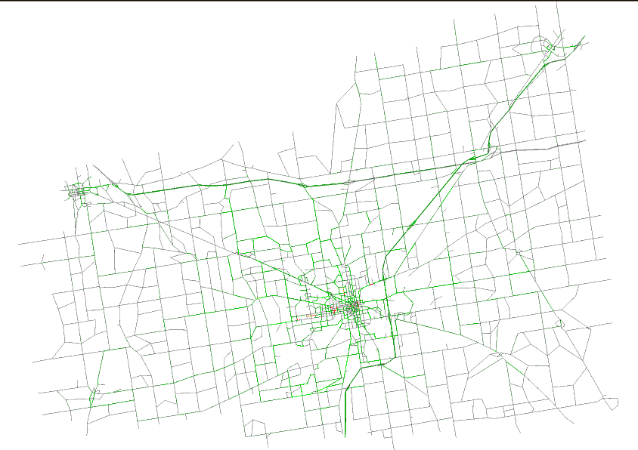
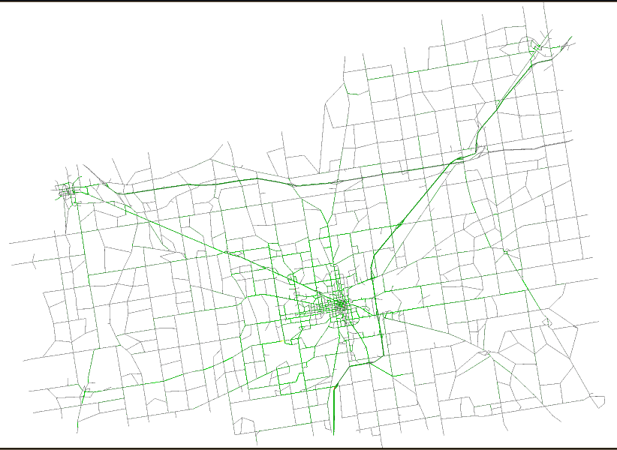
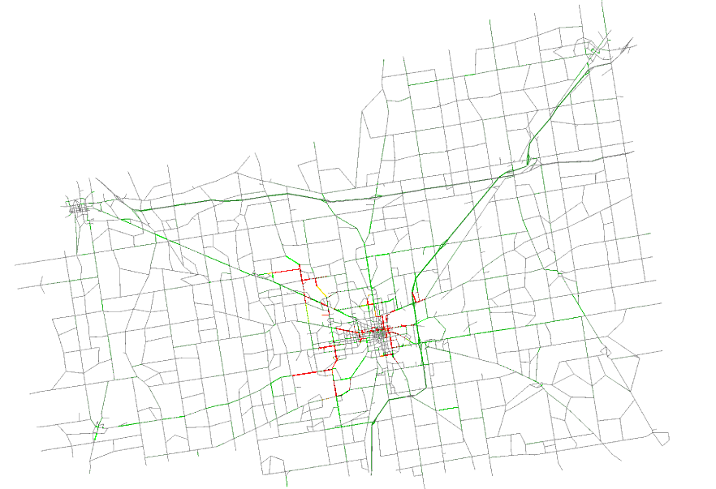
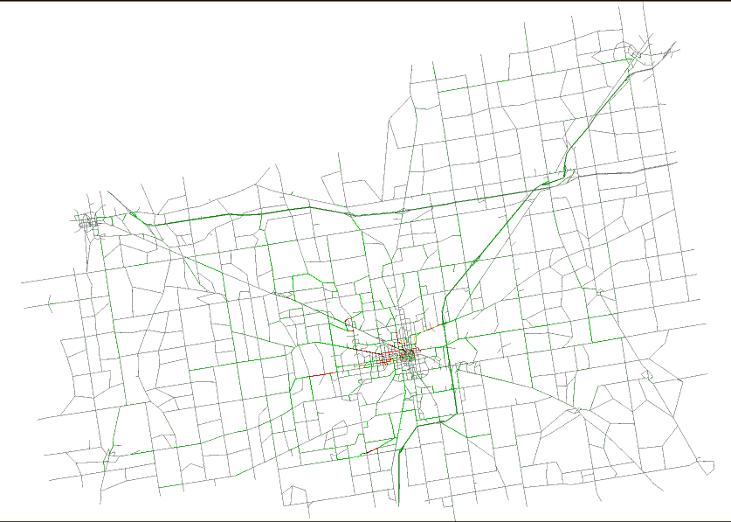
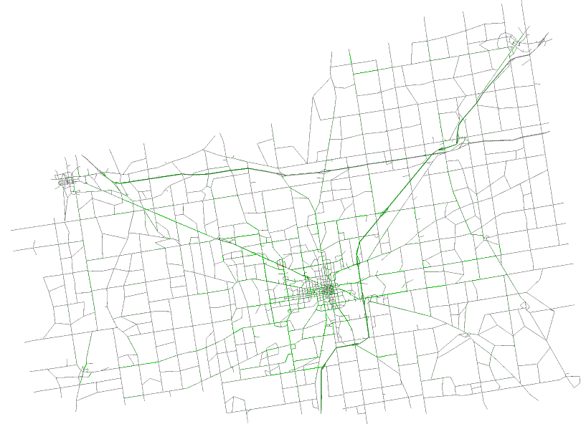
Time step = 2000
Time step = 2000
Time step = 2000
Real-time
occupancy
1.00
0.75
Time step = 4000
Time step = 4000
Time step = 4000
0.50
0.25
0.00
duarouter
PPP
ARNM

