Slide 1
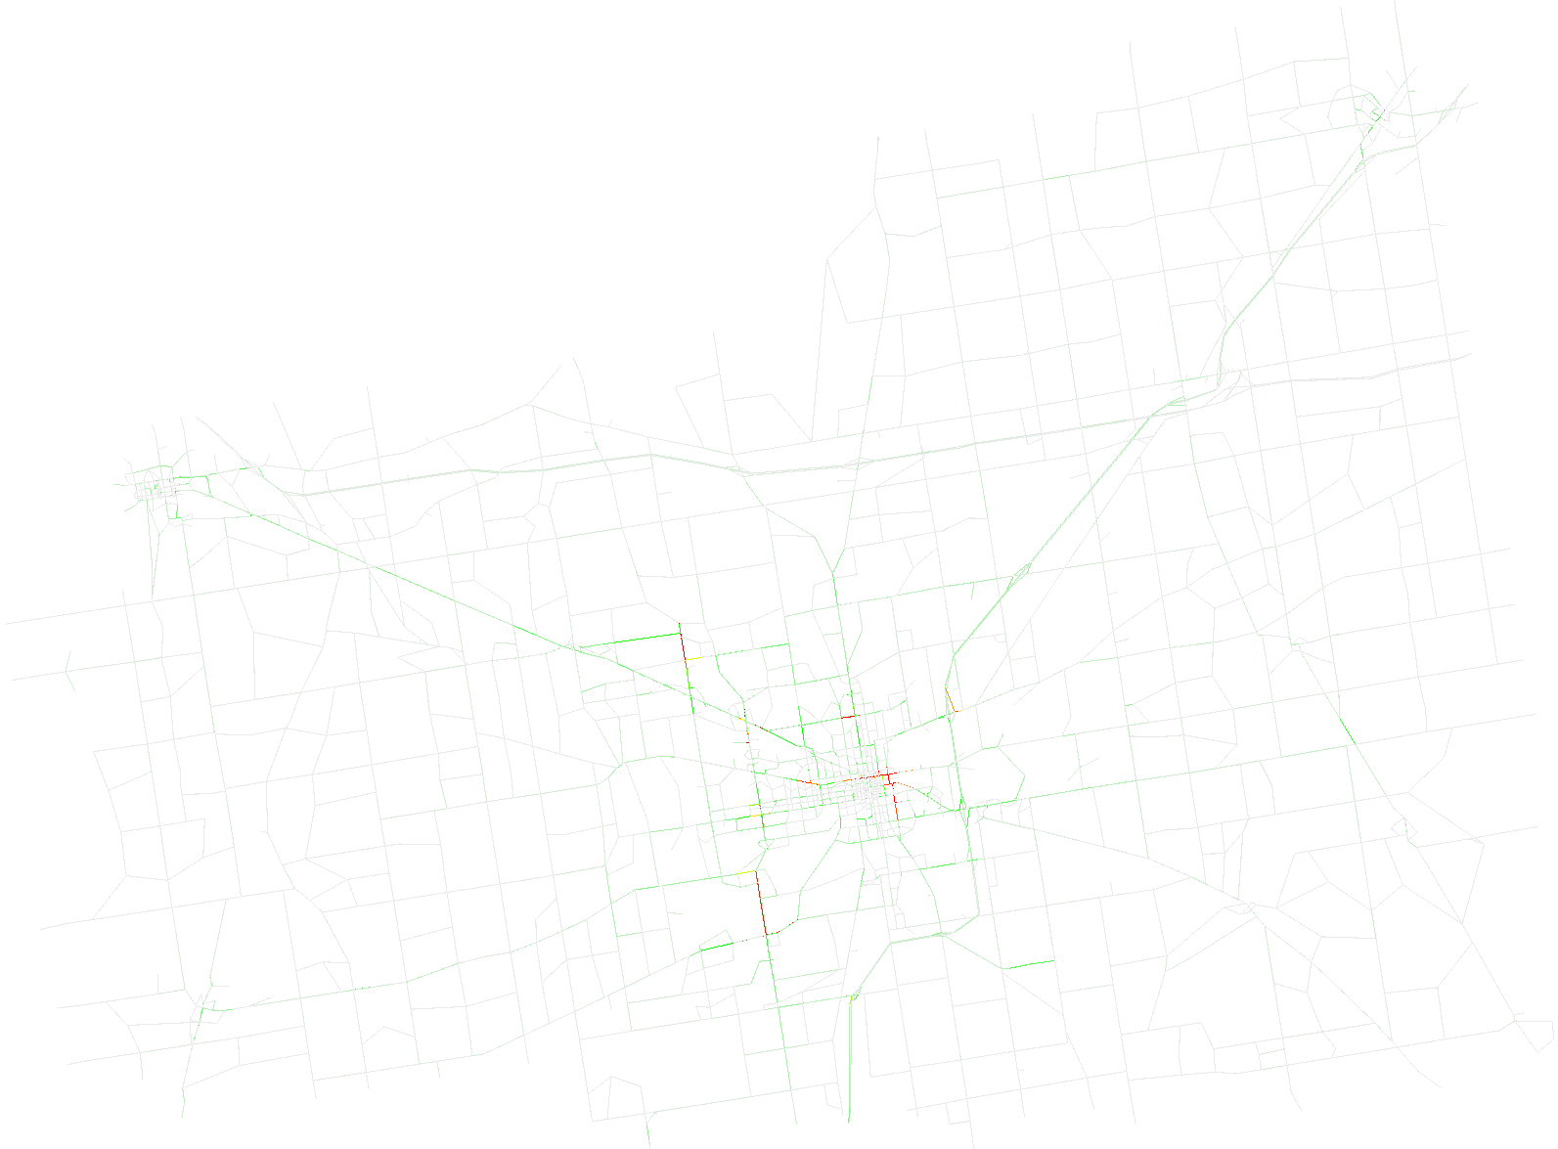
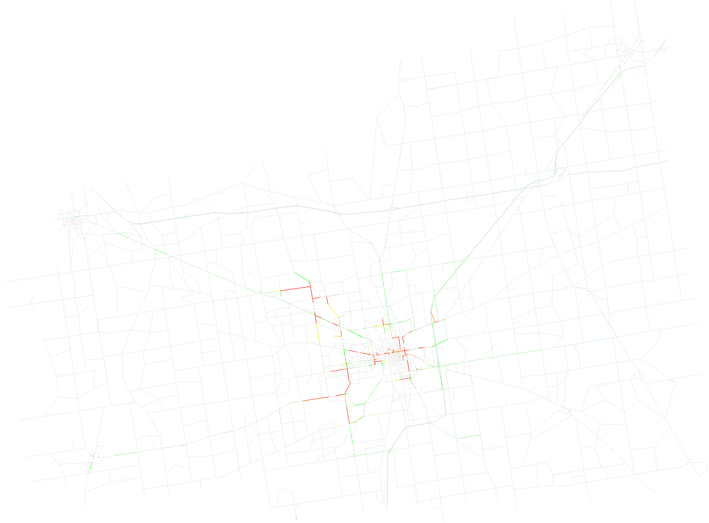
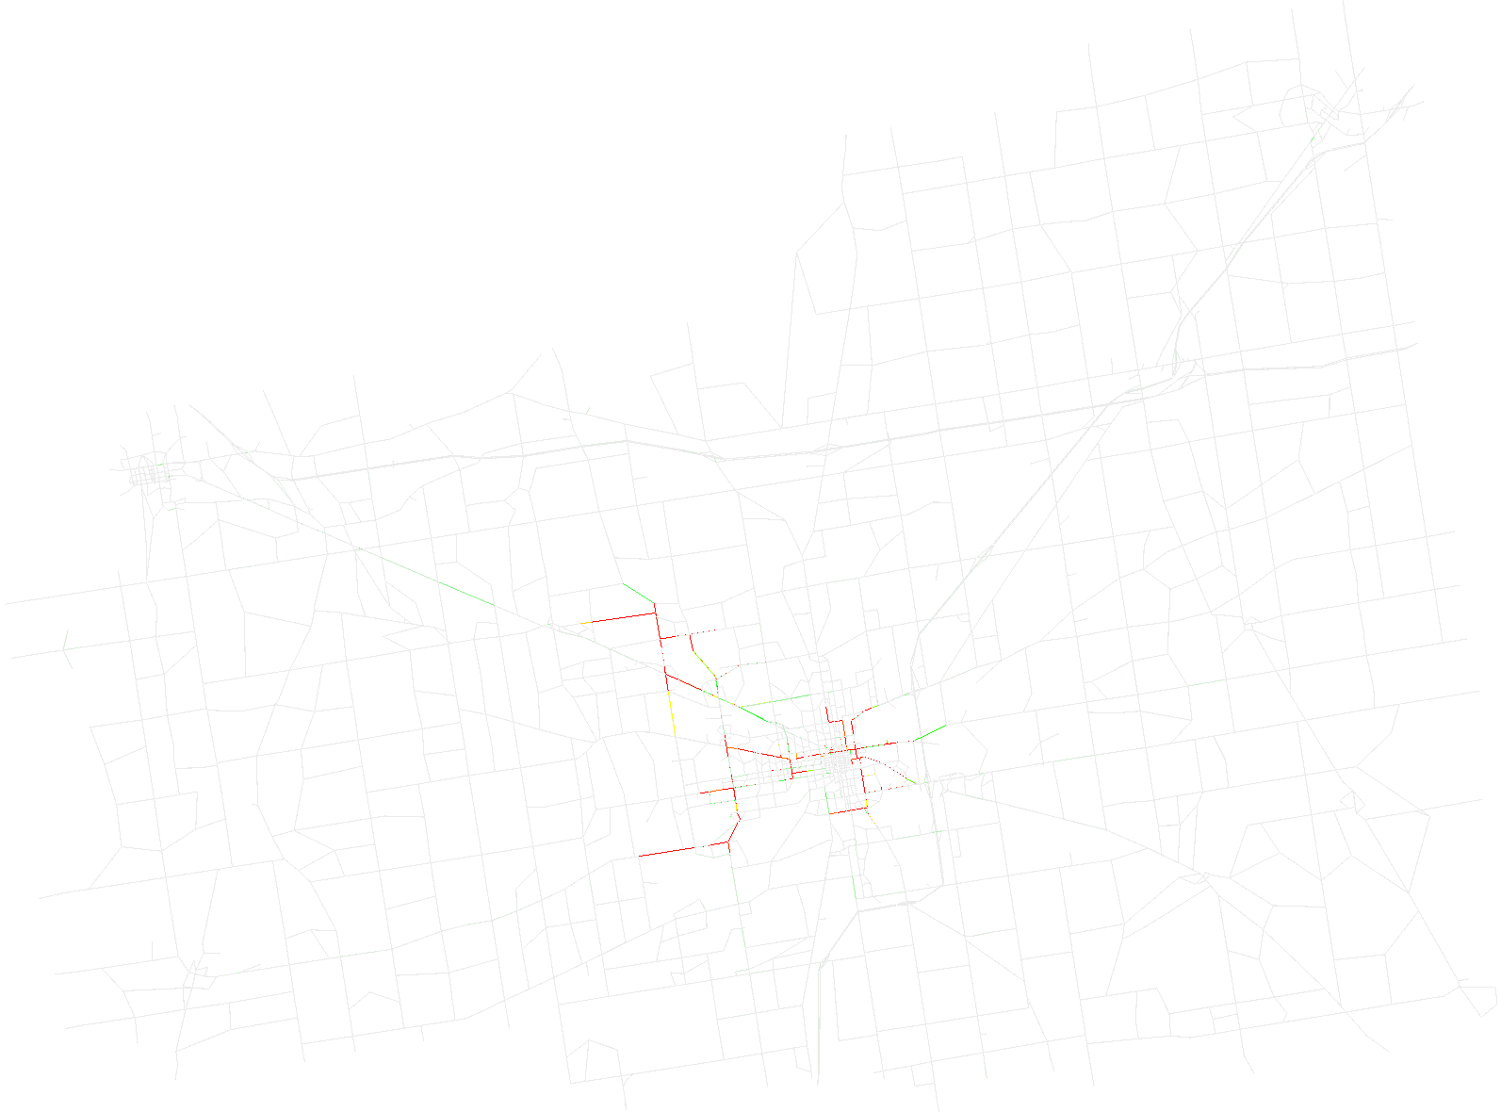

Time step 2009
Time step 4029
Time step 6019
Time step 8030

Slide 2
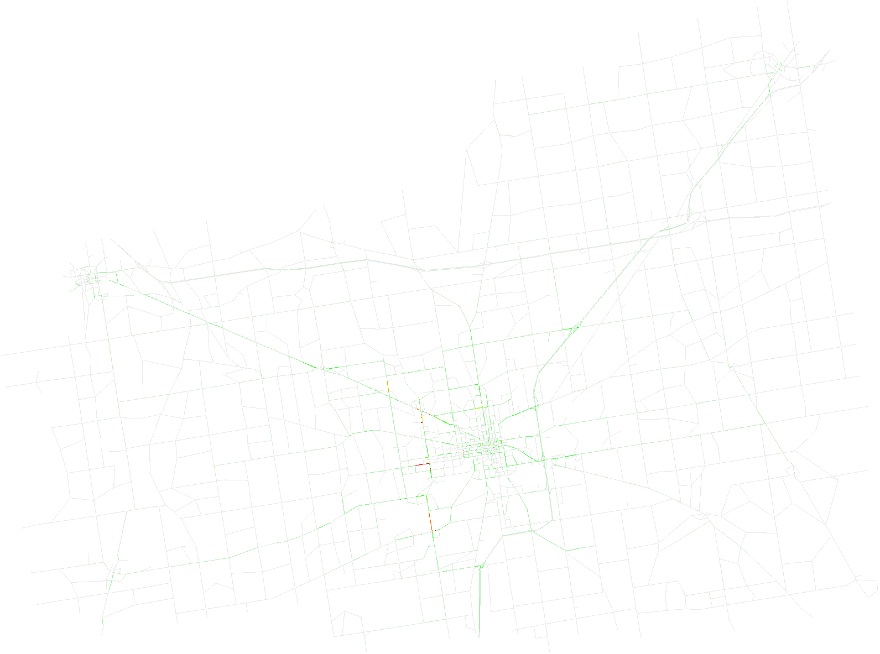
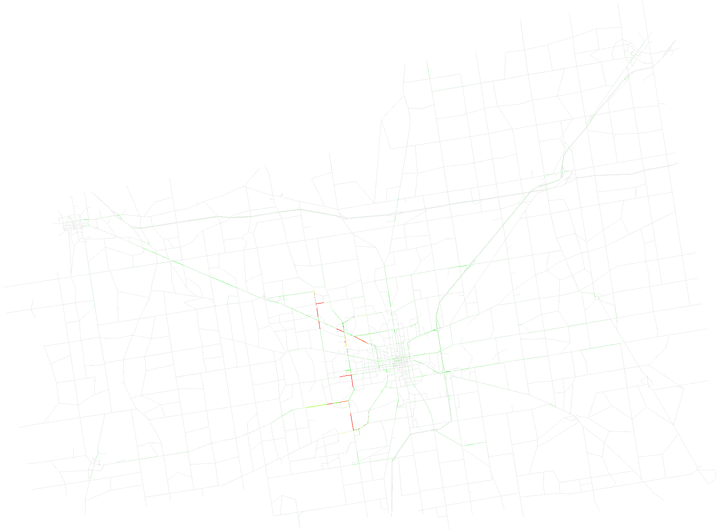
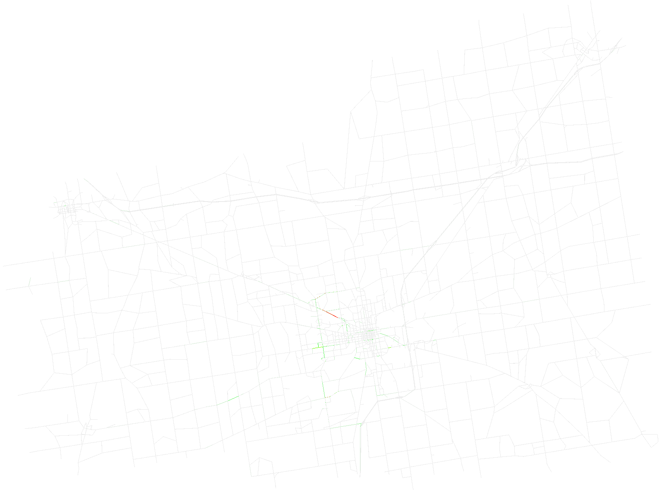

Time step 2010
Time step 4019
Time step 6085
Time step 8016

Slide 3


t
y
$$t_{1}$$
$$t_{0}$$
x

