Slide 1
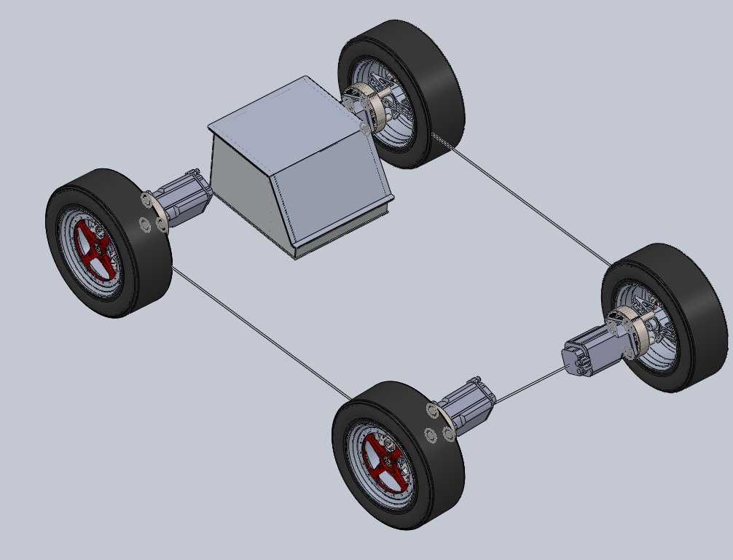
Electric Vehicle Subgroup
Ahmed Abid-Ali
Fe-eze Anyafulu
MEng Electrical Engineering Part 4
City, University of London
11 June 2018

Slide 2
Introduction
Goals
To design a battery and battery management system for the FSAE vehicle that can provide enough energy for 22km of continuous driving
To design a battery that can provide high bursts of energy over short periods
Keep the battery as light and low cost as possible while delivering enough energy
Design a Battery Management System that can reliably protect the battery

Slide 3
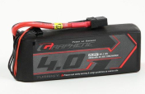
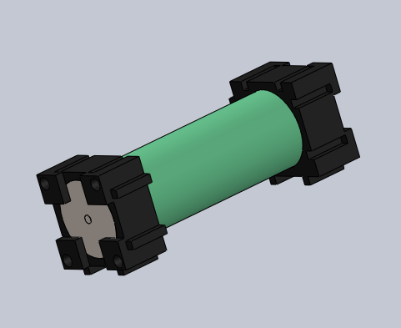
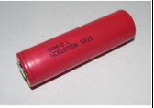
Conceptual Design
. |  | Graphene realistic performance | LG HB2 18650 | Sanyo NCR20700A
 | Cells | 4 | 1 | 1
Ah | Ah | 4 | 1.5 | 3.1
V | Volts nom | 14.8 | 3.65 | 3.6
A | Max Discharge Current | 116 | 30 | 30.07
 | Discharge C rating | 29 | 20 | 9.7
 | Charge C rating | 6 | 5.33 | 3
kg | Mass | 0.484 | 0.044 | 0.06
mm | Size | 144 | 65 | 70.3
mm |  | 51 | 18 | 20.35
mm |  | 34 | 18 | 20.35
 | Cost | £41.90 | £2.25 | £3.60
 | Energy Derived
W/kg | Power to mass | 122 | 124 | 186
kg | Total battery wt | 40.9 | 40.2 | 26.9
 | # Units for 5kWh | 84 | 913 | 448
 | Car cost | £3,520 | £2,054 | £1,613
 | Power derived
kW | Max power per cell | 1.72 | 0.11 | 0.11
 | # cells for 80kW | 47 | 731 | 739
 | Cost to meet power | £1,969 | £1,645 | £2,660
kg | Mass | 22.7 | 32.2 | 44.3
 | Simple car derived
 | # cells | 84 | 913 | 739
 | Cost | £3,520 | £2,054 | £2,660
kg | Mass | 40.9 | 40.2 | 44.3
kW | Max regen power | 29.8 | 26.6 | 24.7
 | Assumed regen efficiency | 75% | 75% | 75%
kW | Braking power available | 39.8 | 35.5 | 33.0
m/s | Assumed average speed | 17.3 | 17.3 | 17.3
kW | Assumed braking power required | 62 | 62 | 62
 | Amount of electrical braking | 48.3% | 43.2% | 40.1%
kWh | Nominal(1C) capacity | 4.9728 | 4.998675 | 8.24724
 | Concept 1 | Concept 2 | Concept 3
Cost | 7 | 9 | 10
Reliability | 5 | 9 | 8
Weight | 9 | 9 | 8
Ease of Setup | 10 | 7 | 7
 | 31 | 34 | 33
Capacity Calculation
Endurance course is about 22km long, lasts about 0.35hours and will need at least 4.675KWh of energy to complete (from 2016 results). Since this is the longest event, we can therefore conclude that a battery with a 5kWh capacity will be sufficient for this event. Therefore, an average power of 4.675/0.35 = 13.2kW will be needed. The battery should be able to deliver 13.2kW and have a capacity of 5kWh.
Max Discharge Calculation Max power - 80kW.
If we use the full power during the Acceleration event, we would need a cell capable of discharging at 80kW/5kWh=16C.

Slide 4
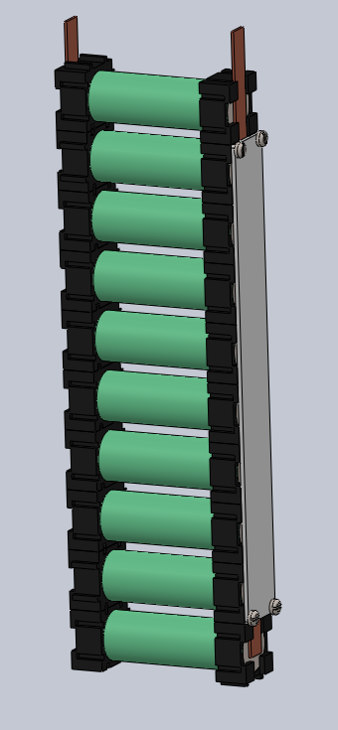
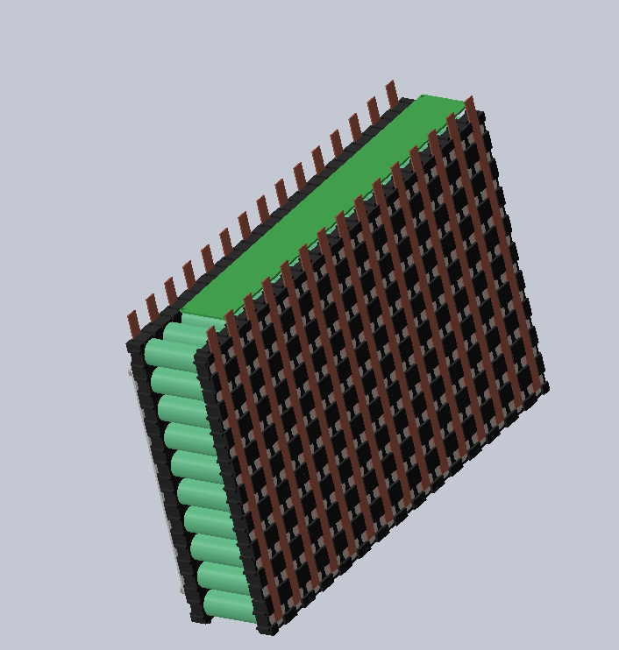
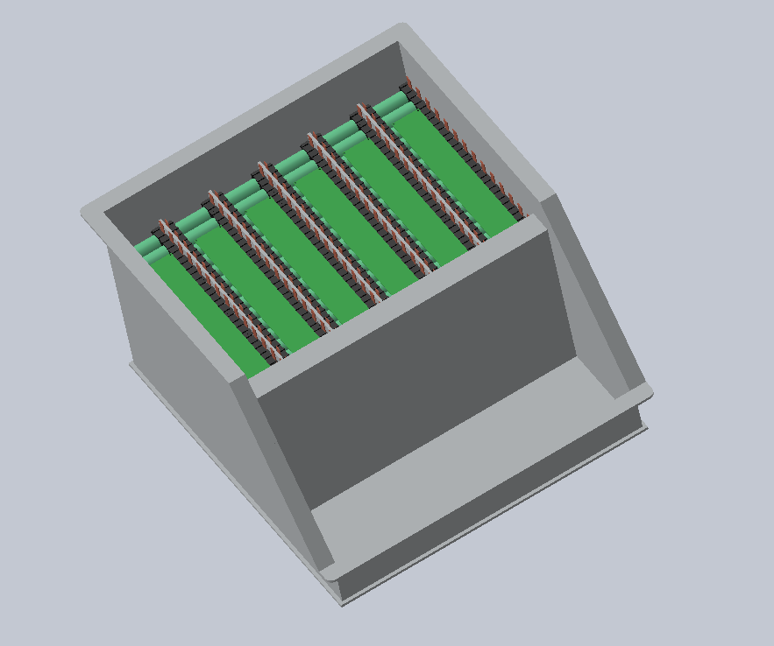
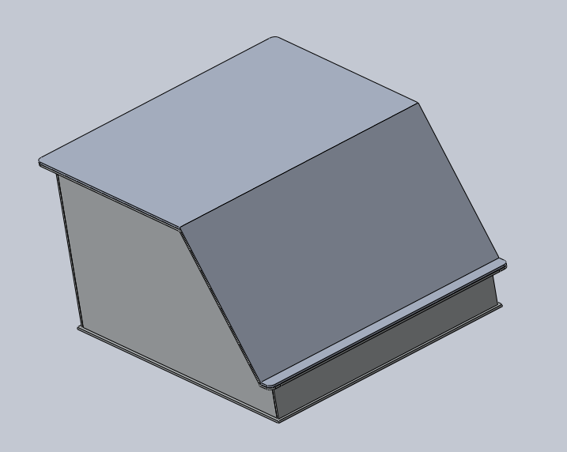
Design: Battery and Battery box
Battery box - 4mm thick, 505*458mm Aluminium plate as a base with four walls (and 300mm high) and a sloping front to facilitate easy maintenance.
Internal sections to divide the box into eight sections and The internal walls to be covered with fire retardant formex and one brick inserted in each section.
PCB for each section will be inserted in the 32mm gap between the top of the modules and the top of the internal vertical wall.
Top cover sealed with gaskets in order to fulfil the rain test requirement.
8 cells form a string - 12A, 3.6V
12 strings form a brick
8 brick sections in the battery box
Final pack characteristics
432V, 12A (1C), 240A Max. discharge

Slide 5
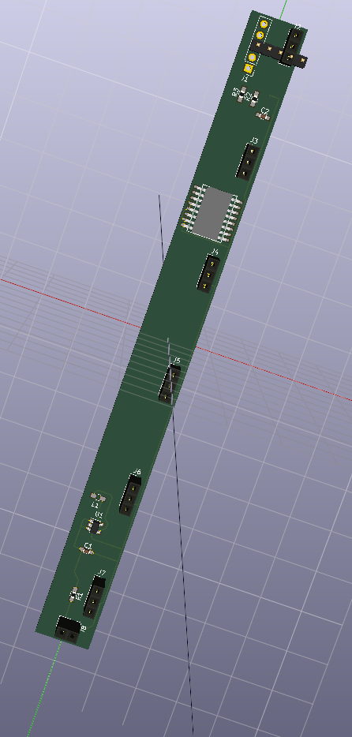
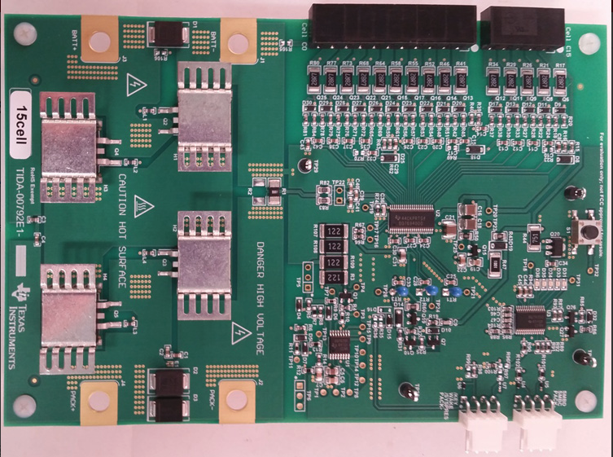
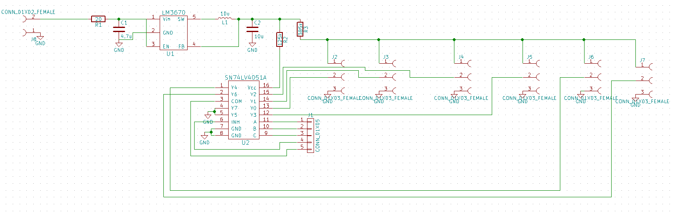
Design: Battery Management System
1st PCB custom designed around TI parts to link 8 parallel cells and perform temperature monitoring.
LMT-84 temp sensor
SN74xx ADC for temperature muxing
2nd PCB is a 15-cell voltage monitor with a FET driver from TI

