Slide 1
Channel Coding: Theory and Applications in LTE Networks
Fe-eze Anyafulu
MEng Electrical and Electronics Engineering
City, University of London

Slide 2
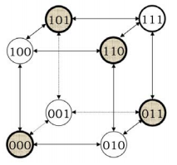
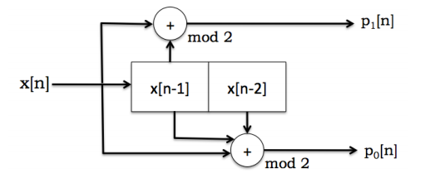
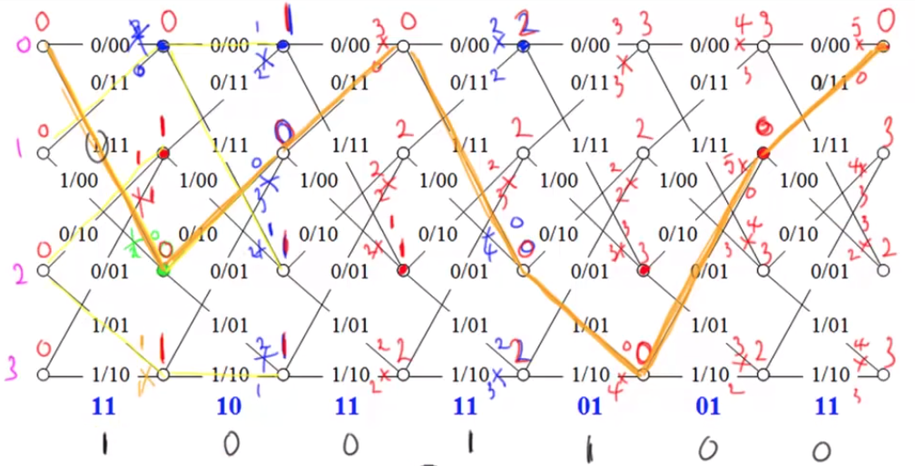


Concepts
Information theory
Claude E. Shannon (1948) and R.V. Harley
Information, irrespective of semantics can be defined
Higher probability conveys less information
Expressed in bits
Source Coding
SC – Aim is efficiency; Channel Coding – Aim is redundancy
Fixed coding – ASCII
Variable Coding – Lossless compression
Huffman Coding
Lempel-Ziv
Hamming distance
Spread out errors with codeword separation
Linear Block codes
Add parity bits to the message for error detection & correction
Detect (d-1) errors
Correct $floor\frac{(d−1)}{2}$ errors
Syndrome decoding
Convolutional Codes
Use a Sliding Window & convolution operation to generate parity bits
Transmit only parity bits
Viterbi Algorithm
Andrew Viterbi, 1957;
Elegant way of decoding Convolutional Codes
Trellis Diagram
Visualize the decoding task
Understand changes in state machine over time

Slide 3
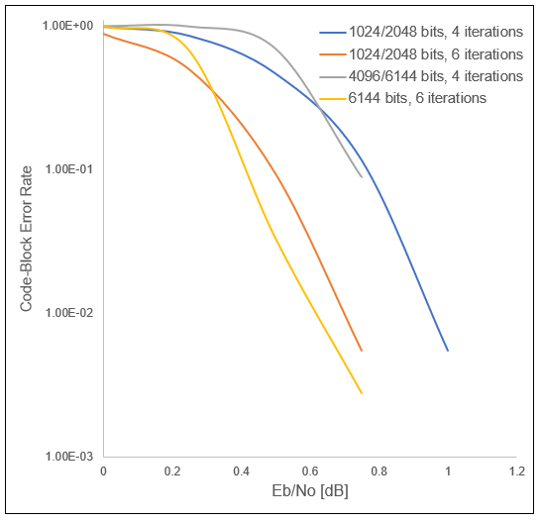
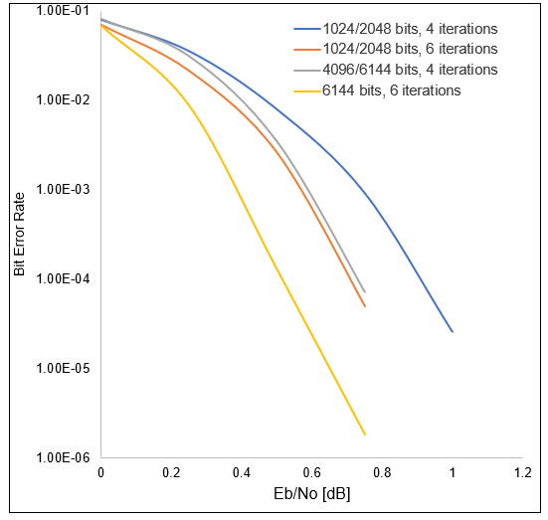
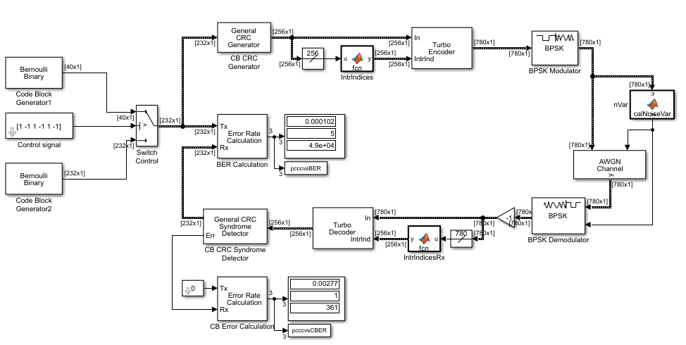
Experiment
Turbo Code
High performance FEC code
First code scheme to approach Shannon Limit
Turbo Encoder is 2 conv. Encoders in parallel
Turbo Decoder is 2 decoders connected in series, D1 uses a soft decision approach (log of likelihood ratio), the other uses a hard decision approach and takes LLR of Dec 1 into account
An Interleaver placed between D1 & D2 to scatter burst errors
Innovation is the use of probability data to interpret intended bit @receiver
Used extensively in LTE
CBER
BER

Slide 4
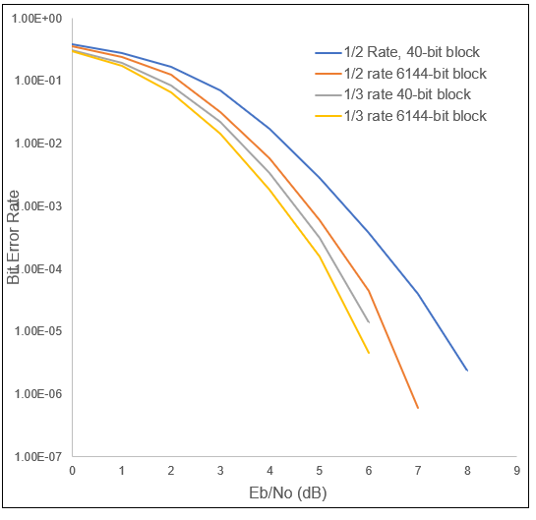
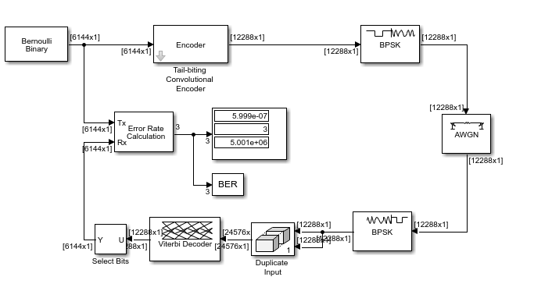
Experiment
Tail Biting Convolutional Code
Terminating trellis is a key parameter for performance in packet based comms
Zero tailed coding attaches a string of zeros to each data block, causing a rate loss due to extra tail (non-info)bits
Tail biting terminates trellis by initializing m memory elements of encoder with last m bits of the info block
Input entire code block then use L*m as codeword
This accomplishes trellis termination without rate loss present in zero tailed encoder but is a more complex design

