Slide 1


Slide 2
Entity Relationship Diagram

Slide 3
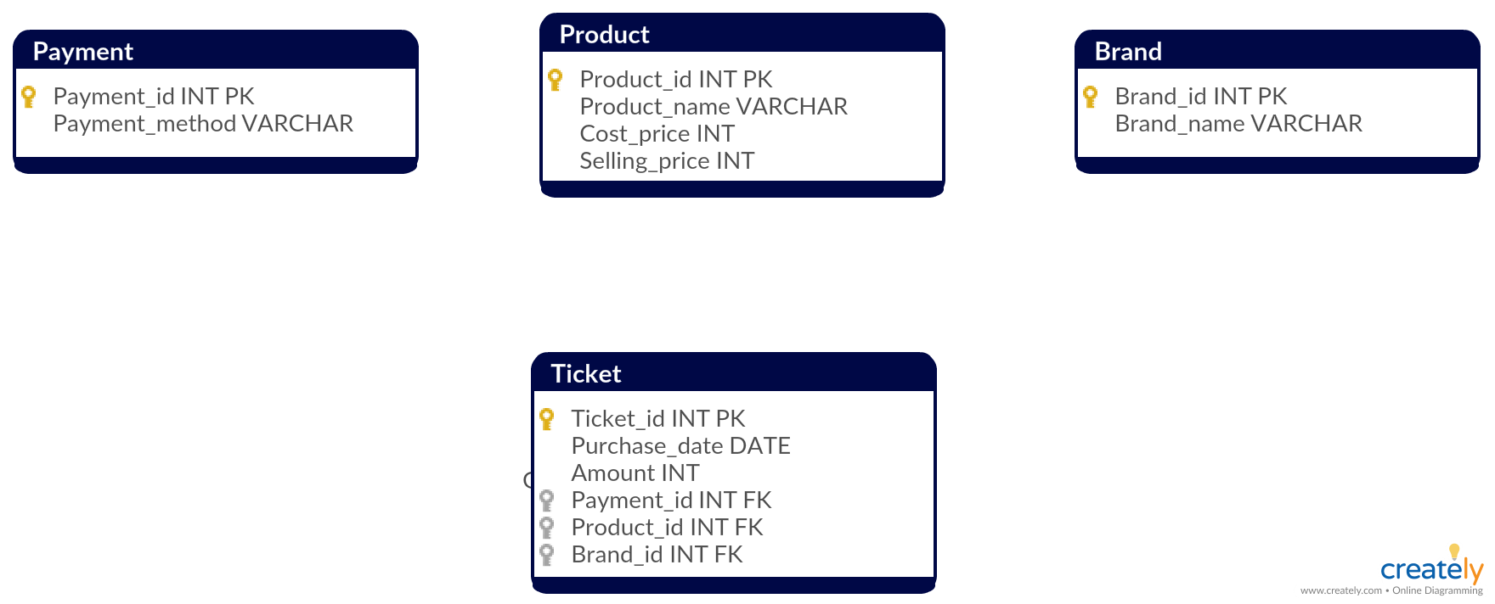


Slide 4
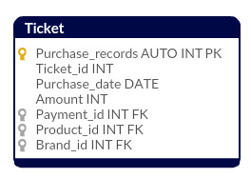

Slide 5
Data Exploration

Slide 6
SELECT * FROM Products
PRODUCT_ID PRODUCT_NAME COST_PRICE SALE_PRICE
---------------------------------------------------------------------------------------------------------
1 Bread 2 11
2 Milk 2 5
3 Water 1 3
4 Gin 20 37
5 Tonic 7 8
6 Apple 14 49
7 Banana 22 39
8 Butter 14 29
9 Cheese 33 61
10 Yoghurt 23 53
11 Juice 3 52
12 Wodka 10 39
13 Jamon 14 26
14 Whisky 20 36

Slide 7
SELECT * FROM Brand LIMIT 10
BRAND_ID BRAND_NAME
---------------------------------------------------------
1 WASA
2 Nestle
3 Tanqueray
4 Thomas Henry
5 Fruits-Import
6 Puerto de Indias
7 Kaergarden
8 Geramont
9 Activia
10 Schweppes

Slide 8
SELECT * FROM Payment
PAYMENT_ID PAYMENT_METHOD
---------------------------------------------------------
1 Visa
2 MasterCard
3 AmericanExpress
4 CASH

Slide 9
SELECT * FROM Ticket LIMIT 10
PURCHASE TICKET_ID PRODUCT_ID BRAND_ID PAYMENT_ID PURCHASE_DATE AMOUNT
_RECORDS
---------------------------------------------------------------------------------------------------------------------------------------
1 1 7 12 2 11/26/2018 207
2 1 8 4 1 11/26/2018 207
3 1 5 6 1 11/26/2018 207
4 1 1 2 1 11/26/2018 207
5 1 14 12 3 11/26/2018 207
6 1 5 5 3 11/26/2018 207
7 1 8 12 4 11/26/2018 207
8 1 2 11 3 11/26/2018 207
9 1 12 11 3 11/26/2018 207
10 1 3 9 2 11/26/2018 207

Slide 10
Data Insights

Slide 11
Which are the top 4 products sold?
SELECT Products.Product_Name, COUNT(Ticket.Product_id) AS Count FROM Ticket INNER JOIN Products ON
Ticket.Product_id = Products.Product_id
GROUP BY Products.Product_Name
ORDER BY Count DESC
LIMIT 4;
PRODUCT_NAME COUNT -------------------------------------------------
Bread 15
Tonic 15
Butter 13
Wodka 13

Slide 12
What is the average amount spent per purchase?
SELECT SUM(SALE_PRICE)/COUNT(DISTINCT TICKET_ID) AS AVG_SPENDING FROM TICKET AS T JOIN PRODUCTS AS P
ON T.PRODUCT_ID = P.PRODUCT_ID
AVG_SPENDING
------------------------
295

Slide 13
What is the revenue per type of credit card?
SELECT P.Payment_method, SUM(DISTINCT T.Amount) AS REVENUE TROM Ticket T
INNER JOIN PAYMENTS P ON T.Payment_id = P.Payment_id
GROUP BY P.Payment_method
PAYMENT_METHOD REVENUE
---------------------------------------------------------------------------------
AmericanExpress 1293
CASH 331
MasterCard 878
Visa 2530

Slide 14
Which brand has the highest profit?
SELECT B.Brand_name,SUM(P.PROFIT) AS SUM_PROFIT FROM PRODUCTS P INNER JOIN BRANDS B
ON P.Product_id = B.Brand_ID
GROUP BY B.Brand_name
ORDER BY SUM_PROFIT DESC
LIMIT 10;

Slide 15
Which brand has the highest profit?
BRAND_NAME SUM_PROFIT
------------------------------------------------
Multi 49
Puerto de Indias 35
Schweppes 30
Smirnoff 29
Activia 28
Kaergarden 17
Thomas Henry 17
Jamon Sevilla 16
Geramont 15
Monkey47 12

Slide 16
Which product is most likely bought on SUNDAYS?
PURCHASE TICKET_ID PRODUCT_ID BRAND_ID PAYMENT_ID PURCHASE_DATE AMOUNT
_RECORDS
---------------------------------------------------------------------------------------------------------------------------------------
1 1 7 12 2 11/26/2018 207
2 1 8 4 1 11/26/2018 207
3 1 5 6 1 11/26/2018 207
4 1 1 2 1 11/26/2018 207
5 1 14 12 3 11/26/2018 207
6 1 5 5 3 11/26/2018 207
7 1 8 12 4 11/26/2018 207
8 1 2 11 3 11/26/2018 207
9 1 12 11 3 11/26/2018 207
10 1 3 9 2 11/26/2018 207

Slide 17
Which product is most likely bought on SUNDAYS?
ALTER TABLE TICKET
ADD COLUMN WEEKDAY_NUMBER INT DEFAULT 0;
UPDATE TICKET
SET WEEKDAY_NUMBER = DAYOFWEEK(PURCHASE_DATE);

Slide 18
Which product is most likely bought on SUNDAYS?
PURCHASE TICKET_ID PRODUCT_ID BRAND_ID PAYMENT_ID PURCHASE_DATE AMOUNT WEEKDAY_NUMBER
_RECORDS
-----------------------------------------------------------------------------------------------------------------------------------------------------------------
1 1 7 12 2 11/26/2018 207 2
2 1 8 4 1 11/26/2018 207 2
3 1 5 6 1 11/26/2018 207 2
4 1 1 2 1 11/26/2018 207 2
5 1 14 12 3 11/26/2018 207 2
6 1 5 5 3 11/26/2018 207 2
7 1 8 12 4 11/26/2018 207 2
8 1 2 11 3 11/26/2018 207 2
9 1 12 11 3 11/26/2018 207 2
10 1 3 9 2 11/26/2018 207 2

Slide 19
Which product is most likely bought on SUNDAYS?
SELECT COUNT(PRODUCTS.PRODUCT_NAME) AS TIMES_BOUGHT , TICKET.WEEKDAY_NUMBER , PRODUCTS.PRODUCT_NAME FROM PRODUCTS
INNER JOIN TICKET ON PRODUCTS.PRODUCT_ID = TICKET.PRODUCT_I
GROUP BY PRODUCTS.PRODUCT_NAME, TICKET.WEEKDAY_NUMBER
HAVING TICKET.WEEKDAY_NUMBER > 6
ORDER BY TIMES_BOUGHT DESC
LIMIT 3;

Slide 20
Which product is most likely bought on SUNDAYS?
TIMES_BOUGHT PRODUCT_NAME WEEKDAY_NUMBER
-----------------------------------------------------------------------------------
2 Bread 7
2 Tonic 7
2 Juice 7

