Slide 1
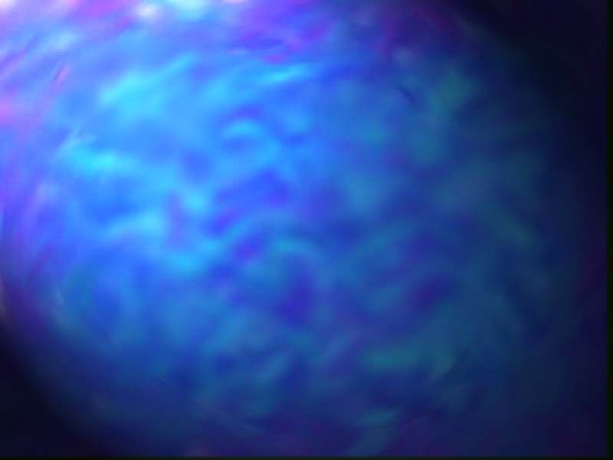
Just What is a Supernova?

Slide 2
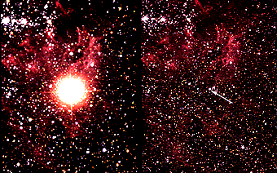
Types of Supernovae
Type I
No Hydrogen is observed
Outer stellar layers are already missing prior to the explosion – due to binary system evolution?
Found in elliptical and spiral galaxies
Subgroups are Ia, Ib and Ic
Type II
Hydrogen is observed
Probably from higher mass stars
Found primarily in spiral galaxy arms
SN1987A

Slide 3
How stars die
Single stars that are below about 8 M_{o} form red giants at the end of their lives on the main sequence
Red giants evolve into white dwarfs, often accompanied by planetary nebulae
More massive stars form red supergiants
Red supergiants undergo Type II supernova explosions, often leaving behind a stellar core which is a neutron star, or perhaps a black hole
Notes:
The Pleiades contains over 3000 stars, is about 400 light years away, and only 13 light years across. Quite evident in the above photograph are the blue reflection nebulae that surround the bright cluster stars. Low mass, faint, brown dwarfs have recently been found in the Pleiades.

Slide 4
Stars in binary systems
In a binary star system consisting of a white dwarf and a main sequence star, the main sequence star will transfer matter to the white dwarf
When the white dwarf reaches the “Chandresekhar limit” of 1.4 Mo, it can no longer support itself, and it implodes with a bright flash of energy released due to carbon and oxygen fusion inside the star

Slide 5

Matter transfer in a binary system
Matter transfers between white dwarf and more massive companion
“Roche lobe”
John Blondin/NCSU
Blondin 1998
Notes:
‹#›
*
*
*

Slide 6
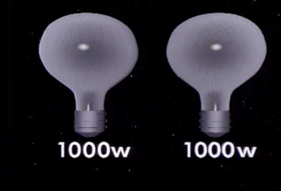
Distances to Type Ia Supernovae
All Ias are due to implosion of 1.4 Mo white dwarfs, so they all have the same amount of fuel to burn and produce the same luminosity
They therefore act like “standard candles”
Notes:
The Pleiades contains over 3000 stars, is about 400 light years away, and only 13 light years across. Quite evident in the above photograph are the blue reflection nebulae that surround the bright cluster stars. Low mass, faint, brown dwarfs have recently been found in the Pleiades.

Slide 7
Distances to Type Ia Supernovae
Decay time of light curve is correlated to absolute luminosity
Luminosity comes from the radioactive decay of Cobalt and Nickel into Iron
Some Type Ia supernovae are in galaxies with Cepheid variables
Good to 20% as a distance measure
Notes:
The Pleiades contains over 3000 stars, is about 400 light years away, and only 13 light years across. Quite evident in the above photograph are the blue reflection nebulae that surround the bright cluster stars. Low mass, faint, brown dwarfs have recently been found in the Pleiades.

Slide 8
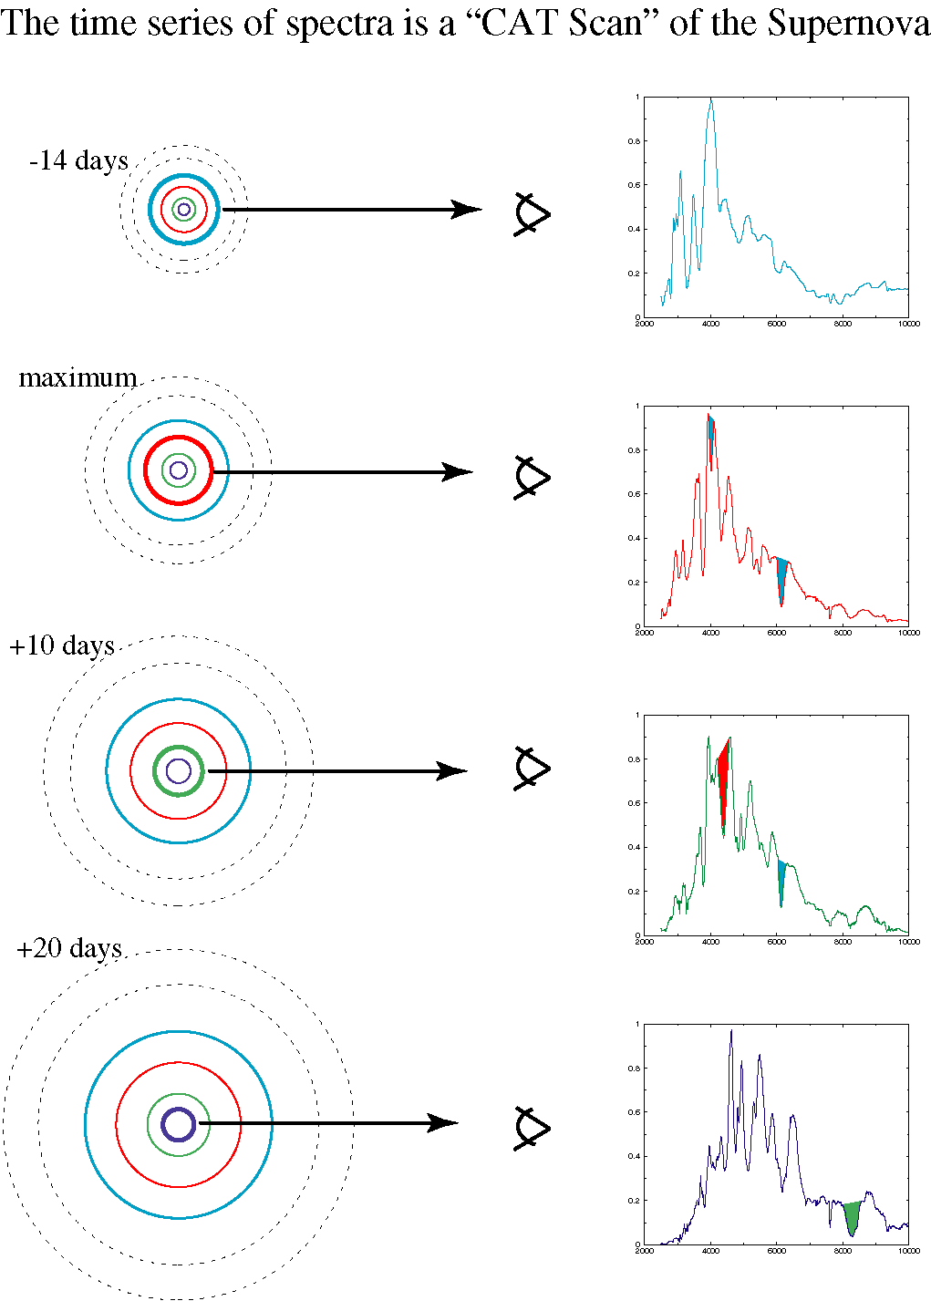
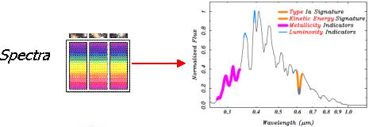
Supernova
Over time the SN atmosphere expands and thins, allowing us to see every layer.
The energy spectrum of a supernova tells us in fine detail about its origin and properties.

Slide 9
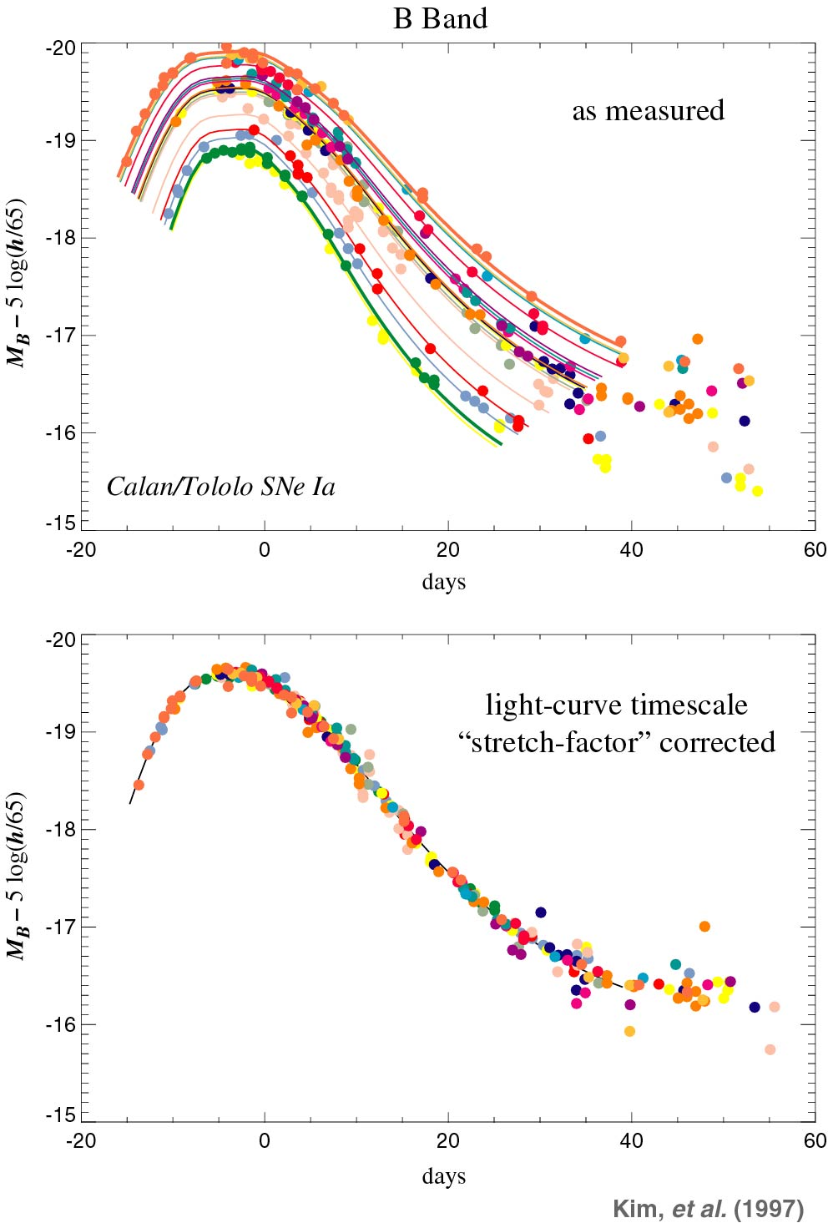
Type Ia Supernova lightcurves
Peak brightness tells us distance away (lookback time)‏
Redshift measured tells us expansion factor (average distance between galaxies)‏

Slide 10
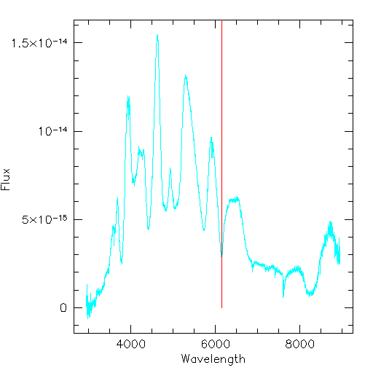
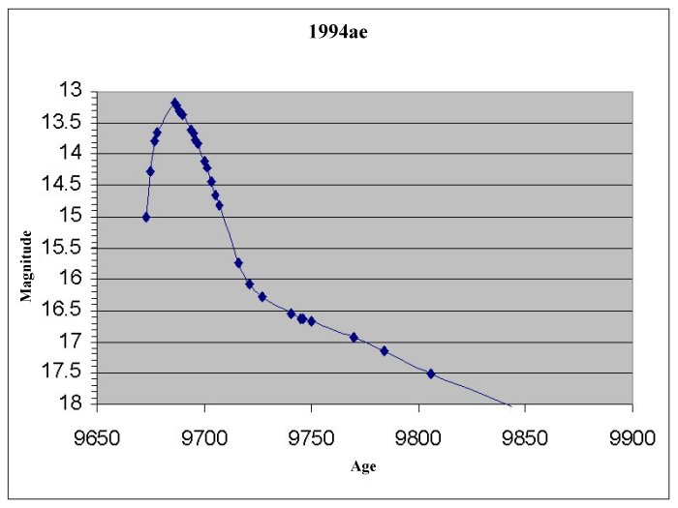
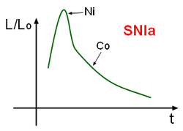
Type Ia Supernovae and Cosmology
Here is a typical supernova lightcurve and its spectrum
Compare two distances to see if expansion rate has changed
Measure redshift 🡪 distance
Measure shape of curve and peak🡪 distance

Slide 11
Type Ia Supernovae and Dark Energy
Analyze lightcurves vs. redshifts for many Type Ia supernovae at redshifts z <2
Observations of over 100 SN (over 7 years) by Perlmutter et al. and Schmidt et al. have showed that they are dimmer than would be expected if the Universe was expanding at a constant rate or slowing down (as was previously thought)‏
This means that some unknown “dark energy” is causing the Universe to fly apart at ever-increasing speeds.

