Slide 1
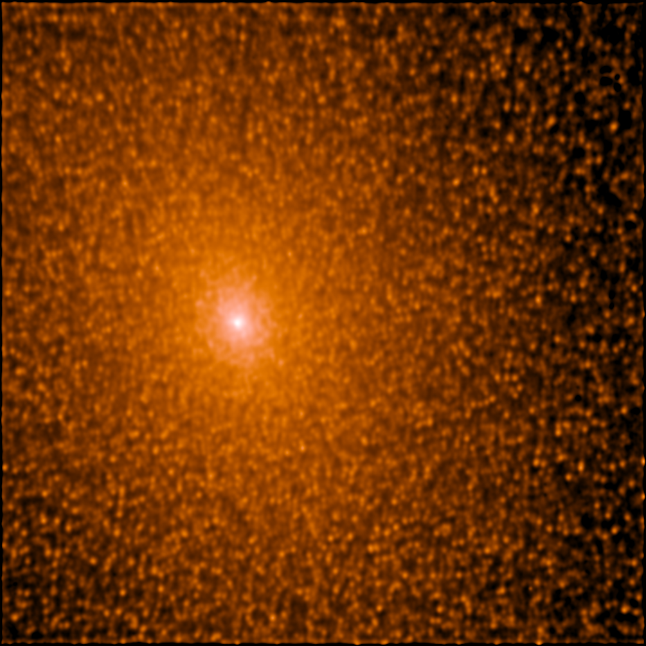
Surface Brightness Fluctuation Measurements

Slide 2

Surface Brightness Fluctuations
as a Distance Indicator
Relies on the Poisson statistics of stellar populations
The “standard candles” are red giant stars—relatively well-understood creatures
Well calibrated empirically (using Cepheids)‏
Accurate to better than 10%
Fluctuation magnitudes compare well to predictions of stellar population models

Slide 3
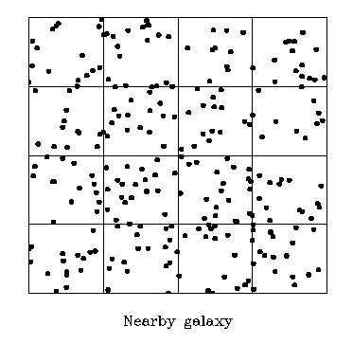
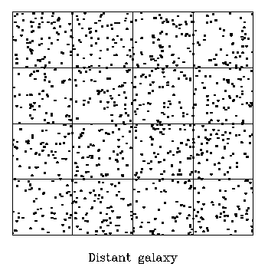
μ = 64
σ = 8
σ/μ = 12.5%
μ = 16
σ = 4
σ/μ = 25%
Notes:
The distant galaxy is twice as far away as the nearby galaxy in this example.

Slide 4
SBFs and Adaptive Optics
  Surface brightness fluctuations are convolved with the point-spread function
  You don’t need to resolve individual point sources

Slide 5
Overview
The surface brightness fluctuations (SBFs) are useful as a distance indicator to galaxies beyond 100 Mpc thanks to high-resolution imaging.

Slide 6
Si N es el número medio estrellas, el flujo medio por pixel es Nf y la varianza en el flujo es Nf^2
N escala como d^2 y f escala como d^-2 por lo que el cociente:
Σ nf^2/Σnf depende de la distancia
La f media para una dada banda depende del tipo de estrella por lo que la técnica también da información sobre la población estelar.

Slide 7
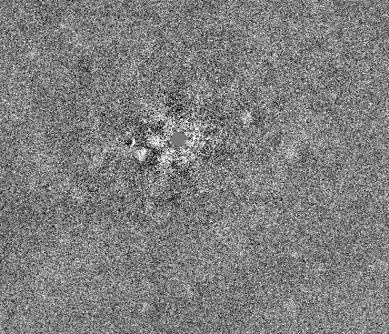
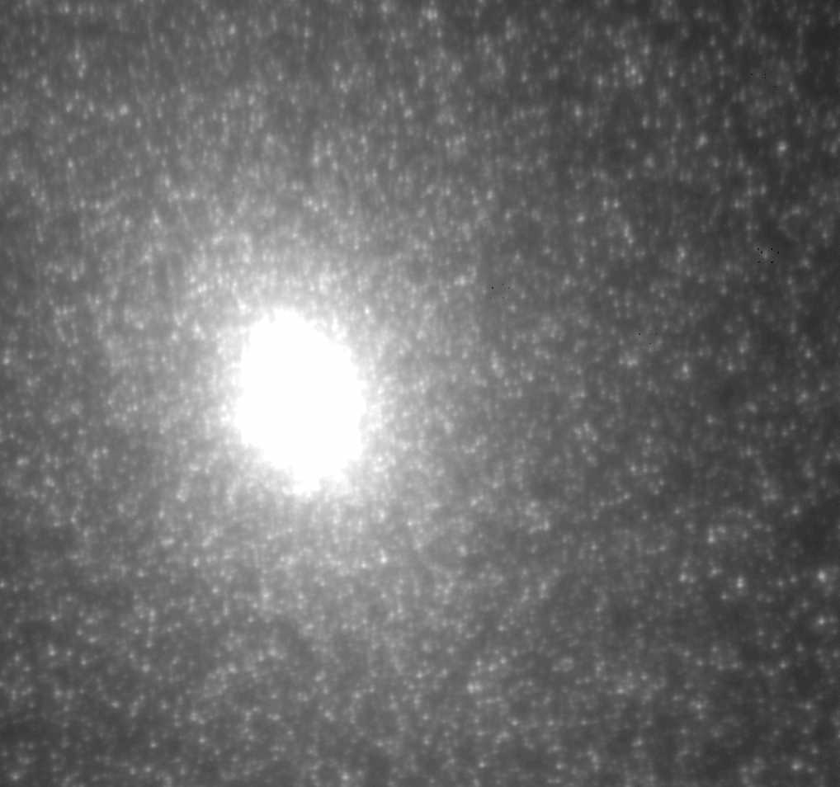
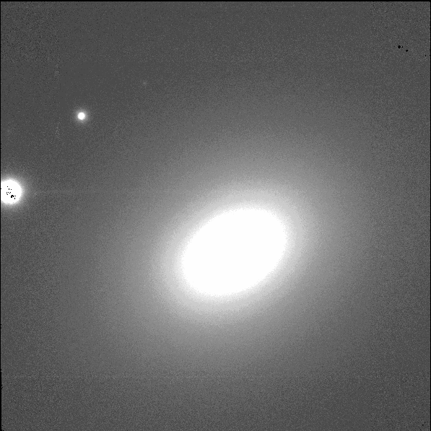
Distant galaxies appear smooth compared to nearby ones.
5”
M 32 (0.77 Mpc)‏
NGC 7768 (100 Mpc)‏

Slide 8
IR SBFs
Much less sensitive to extinction by dust
30 times brighter at K than at I
  (Red giants, the brightest stars in old populations, really are red! )‏
Seeing is much better in the near-IR (especially with AO)‏
Integration time scales linearly with seeing
Greater contrast of fluctuations with respect to globular clusters and background galaxies
You can go much further using IR SBFs!

Slide 9
Potential Applications
Determine the Hubble constant far enough out that peculiar velocities are negligible
Establish the linearity of the Hubble flow out to 200 Mpc
Explore the mass distribution in the local universe by mapping the peculiar velocity field
Probe stellar populations in galaxies without resolving individual stars

Slide 10
The basic procedure:
Get good, deep images of an elliptical galaxy
Subtract a smooth fit to the galaxy
Fourier-transform and compute the spatial power spectrum
Measure the power spectrum of the PSF
Fit the data spectrum to the sum of the scaled PSF power spectrum and a constant white noise component
P₀×PSF(k) + P₁

Slide 11
Using SBFs to Measure PSF Variations
Point sources are pixel-to-pixel Poisson fluctuations, not individual stars, convolved with seeing
Does not rely on clean separation of PSF stars from neighbors (in fact, you want the stars blended!)
‏
Power spectrum is statistical combination of many PSF measurements

Slide 12
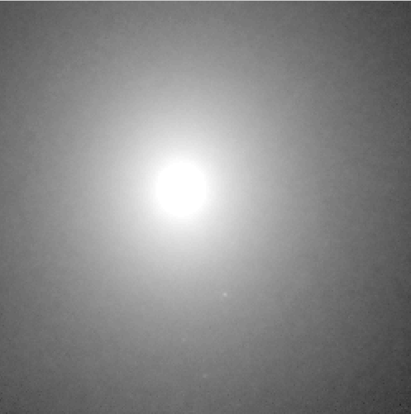
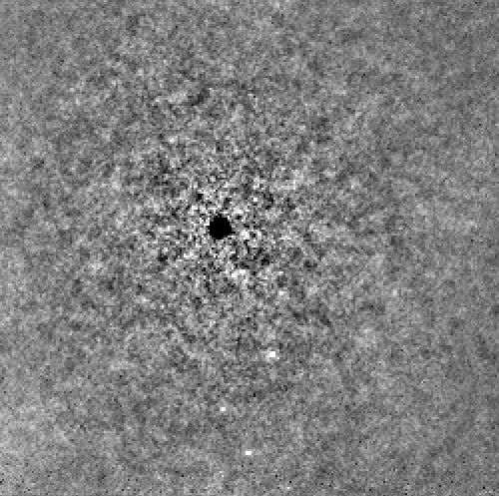
NGC3379

Slide 13
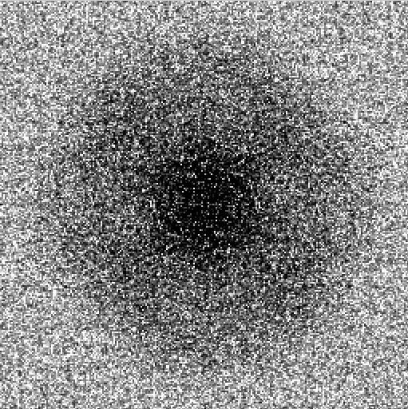
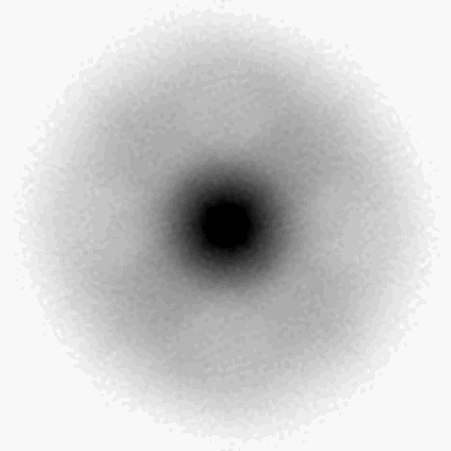
NGC3379

Slide 14
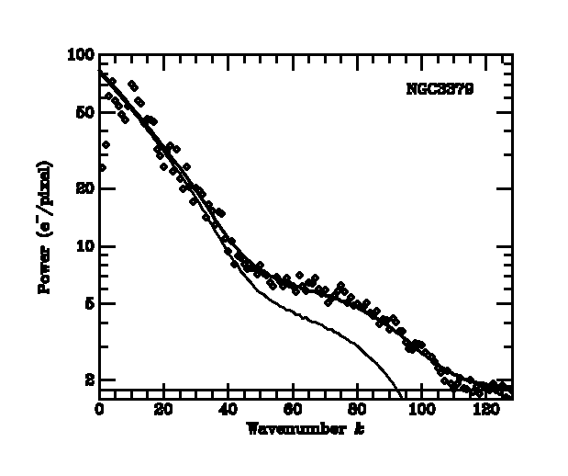

Slide 15
5”
NGC 7768 (100 Mpc)‏

Slide 16
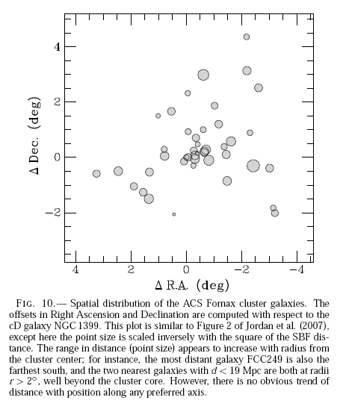
ACS Fornax & Virgo

Slide 17
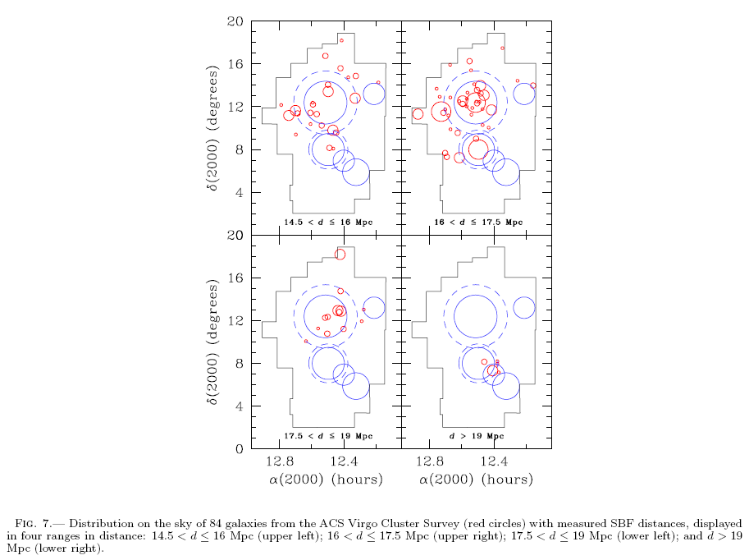

Slide 18
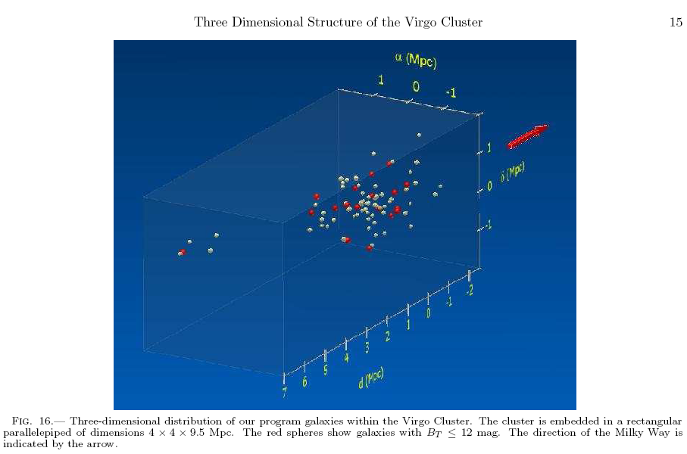

Slide 19
Pasar a clase13-II.ppt pero primero ver Para_clase13_II-2.pdf

