Slide 1
qmdr - A SIMPLE and computationally efficient approach to multifactor dimensionality analysis of gene-gene interactions for quantitative traits
9/9/2020
Gui et Al, 2013

Slide 2
Objective and main points
extends mdr to be applied at quantitive traits
same cv procedure as standard mdr
t-statistic calculated as normalized mean difference between high level and low level [equivalent of high risk low risk]
Biggest differences: t-statistic used for training and testing scores instead of the balanced accuracy
comparison between observed t-statistic and a simulated distribution under H₀ absence of snp effect
built the aforementioned threshold through a simulation

Slide 3
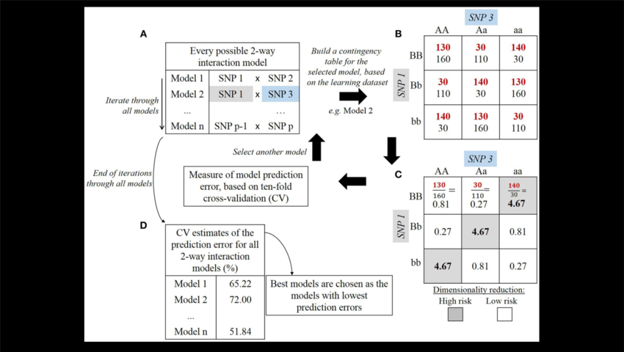
MDR workflow

Slide 4
QMDR steps
select K SNPs from all the m SNPs
for each multi-locus combination [contingency table], calculate phenotype value of the cell [Cell_P] and compare it with overall mean phenotype value [over_p].
if Cell_P > Over_P --> mark the cell as high level, else low level
pool all “high-level genotype combination in one group and low-level in another group.
calculate t-statistic as a difference between high level and low level.
6. use this t-statistic to compute training and testing score, to determine best k-order interaction model and best overall model.
7. estimate p-value of the t-statistic with a comparison with an empirical null distribution

Slide 5
results on simulated data
parameters: heritability and sample size.
simulation: 1000 for each setting
metric: success rate --> #snp_correctly_identified / #simulation
gmdr and qmdr better than mdr, gmdr best for low sample size and low heritability setting, qmdr for high sample size and heritability > 0.1

Slide 6
performance, software and applicability
for 100 datasets of the former simulation gmdr took 7.7 minutes, while Qmdr 4.6 minutes
qmdr's computing time is O(p²) for 2-way interaction [p = #SNPs], O(p^{k}) for k-way interaction
originally available on java: http://sourceforge.net/projects/mdr/
found a r-based multi qmdr github project that can also deal with our use case: https://github.com/wbaopaul/Multi-QMDR
Think this method is applicable in our use-case after having correct for confounders

Slide 7
comments personal and solutions
reducting to two level [low, high level] seems reductive
using only t-statistic as score seems reductive
SOLUTIONS:
1_SOL. Binning with centering on overall mean [or median] in more than two categories
2_SOL. Compute a y = alpha + beta * x ; x binned variable, using mse or R^2 to compute training and testing scores

