Slide 1
Epistasis detection through Bayesian Networks
4 May 2020
Edoardo Gervasoni
Notes:
Prova nota
Prova

Slide 2
Index
Introduction
Bayesian Networks
2010: Identifying Genetic Interactions in Genome-Wide Data Using Bayesian networks
2011: Learning genetic epistasis using Bayesian network scoring criteria
2019: Epi-GTBN an approach of epistasis mining based on genetic Tabu algorithm and Bayesian networks
Conclusion: Bayesian Networks in Epistasis Detection
Notes:
Presentazione suddivisa

Slide 3
Introduction
Epistasis: interaction between two or more genes to affect a phenotype
statistically speaking: the net effect on phenotype cannot be predicted by simply combining the effects
of the individual loci.
Notes:
Prova nota
Prova

Slide 4
Bayesian Networks
Bayesian Networks: probabilistic models that consist of a DAG and a joint probability distribution.
used to detect casual structure among the data
Structure learning: algorithms to automatically construct BN from the data
Notes:
Prova nota
Prova

Slide 5
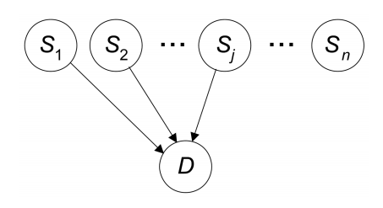
2010: Identifying Genetic Interactions in Genome-Wide Data Using Bayesian networks
BNMBL, Bayesian network minimum bit length method, compared to MDR (multifactor dimensionality reduction) combinatorial method.
Networks constructed by BNMBL are DDAGs (direct DAGs).
Notes:
Prova nota
Prova

Slide 6

2010: Identifying Genetic Interactions in Genome-Wide Data Using Bayesian networks
BNMBL structure learning algorithm is score-based according to the Minimum Description Length principle:
n of bits to encode the DAG
n of bits to encode the data given the DAG
Notes:
Prova nota
Prova

Slide 7
2010: Identifying Genetic Interactions in Genome-Wide Data Using Bayesian networks
BNMBL and MDR tested on simulated and real (LOAD Alzheimer) datasets.
BNMBL outperformed MDR in terms of accuracy and speed.
BNMBL is more efficient, less time-consuming since MDR needs to run cross-validation in order to evaluate an SNP model.
Notes:
Prova nota
Prova

Slide 8
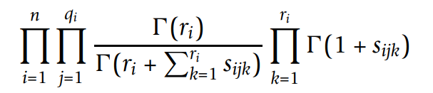
2011: Learning genetic epistasis using Bayesian network scoring criteria
Generalization of the previous paper: different score-based structure learning algorithms are compared on simulated and real (LOAD Alzheimer) datasets.
K2 score:
Each parameter to be estimated follows a Dirichlet distribution
Notes:
Prova nota
Prova

Slide 9
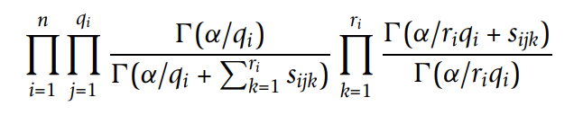
2011: Learning genetic epistasis using Bayesian network scoring criteria
K2 has the problem that Markov equivalent BN don’t obtain same score, so we define α score:
BNMBL score:
Notes:
Prova nota
Prova

Slide 10
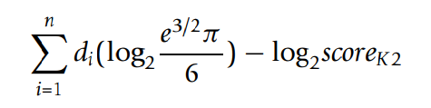
2011: Learning genetic epistasis using Bayesian network scoring criteria
MML (Minimum Message Length) score:
The different models together with MDR were tested on the dataset varying the parameters
Notes:
Prova nota
Prova

Slide 11
2011: Learning genetic epistasis using Bayesian network scoring criteria
Models were evaluated considering the top-k networks constructed by the algorithms according to their scores.
Best model was α score, with large values of α (54 and 162) in terms of recall and at identifying hard-to-detect models.
Larger α values assign less DAG penalty than other models.
Notes:
Prova nota
Prova

Slide 12
2019: Epi-GTBN an approach of epistasis mining based on genetic Tabu algorithm and Bayesian networks
Proposed a new method for learning BN for epistasis detection.
Epi-GTBN: Structure Learning is carried out through a Genetic Algorithm improved with Tabu Search strategy.
Advantages on previous approaches
Less likely to fall into a local minimum
Greater learning efficiency
Notes:
Prova nota
Prova

Slide 13
2019: Epi-GTBN an approach of epistasis mining based on genetic Tabu algorithm and Bayesian networks
How Epi-GTBN works:
1) Generation of initial population
Evaluate mutual information of each combination of loci and phenotype
Select top-N loci to construct first individual
Randomly change edges between nodes to create other individuals
Notes:
Prova nota
Prova

Slide 14
2019: Epi-GTBN an approach of epistasis mining based on genetic Tabu algorithm and Bayesian networks
2) Applying GA:
Selection of individuals with greater fitness function value
Multi Column Crossover improved with Tabu operator
Mutation improved with Tabu operator
Tabu avoids falling into a local minimum and accelerates the convergence of the algorithm.
Notes:
Prova nota
Prova

Slide 15

2019: Epi-GTBN an approach of epistasis mining based on genetic Tabu algorithm and Bayesian networks
Fitness function used is Bayesian Information Criterion BIC:
Together with Epi-GTBN were also tested MDR, AntEpiSeeker, BOOST, SNPRuler, Hill Climbing.
Notes:
Prova nota
Prova

Slide 16
2019: Epi-GTBN an approach of epistasis mining based on genetic Tabu algorithm and Bayesian networks
The various models were tested on simulated and real (Age-related Macular Degeneration) datasets.
Epi-GTBN performed better than the others in terms of accuracy.
On the real dataset, its findings strongly support literature.
Notes:
Prova nota
Prova

Slide 17
Conclusion: Bayesian Networks in Epistasis Detection
Pros of BN applied in Epistasis Detection:
can handle datasets with hundreds of thousands of SNPs
generally more accurate and faster
directly mine causal relationships among the data offering better knowledge
Notes:
Prova nota
Prova

Slide 18
Epistasis detection through Bayesian Networks
26 May 2020
Edoardo Gervasoni
Notes:
Prova nota
Prova

Slide 19
Other articles about BN apporach
BnBeeEpi: An approach of epistasis mining based on artificial bee colony algorithm optimizing Bayesian Network (2019), code without example and description
AFSBN: A Method of Artificial Fish Swarm Optimizing
Bayesian Network for Epistasis Detection
(2019), no code
Notes:
Prova nota
Prova

Slide 20
Epi-GTBN code
Epi-GTBN simple example explained: http://122.205.95.139/Epi-GTBN/
Epi-GTBN github repository:
https://github.com/Epi-GTBN
(lot of R. files but without explanation)
Notes:
Prova nota
Prova

Slide 21
Epi-GTBN code
Epigtnb R library is defined
functions for detecting 2-loci and 3-loci epistasis: gtbn2 and gtbn3
Example is performed on simulated data with binary class column
Notes:
Prova nota
Prova

Slide 22
Epi-GTBN code
Issues of the example code:
User has to previously decide for 2-loci or 3-loci epistasis
There is no construction of initial network
Evaluation part is missing
Notes:
Prova nota
Prova

Slide 23
End

