Slide 1
IDENTIFICAÇÃO DE DEPRESSÃO A PARTIR DE ANÁLISE DE TEXTOS

Slide 2

Integrantes
Adriana Maria Padilla – 15.00792-8
Felipe Sarmento Araújo – 15.02177-7
Fernanda Tanajura Piva – 12.02643-3
Vinícius Lago Fernandes – 14.01293-6
Professor Orientador: Tiago Sanches

Slide 3
Histórico

Slide 4
788 mil pessoas se suicidam por ano, em média
322 milhões de pessoas com depressão ao redor do mundo
O índice de depressão aumentou 18,4% nos últimos 10 anos
4

Slide 5
Motivação

Slide 6
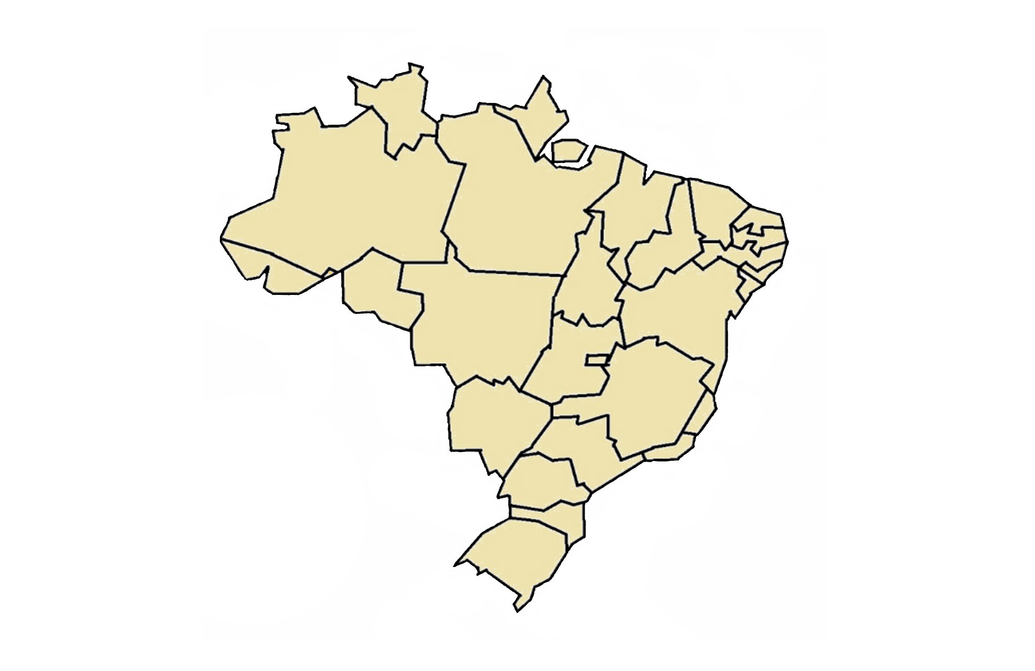
5,8% da população brasileira sofre de depressão
Aumento de 30% nos últimos 25 anos
1º maior índice da América Latina, 8º no mundo
6

Slide 7
Referências

Slide 8
Uso Potencial de ferramentas de classificação de texto como assinaturas de comportamentos suicidas: um estudo de prova de conceito usando os escritos pessoais de Virginia Wolf.
Gabriela de Ávilla

Slide 9
Um método de identificação de emoções em textos curtos para o português do Brasil
Barbara Martinazzo

Slide 10
Researching Mental Health Disorders in the Era of Social Media: Systematic Review
Akkapon Wongkoblab, Miguel A. Vadillo, Vasa Curcin

Slide 11
Metodologia

Slide 12
Texto a ser análisado
Pré-processamento
Pré-processamento
Pré-processamento
Análise de sentimentos
Contagem de Palavras
Outros a serem definidos
Emoções
Pronomes
pessoais
Palavras
negativas
Palavras
absolutistas
Resultados
estatísticos
Resultados
estatísticos
Resultados
estatísticos
Resultados
estatísticos
Resultados
estatísticos
Rede Neural
12
Resultados

Slide 13
Pré-processamento

Slide 14
Eu amo rosas. Elas são adoráveis e amorosas.
Stop Word
Named Entity Recognition
classificação em categorias
Stemming
am
Pronome pessoal +1
Bag-of-Words: - extração de features
Tokenization: - palavras do texto são associadas a tokens

Slide 15
Contagem de palavras

Slide 16



EU
minha
Pré-processamento
MEU
mim
Pronomes
nada
NUNCA
Stop words
Named Entity Recognition
SEMPRE
Texto
Absolutistas
morrer
DOR
desânimo
Negativas

Slide 17
EU
minha
Pré-processamento
MEU
mim
Pronomes
nada
NUNCA
Stop words
Named Entity Recognition
SEMPRE
Texto
Absolutistas
morrer
DOR
desânimo
Negativas

Slide 18
Análise de sentimentos

Slide 19
Stop words , stemming – Python
Algoritmo de Naive Bayes
Desgosto
Raiva
Alegria
Surpresa
Medo
Bag-of-words e Tokenization
Tristeza
Neutro

Slide 20
Rede neural

Slide 21
Rede neural principal
Resultados
estatísticos
Contagem de palavras
Resultado
final
Análise de Sentimentos
Outros

Slide 22
Cronograma

Slide 23
Obrigado!
Perguntas?

Slide 24
INSTRUCTIONS FOR USE
EDIT IN GOOGLE SLIDES
Click on the button under the presentation preview that says "Use as Google Slides Theme".
You will get a copy of this document on your Google Drive and will be able to edit, add or delete slides.
You have to be signed in to your Google account.
EDIT IN POWERPOINT®
Click on the button under the presentation preview that says "Download as PowerPoint template". You will get a .pptx file that you can edit in PowerPoint.
Remember to download and install the fonts used in this presentation (you’ll find the links to the font files needed in the Presentation design slide)
More info on how to use this template at www.slidescarnival.com/help-use-presentation-template
This template is free to use under Creative Commons Attribution license. You can keep the Credits slide or mention SlidesCarnival and other resources used in a slide footer.

Slide 25
1.
TRANSITION HEADLINE
Let’s start with the first set of slides

Slide 26
Quotations are commonly printed as a means of inspiration and to invoke philosophical thoughts from the reader.

Slide 27
THIS IS A SLIDE TITLE
Here you have a list of items
And some text
But remember not to overload your slides with content
Your audience will listen to you or read the content, but won’t do both.

Slide 28
BIG CONCEPT
Bring the attention of your audience over a key concept using icons or illustrations

Slide 29
YOU CAN ALSO SPLIT YOUR CONTENT
White
Is the color of milk and fresh snow, the color produced by the combination of all the colors of the visible spectrum.
Black
Is the color of coal, ebony, and of outer space. It is the darkest color, the result of the absence of or complete absorption of light.

Slide 30
IN TWO OR THREE COLUMNS
Yellow
Is the color of gold, butter and ripe lemons. In the spectrum of visible light, yellow is found between green and orange.
Blue
Is the colour of the clear sky and the deep sea. It is located between violet and green on the optical spectrum.
Red
Is the color of blood, and because of this it has historically been associated with sacrifice, danger and courage.

Slide 31
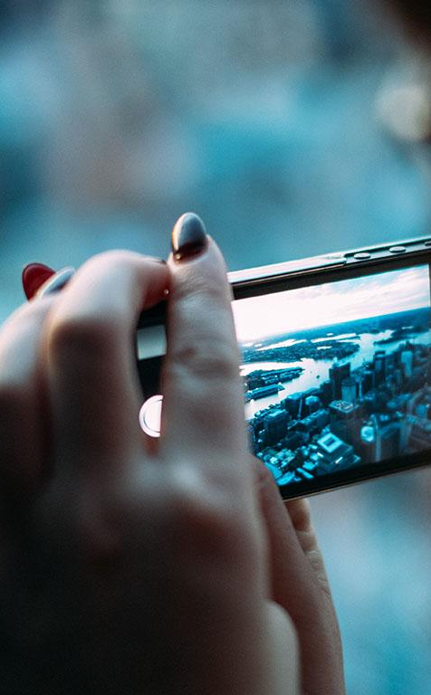
A PICTURE IS WORTH A THOUSAND WORDS
A complex idea can be conveyed with just a single still image, namely making it possible to absorb large amounts of data quickly.

Slide 32

Want big impact?
Use big image.

Slide 33
USE CHARTS TO EXPLAIN YOUR IDEAS
Triste
abst
Black

Slide 34
AND TABLES TO COMPARE DATA
 | A | B | C
Yellow | 10 | 20 | 7
Blue | 30 | 15 | 10
Orange | 5 | 24 | 16

Slide 35
89,526,124
Whoa! That’s a big number, aren’t you proud?

Slide 36
89,526,124$
185,244 users
100%
That’s a lot of money
And a lot of users
Total success!

Slide 37
LET’S REVIEW SOME CONCEPTS
Yellow
Is the color of gold, butter and ripe lemons. In the spectrum of visible light, yellow is found between green and orange.
Blue
Is the colour of the clear sky and the deep sea. It is located between violet and green on the optical spectrum.
Red
Is the color of blood, and because of this it has historically been associated with sacrifice, danger and courage.
Yellow
Is the color of gold, butter and ripe lemons. In the spectrum of visible light, yellow is found between green and orange.
Blue
Is the colour of the clear sky and the deep sea. It is located between violet and green on the optical spectrum.
Red
Is the color of blood, and because of this it has historically been associated with sacrifice, danger and courage.

Slide 38
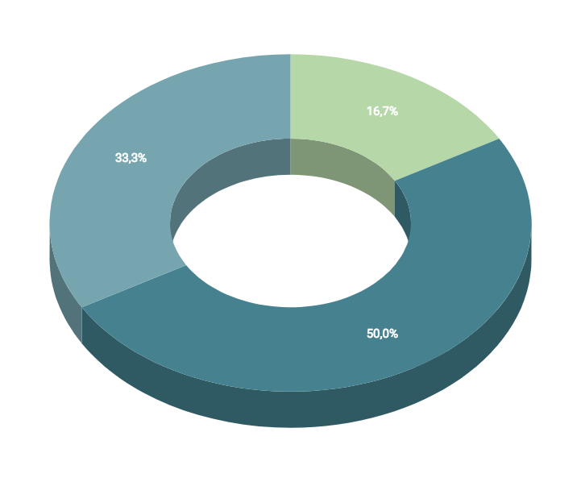
You can insert graphs from Google Sheets

Slide 39
ANDROID PROJECT
Show and explain your web, app or software projects using these gadget templates.
Place your screenshot here

Slide 40
iPHONE PROJECT
Show and explain your web, app or software projects using these gadget templates.
Place your screenshot here

Slide 41
TABLET PROJECT
Show and explain your web, app or software projects using these gadget templates.
Place your screenshot here

Slide 42
DESKTOP PROJECT
Show and explain your web, app or software projects using these gadget templates.
Place your screenshot here

Slide 43
CREDITS
Special thanks to all the people who made and released these awesome resources for free:
Presentation template by SlidesCarnival
Photographs by Unsplash

Slide 44
PRESENTATION DESIGN
This presentation uses the following typographies and colors:
Titles: Dosis
Body copy: Titillium Web
You can download the fonts on these pages:
http://www.impallari.com/dosis
http://www.campivisivi.net/titillium/
Pastel green #d3ebd5 · Green #80bfb7 · Teal #0b87a1 · Navy #01597f · Dark navy #003b55
You don’t need to keep this slide in your presentation. It’s only here to serve you as a design guide if you need to create new slides or download the fonts to edit the presentation in PowerPoint®

Slide 45
SlidesCarnival icons are editable shapes.
This means that you can:
Resize them without losing quality.
Change fill color and opacity.
Change line color, width and style.
Isn’t that nice? :)
Examples:

Slide 46
our office

Slide 47
😉
Now you can use any emoji as an icon!
And of course it resizes without losing quality and you can change the color.
How? Follow Google instructions https://twitter.com/googledocs/status/730087240156643328
✋👆👉👍👤👦👧👨👩👪💃🏃💑❤😂😉😋😒😭👶😸🐟🍒🍔💣📌📖🔨🎃🎈🎨🏈🏰🌏🔌🔑 and many more...

