Slide 1
Academic Pathway
Pathway
Group: Goodfellas

Slide 2
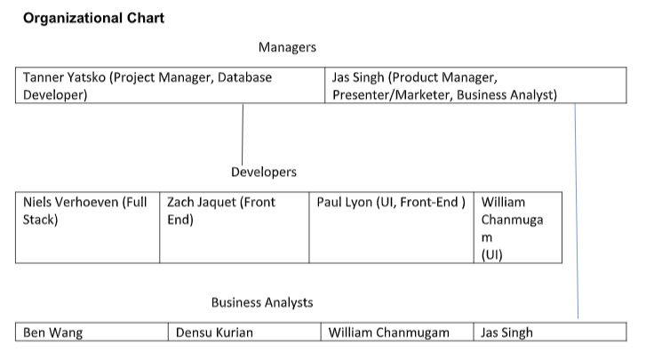

Slide 3
Manager Interview Background
Interviewee: Carlos Mckinney
Position: Senior Lecturer for Information System related course work.
Time & Location: March 13th 6:45pm
Interviewer: Jas Raj Singh
Interviewee: Oscar Urquiza
Position: Residential Assistant for Hillside Apartments
Time & Location: Hillside Apartments 5:00 pm March 27th
Interviewer: Jas Raj Singh

Slide 4
Manager Interview Summary
Keep the software simple, easy to use, and mobile friendly.
A non-complex system allows high success rate in which the application can be used.
Offer a way to quick save or download the pathway you have created so the user can share or store the template they created.
Application should have the least amount of barriers to use; no email verification, no student requirement. This allows people who are younger to anticipate and get an idea of what they maybe want to study in college.
Software can provide some bias on coursework suggesting that a class is more “difficult” and requires more “work” to get an A or passing grade in the class.

Slide 5
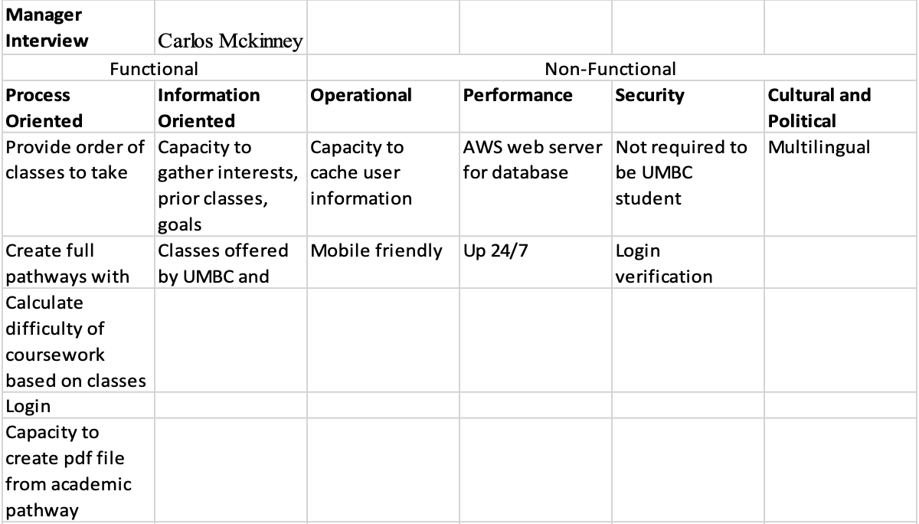

Slide 6
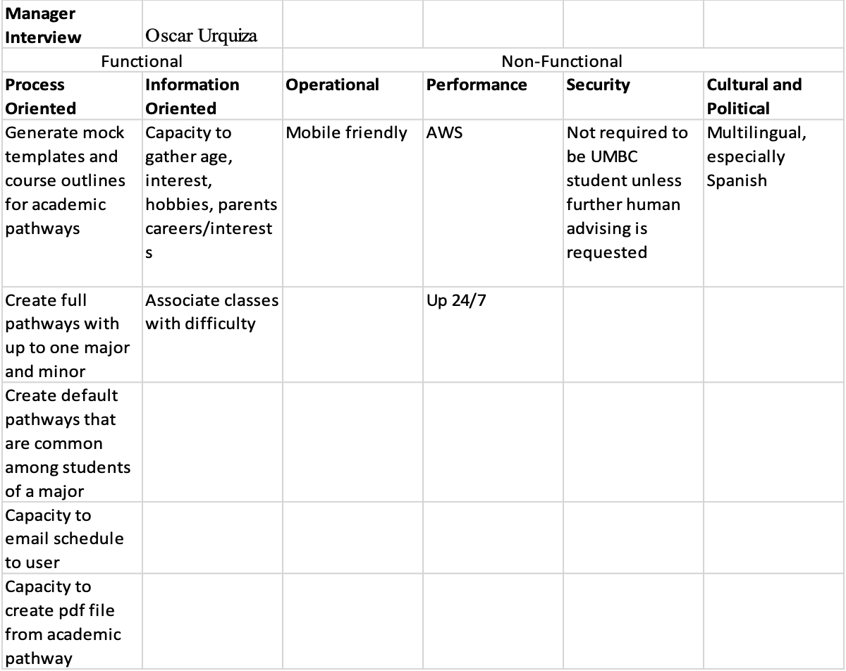

Slide 7
Freshman Interviews
Students emphasized the site being secure (confidential/password protected)
Liked the idea of having difficulty measurements of classes
Want to be able to develop a full schedule for all four years
Would like to have a tracking system for all four years
Would like to add and edit interests at any points of time
Gave more information on professors than the rate my professor website

Slide 8
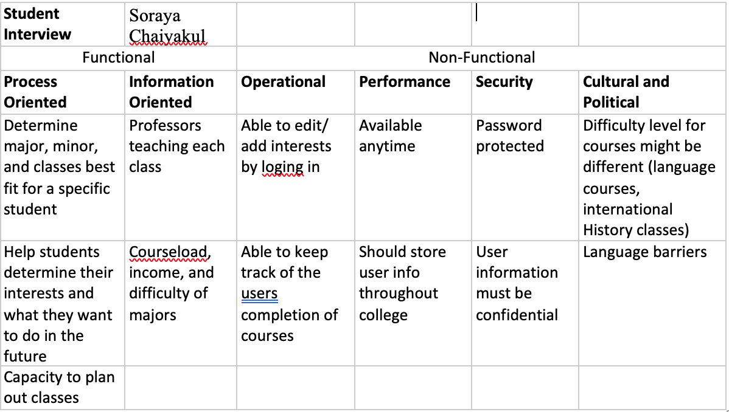

Slide 9
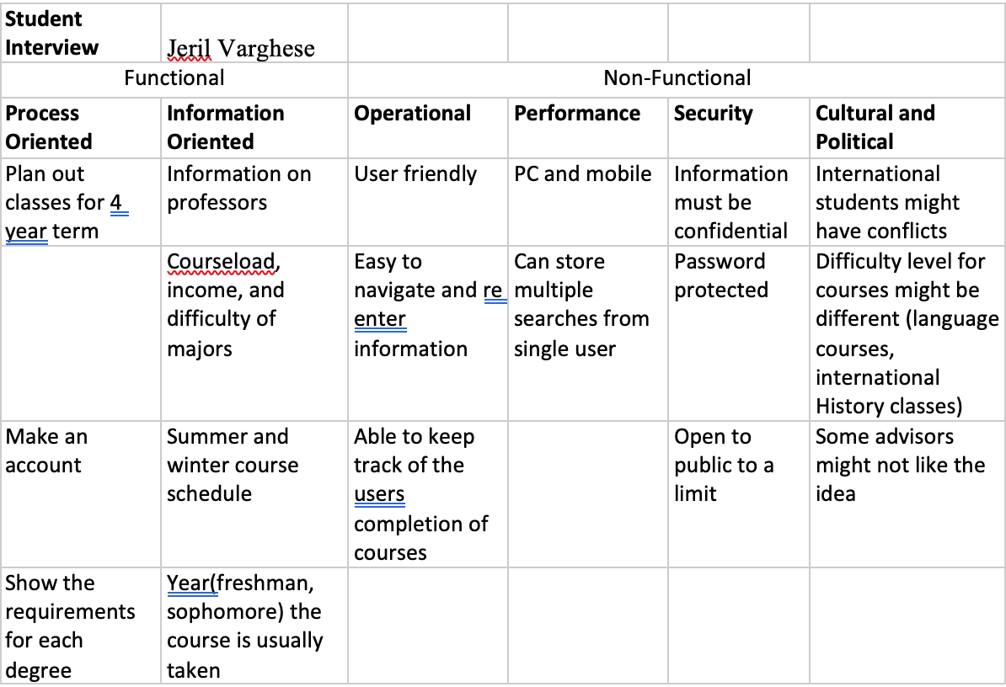

Slide 10
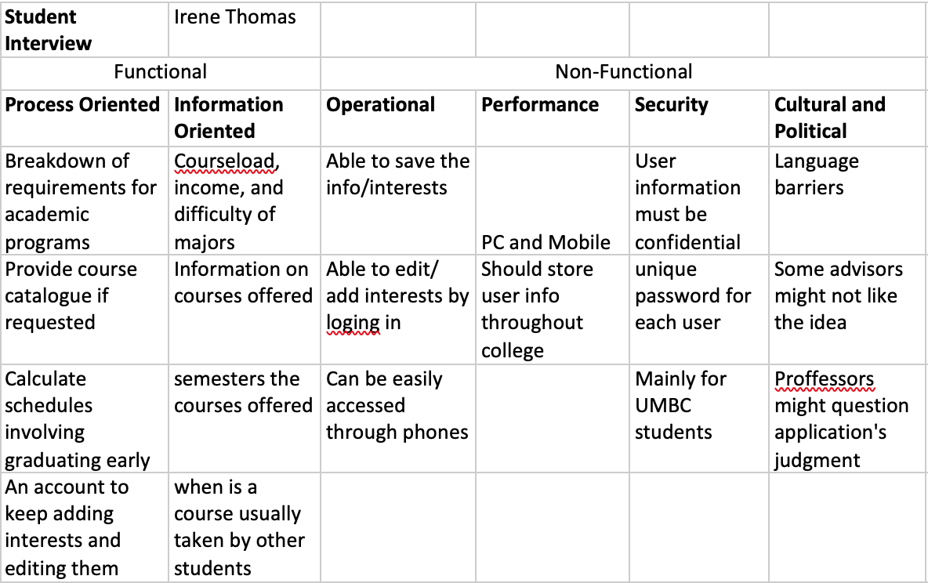

Slide 11
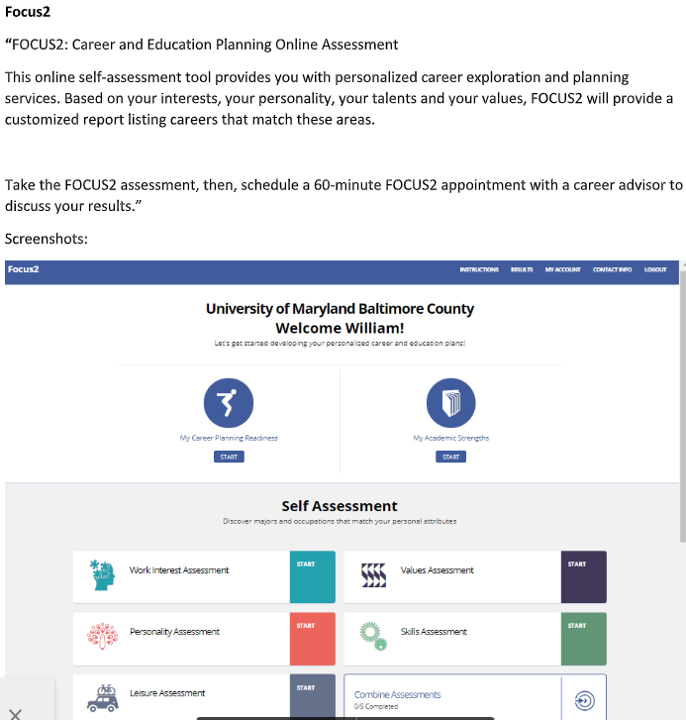
Document analysis
FOCUS2
Focus contains up to date information and contains other surveys not shown that include a work
interests, personality, skills, values, and leisure assessment. Overall this web tool is easy to use and
contains tools that go beyond the scope of our current project because it puts a large focus on career
planning and allows students to keep track of the academic progress.

Slide 12
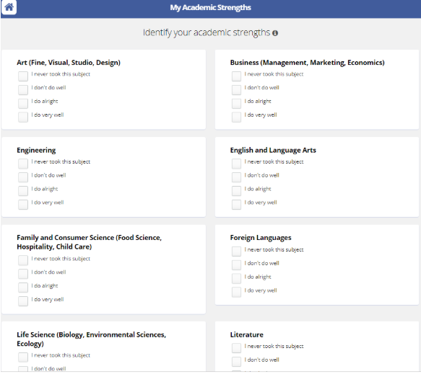

Slide 13
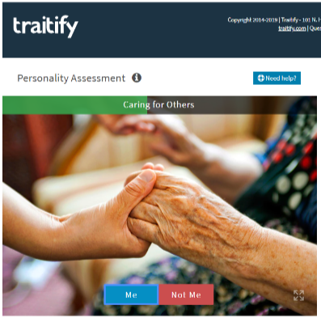
simple, fast and easy to use
Shows a picture of concept and asks the user to choose “me” or “not me”.
provides a detailed list of your varying personality traits along with a description of those personality traits.
generates a list of different career matches that would well with your personality type.

Slide 14
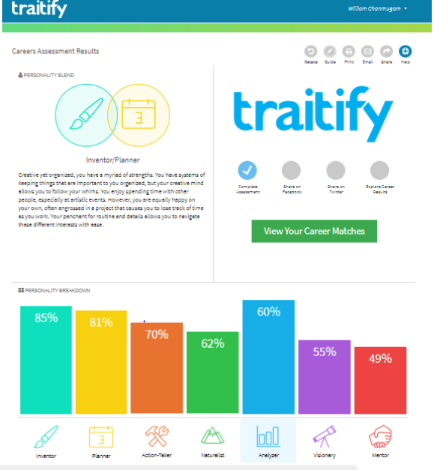
Traitify
This test differs from our project in that it focuses more on personality type and is more directed at choosing a career instead of choosing a given major.
This tool can be useful reference point for our project and is a good example of an easy to use and effective program.

Slide 15
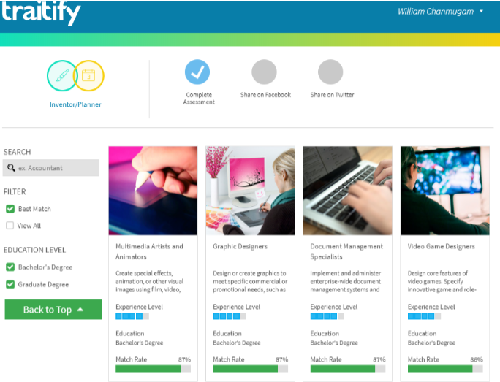

Slide 16
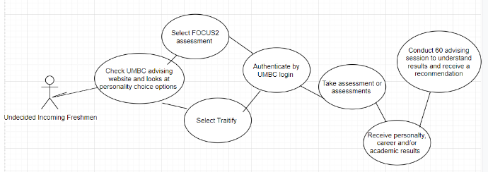
As-is options diagram

Slide 17
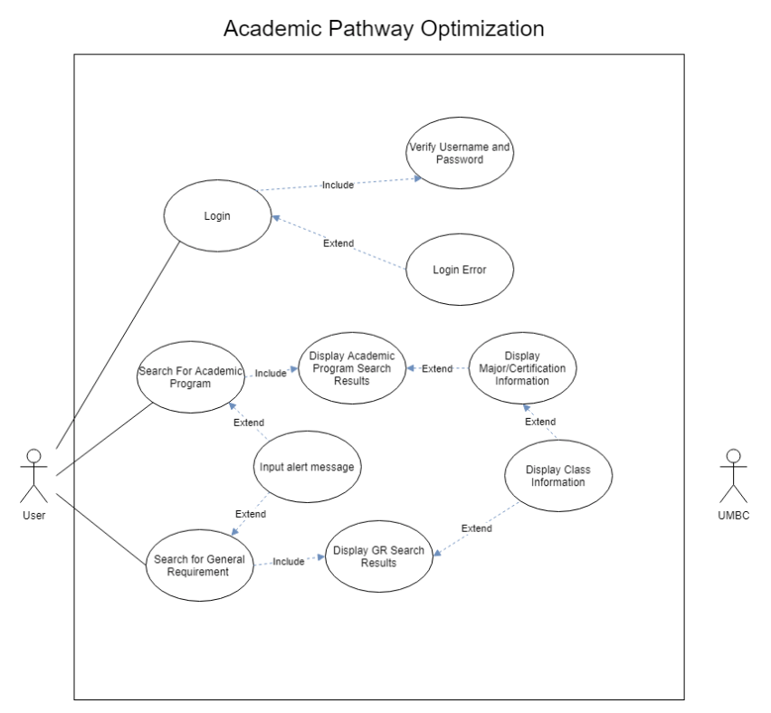

Slide 18
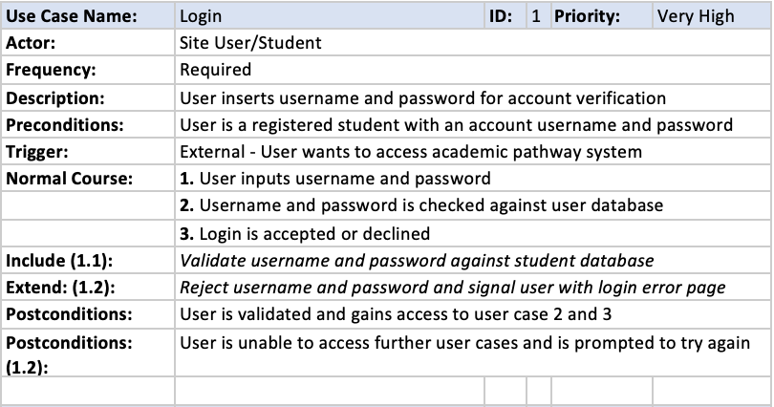

Slide 19
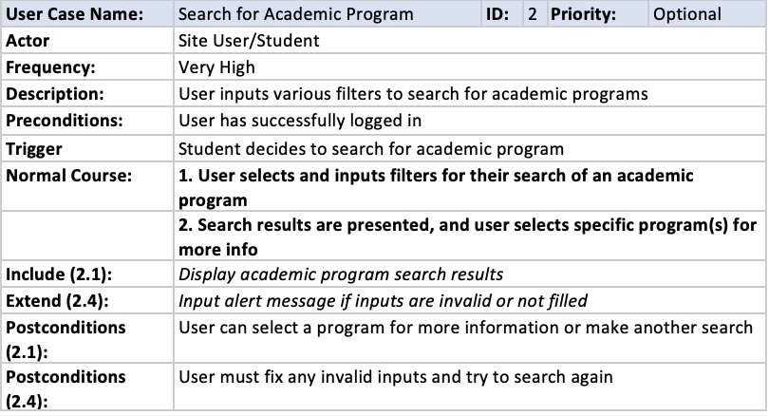

Slide 20
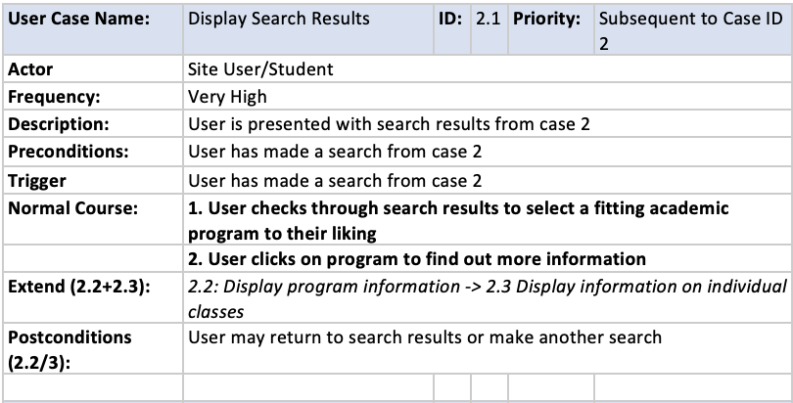

Slide 21
