Slide 1
ON412
Understanding Key Network Types
Week3

Slide 2
Agenda
Differentiating Between:
Internet
Intranets
Extranets
Network Types

Slide 3
Outcomes
Understand the definitions and purposes of the Internet, Intranets, Extranets, and various network types.
Identify the key differences between these network types.
Recognize the use cases and security considerations for each network type.

Slide 4
Open question
What is the Internet?

Slide 5
Defining the Internet
Definition: A global network connecting millions of private, public, academic, business, and government networks.
Accessibility: Publicly accessible to anyone with an internet connection.
Purpose: To share information and resources globally.
Examples: Websites, email, social media platforms.

Slide 6
Open question
What is an Intranet?

Slide 7
Defining the Intranet
Definition: A private network accessible only to an organization’s employees.
Accessibility: Restricted to internal users within an organization.
Purpose: To share information and resources within the organization.
Examples: Internal websites, company portals, HR systems.

Slide 8
Open question
What is an Extranet?

Slide 9
Defining the Extranet
Definition: A private network that allows controlled access to external users.
Accessibility: Accessible to selected external users (e.g., partners, suppliers).
Purpose: To share information and collaborate with external stakeholders.
Examples: Partner portals, supplier networks, customer extranets.

Slide 10
Key Differences
Internet:
Publicly accessible
Global reach
General public usage
Intranet:
Private and restricted
Internal organizational use
Secure and controlled environment
Extranet:
Private with controlled external access
Collaboration with external partners
Secure and controlled environment
LAN:
Limited to a specific physical location
Internal resource sharing
Secure and controlled environment

Slide 11

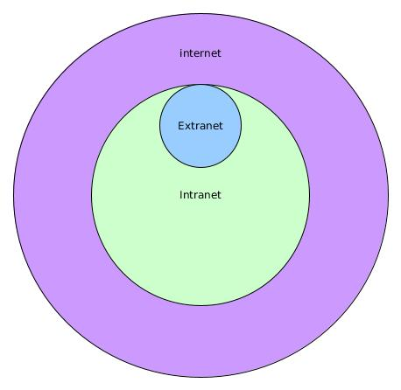
Use Cases
Internet: Public websites, online services, social media.
Intranet: Internal communication, document sharing, employee resources.
Extranet: Partner collaboration, supply chain management, customer support.
LAN: Home networking, office networking, school networking.

Slide 12
Open question
What is a Local Area Network (LAN)?

Slide 13
Defining Local Area Network (LAN)
Definition: A network that interconnects computers within a limited area such as a residence, school, or office building.
Accessibility: Restricted to a specific physical location.
Purpose: To enable resource sharing (e.g., files, printers, internet access) among devices within the same area.
Examples: Home networks, office networks, school networks.

Slide 14
Open question
What is a Personal Area Network (PAN)?

Slide 15
Defining Personal Area Network (PAN)
Definition: A network for connecting devices within the range of an individual person, typically within a range of 10 meters.
Accessibility: Limited to personal devices.
Purpose: To connect personal devices such as smartphones, tablets, and laptops.
Examples: Bluetooth connections, personal hotspots.

Slide 16
Open question
What is a Campus Area Network (CAN)?

Slide 17
Defining Campus Area Network (CAN)
Definition: A network that connects multiple LANs within a limited geographical area, such as a university campus or corporate campus.
Accessibility: Restricted to the campus area.
Purpose: To connect various departments or buildings within the campus.
Examples: University networks, corporate campus networks.

Slide 18
Open question
What is a Metropolitan Area Network (MAN)?

Slide 19
Defining Metropolitan Area Network (MAN)
Definition: A network that spans a city or a large campus, connecting multiple LANs.
Accessibility: Covers a larger area than a LAN but smaller than a WAN.
Purpose: To connect users and resources in a geographic area larger than a LAN.
Examples: City-wide networks, cable TV networks.

Slide 20
Open question
What is a Wide Area Network (WAN)?

Slide 21
Defining Wide Area Network (WAN)
Definition: A network that covers a broad area (e.g., any network whose communications links cross metropolitan, regional, or national boundaries).
Accessibility: Can span cities, countries, or even continents.
Purpose: To connect multiple LANs and MANs.
Examples: The Internet, corporate networks spanning multiple locations.

Slide 22
Key Differences
LAN:
Limited to a specific physical location
Internal resource sharing
Secure and controlled environment
PAN:
Very small range (up to 10 meters)
Personal device connectivity
Secure and controlled by the user
CAN:
Limited to a campus area
Connects multiple LANs within the campus
Secure and controlled environment
MAN:
Covers a city or large campus
Connects multiple LANs
Secure but requires more management
WAN:
Covers large geographical areas
Connects multiple LANs and MANs
Secure but complex to manage

Slide 23
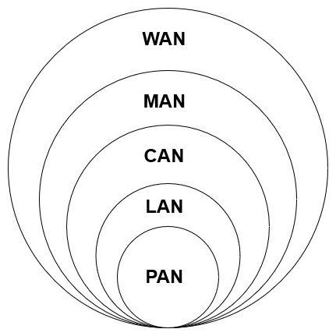
Use Cases
LAN: Home networking, office networking, school networking.
PAN: Personal device connectivity, Bluetooth connections.
CAN: University networks, corporate campus networks.
MAN: City-wide networks, cable TV networks.
WAN: The Internet, corporate networks spanning multiple locations.

Slide 24
Security Considerations
Internet: Generally less secure; relies on individual users and organizations to implement security measures.
Intranet: More secure; controlled access and internal security measures.
Extranet: Secure but requires careful management of external access.
LAN: Secure within the physical location; requires proper network security measures.
PAN: Secure but limited to personal control.
CAN: Secure within the campus; requires proper network security measures.
MAN: Secure but requires more management due to larger area.
WAN: Secure but complex to manage due to large geographical coverage.

Slide 25
Conclusion
Summary:
We have explored the definitions, purposes, and key differences between the Internet, Intranets, Extranets, and various network types (LAN, PAN, CAN, MAN, WAN).
Each network type serves a specific purpose and has unique characteristics that make it suitable for different scenarios.
Understanding these differences is crucial for effective network management and ensuring security.

Slide 26
Q&A
Let's open the floor for any questions you may have…

