Slide 1
ON412
Defining Networks with the OSI Model
Week4

Slide 2
introduction
Importance of the OSI Model
The OSI (Open Systems Interconnection) Model is a conceptual framework used to understand and implement network protocols in seven layers.

Slide 3
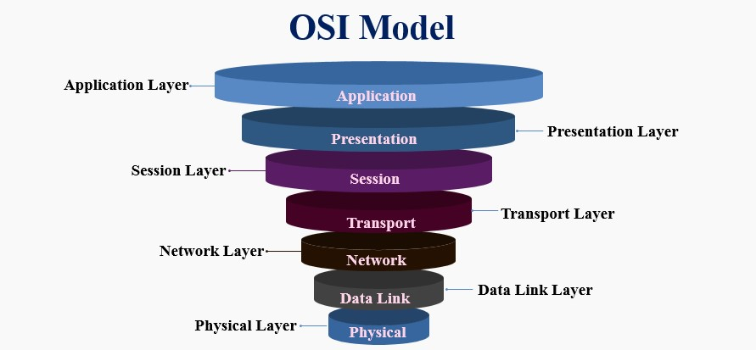
The OSI Model
The OSI Model is a seven-layer framework that standardizes the functions of a telecommunication or computing system without regard to its underlying internal structure and technology.

Slide 4
Layer1: Physical Layer
This layer deals with the physical connection between devices and the transmission and reception of raw bit streams over a physical medium.
Components: Cables, switches, hubs, and other physical devices.
Key Concepts:
Bit rate, physical topology, and transmission mode (simplex, half-duplex, full-duplex).

Slide 5
Layer2: Data Link Layer
Responsible for node-to-node data transfer and error detection and correction.
Sub-layers:
MAC (Media Access Control): Controls how devices on the network gain access to the medium and permission to transmit data.
LLC (Logical Link Control): Manages frame synchronization, flow control, and error checking.
Key Concepts:
addresses, frames, and switches.

Slide 6
Layer3: Network Layer
Manages the delivery of packets across multiple networks and handles routing through intermediate routers.
Protocols:
IP (Internet Protocol)
ICMP (Internet Control Message Protocol
ARP (Address Resolution Protocol).
Key Concepts:
IP addresses, routing, and packet forwarding.

Slide 7
Layer4: Transport Layer
Ensures complete data transfer and manages error recovery and flow control.
Protocols:
TCP (Transmission Control Protocol)
UDP (User Datagram Protocol).
Key Concepts:
Segmentation, reassembly, and connection management.

Slide 8
Layer5: Session Layer
Manages sessions between applications, including establishing, maintaining, and terminating connections.
Protocols:
NetBIOS
RPC (Remote Procedure Call)
Key Concepts:
Session establishment, maintenance, and termination.

Slide 9
Layer6: Presentation Layer
Translates data between the application layer and the network format, ensuring that data is readable by the receiving system.
Protocols:
SSL/TLS (Secure Sockets Layer/Transport Layer Security)
JPEG
GIF
Key Concepts:
Data encryption, compression, and translation.

Slide 10
Layer7: Application Layer
Provides network services directly to end-user applications.
Protocols:
HTTP
FTP
SMTP
DNS
Key Concepts:
Network services, application protocols.

Slide 11
Q&A
Let's open the floor for any questions you may have…

