Slide 1
ON412
Understanding Network Hardware
Week4

Slide 2
Agenda
Understanding Networking Essentials
Routers
Understanding how routers make routing decisions, the different types of routing, and key concepts like NAT and QoS.

Slide 3
Understanding Routers
Importance of Routers:
Routers are essential devices in networking that connect multiple networks and direct data packets between them. They play a crucial role in ensuring efficient and secure data transmission across the internet and within local networks.
View Route:
On your Windows PC, open Command Prompt and type “route print”.

Slide 4
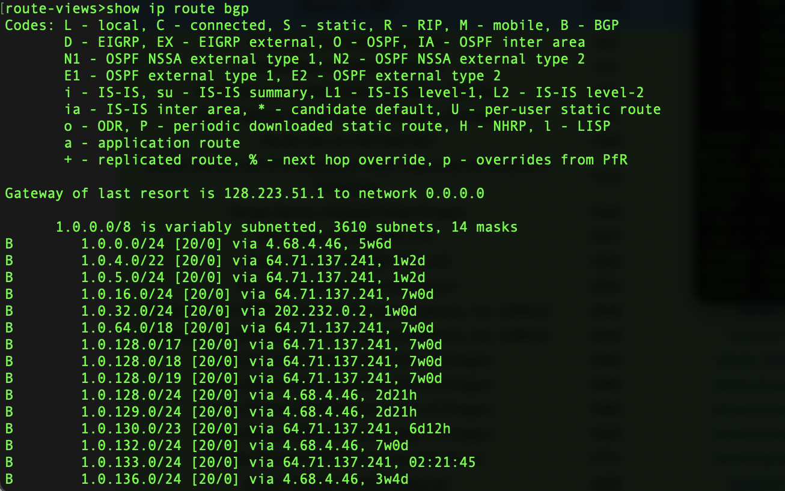
Making Routing Decisions
Routing Table:
A routing table is a data table stored in a router or a networked computer that lists the routes to particular network destinations.
It is used by the router to determine the best path for forwarding packets.

Slide 5
Key Terms:
Network Destination
This shows either the network address, a specific IP address, or the broadcast address. It indicates where the data packet is intended to go.
Netmask
Another term for the subnet mask, which helps in determining the network portion of an IP address.
Gateway
If the network is outside of your subnet, this is the default gateway to which the data is sent. It acts as an access point to another network.
Interface
This lists the IP address of the local interface (that is, the one on the device) from which the data will be sent. It specifies the outgoing interface for the packet.
Metric
This is the metric value attributed to that route/interface. It helps in determining the best route among multiple routes to the same destination.

Slide 6

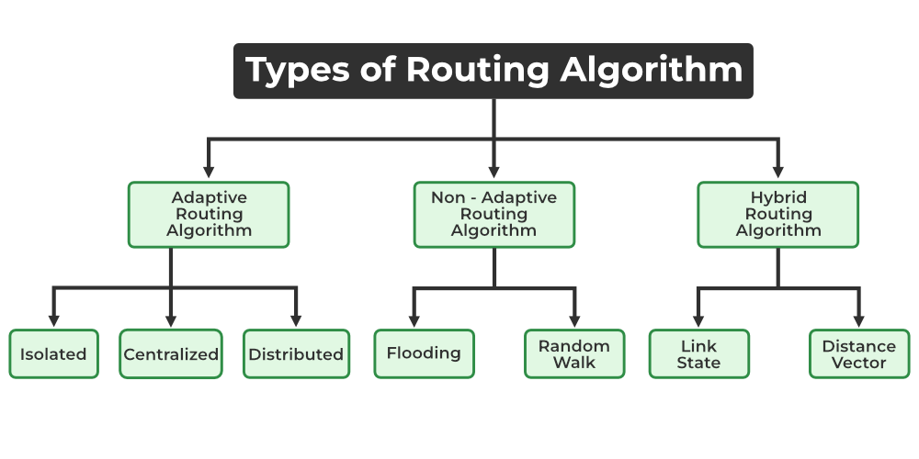
Metrics factors
Hop Count: The number of intermediate devices (like routers) through which data must pass to reach its destination.
Bandwidth: The data transfer capacity of a network path.
Delay: The time it takes for data to travel from the source to the destination.
Cost: A value assigned to a route, often based on the above factors, to determine the most efficient path.

Slide 7
Open question
What are some key Metrics factors?

Slide 8
Some examples of Algorithms used in routing
Dijkstra’s Algorithm
Used in link-state routing protocols to find the shortest path.
Bellman-Ford Algorithm
Used in distance-vector routing protocols to calculate the best path.

Slide 9
Understanding Static and Default Routes
Static Routes
Manually configured routes that do not change unless updated by an administrator.
Advantages: Simple to configure and understand, provides control over routing decisions.
Limitations: Not flexible, requires manual updates if network changes.
Example Configuration: ip route 192.168.1.0 255.255.255.0 10.0.0.1
Default Routes
A route used when no specific path is found in the routing table.
Purpose: Provides a gateway of last resort for packets with unknown destinations.
Example Configuration: ip route 0.0.0.0 0.0.0.0 10.0.0.1

Slide 10
Types of Routing Protocols
Interior Gateway Protocols (IGP)
Used within a single autonomous system [e.g., RIP(Routing Information Protocol), OSPF(Open Shortest Path First)].
Exterior Gateway Protocols (EGP)
Used between different autonomous systems [e.g., BGP (Border Gateway Protocol)].

Slide 11
examples of Routing Protocols
RIP (Routing Information Protocol)
A distance-vector protocol that uses hop count as a metric.
Characteristics: Simple, but limited to 15 hops.
OSPF (Open Shortest Path First)
A link-state protocol that uses the Dijkstra algorithm.
Characteristics: More complex, supports large and hierarchical networks.
BGP (Border Gateway Protocol)
An exterior gateway protocol used for routing between large networks, such as ISPs.
Characteristics: Highly scalable, uses path vector protocol.

Slide 12
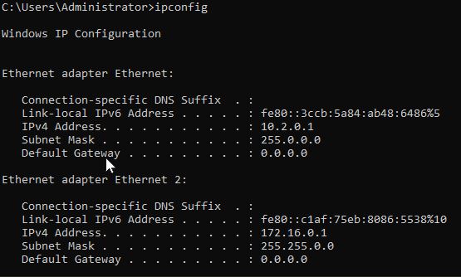
Implementing Routing Using Windows Server
Role of Windows Server:
Windows Server can be configured to act as a router, providing routing and remote access services.
Benefits: Integrates with existing Windows infrastructure, provides additional features like VPN and NAT.

Slide 13
How to set up a windows server
Install the Routing and Remote Access Service (RRAS) role.
Configure the server as a router.
Set up static routes or enable dynamic routing protocols.
Some Windows Server Features include:
VPN Support: Allows secure remote access to the network.
NAT: Provides network address translation services.

Slide 14
Network Address Translation (NAT)
Purpose of NAT:
IP Address Conservation: Allows multiple devices on a local network to share a single public IP address.
In terms of Security:
NAT Hides internal IP addresses from external networks.
Types of NAT:
Static NAT
Maps a single private IP address to a single public IP address.
Dynamic NAT
Maps a private IP address to a public IP address from a pool of available addresses.
PAT (Port Address Translation)
Maps multiple private IP addresses to a single public IP address using different ports.
How to Implement NAT:
Setting up NAT on a router or firewall to translate private IP addresses to public IP addresses.

Slide 15
Open question
What is NAT?

Slide 16
Quality of Service (QoS)
What is Quality of Service (QoS)?
QoS refers to the set of technologies used to manage network traffic and ensure the performance of critical applications.
Mechanisms:
Traffic Shaping
Controls the flow of data to ensure a smooth and consistent transmission.
Prioritization
Assigns priority levels to different types of traffic (e.g., VoIP, video streaming).
Bandwidth Management
Allocates bandwidth to ensure that high-priority applications receive the necessary resources.
How to Implement QoS:
Determine which traffic needs prioritization.
Create policies for traffic treatment.
Use mechanisms to classify packets.
Apply QoS markings based on classification.
Enable QoS on network devices.
Control traffic flow to prevent congestion.
Regularly check and optimize QoS settings.
Test QoS setups before deploying.

Slide 17
Open question
What is QoS?

Slide 18
Q&A
Let's open the floor for any questions you may have…

