Slide 1
ON412
Understanding Network Hardware
Week4

Slide 2
Agenda
Understanding Networking Essentials
Switches

Slide 3
The Purpose of Switches and Switching
Switches in LANs:
Switches are devices used to forward traffic within a local network, segmenting it into smaller, more manageable, and efficient areas.
Collision Reduction:
Switches reduce collisions by creating separate collision domains for each port, leading to more efficient network performance.
Zero Collisions:
In modern switched networks, properly configured switch ports are connected to individual devices, resulting in zero collisions. However, incorrect configurations or connecting hubs can still cause collisions.
VLANs for Further Segmentation:
Virtual LANs (VLANs) can be used for additional network segmentation beyond the basic switch setup.
Forwarding Frames:
Switches forward frames within the network to ensure efficient communication between devices

Slide 4
Types of Frame Forwarding
Frame Forwarding in computer networks refers to the process by which switches handle incoming data frames to ensure they reach their intended destination efficiently. Here is a summary of how frame forwarding works:
Store-and-Forward Switching:
When a switch receives a frame, it stores the frame data in buffers until the full frame has been received. This method involves receiving the entire frame, computing the CRC(Cyclic Redundancy Check), and then forwarding it.
Cut-Through Switching:
In this method, the switch starts forwarding the frame as soon as it reads the destination MAC address. It does not wait for the entire frame to arrive before forwarding it.
Destination MAC Address Lookup:
Switches determine the correct port for forwarding by looking at the destination MAC address of the incoming frame. This information is typically stored in a Content Addressable Memory (CAM) table.
Efficient Communication:
By using these frame forwarding methods, switches ensure that data packets are delivered accurately and swiftly within the network, contributing to efficient communication between devices.

Slide 5
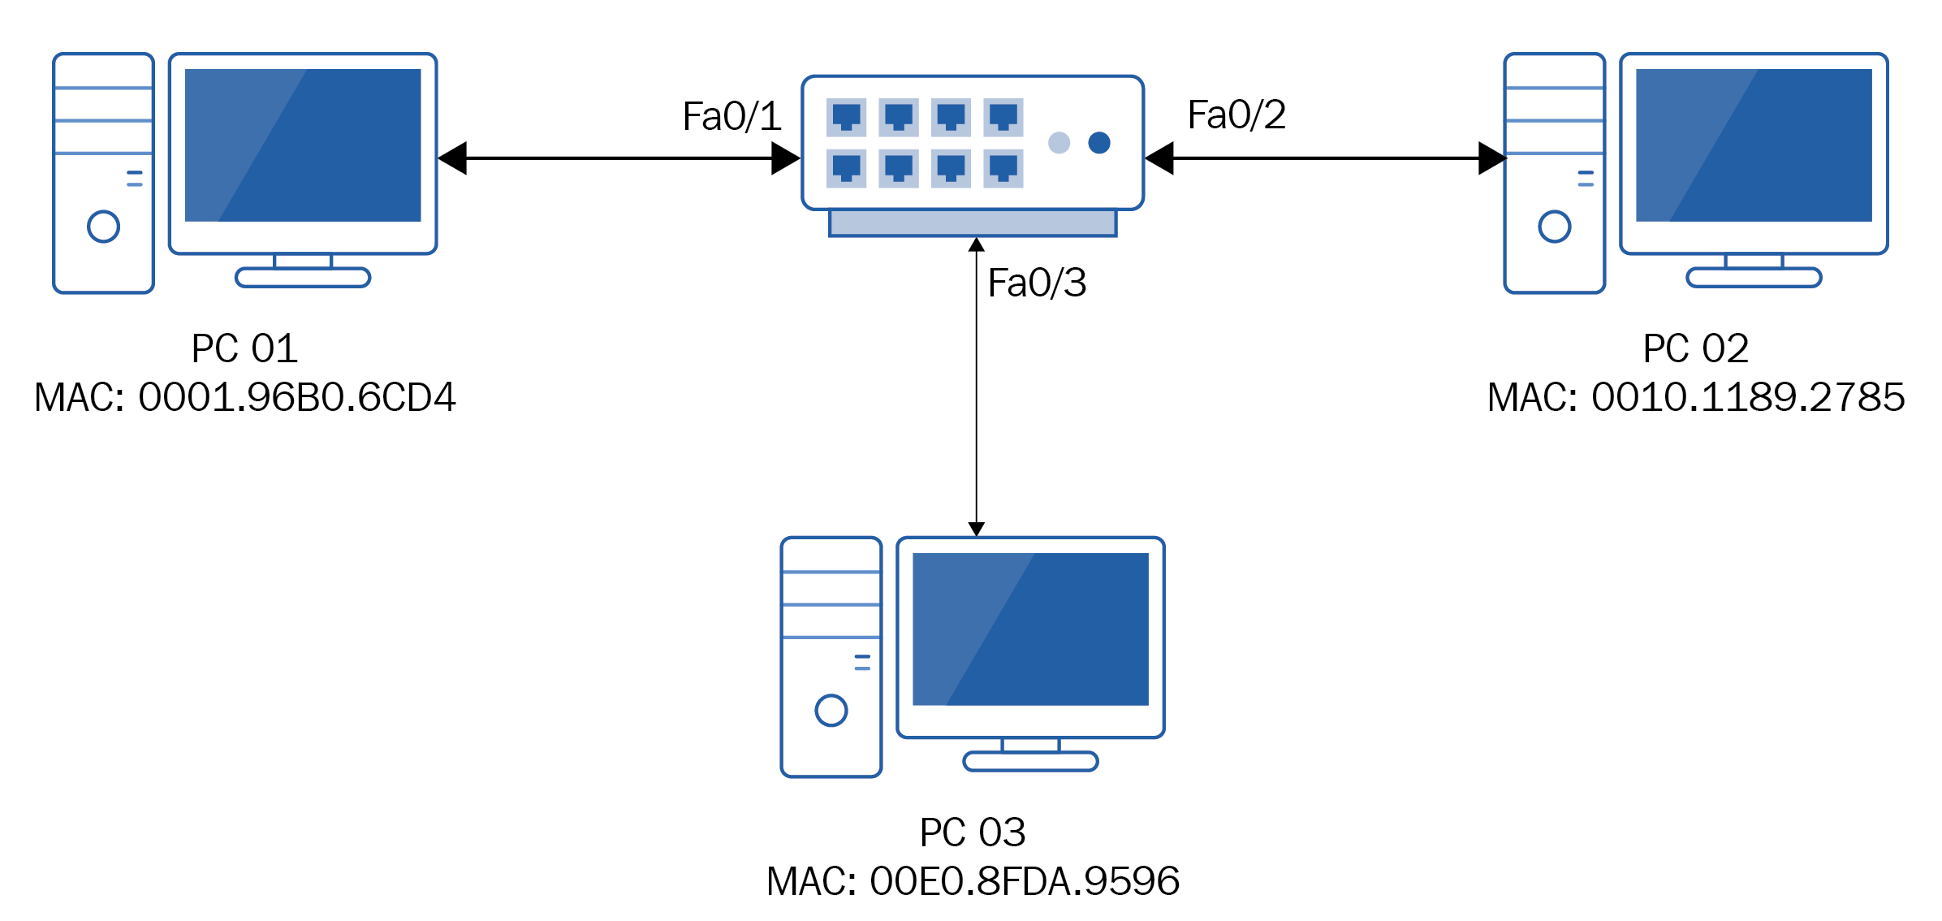
steps Frame forwarding takes to process a signal when it receives it
Signal Reception
MAC Address Table Lookup
Buffering
MAC Address Learning
Destination MAC Address Lookup
Port Forwarding Decision
Collision Domain Isolation
Frame Forwarding
Hardware Acceleration
Efficient Routing

Slide 6
steps Frame forwarding takes to process a signal when it receives it
Signal Reception: The switch receives an incoming signal on one of its ports from a connected device.
MAC Address Table Lookup: The switch checks the incoming frame's MAC address to determine the source device from which the signal originated.
Buffering: If the switch port is busy or the switch's processing capacity is temporarily exceeded, the incoming frame may be buffered in the switch's memory until it can be processed.
MAC Address Learning: If the MAC address of the source device is not already in the switch's MAC address table, it learns this association by recording the MAC address and the port on which the frame was received.
Destination MAC Address Lookup: The switch examines the destination MAC address in the frame header to determine the port to which the frame should be forwarded.
Port Forwarding Decision: Based on the destination MAC address lookup, the switch determines the outgoing port through which the frame should be transmitted to reach its intended destination.
Collision Domain Isolation: Each port on the switch is considered a separate collision domain, which helps reduce collisions and ensures efficient data transmission.
Frame Forwarding: The switch forwards the frame out of the correct port towards the destination device, ensuring that the data packet reaches its intended recipient.
Hardware Acceleration: Some switches may utilize hardware acceleration techniques to expedite the processing of frames, enhance throughput, and reduce latency in forwarding data packets.
Efficient Routing: By using hardware-based MAC address tables and port forwarding mechanisms, switches can efficiently route signals within a local network, improving network performance and reducing unnecessary broadcast traffic.

Slide 7
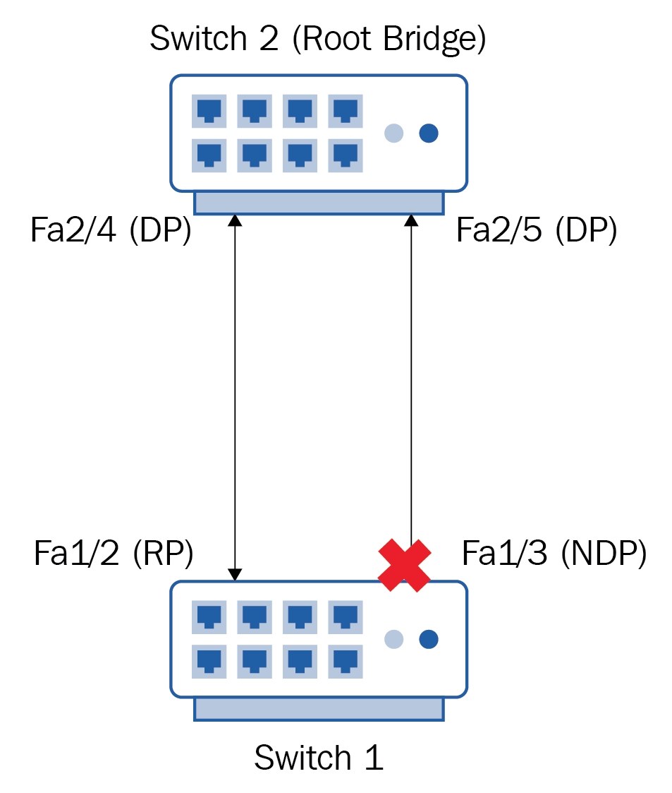
What is the Root bridge?
is the main switch in a network that controls the flow of data and prevents loops by creating a tree-like structure for communication.

Slide 8
How the Spanning Tree Protocol (STP) works:
Root Bridge Election
The network chooses one main switch called the Root Bridge based on the lowest ID.
Designated Ports
Each switch picks the best path to the Root Bridge, marking those ports as Designated Ports for forwarding.
Blocking Ports
Other ports are Blocked to prevent loops in the network.
Loop-Free Setup
STP ensures there are no loops by identifying and blocking redundant paths.
Communication (BPDU- Bridge Protocol Data Unit)
Switches exchange messages to share network details and make decisions.
Cost Calculation
Each path's cost is determined based on link speed to find the best route.
Port States
Ports go through stages like Blocking, Listening, Learning, and Forwarding to manage network traffic.
Adapting to Changes
STP adjusts to network changes by updating port states to maintain a stable network.

Slide 9

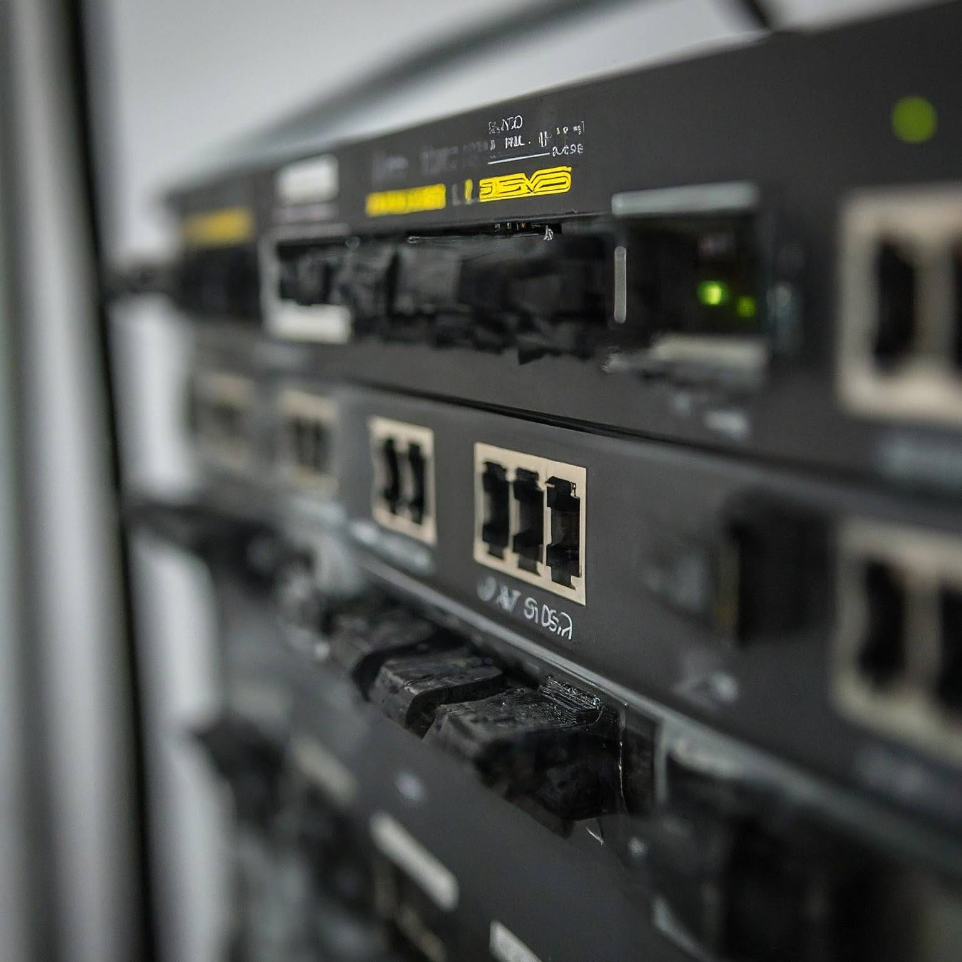
Layer 3 switches
Layer 3 switches combine features of traditional Layer 2 switches and routers.
They can make routing decisions based on IP addresses like routers, allowing for faster packet processing.
Layer 3 switches can route traffic between different subnets within a network, improving network performance by reducing the need to send data to an external router for inter-VLAN routing.

Slide 10
Open question
What is a VLAN (Virtual Local Area Network)?

Slide 11
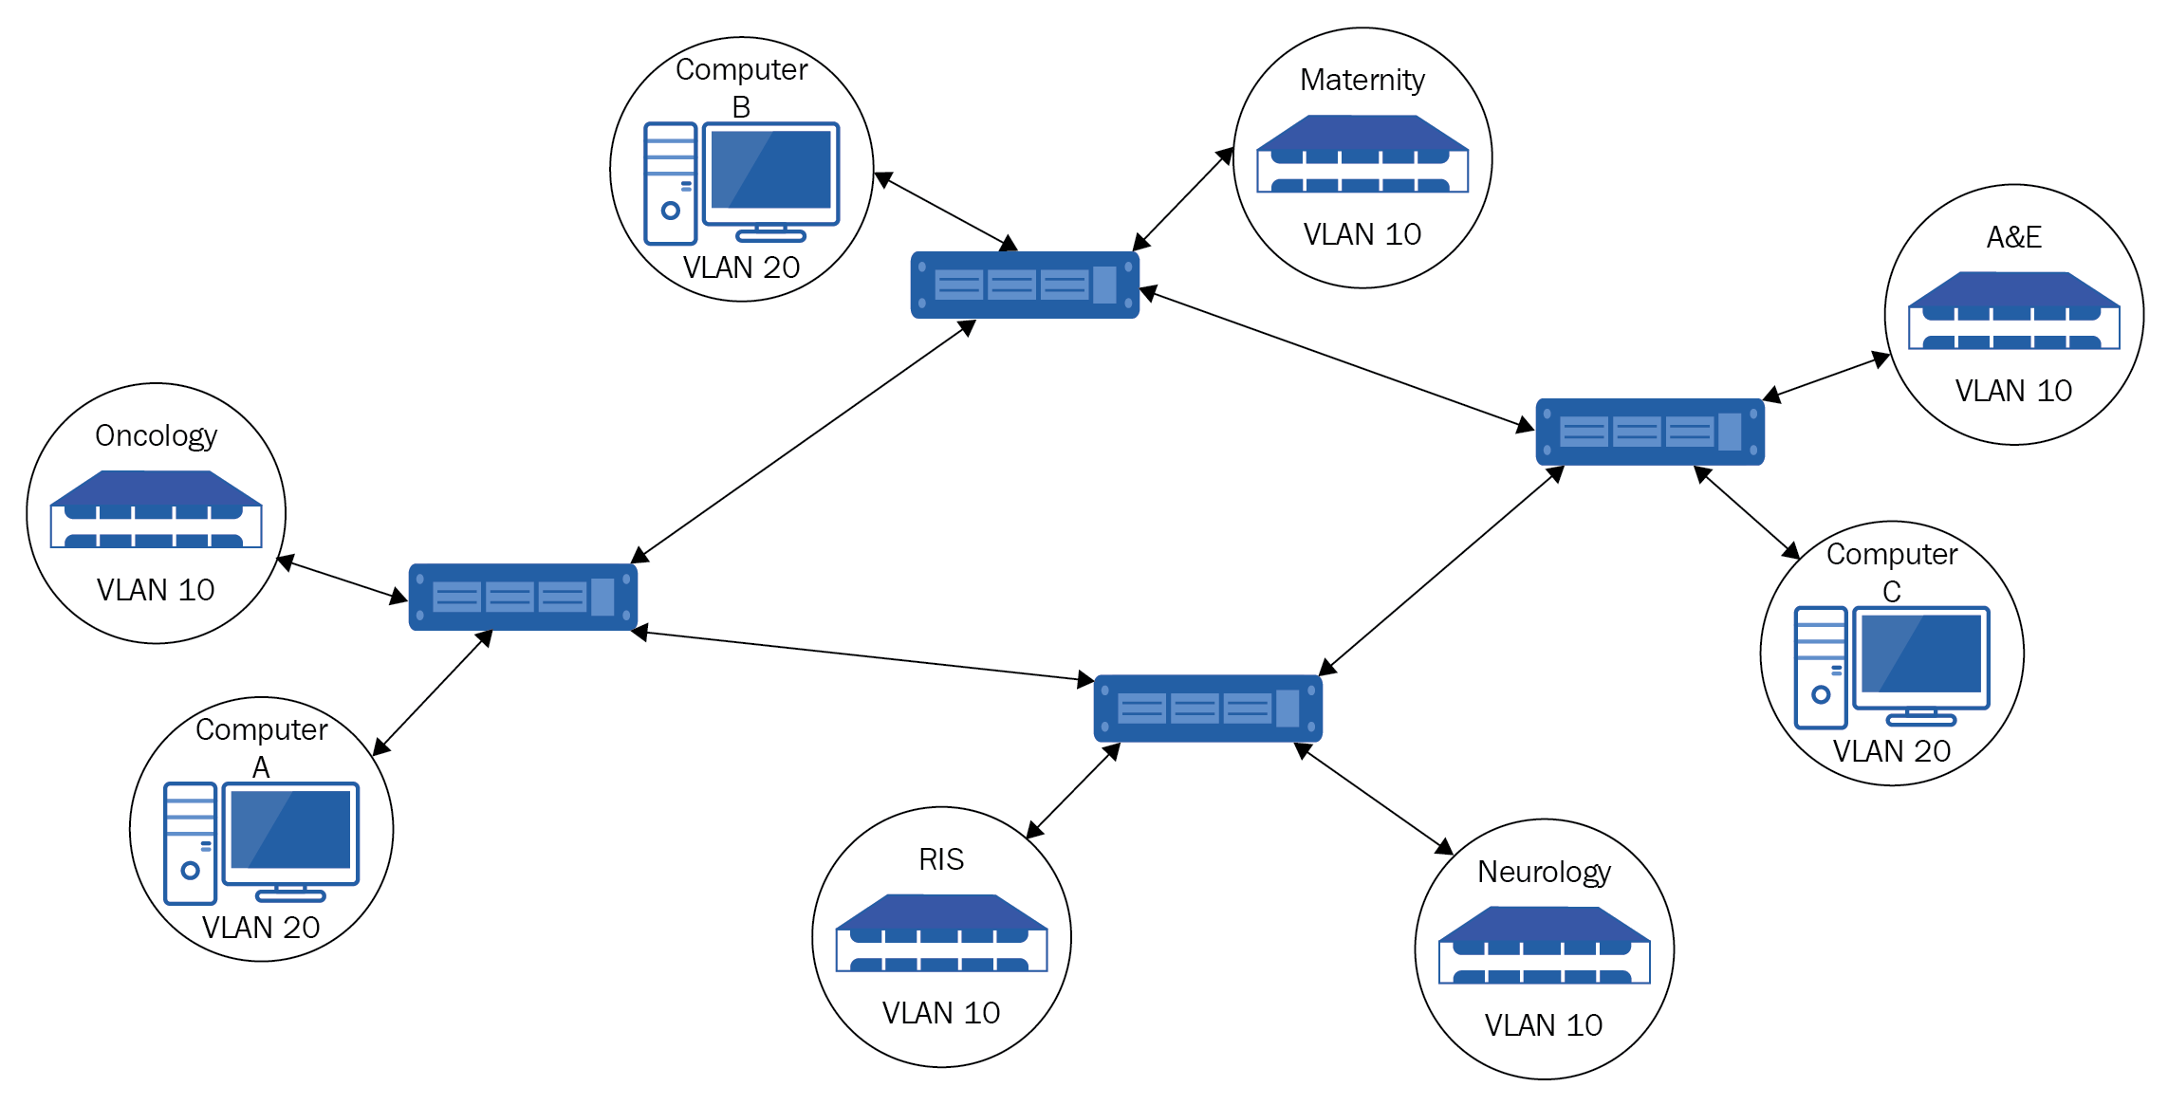
VLANs (Virtual Local Area Networks)
VLANs are used to logically divide a single physical network into multiple isolated virtual networks.
Devices within the same VLAN can communicate as if they are connected to the same physical network, even if they are physically located in different parts of the network.
VLANs improve network security, efficiency, and management by segregating traffic and controlling communication between different groups of devices.

Slide 12
Switch Security
Switches increase network efficiency by reducing collision domains and forwarding data only to specific interfaces.
Security measures include password-protecting console connections to prevent unauthorized access.
To prevent physical tampering, unused switch ports should be disabled, and port security can be implemented to control MAC addresses on ports.
MAC Flooding can overwhelm a switch, causing it to fail open and broadcast frames to all ports; port security helps prevent this by authenticating new MAC addresses.

Slide 13
Q&A
Let's open the floor for any questions you may have…

