Slide 1

ПРОГНОЗИРОВАНИЕ
ОТТОКА
КЛИЕНТОВ

Slide 2





TEAM
EGOR
SHULGIN
КIRILL
IVANOV
IVAN
RADKO
ROMAN
KOZYREV
GLEB
KAZAKOV

Slide 3
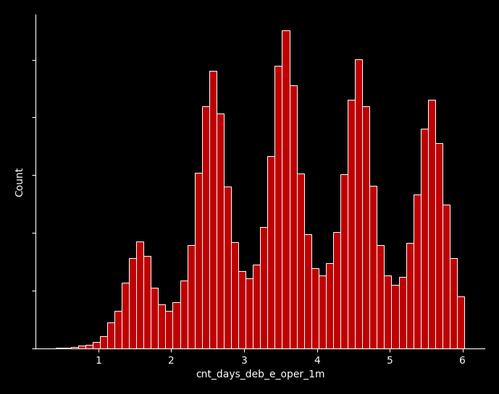
DATA CLEANING
1
TASK
Clear data from outliers
2
HOW?
Removed negative values
Removed inappropriate values ​​(example: 100 days a month)
3
NOISE?
Determining the boundaries of a feature + number of unique values
Что сделали?

Slide 4
FEATURES
Features with a large percentage of NaN are highlighted. Some of them have been removed (index_city_code)
Features with a large percentage of NaN are highlighted. Some of them have been removed (index_city_code)
1
The most indicative and important values ​​in each of the features are highlighted
2
Feature encoding techniques discussed
3
New features were generated based on operation data
4

Slide 5
LEADERBOARD MODEL
TOP 10 FEATURES:
CAT:
Full set of features
1.sum_deb_e_oper_1m
2.sum_a_oper_1m
3.cnt_cred_e_oper_3m 4.cnt_days_cred_e_oper_3m
5. ogrn_exist_months
6. balance_amt_max
7. sum_cred_e_oper_1m
8. balance_amt_day_avg
9. balance_amt_avg
10. balance_amt_min
Imputation
LGBMClassifier + CatBoostClassifier
1. min_founderpres
2. cnt_cred_e_oper_3m
3. ogrn_exist_months 4. cnt_days_cred_e_oper_1m
5. sum_of_paym_1y
6. sum_deb_e_oper_1m
7. rko_start_months
8. cnt_days_cred_e_oper_3m
9. sum_cred_e_oper_1m
10. balance_amt_min
LGBM:
Stacking
Logistic regression

Slide 6
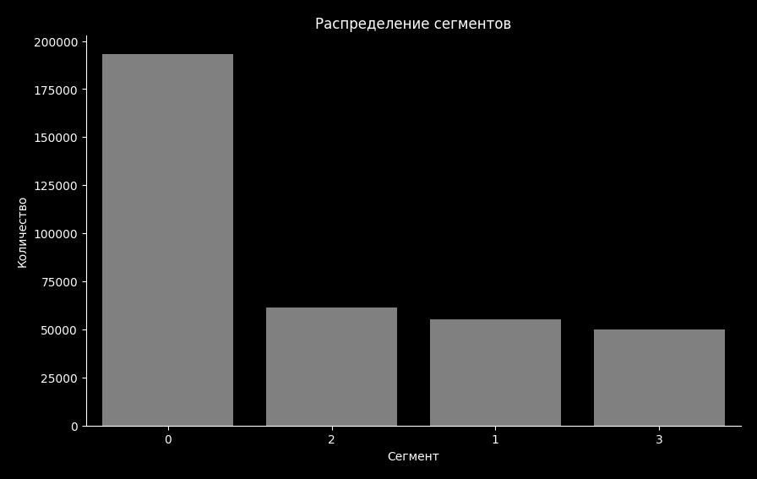
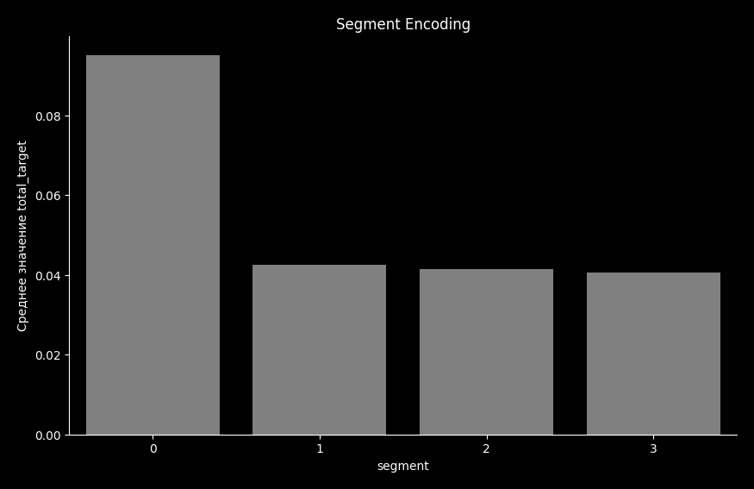
TARGET IN VARIOUS SEGMENTS
One of the most revealing features is segment. During the initial analysis, segment <0> catches the eye; it has the largest number of people and the largest percentage of those leaving.

Slide 7
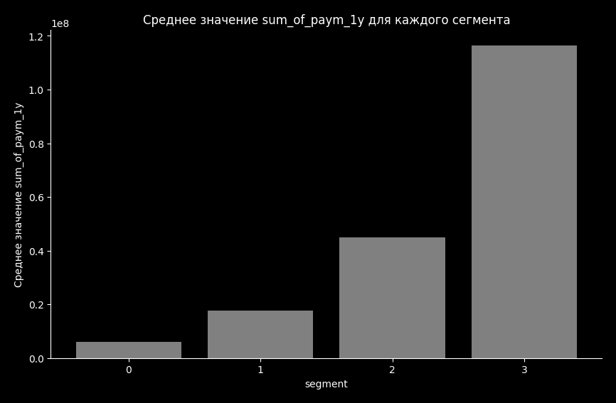
PECULIARITIES
1
Clients from the zero segment have a very small amount of transactions per year
2
Clients from segment 3 have huge annual transaction amounts and are very unlikely to leave!

Slide 8
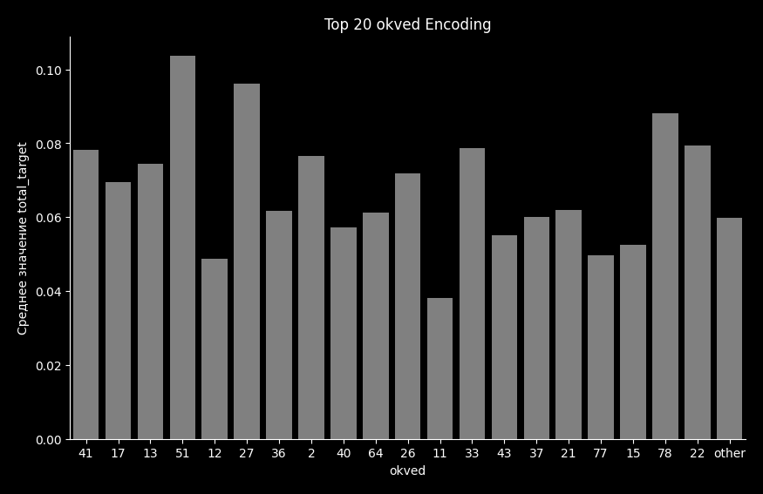
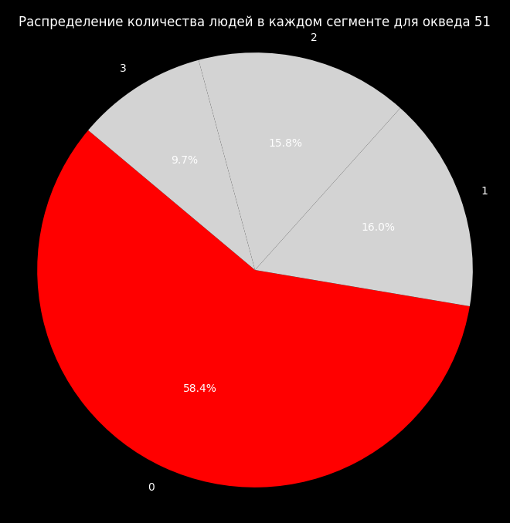
OKVED ANALYSIS
1
Clients with okved 11 clearly stand out from the rest, despite the fact that the indicators in general are not very different
2

Slide 9
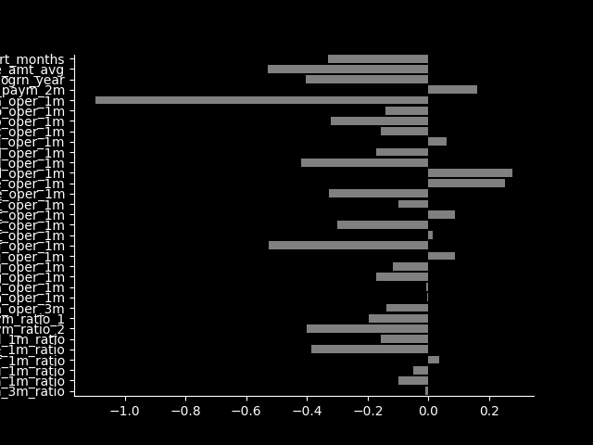
INTERPRETABLE MODEL
Model weights can show the importance of each feature and its impact on final prediction
LOGISTIC REGRESSION
Features:
37 uncorrelated numeric features
OptBinning
POSITIVE:
rko_start_months balance_amt_avg
Sum_a_oder_1m
IMPACT
NEGATIVE:
Cnt_deb_e_oper_1m
Sum_of_paym_2m
Cnt_cred_d_oper_1m

Slide 10
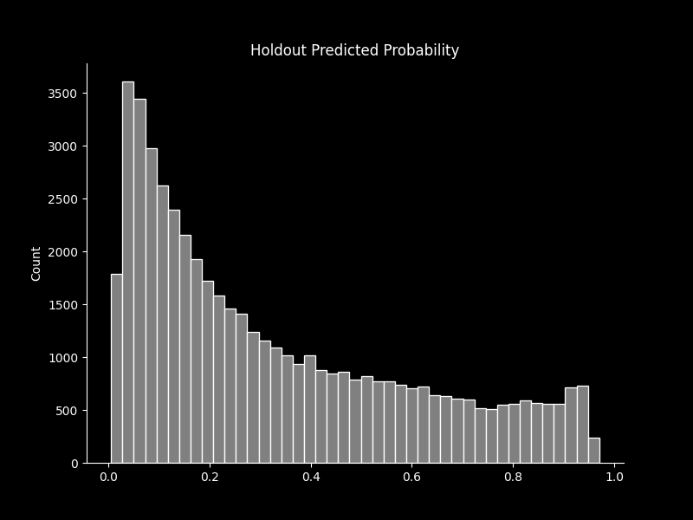
METRICS
1
Confusion Matrix | Positive | Negative
Positive Predict | 36242 | 10257
Negative Predict | 710 | 2791
2
ROC-AUC: 0.863
3
GINI: 0.726
4
Lost business value: 1.9 billion roubles

Slide 11
BUSINESS INSIGHT
1
Pay attention to clients from segment 0. There are a lot of them compared to others, however, they leave on average more often. Having also analyzed their annual amount of transactions, it is clear that they spend less than others
Mostly new bank clients are leaving for outflow. For older users this statistic is better
2
You should pay attention to the average balance in the user's account. Probably, if the client has money lying around, he does not plan to leave the bank quickly
3
Using time series analysis models on streaming client wallet data
4

Slide 12
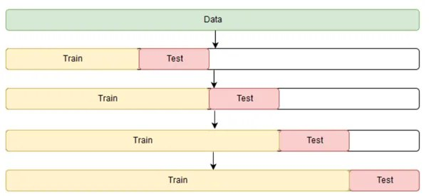
THINGS THAT WENT WRONG
Categorical features brought little impact to the model performance
1
Inconsistency between CV and LB AUC-ROC
Possible reasons:
Poor cleaning techniques
Data-shift
2

