Slide 1
Laborpraktikum
Implementation of Software Product Line with FOP
(2D Game)
Lei Luo
Liang Liang
Songxuan Wu
11.27.2009

Slide 2
Content
Introduction
    Motivation
    Tools for Implementation
    Milestones
    UML
Game demonstration
    “Tank-War” show
Implementation details
    Final feature-tree
    Map
    AI
Gtroffene Probleme

Slide 3
Introduction
Software product line:
A software product line (SPL) is a set of software-intensive systems that share a common, managed set of features satisfying the specific needs of a particular market segment or mission and that are developed from a common set of core assets in a prescribed way.
-- Software Engineering Institute Carnegie Mellon University

Slide 4
Introduction
Feature oriented programming:
Feature Oriented Programming (FOP) is a general paradigm for program synthesis in software product lines.
The bases of FOP are features.

Slide 5
Introduction
Motivation
Make a demo of a game for showing, how can FOP in SPL and in mobile phone be used
Tools for Implementation
Eclipse: a multi-language software development platform comprising an IDE and a plug-in system to extend it.
Feature IDE: an Eclipse-based IDE that supports building program families following the AHEAD architecture model.
J2ME Platform SDK 3.0: a state-of-the-art toolbox for developing mobile applications.

Slide 6
Introduction
Milestones
1. Basic planning (from 4th May to 17th May)
2. Develop Java prototype for 2D Game (from 18th May to 7th June)
3. Implement all expected features (from 8th June to 11th September)
4. Test and Improve this Game (from 12th Septembert to 30th September)
5. Final presentation and discussion (at about 7th October)

Slide 7
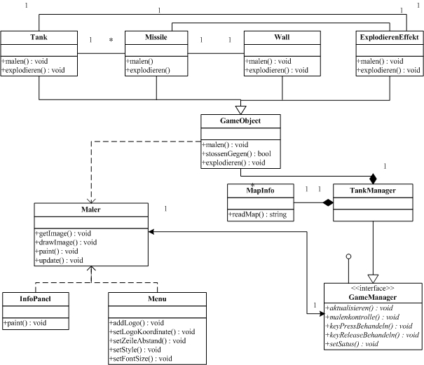

Slide 8
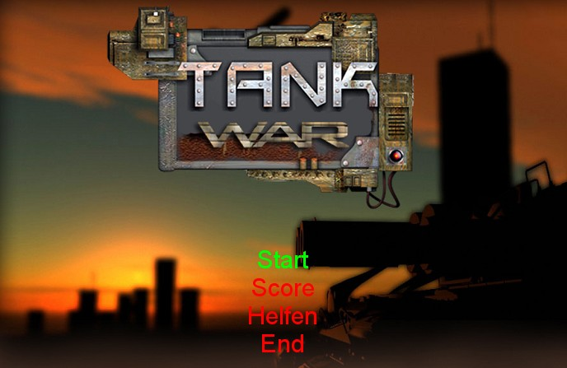
Game demonstration
“Tank-War” show

Slide 9
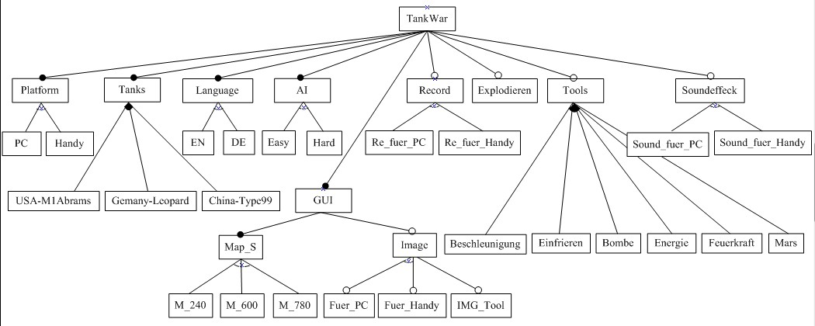
Implementation details
Final feature-tree

Slide 10
Implementation details
An example of a map file
a60d00321604d12360412d00481604c32270412e00361210f2901f5601f2518f3318g20h05i11i12i13i21i22i23j2454k2954z
Map analyze
"a" map size (60 means 60 multiply 60 units (square) )
“b” the location of a brick wall (rectangle)
"c" the location of a metal wall (rectangle)
"d" the location of a grass (rectangle)
"e" the location of a river (rectangle)
“f” the initial location of a enemy‘s tank
"g" the total number of the enemy's tanks
"h" the max-appeared number of the enemy's tanks
“i” the set of enemy‘s tank types
"j" the initial location of a player's tank
"k" the location of the player's base
"z" the end of the map's information

Slide 11
Implementation details
Map display
because of the problem of the covering in image-layers ，we draw missiles after the water, and grasses after tanks and missiles.
Display sequence in the game:
gruppeMalen(brickwall);
gruppeMalen(tankMenge);
gruppeMalen(waterwall);
gruppeMalen(missilesMenge);
gruppeMalen(metalwall);
gruppeMalen(expEffekt);
gruppeMalen(grasswall);

Slide 12
Easy AI：lower fire and direction changing frequency ，each direction has the same probability
Implementation details
protected void tankFeindKI() {
long timeJ = System.currentTimeMillis();
long timeR = timeJ;
if (timeJ - time > 800) {
feuern();
time = timeJ;
}
if (timeR - time1 > 600) {
int[] richtung = { 0, 1, 3, 5, 7 };
int index = Math.abs(random.nextInt() % 5);
tankRichtung = richtung[index];
time1 = timeJ;
}
}
// U=1 R=3 D=5 L=7 （No Movement=0）

Slide 13
Hard AI：higher fire and direction changing frequency ，direction probabilities base on the player‘s tank
Implementation details
protected void tankFeindKI() {
long timeJ = System.currentTimeMillis();
long timeR = timeJ;
if (timeJ - time > 400) {
feuern();
time = timeJ;
}
if (timeR - time1 > 300) {
int[] richtung = { 0, 1, 3, 5, 7, richtungAI,
richtungAI,richtungAI, richtungAI };
int index = Math.abs(random.nextInt() % 9);
tankRichtung = richtung[index];
time1 = timeJ;
}
}

Slide 14
richtungAI algorithm
Implementation details
| Left or right | = X
Enemy
Up or down = Y
Player
1, decide the relative player's location// U,UR,R,DR,D,LD,L,UL
2, decide the shorter distance //X or Y
3, richtungAI = optimal direction

Slide 15
Gtroffene Probleme
1. Verschiedene Platform Verschiedene Struktur(entry point)
Das Programm für PC braucht ein main() Method als Entriit Punkt. Aber das Programm für Handy( MIDlet) braucht kein main() Method. Es muss eine Erweitung von Class MIDlet sein .

Slide 16
Gtroffene Probleme
      J2SE :
      public class MyClass{
      public static void main(String[] args) {
      ……….
      }
      }
J2ME :
      import javax.microedition.midlet.MIDlet;
      public class MyClass extends MIDlet {
      }
Lösung : eine Leere Class für PC(J2SE).

Slide 17
Gtroffene Probleme
2. Verkleinere lib in J2ME
Die lib von J2ME und von J2SE sind nicht gleich. Manche Method in der lib von J2SE ist unverfügbar in der lib von J2SE.
Z.B Explodiereneffekt
Wir möchten ein Dreiecke auf den Bildschirm malen.in J2ME müssen wir nene Method entwerfen. In J2SE ganz einfach.-----fillPolygon(int[] xPoints, int[] yPoints, int nPoints)

Slide 18
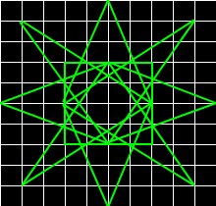
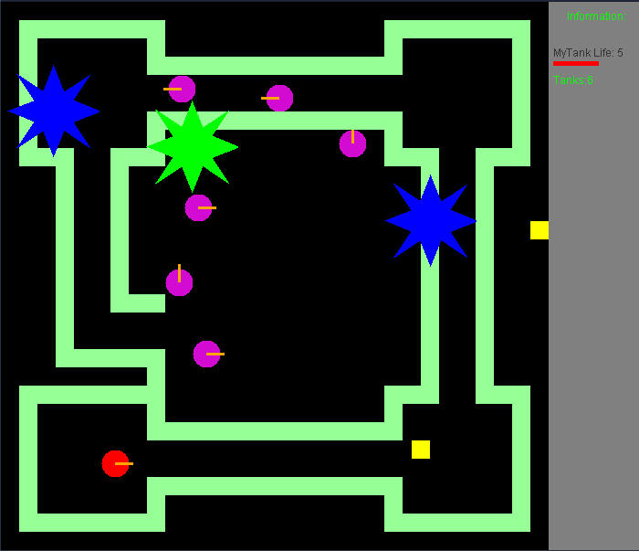
Gtroffene Probleme

Slide 19
Gtroffene Probleme
Z.B ein nächste ganze Zahl von float bekommen.
J2SE : Math.round(float a)
J2ME : keine
GameObject.getRund(float f)
Ein ZufallsZahl bekommen
J2SE : random.nextInt(int n)
J2ME : Math.abs(random.nextInt()%5) (CLDC1.0)
random.nextInt(int n) (CLDC 1.1)

Slide 20
Gtroffene Probleme
3. Verschiedene platform Verschiedene Implementierung.
Z.B Soundplayer
J2SE : sun.audio.AudioPlayer
J2ME : javax.microedition.media
Record
J2SE : file
J2ME : javax.microedition.rms RecordStore
InputText
J2SE : TextField J2ME : eigene Class

Slide 21
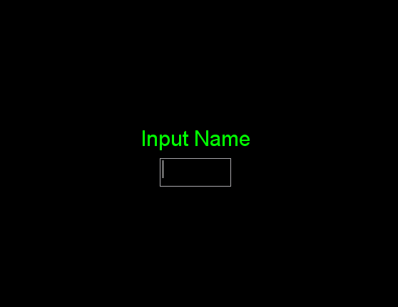
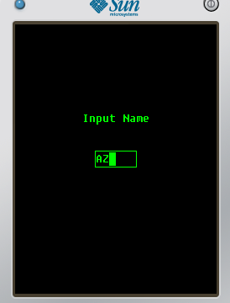
Gtroffene Probleme

Slide 22
Gtroffene Probleme
4. Beschränketer Speicher für J2ME
  Bild verkleinen
  Sound verkürzen
5. Wenige Hilfe-Informationen bei FeatureIDE

Slide 23
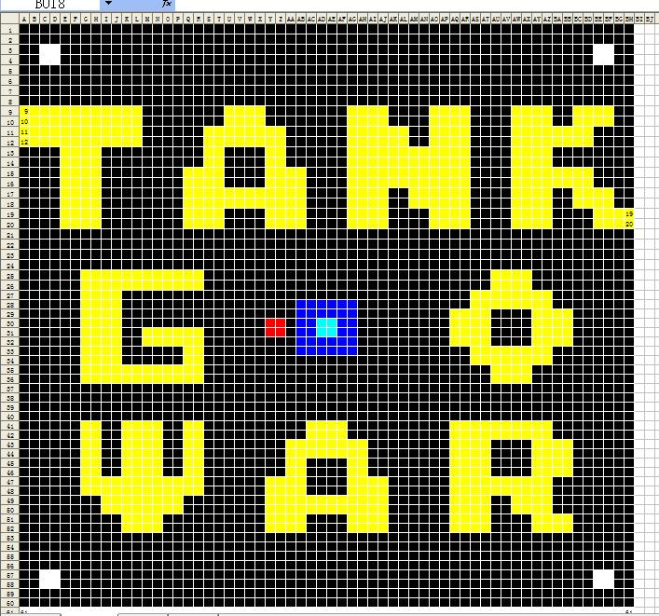
Thank you very much

