Slide 1
NAME : FEBI S
DEPT : COMPUTER SCIENCE
AND ENGINEERING
INSTITUTION : ANNA UNIVERSITY
REGIONAL CAMPUS TIRUNELVELI
PROJECT TITLE : IMAGE GENERATION
– GEN AI
3/21/2024 Annual Review

Slide 2
AGENDA
PROBLEM STATEMENT
PROJECT OVERVIEW
IMAGE GENERATION TECHNIQUES
PROPOSED SOLUTION
RESULT
3/21/2024 Annual Review

Slide 3


PROBLEM STATEMENT
The problem aims to develop a generated image from the fake face image dataset which consists of real faces and masked faces. It involves various Generative Adversial Network(GAN) techniques for generating set of fake face and real face images into real face image.
3/21/2024 Annual Review

Slide 4
PROBLEM OVERVIEW
This project focused on generating CIFAR-10-like images using Generative Adversarial Networks (GANs). The custom GAN model consists of a Generator and a Discriminator, trained to produce realistic images and differentiate between real and generated ones. These innovative tools utilize deep learning algorithms to create images that can be used for a variety of purposes, from personal art projects to marketing campaigns.

Slide 5

IMAGE GENERATION TECHNIQUES
An overview of different image generation techniques, including Variational Autoencoders (VAEs), Generative Adversarial Networks (GANs), and Auto-regressive Models
Variational Autoencoders (VAEs):
The model consists of an encoder network that maps input images to a probability distribution in the latent space and a decoder network that reconstructs images from samples drawn from this distribution.
VAEs are capable of generating diverse outputs by sampling from the learned latent space, but they may produce blurry images due to the nature of the reconstruction objective.
3/21/2024 Annual Review

Slide 6

2. Generative Adversarial Networks (GANs):
GANs are composed of two neural networks: a generator and a discriminator, trained simultaneously in a adversarial manner.
During training, the generator aims to fool the discriminator by generating increasingly realistic images, while the discriminator strives to distinguish between real and fake images.
3. Auto-regressive Models:
Auto-regressive models generate images pixel by pixel, sequentially, based on the previously generated pixels.
Auto-regressive models are suitable for generating images with structured patterns and fine-grained details, such as natural scenes and textures.
3/21/2024 Annual Review

Slide 7

PROPOSED SOLUTION
Generator and Discriminator Networks:
Generator: The generator network takes random noise vector as input and generates synthetic data samples. It typically consists of multiple layers of neural networks, such as convolutional or deconvolutional layers, followed by activation functions (e.g., ReLU) and normalization layers (e.g., batch normalization).
Discriminator: The discriminator network evaluates the authenticity of the generated samples by distinguishing between real samples from the training dataset and fake samples generated by the generator. Like the generator, the discriminator consists of multiple layers of neural networks, often convolutional layers followed by activation functions and normalization layers.
3/21/2024 Annual Review

Slide 8
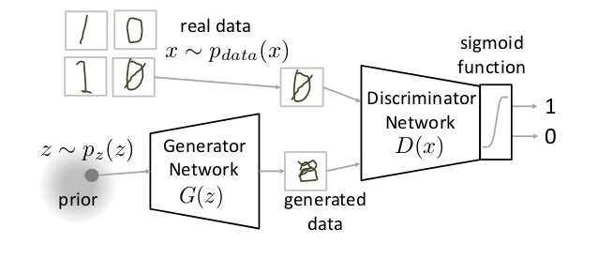
Objective Function:
The training objective of GANs is formulated as a minimax game between the generator and the discriminator:
The generator aims to minimize the following objective function: min⁡Gmax⁡D𝑉(𝐷,𝐺)=𝐸𝑥∼𝑝𝑑𝑎𝑡𝑎(𝑥)[log⁡𝐷(𝑥)]+𝐸𝑧∼𝑝𝑧(𝑧)[log⁡(−𝐷(𝐺(𝑧)))]minG​maxD​V(D,G)=Ex∼pdata​(x)​[logD(x)]+Ez∼pz​(z)​[log(1−D(G(z)))]
3/21/2024 Annual Review

Slide 9
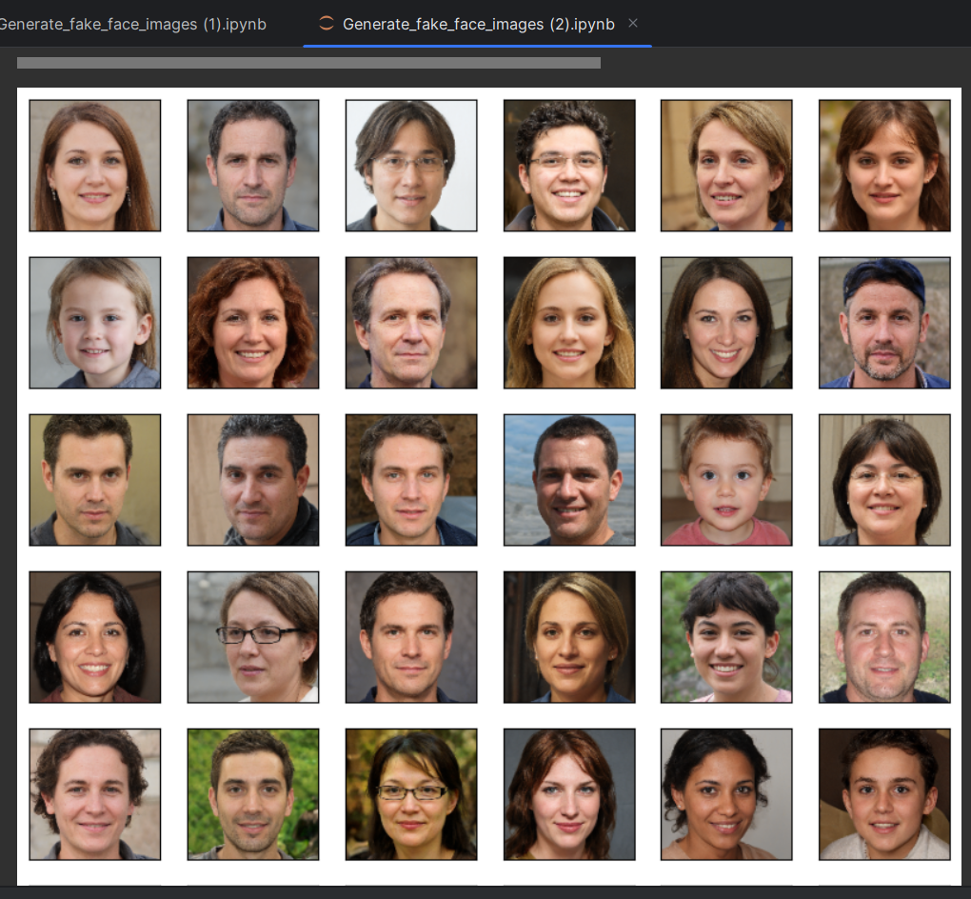
RESULT
The project demonstrates the effectiveness of GAN in generating realistic images and provides insights into the challenges and opportunities in training and deploying generative models .
9

