Slide 1


ENERGY CONSUMPTION FORECASTING USING MACHINE LEARNING FOR SMART GRID TECHNOLOGY
Submitted by,
Anish Appu Kuttan
Email: appukuttan0830@saskpolytech.ca
Febin Lawrence Pravada Rence
Email: lawrencepravadar@saskpolytech.ca

Slide 2
Agenda
Aim of the Project
Dataset Architecture & Technologies
Introduction
Timeline
Budget
Objective
Project Methodology
Conclusion

Slide 3

Introduction
This project aims to use machine learning to predict household energy consumption in smart grids.
The goal is to optimize electricity usage and improve the efficiency of the power grid.
This project applies machine learning to predict household energy consumption in smart grids, helping improve electricity management.
The project focuses on reducing energy costs, increasing efficiency, and supporting a more reliable and sustainable grid.

Slide 4
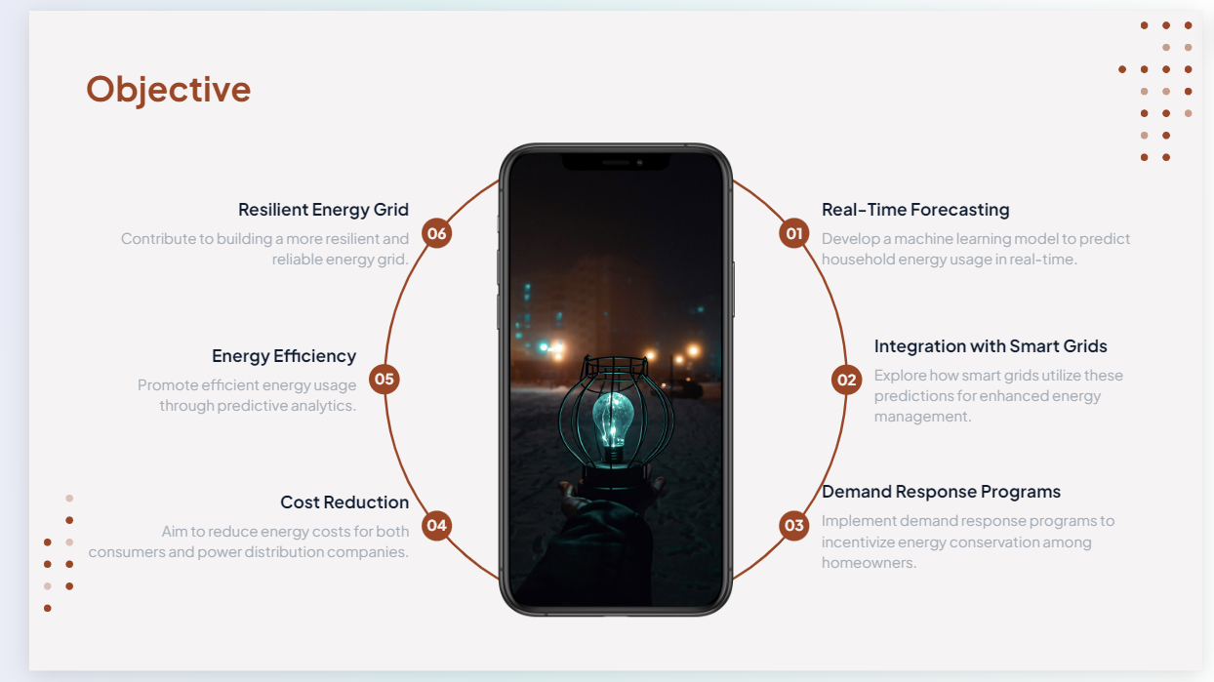
Objective
Create a predictive model for forecasting household energy consumption using machine learning techniques.
Assist energy providers in optimizing power generation and supply management.
Analyze and predict changes in energy demand during holidays to improve grid reliability.
Forecast renewable energy generation (wind and solar) to balance the energy grid more efficiently.
Enhance energy storage optimization by predicting when to store surplus energy.
Detect anomalies in energy demand or generation, identifying outages or inefficiencies in the grid system.

Slide 5
Timeline: Project Duration: September 23rd – November 30th
Sprint 2:
(Sept 30 – Oct 6)
Sprint 5:
(Oct 21 – Oct 27)
Data Preprocessing
Model Training and Optimization
Sprint 1:
(Sept 23 – Sept 29)
Sprint 3:
(Oct 7 – Oct 13)
Sprint 4:
(Oct 14 – Oct 20)
Project Setup and Initial Research
Feature Engineering
Model Selection and Baseline Model Implementation

Slide 6
Timeline: Project Duration: September 23rd – November 30th
Sprint 7:
(Nov 4 – Nov 10)
Sprint 10:
(Nov 25 – Nov 30)
Model Comparison and Selection
Final Presentation and Project Wrap-up
Sprint 6:
(Oct 28 – Nov 3)
Sprint 8:
(Nov 11 – Nov 17)
Sprint 9:
(Nov 18 – Nov 24)
Model Validation and Testing
Model Performance Enhancement
Final Documentation and Report Preparation

Slide 7
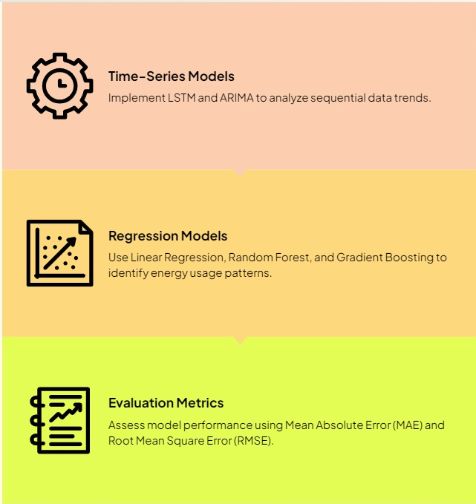
Project Methodology
Utilizing an advanced model for effective energy forecasting

Slide 8
Dataset and Technologies Exploring Energy Consumption Data for Smart Grid Applications
The Dataset covers electricity
Consumption from 2009 to 2024,
Providing a comprehensive view of trends.
Key Columns: Settlement date, demand, generation capacity
Essential data metrics
Utilizing advanced technologies for efficient data processing and model training in machine learning.
Data visualization with Matplotlib and Seaborn
Visual Insights for decision-making
Electricity Consumption UK 2009-2024
Long-term dataset for analysis
The Dataset includes
critical columns for analysis, enabling accurate forecasting and insights.
Technologies: Python, Azure Cloud, Scikit-learn, Matplotlib
Tools for data processing
Employing Matplotlib and Seaborn for clear and effective data visualization enhances understanding.

Slide 9

Budget
Category | Details | Cost Range (CAD)
Software | Python, Pandas, Scikit-learn, ARIMA, Power Bi | $0 - $94
Data Storage (Optional) | AWS S3, Google Cloud Storage | $0 - $13
Research Materials | Books, Journals, Papers | $20 - $100
Presentation/Printing | Project Presentation Materials, Printing | $20 - $60
Miscellaneous | Unforeseen Costs | $70
Total Estimated Budget |  | $20 - $200

Slide 10


Conclusion
The predictions optimize electricity distribution, minimize energy waste, and enhance grid management, ultimately resulting in cost savings for both energy providers and consumers
Enhanced energy forecasting also promotes the integration of renewable sources like wind and solar, contributing to more sustainable energy practices.
By leveraging predictive analytics, the project opens doors to smarter, data-driven energy solutions, ensuring grid reliability and resilience.
Future advancements could include real-time forecasting through IoT-enabled smart meters, further improving energy efficiency and enabling dynamic load balancing in smart grids.

Slide 11
REFERENCE: 1.https://www.geeksforgeeks.org/ml-linear-regression/ 2.https://www.mdpi.com/2071-1050/15/9/7087 3.How to Create an ARIMA Model for Time Series Forecasting in Python - MachineLearningMastery.com 4.Short-Term Firm-Level Energy-Consumption Forecasting for Energy-Intensive Manufacturing: A Comparison of Machine Learning and Deep Learning Models (mdpi.com) 5.Forecasting Renewable Energy Generation with Machine Learning and Deep Learning: Current Advances and Future Prospects (mdpi.com) 6.Thanksgiving holiday causes unique electricity usage patterns across the country - U.S. Energy Information Administration (EIA) 7.Multi-Time-Scale Energy Storage Optimization Configuration for Power Balance in Distribution Systems (mdpi.com)

Slide 12
Questions?

Slide 13




Thank you
Submitted by,
Anish Appu Kuttan
Email: appukuttan0830@saskpolytech.ca
Febin Lawrence Pravada Rence
Email: lawrencepravadar@saskpolytech.ca

