Slide 1
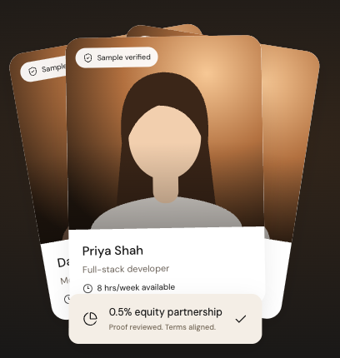
bizbazooka.
01 / 11
BUILDYYC / TEAM 5 — CREWYYC
Build a venture.
Launch a career.
Verified builders. Clear terms.
Shared upside.
FOUNDERS × BUILDERS × EMERGING TALENT
A local prototype with sample partner and verification records
Abdeslem · CK · Michio · Pradeep · Thu
Notes:
BizBazooka helps founders turn an idea into a team, with reviewed project evidence, clear commitments and a path for emerging talent. Team 5 — CrewYYC: Abdeslem, CK, Michio, Pradeep and Thu. The product headline matches the web preview: Build a venture. Launch a career. This is a local prototype with fictional people, partner records and verification examples.
Source: latest CrewYYC-BuildYYC-Pitch.pptx, slide 1, supplied October 24, 2026. Current website reference: BizBazooka local preview, inspected October 24, 2026, http://127.0.0.1:4173/. All partner names, people, verification records, offers and legal acceptance shown in the prototype are samples or simulations.
Visual sources: Current web preview homepage capture; portrait artwork from the user-supplied BizBazooka.html reference.

Slide 2

bizbazooka.
02 / 11
The problem
An idea needs a team
to become a business
Founders struggle to turn an idea
into a product when the right people,
time and commitment are unclear.
Illustrative workspace, not the team
SEARCH
OPPORTUNITY
CONTINUITY
Weeks of cold outreach
Business potential is lost
Ideas stall before launch
Notes:
The pain hypothesis is lost business opportunity: founders have ideas but struggle to find people with the right skills, available time and willingness to commit. Current routes include LinkedIn messages, Slack posts, meetups and personal contacts. The result can be long searches or stalled ideas. No measured local survey or independently validated job/graduate statistic is presented as proof.
Source: latest CrewYYC-BuildYYC-Pitch.pptx, slide 2, supplied October 24, 2026. Current website reference: BizBazooka local preview, inspected October 24, 2026, http://127.0.0.1:4173/. All partner names, people, verification records, offers and legal acceptance shown in the prototype are samples or simulations.
Visual sources: Existing illustrative workspace photo: app/public/images/builders.jpg; Unsplash photo-1522071820081-009f0129c71c, not a photograph of the team.

Slide 3
bizbazooka.
03 / 11
Who we serve first
Founders with an idea
and budget to build.
USERS
Founders + builders
Build a product, find a first role,
or grow a long-term team.
Find founders through events,
accelerators and campus networks.
BUYER HYPOTHESIS
Programme operator
POTENTIAL PILOT CHANNELS / NOT SIGNED PARTNERS
Platform Calgary · Tech Hub · AI Tinkerers
University business clubs and mentors
Cohort licence. Builders join free.
Notes:
The first founder has a concrete idea and budget, often with a product, event or demo milestone. Programme operators are a proposed institutional buyer; builders and emerging talent are users. Prospective access channels include Platform Calgary, Tech Hub, AI Tinkerers, university business clubs and mentors. These names are potential channels, not signed partnerships.
Source: latest CrewYYC-BuildYYC-Pitch.pptx, slide 3, supplied October 24, 2026. Current website reference: BizBazooka local preview, inspected October 24, 2026, http://127.0.0.1:4173/. All partner names, people, verification records, offers and legal acceptance shown in the prototype are samples or simulations.

Slide 4
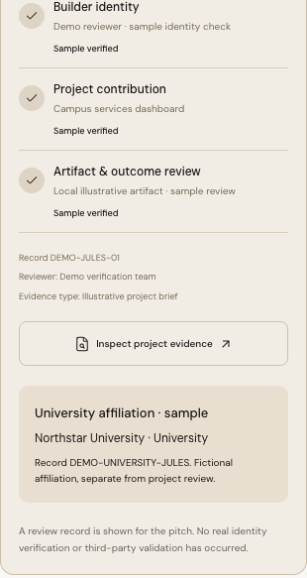
bizbazooka.
04 / 11
Verified teams, clear commitments
01
Recommend
Venture idea → relevant skills, current capacity and preferences.
02
Interview
Review project evidence, affiliation and mutual fit.
03
Agree
Paid terms, optional equity and versioned acceptance.
04
Grow
Long-term roles and mentored internships.
Sample verification dossier
Notes:
The web preview connects venture-based recommendations, project and affiliation evidence, interviews, paid or equity offers, versioned acceptance and mentored internships. Recommendations use explainable keyword and eligibility rules, not an AI success prediction. Verification and affiliation records are examples; new profiles remain self-reported. Agreements do not create employment, issued equity or a binding legal contract.
Source: latest CrewYYC-BuildYYC-Pitch.pptx, slide 4, supplied October 24, 2026. Current website reference: BizBazooka local preview, inspected October 24, 2026, http://127.0.0.1:4173/. All partner names, people, verification records, offers and legal acceptance shown in the prototype are samples or simulations.
Visual sources: Current prototype verification dossier screenshot: app/output/playwright/ecosystem/13-university-verification-mobile.png.

Slide 5
bizbazooka.
05 / 11
Market opportunity
LATEST TEAM MODEL / UNVALIDATED INPUTS
~$1.2B
~$22M
~$0.5M
Canada / draft TAM
Alberta / draft SAM
Alberta / draft SOM
8.4M assumed users
× $144 per year
153K assumed users
× $144 per year
3,500 assumed paid founders
× $144 = $504K per year
Illustrative annual revenue model. Market size, adoption and willingness to pay still need validation.
Displayed arithmetic uses founder subscriptions; programme and transaction revenue are not included.
Notes:
Illustrative market assumptions: 8.4M assumed Canadian users × $144 per year = $1.2096B, rounded to ~$1.2B. 153,000 assumed Alberta users × $144 = $22.032M, rounded to ~$22M. A separate scenario of 3,500 paid founders × $144 = $504,000 per year, rounded to ~$0.5M. The population, interest, addressable-user and willingness-to-pay assumptions remain unvalidated. A 2% capture of 153,000 would be 3,060 rather than 3,500. Programme licences and transaction revenue are excluded from the displayed calculation; a 90% B2B revenue mix is not established by this model.
Source: latest CrewYYC-BuildYYC-Pitch.pptx, slide 5, supplied October 24, 2026. Current website reference: BizBazooka local preview, inspected October 24, 2026, http://127.0.0.1:4173/. All partner names, people, verification records, offers and legal acceptance shown in the prototype are samples or simulations.

Slide 6
bizbazooka.
06 / 11
Competition & differentiation
TEAM POSITIONING ASSESSMENT / TO VALIDATE
Criterion | BizBazooka prototype | ICTC / TalentED | College programmes | Recruiters / Fiverr
Local & verified expertise | Strong | — | Strong | —
Cost effectiveness | Strong | Some | — | Good
Founder-to-builder match | Strong | Good | Some | —
Our focus: reviewed evidence, current capacity and clear paid or equity terms
Qualitative ratings reflect the source team’s view, not an independent comparison. Sample verification in the demo.
Notes:
These qualitative ratings express the team's positioning hypotheses, not an independent competitive assessment. Strong, Good and Some correspond to three, two and one source checkmarks; a dash corresponds to a source cross. Criteria are local/verified expertise, cost effectiveness, and founder-to-builder matching. The comparison is against ICTC/TalentED, college programmes, and recruiters/Fiverr. The BizBazooka proposition still needs real participant and partner validation.
Source: latest CrewYYC-BuildYYC-Pitch.pptx, slide 6, supplied October 24, 2026. Current website reference: BizBazooka local preview, inspected October 24, 2026, http://127.0.0.1:4173/. All partner names, people, verification records, offers and legal acceptance shown in the prototype are samples or simulations.

Slide 7
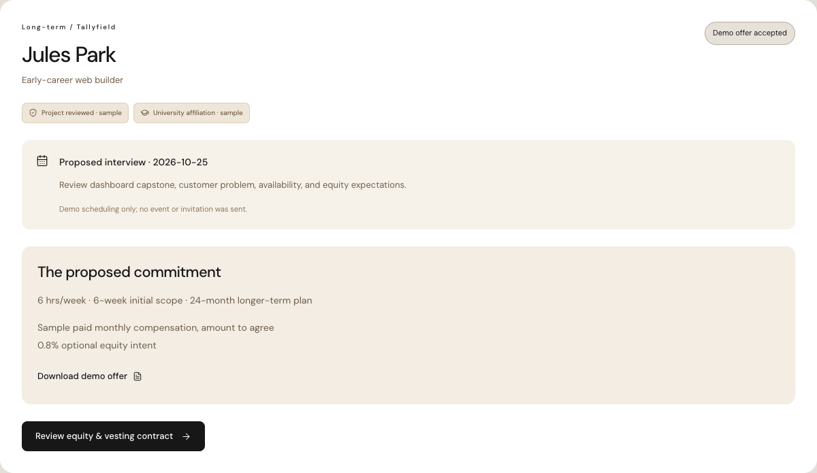
bizbazooka.
07 / 11
One end-to-end founder journey
LOCAL PROTOTYPE / SAMPLE DATA / NO EXTERNAL DELIVERY
01 Venture
Recommend builders for the idea.
02 Interview
Invite, confirm and review fit.
03 Offer
Agree paid terms and equity intent.
04 Contract
Monthly, quarterly or milestones.
Both people simulate acceptance.
Also working locally: internships, profile creation, downloads, capacity checks and saved state
Notes:
Demo sequence: describe a venture; recommend eligible builders; inspect Jules's sample university and capstone evidence; invite an interview; confirm separately as candidate; complete as founder; prepare and accept a paid long-term offer with optional equity; then review monthly, quarterly or milestone vesting and simulate acceptance by both participants. A second path demonstrates mentored internship posting, consented application, interview and paid offer. Profiles, downloads, capacity checks and saved state work locally. Authentication, external delivery, employment, independent verification and legal execution require a connected product.
Source: latest CrewYYC-BuildYYC-Pitch.pptx, slide 7, supplied October 24, 2026. Current website reference: BizBazooka local preview, inspected October 24, 2026, http://127.0.0.1:4173/. All partner names, people, verification records, offers and legal acceptance shown in the prototype are samples or simulations.
Visual sources: Current prototype recruiting screenshot: app/output/playwright/ecosystem/06-recruiting-desktop.png.

Slide 8
bizbazooka.
08 / 11
Business model
Free to join. Premium tools for founders.
PROPOSED COMMERCIAL MODEL / NO CHARGES IN THE PROTOTYPE
Founder premium
Contract work
Partners + events
$144/yr
5%
$750–$2,000
One free idea trial.
Paid idea submissions after.
Proposed contract commission.
No fee is collected in the demo.
Institutional partnership proposal.
Billing terms to validate.
Estimated CAC
Estimated LTV
LTV : CAC
$100
$350
3.5 : 1
Pricing and unit economics are assumptions. No paywall, payment processing or equity transaction is implemented.
Notes:
Proposed revenue model: free entry for founders and builders; one idea-submission trial, then founder premium access at $144 per year; 5% contract-work commission; and $750–$2,000 institutional/event partnerships. No partnership billing interval or currency is specified. Estimated CAC is $100 and estimated LTV is $350, giving $350/$100 = 3.5:1. These are assumptions, not observed customer economics. Paywalls, payments, commissions and equity services are not implemented in the current prototype. Any real equity service needs a reviewed legal and commercial framework.
Source: latest CrewYYC-BuildYYC-Pitch.pptx, slide 8, supplied October 24, 2026. Current website reference: BizBazooka local preview, inspected October 24, 2026, http://127.0.0.1:4173/. All partner names, people, verification records, offers and legal acceptance shown in the prototype are samples or simulations.

Slide 9
bizbazooka.
09 / 11
Grow through partner communities
PROPOSED ACQUISITION PATH / NOT CURRENT TRACTION
10
100
Scale
First founders
Word of mouth
Broader reach
Events + local partners
Founders bring builders
Outreach + integrations
Meet founders at events.
Seed projects and reviewed
builder profiles.
Keep partnering. Builders join
for work; universities expand
the talent network.
LinkedIn, TikTok and Instagram.
Connect university and
organisation programmes.
North star: accepted introductions that lead to a second meeting
Notes:
Proposed acquisition sequence: first founders through organisations and events; seed initial projects and reviewed profiles; grow toward the first hundred through continued partnerships, founder word of mouth and builders seeking work; then broaden outreach through LinkedIn, TikTok, Instagram and university/organisation integrations. No current traction or signed distribution relationship is claimed. The north star is accepted introductions that lead to a second meeting; real meetings and continued collaboration still need pilot measurement.
Source: latest CrewYYC-BuildYYC-Pitch.pptx, slide 9, supplied October 24, 2026. Current website reference: BizBazooka local preview, inspected October 24, 2026, http://127.0.0.1:4173/. All partner names, people, verification records, offers and legal acceptance shown in the prototype are samples or simulations.

Slide 10
bizbazooka.
10 / 11
Roadmap & the ask
PROPOSED NEXT STEPS / NOT CURRENT RESULTS
30 days
90 days
6–12 months
Onboard event founders.
Test talent and discovery needs.
Ship the MVP; seek first partners.
Review legal framework with firms.
Improve from founder feedback.
Develop university partnerships.
5–10 programme licences.
1,000 Calgary builders; Edmonton.
Formal university internships.
One event pilot. Two accelerator introductions.
Ten builders to try it this week.
Seeking a Platform Calgary or Product Calgary pilot; no existing partnership is claimed.
Future ecosystem: VC lists · how-to guides · pitch deck tools
Notes:
First 30 days: onboard event founders, validate talent/discovery needs, ship the MVP and seek initial partners. By 90 days: professional legal-framework review, feedback-led product improvements and university/institutional partnership development. Six to twelve months: target 5–10 programme licences, 1,000 Calgary builders, an Edmonton launch plan and formal university internship integration. The ask is an event pilot with Platform Calgary or Product Calgary, introductions to two accelerator programme leads and ten builders to try the pilot. These are prospective commitments and targets. VC lists, how-to guides and pitch deck tools are future ecosystem concepts; there is no active VC persona.
Source: latest CrewYYC-BuildYYC-Pitch.pptx, slide 10, supplied October 24, 2026. Current website reference: BizBazooka local preview, inspected October 24, 2026, http://127.0.0.1:4173/. All partner names, people, verification records, offers and legal acceptance shown in the prototype are samples or simulations.

Slide 11
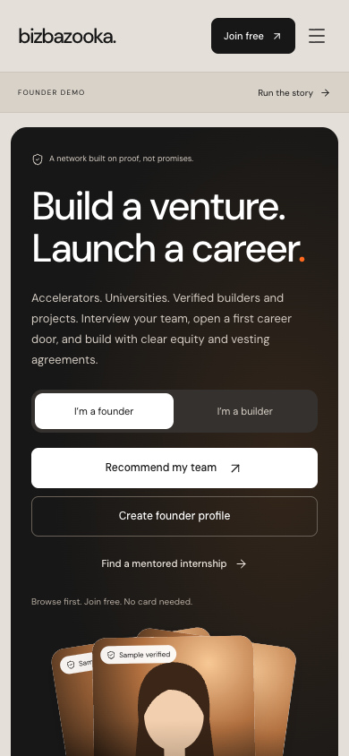
bizbazooka.
11 / 11
Thank you
for listening
Build a venture.
Launch a career.
Open the web preview →
127.0.0.1:4173 · local demo on the presenter’s computer
Abdeslem · CK · Michio · Pradeep · Thu
hoskote.pradeep@gmail.com
Notes:
Thank the audience and invite them to explore the prototype. The clickable link is http://127.0.0.1:4173/ and works on the computer running the local preview server. It is not a public signup URL and cannot be used from another device without deployment or network configuration. The prototype stores demonstration profiles in that browser; no real account or external notification is created. Team contact: hoskote.pradeep@gmail.com.
Source: latest CrewYYC-BuildYYC-Pitch.pptx, slide 11, supplied October 24, 2026. Current website reference: BizBazooka local preview, inspected October 24, 2026, http://127.0.0.1:4173/. All partner names, people, verification records, offers and legal acceptance shown in the prototype are samples or simulations.
Visual sources: Current prototype mobile homepage: app/output/playwright/ecosystem/03-home-mobile.png.

