Slide 1
SIMPARC FOR ALBERTA
Porting a Quebec housing-stock energy model to Calgary on open data
NRCan EnerGuide · Census 2021 · seeded & scripted
Notes:
Residential stock models tell you what a city's homes will demand before you
build the grid to serve them. Hydro-Quebec has one, called SimParc. Alberta
doesn't. This is what it took to move that model across the country - using only
open data.

Slide 2
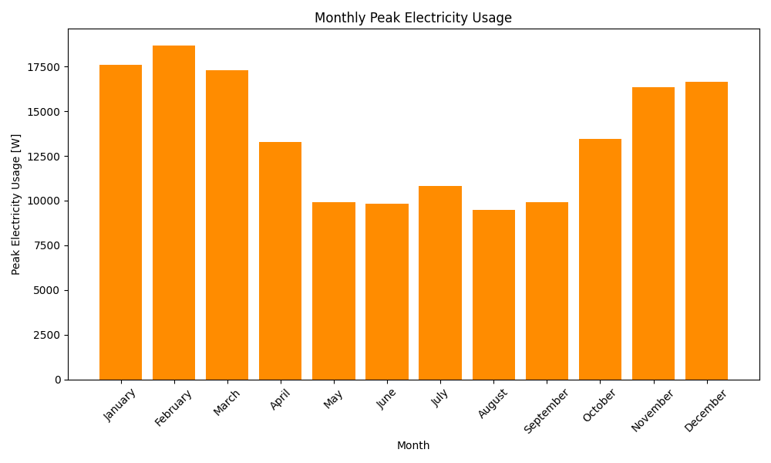
WHY STOCK MODELS
— What's the baseline demand?
— How fast is it growing?
— When does it peak?
≈ 2×
winter peak vs summer, one dwelling
NRCan EnerGuide · Census 2021 · seeded & scripted
2
Notes:
A stock model answers three questions utilities actually pay for: what's the
baseline, how fast is it growing, and when does it peak. This is one Montreal
apartment across a year - note the shape, not the city. Winter peak is roughly
double summer. Multiply that by a million homes and it's a capacity planning
problem. SimParc does exactly that multiplication for Quebec.

Slide 3
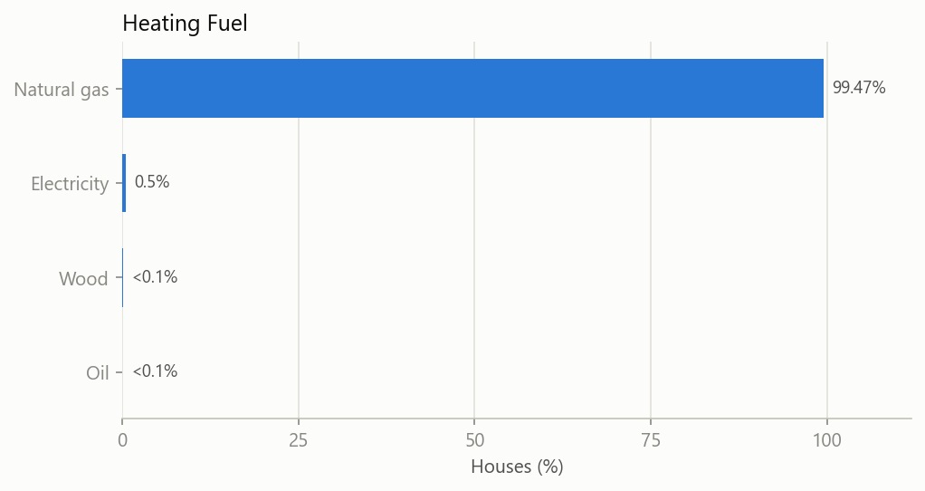
THE PROBLEM
99.5%
of Alberta homes heat with natural gas.
Quebec's model assumes electric baseboards.
— Code ports in an afternoon
— Statistics don't port at all
NRCan EnerGuide · Census 2021 · seeded & scripted
3
Notes:
Here's why you can't just point SimParc at Calgary. Quebec heats with electric
baseboards - cheap hydro made that the default. Alberta is ninety-nine and a half
percent natural gas. Every probability in the model is conditioned on the Quebec
answer. The code ports in an afternoon. The statistics don't port at all.

Slide 4
WHAT'S INSIDE
40
dwelling &
occupant nodes
52
technical
attributes
219
measure
arguments
Bayesian network
ResStock sampling
HPXML mapping
97 columns
the schema all three layers meet in — every one of them trained on a Quebec survey
NRCan EnerGuide · Census 2021 · seeded & scripted
4
Notes:
Three layers. A Bayesian network draws forty dwelling and occupant variables -
type, vintage, fuel. ResStock-style tables add fifty-two technical attributes on
top. A deterministic mapper turns all of it into HPXML arguments the simulator
runs. Those layers meet in a ninety-seven column schema, and every one of those
columns was trained on a Quebec survey. That schema is the thing we have to
re-derive.

Slide 5
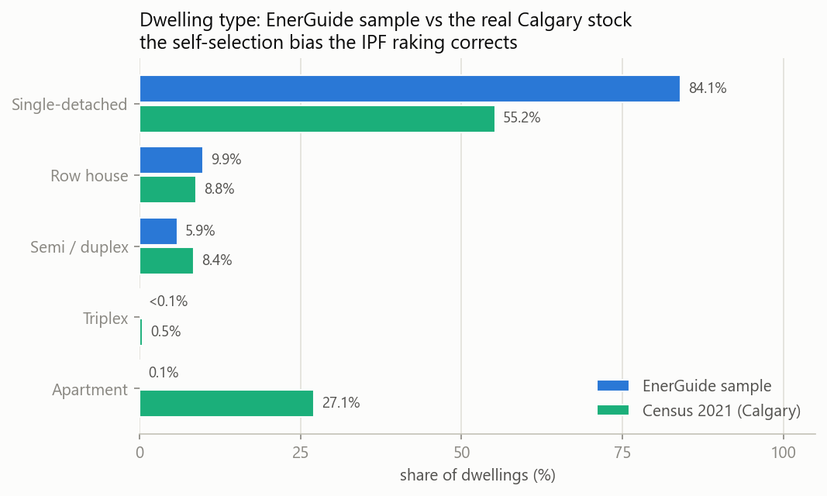
THE BIAS
— Nobody sampled this data
— People opt in: retrofit grants, new builds
27% vs 0.1%
apartments in Calgary
vs in the sample
NRCan EnerGuide · Census 2021 · seeded & scripted
5
Notes:
Quebec has a designed energy survey. Alberta has EnerGuide - a hundred ninety
thousand audited homes, but nobody sampled them. People opt in by applying for a
retrofit grant or labelling a new build. Look at the gap. Eighty-four percent of
the sample is single-detached; the real city is fifty-five. Apartments are
twenty-seven percent of Calgary and essentially zero in the data. Averaging this
describes grant applicants.

Slide 6
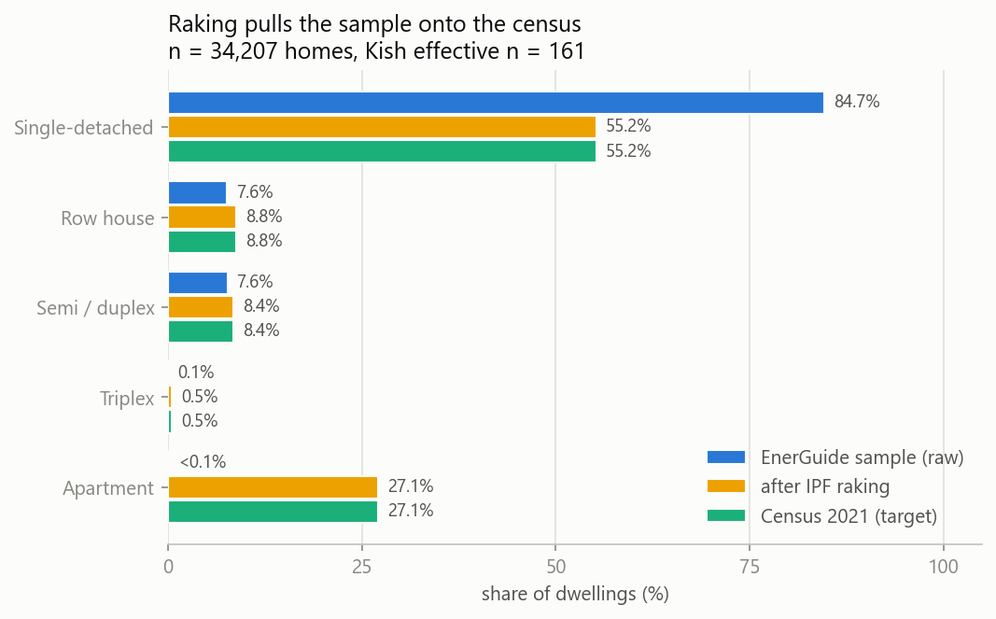
THE FIX: RAKING
— Sort every home into a census cell
— Solve for weights that match the margins
34,207 → 161
homes → effective sample size.
The honest cost of the correction.
NRCan EnerGuide · Census 2021 · seeded & scripted
6
Notes:
So we don't average it. Every home is sorted into a census cell - type, vintage,
tenure - and iterative proportional fitting solves for weights that force the
weighted mix onto the census margins. Blue is the raw sample, green is the census,
and the orange bar is the reweighted sample landing on target. The cost is honest:
thirty-four thousand homes behave statistically like about a hundred sixty.

Slide 7
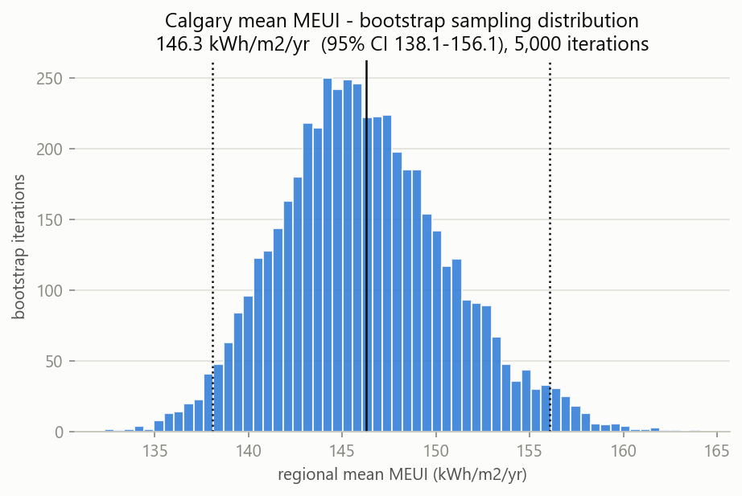
CALGARY'S NUMBER
146
kWh / m² · yr
138 – 156
95% confidence interval,
161 effective samples
NRCan EnerGuide · Census 2021 · seeded & scripted
7
Notes:
One hundred forty-six kilowatt-hours per square metre per year. The interval is
a post-stratified bootstrap - five thousand resamples, priced at that reduced
effective sample size, not the raw thirty-four thousand. So the error bar is real:
one thirty-eight to one fifty-six. That's a defensible city baseline, with the
uncertainty stated rather than hidden.

Slide 8
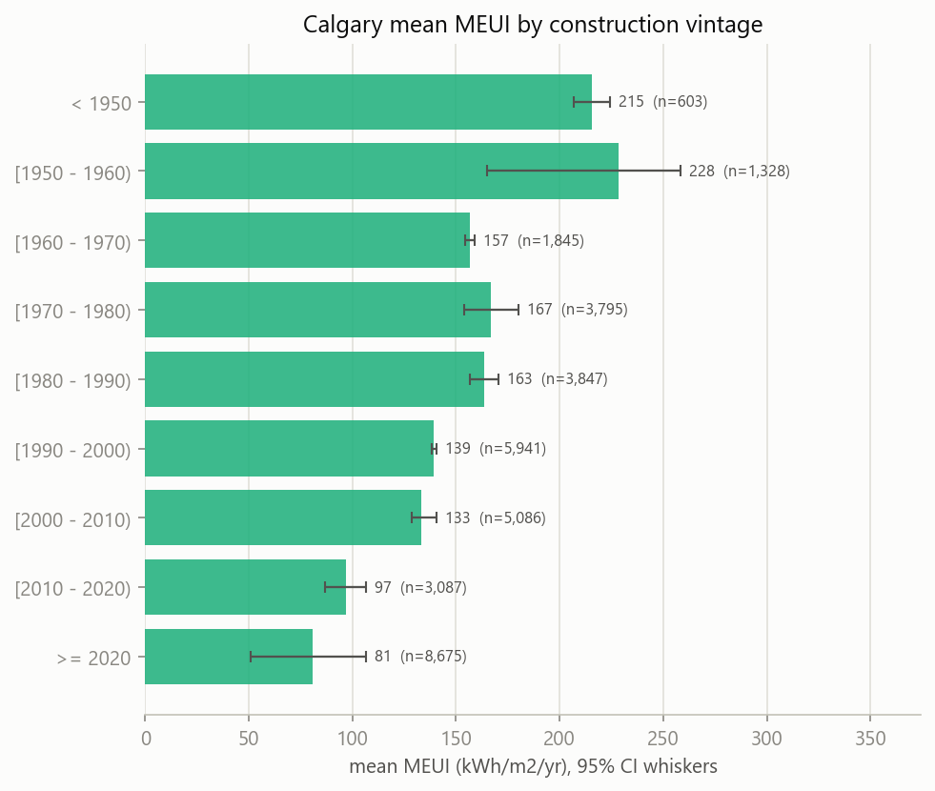
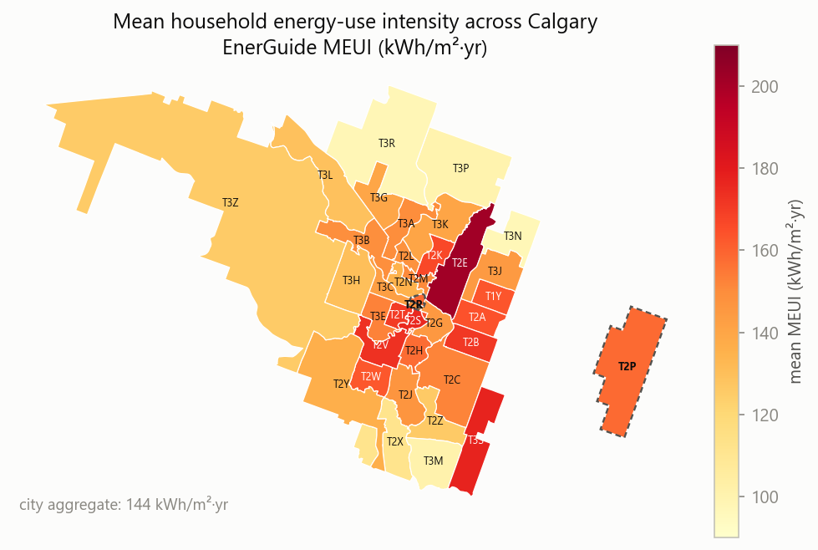
WHERE AND WHEN
— Newest stock 81, oldest 228 kWh/m²·yr — the building code, visible
— Inner ring oldest and most intense; pale FSAs are thin samples
NRCan EnerGuide · Census 2021 · seeded & scripted
8
Notes:
Two cuts. By age: post-2020 homes come in at eighty-one, the oldest stock at two
twenty-eight - nearly three times the intensity. That's forty years of building
code, visible in the data, and it's our physical sanity check. By geography: the
inner-city ring is oldest and most intense, the new suburbs lightest. Pale FSAs
are thin samples - compare neighbourhoods, don't quote a single one.

Slide 9
NEXT · AND WHAT THIS ISN'T
Source Albertan datasets
at this resolution or better
Rewrite the mapper's
hardcoded Quebec parameters
Retrain the Bayesian
network on Calgary
— Apartments and oldest vintages: wide intervals
— Audit-modelled intensity, not a weather simulation
Decision-grade for comparison.
Not a per-building predictor.
NRCan EnerGuide · Census 2021 · seeded & scripted
9
Notes:
Three things next: source Albertan datasets at this resolution or better,
rewrite the mapper's hardcoded Quebec parameters, and retrain the Bayesian network
on Calgary. Two honest limits - apartments and the oldest vintages stay thin, so
their intervals are wide; and this is audit-modelled intensity, not a weather
simulation. It's decision-grade for comparing neighbourhoods and vintages. Not a
per-building predictor.

