Slide 1
Re-calibrating a residential building-stock sampler for Calgary
Porting Hydro-Québec's EUEMr / SimParc pipeline to Alberta using open data
EnerGuide microdata + 2021 Census — no proprietary survey, fully scripted

Slide 2
CONTEXT
The pipeline: what this tool is
• The sampler is a front end for SimParc — Hydro-Québec's fleet-scale OS-HPXML / EnergyPlus building-stock simulator.
• It draws synthetic dwellings and emits ~219 OS-HPXML measure arguments per home (building-mapping.csv) that SimParc runs directly.
• Three probability layers carry the statistical content:
– Bayesian network — 40 dwelling/occupant nodes (type, vintage, fuel, system…)
– ResStock-style CPTs — 52 technical attributes (envelope, HVAC, setpoints, PV)
– Deterministic HPXML mapper — labels → HPXML args (weather, geometry, fuels)
• All three were trained on Québec's EUEMr 2022 survey. Calgary needs new numbers — not new node or option names.
2

Slide 3
OBJECTIVE
Goal & the naming constraint
• Replace the Québec probability values with Calgary values — keep every parameter, node, and option label byte-for-byte.
• Where a state is impossible in Alberta (e.g. Hydro-Québec's Bi-energie tariff), its probability is set to 0; the state name is preserved.
• Geography is already collapsed: Territoire_HQ = Calgary, Region = Alberta, EPW/UTC/DST already Mountain Time.
• What still needs replacing is every downstream probability — that is the real project, and it is a data problem, not a code problem.
3

Slide 4
THE MAP
SimParc → what needs to be replaced
What each SimParc input needs | status | # cols
Tier A — replace from EnerGuide microdata | direct | 30
Tier B/imputed — census / external aggregate | imputed | 3
Tier C — no Alberta data, keep Québec CPT | keep-qc | 22
ResStock-generic — location-independent default | resstock | 35
Already set to Calgary / derived | set/derived | 7
• 97 columns in the SimParc input schema, triaged column-by-column.
• ~⅓ map to real Calgary microdata; the rest are kept, imputed, or generic.
• Data-driven — see energuide_vs_quebec_crosswalk.csv
4

Slide 5
INGREDIENT 1
The data gap: no Alberta EUEMr
• Québec has EUEMr — a designed, weighted residential energy survey. Alberta has no equivalent.
• Substitute: NRCan EnerGuide open microdata — ~191,600 audited Alberta houses, 2004–2025, ~100 fields per home (envelope, fuels, MEUI).
• But it is administrative, self-selected data — retrofit-grant applicants and new-home labelling — not a representative sample.
• So the method must correct the sample before it can stand in for a survey.
5

Slide 6
COVERAGE
EnerGuide vs the Québec input CSV
SimParc input | EnerGuide field | % populated
HVAC Heating Efficiency | FURSSEFF | 100.0
Insulation Foundation Wall | FNDWALLINS | 100.0
Insulation Ceiling | CEILINS | 100.0
Insulation Wall | MAINWALLINS | 100.0
Basement Heating Setpoint | TBSMNT | 100.0
Heating Setpoint | TMAIN | 100.0
ModeConsigne | ThermostatHeatingNighttime | 50.9
Cooling Setpoint | ThermostatCooling | 50.9
Insulation Slab | SLABINSUL | 56.1
Battery | BATTERYSTORAGE | 56.1
PV System Size | KWPV | 56.5
Has PV | KWPV | 56.5
• 30 SimParc inputs map directly to a named EnerGuide field.
• Some map in theory but are sparse in practice — modelled intensity, setpoints, PV, DHW capacity sit near ~50–56% coverage.
• Envelope (RSI, ACH50), storeys, type, vintage, fuel: ~100% populated — the strongest Alberta signal.
• The rest is imputed from census or kept from Québec (Tier C).
6

Slide 7
ALREADY BUILT IN
Filtering the data into SimParc
Dashboard step | What it does
1 — Constrain | Pick any of the 40 variables + a value (e.g. Type = detached)
2 — Sample | GUM_Sampling(N, evs) draws that conditioned population
3 — Map | resstock_args_sampling + MapHPXML → ~219 OS-HPXML args
4 — Export | Download building-input / -mapping CSV → SimParc
• The Streamlit dashboard already *is* the filter: constrain the population, sample it, export the CSV SimParc runs. No extra script needed.
• Separately, the Calgary calibration data already exists: build_alberta_weights.py maps EnerGuide → BN labels and IPF-rakes to the 2021 census (≈74k Calgary homes; alberta_stock_mapped.parquet).
• Honest cost of that raking: Kish effective n ≈ 961 — apartments (n≈118) and the oldest stock stay thin.
7

Slide 8
WHY WE CAN'T TAKE THE MEAN
The bias, quantified
Housing feature | EnerGuide sample | Calgary census
Single-detached | 82.7% | 55.2%
Apartment (Collective) | 0.2% | 27.1%
Row house | 11.6% | 8.8%
Built ≥ 2020 | 21.1% | 2.4%
• A naïve average describes grant applicants and new builds, not Calgary.
• Apartments are 27% of the city but essentially absent from EnerGuide.
• Fix: sort homes into census cells and re-weight (IPF raking) so the weighted mix matches the census.
8

Slide 9
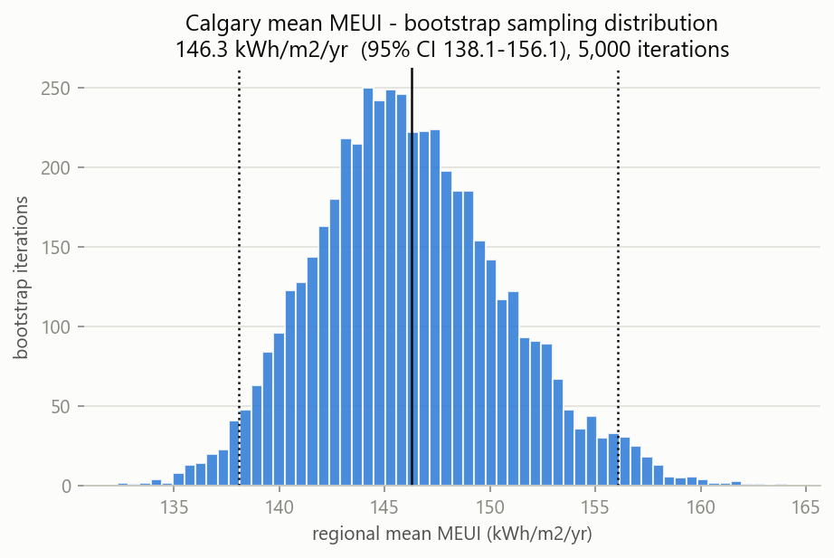
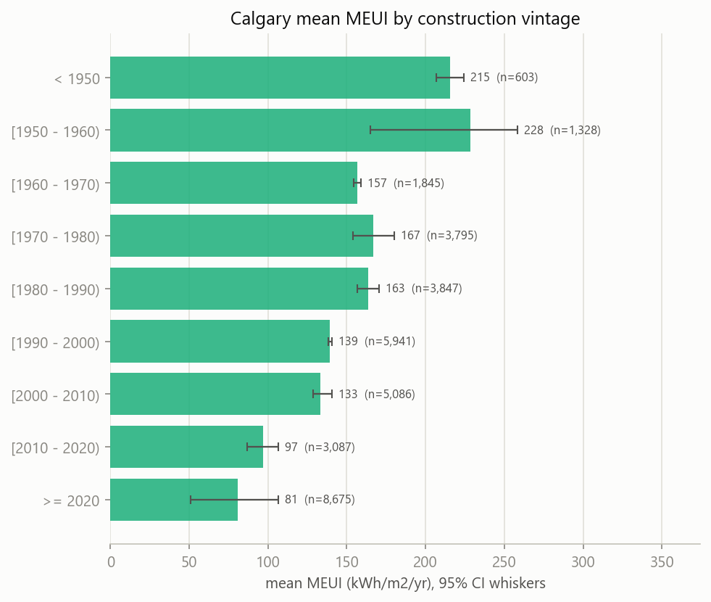
OUTPUT
Result: Calgary's household energy intensity
146 kWh/m²·yr (95% CI 138–156)
• Post-stratified weighted bootstrap — the interval reflects the honest effective sample size, not the raw 34k.
• Strong vintage gradient: post-2020 ≈ 81 vs oldest stock ≈ 215–228 kWh/m²·yr — roughly a third of the intensity.
• Building-code tightening, visible in the data — the physical sanity check.
9

Slide 10
THE UPDATE
Weather: recent, local temperatures
• The simulator still uses one Calgary-airport typical year (CWEC 2020) for every dwelling, citywide.
• We replaced the old web-scraper with local NSRDB data: 60 grid points across Calgary, 2018–2025, and built a per-FSA × year temperature / degree-day profile.
• The real gain is recent actual years, not fine detail — e.g. 2023 was mild (fewer heating degree-days) while 2019 was cold.
• Intra-city temperature spread is tiny (~0.9 °C across FSAs): Calgary is flat, so neighbourhoods barely differ.
• Honest limit: NSRDB here is temperature-only, so it can't build a full weather file — the simulation still leans on the 2020 typical year.
Year | Mean °C | HDD18
2018 | 3.8 | 5411
2019 | 3.3 | 5504
2020 | 4.2 | 5203
2021 | 4.9 | 5082
2022 | 4.6 | 5129
2023 | 6.1 | 4629
2024 | 4.8 | 5059
2025 | 5.2 | 4856
City-mean by year (heating degree-days, base 18 °C)
10

Slide 11
CREDIBILITY
The unglamorous 80%: data-quality traps
• The _id trap — a per-file CKAN row number whose ranges overlap across files; de-duplicating on it would silently delete ~29k real records.
• The value-blending bug — pandas groupby.first() pulls each column's first non-null independently, mixing post-retrofit fields into pre-retrofit records; 17,868 homes affected until fixed.
• Geographic contamination — CLIENTCITY="Calgary" includes mislabelled Edmonton (T6W) and rural FSAs; filtered out by FSA prefix.
• None of these throw errors — they produce plausible-but-wrong answers. Caught by profiling, not by the code crashing.
11

Slide 12
LIMITATIONS
Conclusion — what this does not claim
No large Alberta database
Weather data
• EnerGuide is self-selected, not a survey.
• Modelled intensity on only ~44% of homes.
• Apartments & oldest vintages stay thin (wide CIs).
• Within-cell self-selection is assumed away, not verified.
• Tier-C nodes (pool/spa, appliances) keep Québec values.
• NSRDB gives recent (2018–2025) FSA-level temperature — a real improvement.
• But it is temperature-only: no sunlight / humidity / wind.
• So it can't build a full weather file; simulation still uses the 2020 typical year.
• Grid covers central Calgary; city temperature is nearly uniform anyway.
• Energy figures are audit MEUI, not a weather simulation.
Decision-grade for relative comparisons (neighbourhoods, vintages) and a city average with a real error bar — not a per-building predictor.
12

Slide 13
RECAP
Next steps & reproducibility
• Widen BN coverage — extend EnerGuideToBN to the remaining Tier-A nodes.
• Re-pull NSRDB with all variables (sun/humidity/wind) to build recent-year weather files, then wire them into the simulator.
• Source better Tier-B/C data (SHEU, CEUD, ZEV, CMHC) and quantify Tier-C with Monte-Carlo sensitivity bands.
• Everything is seeded and scripted from public sources:
– compare_energuide_quebec.py · build_alberta_weights.py
– build_fsa_weather_profile.py · build_energy_profile.py · make_presentation.py
13

