Slide 1
Computer vision project
The maze-runner solver

Slide 2
Introduction
Image Analysis
Image Binarization
Morphological Operations
Identification of Regions and Paths in the Maze Solution
Computation Performance
Evaluation Display and Save Output

Slide 3
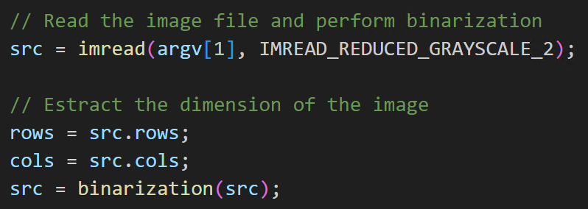
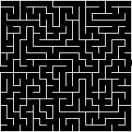
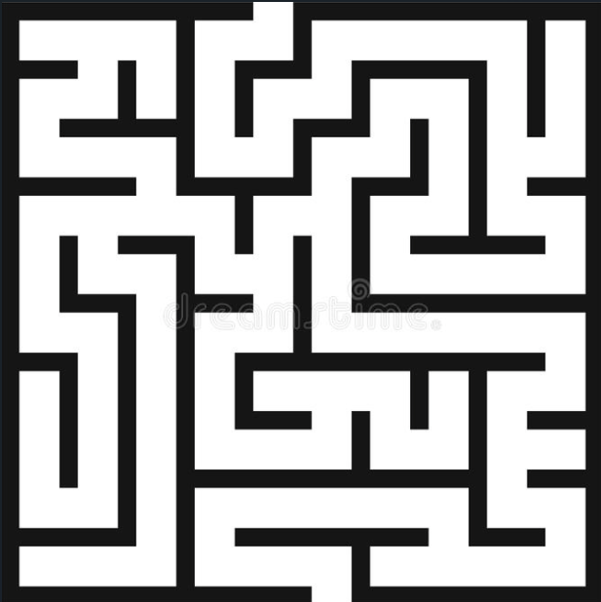
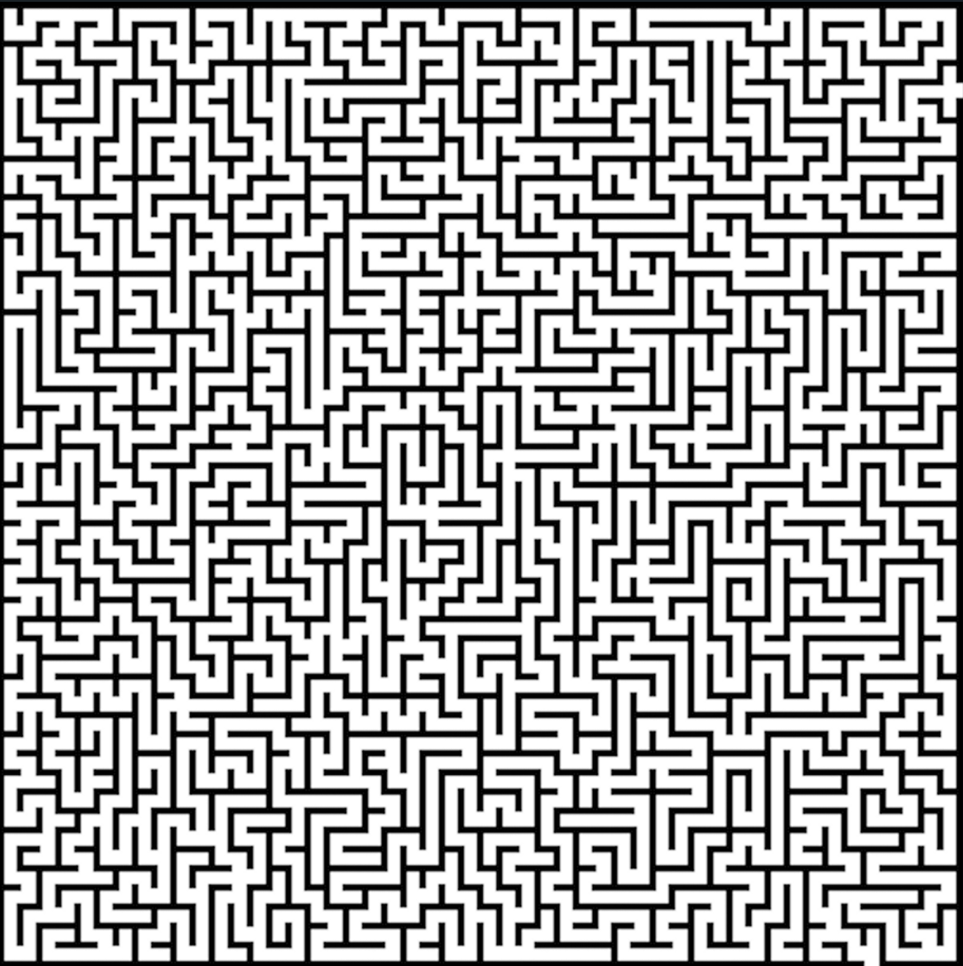
Image Analysis
We load the maze image, which will serve as the foundation for applying various transformations to unveil its structure and find a solution.
Binarization is our initial step, a crucial process in which we convert the grayscale image into a binary form, distinguishing between light and dark areas.
Examples:
Test3.png
Test8.png
Test8000.png

Slide 4
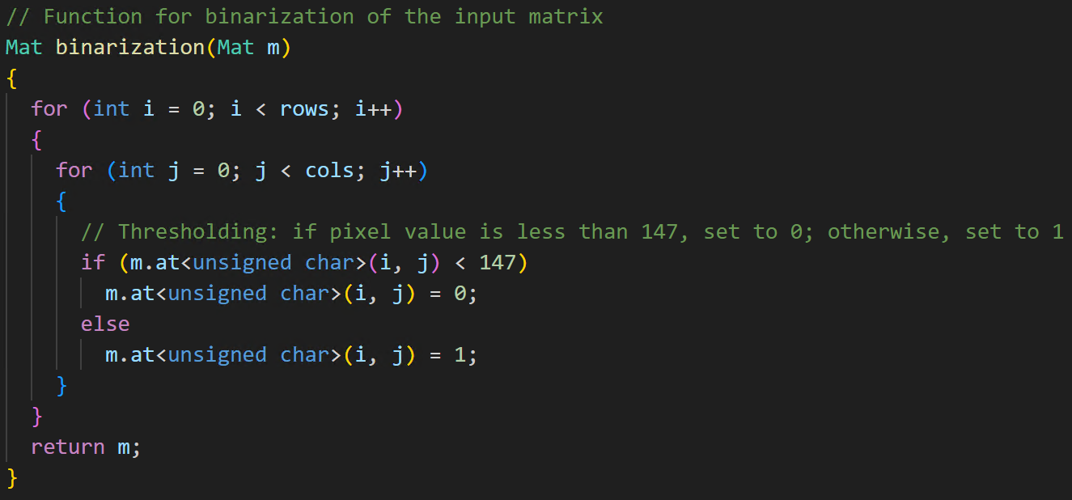
Image Binarization
The `binarization` function converts the input image (`m`) into a binary image, assigning:
The value 0 to pixels with intensity less than 147
The value 1 to pixels with intensity greater than or equal to 147.

Slide 5
Morphological Operations
In the program, we implement crucial morphological operations to analyze the maze.
What morphological operations do we use?
We use the morphological operations of erosion and dilation.
These operations are essential for manipulating the shape of elements in the maze.
Erosion reduces the size of objects, while dilation enlarges them.
In our context, these operations are used to obtain a clearer representation of the maze, simplifying the identification of paths and free regions.

Slide 6
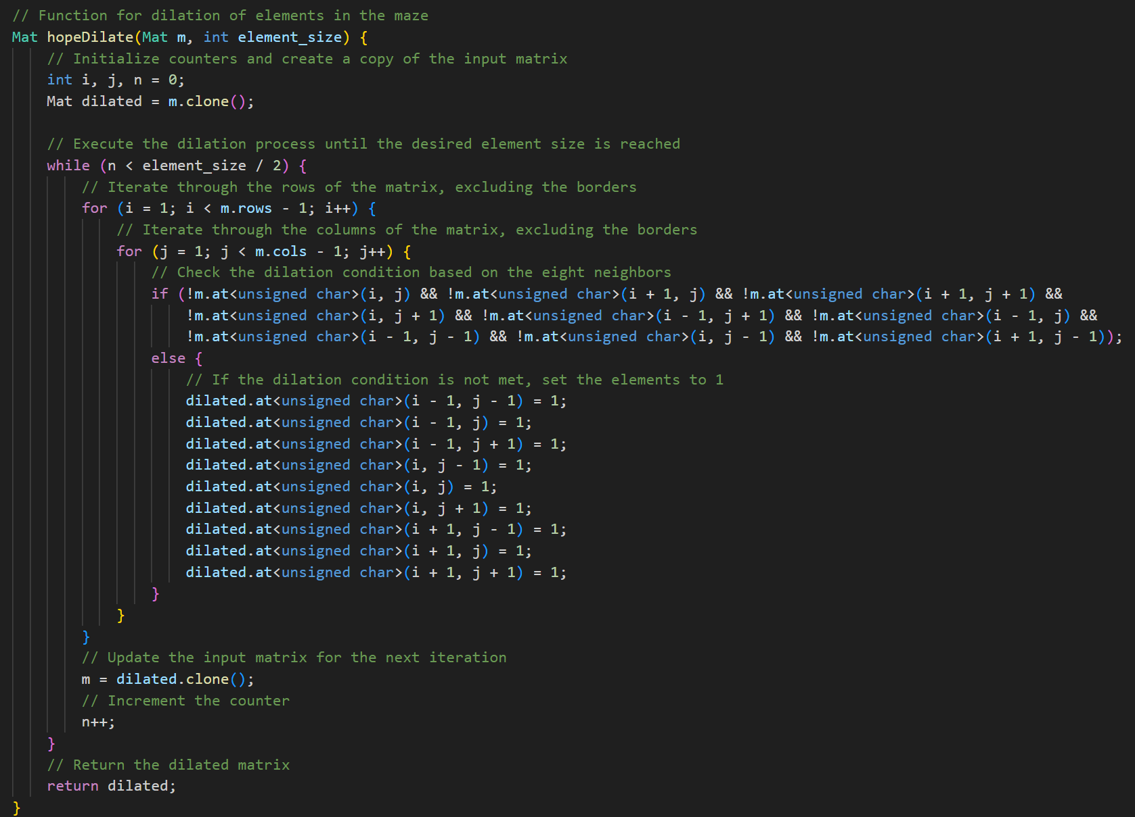
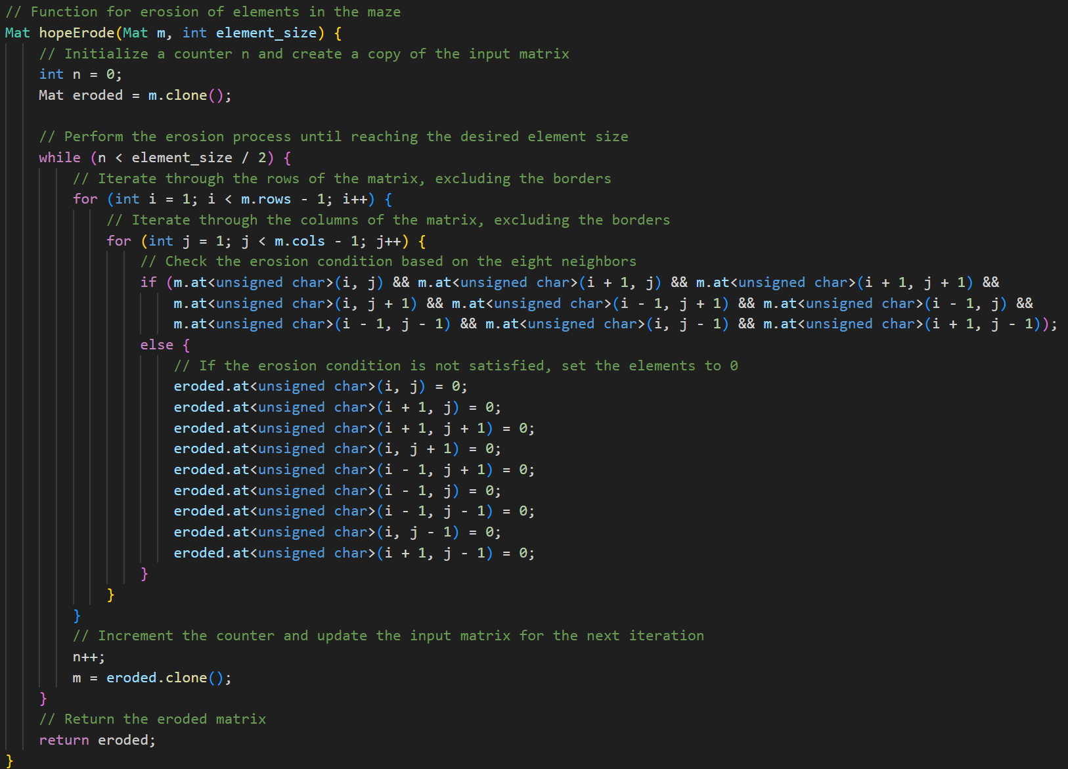
Morphological Operations

Slide 7
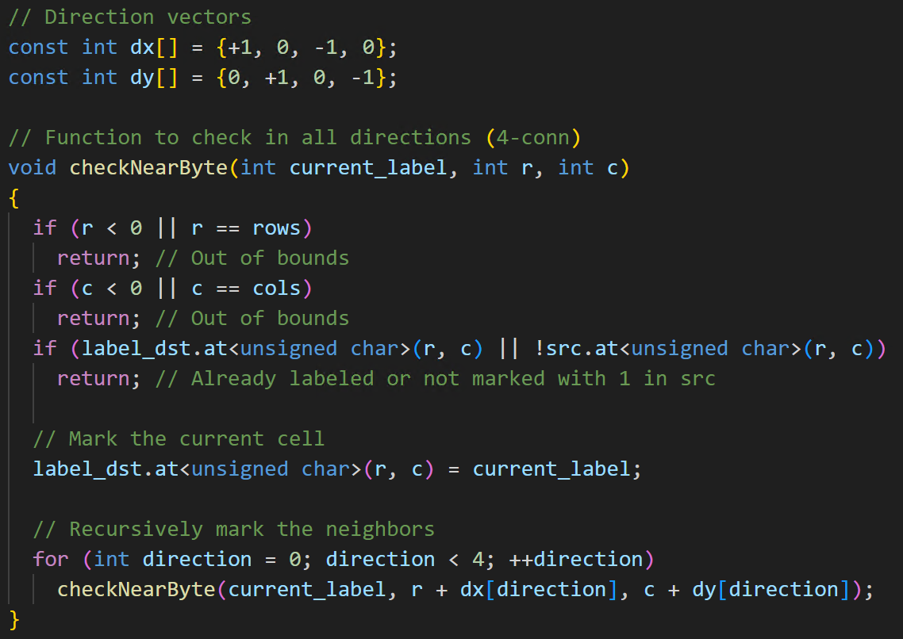
Identification of Regions and Paths in the Maze
This is done by implementing the checkNearByte function
Each value of the matrix is compared with adjacent pixels (4- connectivity).
If the value of the two considered pixels is the same, then a certain label is associated to them, this label will be used until there is at least one adjacent pixel with the same value.
As soon as adjacent elements are different from the reference one in all directions, the label is incremented
a fase di identificazione delle regioni e dei percorsi nel labirinto è strettamente correlata al concetto di "Connected Components" (Componenti Connesse) che potresti aver studiato nel capitolo "Connected Components and Moments". Nel contesto dell'elaborazione delle immagini, le componenti connesse si riferiscono a regioni di pixel connessi tra loro che condividono una certa caratteristica, come essere parte di un percorso nel labirinto.
La funzione find_components nel codice svolge il ruolo di identificare e etichettare queste componenti connesse nel labirinto. Queste informazioni sono cruciali per comprendere la struttura del labirinto e sono spesso utilizzate in analisi più approfondite, come calcolare i momenti delle componenti connesse, che potrebbero essere utili in applicazioni avanzate di visione artificiale.

Slide 8
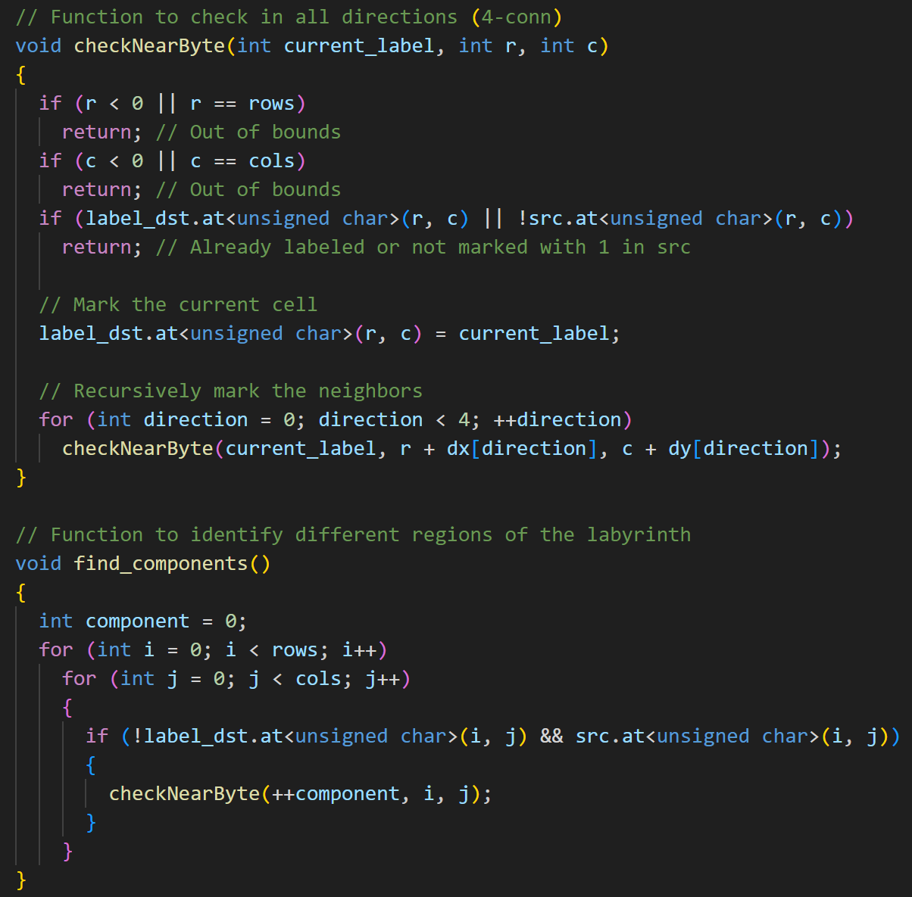
Identification of Regions and Paths in the Maze
The labeling algorithm is a key component of our program, as it allows for the identification and labeling of different regions in the maze.
This step is essential for distinguishing accessible paths.
The algorithm traverses the maze image, identifying connected regions and assigning them a unique label.
This information becomes crucial for the subsequent decision-making process, where we determine which paths to follow based on these regions.

Slide 9
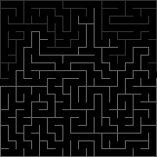
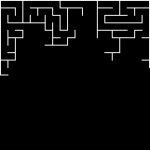
Identification of Regions and Paths in the Maze
After the labelization, the correct path will have the smaller label associated with it, so it is isolated from the rest of the maze

Slide 10
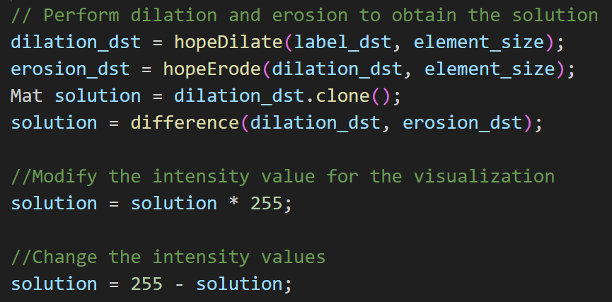
Computation Performance
The solution computation phase involves manipulating the dilated and eroded maps to determine the optimal path through the maze.
In “solution” we have the difference pixel per pixel between the dilation matrix and the erosion matrix.
Sostantially, it will isolate the crossable roads from the closed ones

Slide 11
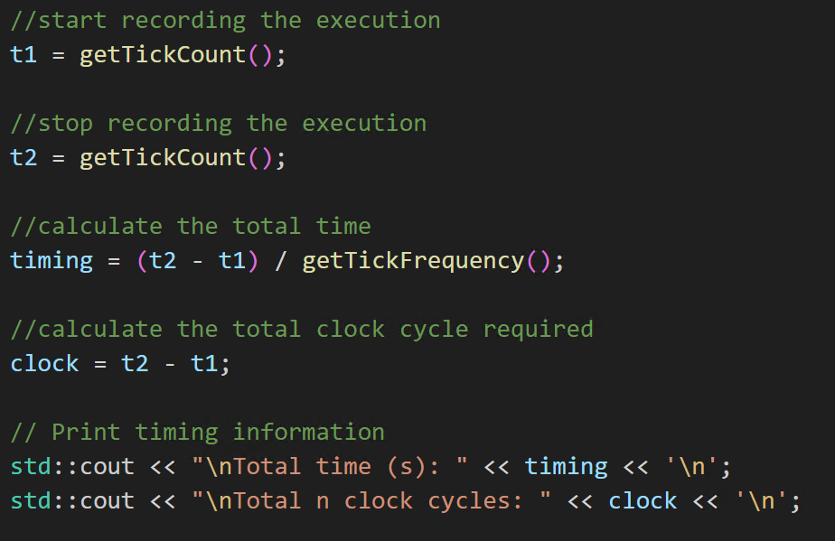
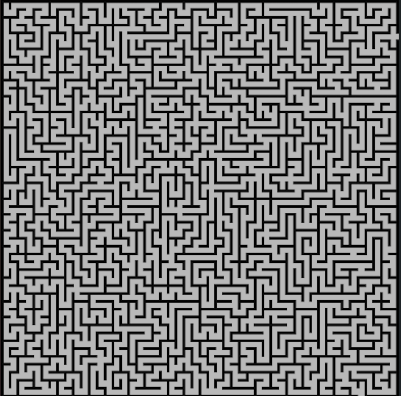
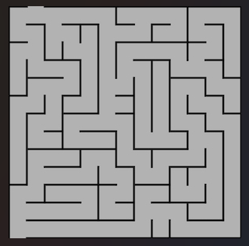


Evaluation Display and Save Output
After implementing morphological operations and calculating the maze solution, it is crucial to evaluate the program's performance.
In this section, we will review the code and explain how to measure and interpret performance.
Legend:
Total Time: Indicates the overall duration of the program from start to finish, expressed in seconds.
Clock Cycles: Represents the total number of clock cycles required to execute the program.
Examples:

Slide 12
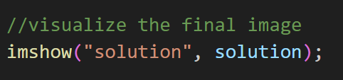


Evaluation Display and Save Output
This section is dedicated to the practical aspect of the program, specifically how the user can visualize and save the obtained result.
Here, the image of the solution obtained through morphological operations is modified for visualization. It is multiplied by 255 to ensure that the values are in the correct range and then inverted to improve readability.
This code snippet saves the solution image to a file named "escape_result.png." The output is thus preserved in a visual format that can be referred to at any time.

