Slide 1
Distributed Systems
Naming
Philippas Tsigas
Notes:
I am Olaf, one of the Assistant Prof. in Compute Science
Year master course

Slide 2

Names
“What's in a name? That which we call a rose by any other name would smell as sweet. ´´
William Shakespeare

Slide 3
Naming
Names are used to uniquely identify entities in Distributed Systems
  Entities may be processes, remote objects, newsgroups, …
Names are mapped to an entity’s location using a name resolution
An example of name resolution
Name
http://www.cdk5.net:8888/WebExamples/earth.html
DNS Lookup
Resource ID (IP Address, Port, File Path)
55.55.55.55
8888
WebExamples/earth.html
MAC address
Host
02:60:8c:02:b0:5a

Slide 4
Importance of Naming
Resource Identification and Access:
Names allow easy identification and access to resources without needing to know their actual physical addresses.
Location Transparency:
Enables access to resources without knowledge of their physical location, promoting flexibility and scalability.
Consistency and Reliability:
Ensures consistent naming across nodes for reliable communication and resource access.
Security and Authorization:
Supports security measures by controlling access, ensuring only authorized entities access resources.
Efficiency and Scalability:
Proper naming enhances system efficiency by simplifying name resolution and supports scalability by accommodating growth without degrading performance

Slide 5
Names, Addresses and Identifiers
An entity can be identified by three types of references
  Name
    A name is a set of bits or characters that references an entity
    Names can be human-friendly (or not)
  Address
    Every entity resides on an access point, and access point has an address
    Addresses may be location-dependent (or not)
    e.g., IP Address + port
  Identifier
    Identifiers are names that uniquely identify an entity
    A true identifier is a name with following properties:
      An identifier refers to at-most one entity
      Each entity is referred to by at-most one identifier
      An identifier always refers to the same entity (i.e. it is never reused)

Slide 6
Types of name
Human-Friendly Names
Designed for ease of use by humans.
Examples: URLs (www.example.com), email addresses.
High-level abstraction; not tied to physical locations.
Require resolution to convert to machine-friendly addresses.
2. Machine-Friendly Names
Intended for system-level communication.
Examples: IP addresses, MAC addresses, UUIDs.
Efficient for machine processing; may contain location information.
Can act as both addresses and true identifiers.

Slide 7
Types of name
3. Logical Names
Abstract references independent of physical location.
Examples: Service names, user identifiers.
Provide flexibility; not location-dependent.
Need resolution to map to physical or machine addresses.
4. Physical Names
Intended for system-level communication.
Examples: IP addresses which indicate a device's location on a
network, and physical memory addresses, which indicate a specific
location in a computer's memory. Efficient for machine processing;
may contain location information.

Slide 8
Key Concept
Name:
A string or identifier that uniquely identifies an entity within a namespace.
  Can be human-readable (e.g., URLs, email addresses) or machine-readable (e.g., IP addresses).
Namespace:
A context or domain where a set of names is defined, along with rules for syntax and semantics.
  Examples: DNS namespace maps domain names to IP addresses; file system namespaces map file names to file descriptors.
Name Resolution:
The process of translating a name into its corresponding address or another name.
  Often involves querying a naming service or directory.
Binding:
The association between a name and an entity.
  Can be static (fixed association) or dynamic (association can change over time).
Aliases and Redirection:
Multiple names (aliases) can refer to a single entity.
  Redirection occurs when one name points to another, useful for load balancing or service migration.

Slide 9
Naming Systems
A naming system is simply a middleware that assists in name resolution
Naming systems are classified into three classes based on the type of names used:
  Flat naming
  Structured naming
  Attribute-based naming

Slide 10
Classes of Naming
Flat naming
Structured naming
Attribute-based naming

Slide 11
Flat Naming
In Flat Naming, identifiers are simply random bits of strings (known as unstructured or flat names)
Flat name does not contain any information on how to locate an entity
We will study four types of name resolution mechanisms for flat names:
  Broadcasting
  Forwarding pointers
  Home-based approaches
  Distributed Hash Tables

Slide 12


1. Broadcasting
Approach: Broadcast the identifier to the complete network. The entity associated with the identifier responds with its current address
Example: Address Resolution Protocol (ARP)
  Resolve an IP address to a MAC address.
  In this application,
    IP address is the identifier of the entity
    MAC address is the address of the
    access point
Challenges:
  Not scalable in large networks
    This technique leads to flooding the network with broadcast messages
  Requires all entities to listen to all requests
Who has the identifier 192.168.0.1?
x
x
I am 192.168.0.1. My address is 02:AB:4A:3C:59:85

Slide 13

2. Forwarding Pointers
  Forwarding Pointers enables locating mobile entities
    Mobile entities move from one access point to another
When an entity moves from location A to location B, it leaves behind (in A) a reference to its new location at B
Name resolution mechanism
  Follow the chain of pointers to reach the entity
  Update the entity’s reference when the present location is found
Challenges:
  Reference to at-least one pointer is necessary
  Long chains lead to longer resolution delays
  Long chains are prone to failure due to
  broken links

Slide 14
Forwarding Pointers – An Example
Stub-Scion Pair (SSP) chains implement remote invocation for mobile entities using forwarding pointers
  Server stub is referred to as Scion in the original paper
Each forwarding pointer is implemented as a pair:
(client stub, server stub)
  The server stub contains a local reference to the actual object or a local reference to the remote client stub
When object moves from A to B,
  It leaves client stub in its place
  It installs server stub that refers to the new remote client stub on B
Process P1
Process P2
Process P3
Process P4
= Process n;
= Remote Object;
= Caller Object;
= Client stub;
= Server stub
n

Slide 15
3. Home-based approaches
Each entity is assigned a home node
  Home node is typically static (has fixed access point and address)
  Home node keeps track of current address of the entity
Entity-home interaction:
  Entity’s home address is registered at a naming service
  Entity updates the home about its current address (foreign address) whenever it moves
Name resolution
  Client contacts the home to obtain the foreign address
  Client then contacts the entity at the foreign location

Slide 16



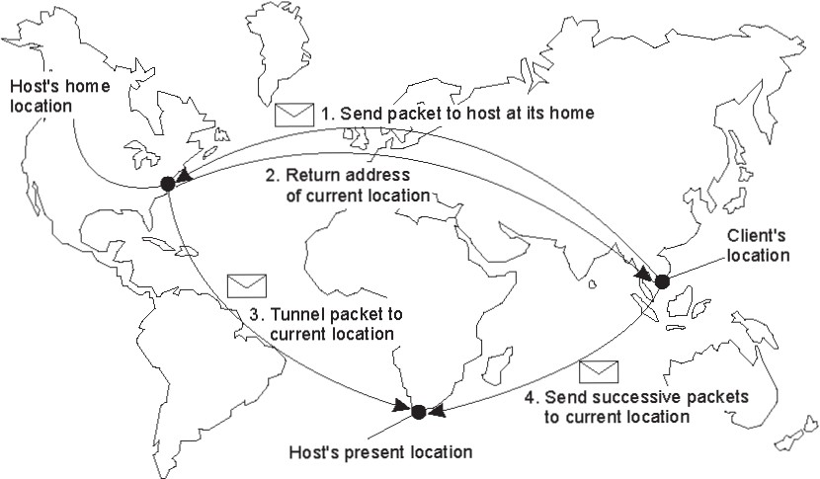
3. Home-based approaches – An example
Example: Mobile-IP
1. Update home node about the foreign address
Mobile entity
Home node
3a. Home node forwards the message to the foreign address of the mobile entity
2. Client sends the packet to the mobile entity at its home node
3b. Home node replies the client with the current IP address of the mobile entity
4. Client directly sends all subsequent packets directly to the foreign address of the mobile entity

Slide 17

3. Home-based approaches – Challenges
Home address is permanent for an entity’s lifetime
  If the entity permanently moves, then a simple home-based approach incurs higher communication overhead
Connection set-up overheads due to communication between the client and home can be excessive
  Consider the scenario where the clients are nearer to the mobile entity than the home entity

Slide 18
4. Distributed Hash Table (DHT)
DHT is a class of decentralized distributed system that provides a lookup service similar to a hash table
  (key, value) pair is stored in the nodes participating in the DHT
  The responsibility for maintaining the mapping from keys to values is distributed among the nodes
  Any participating node can retrieve the value for a given key
We will study a representative DHT known as Chord
DATA
KEY
DISTRIBUTED NETWORK
Pink Panther
Hash function
ASDFADFAD
Participating Nodes
cs.qatar.cmu.edu
Hash function
DGRAFEWRH
86.56.87.93
Hash function
4PINL3LK4DF

Slide 19
Chord
Chord assigns an m-bit identifier key (randomly chosen) to each node
  Each node can be contacted through its network address
Chord also maps each entity to an m-bit identifier key
  Entities can be processes, files, etc.
Mapping of entities to nodes
  Each node is responsible for a set of entities
  An entity with key k falls under the jurisdiction of the node with smallest identifier id >= k. This node is known as the successor of k, and is denoted by succ(k)
Entity with id k
Node n (node with id=n)
000
003
Node 000
004
008
Node 005
040
079
Node 010
540
Node 301
Match each entity with key k with node succ(k)

Slide 20
A Naïve Key Resolution Algorithm
The main issue in DHT-based solution is to efficiently resolve a key k to the network location of succ(k)
  Given an entity with key k on node n, how to find the node succ(k)?
19
All nodes are arranged in a logical ring according to their keys
Each node ‘p’ keeps track of its immediate neighbors: succ(p) and pred(p)
If node ‘n’ receives a request to resolve key ‘k’:
  If pred(p) < k <=p, node will handle it
  Else it will simply forward it to succ(n) or pred(n)
00
01
02
03
04
05
06
07
08
09
10
11
12
13
14
15
16
17
18
19
20
21
22
23
24
25
26
27
28
29
30
31
Solution is not scalable:
As the network grows, forwarding delays increase
  Key resolution has a time complexity of O(n)
n
= Active node with id=n
p
= No node assigned to key p

Slide 21
Key Resolution in Chord
1 | 04
2 | 04
3 | 09
4 | 09
5 | 18
  succ(p + 2^{(i-1)})
i
Chord improves key resolution by reducing the time complexity to O(log n)
All nodes are arranged in a logical ring according to their keys
Each node ‘p’ keeps a table FT_{p} of at-most m entries. This table is called Finger Table
  FT_{p}[i] = succ(p + 2^{(i-1)})
  NOTE: FT_{p}[i] increases exponentially
If node ‘n’ receives a request to resolve key ‘k’:
  Node p will forward it to node q with index j in F_{p} where
  q = FT_{p}[j] <= k < FT_{p}[j+1]
    If k > FT_{p}[m], then node p will forward it to FT_{p}[m]
1 | 01
2 | 01
3 | 01
4 | 04
5 | 14
1 | 09
2 | 09
3 | 09
4 | 14
5 | 20
00
01
02
03
04
05
06
07
08
09
10
11
12
13
14
15
16
17
18
19
20
21
22
23
24
25
26
27
28
29
30
31
26
1 | 11
2 | 11
3 | 14
4 | 18
5 | 28
1 | 28
2 | 28
3 | 28
4 | 01
5 | 09
1 | 14
2 | 14
3 | 18
4 | 20
5 | 28
1 | 21
2 | 28
3 | 28
4 | 28
5 | 04
1 | 20
2 | 20
3 | 28
4 | 28
5 | 04
1 | 18
2 | 18
3 | 18
4 | 28
5 | 01

Slide 22
Chord – Join and Leave Protocol
In large Distributed Systems, nodes dynamically join and leave (voluntarily or due to failure)
If a node p that wants to join:
  Node p contacts arbitrary node, looks up for succ(p+1), and inserts itself into the ring
If node p wants to leave
  Node p contacts pred(p), and updates it
00
01
02
03
04
05
06
07
08
09
10
11
12
13
14
15
16
17
18
19
20
21
22
23
24
25
26
27
28
29
30
31
Who is succ(2+1) ?
Succ(2+1) = 04
Who is succ(2+1) ?
02
Node 4 is succ(2+1)
Who is succ(2+1) ?

Slide 23
Chord – Finger Table Update Protocol
For any node q, FT_{q}[1] should be up-to-date
  It refers to the next node in the ring
  Protocol:
    Periodically, request succ(q+1) to return pred(succ(q+1))
    If q = pred(succ(q+1)), then information is up-to-date
    Otherwise, a new node p has been added to the ring such that q < p < succ(q+1)
      FT_{q}[1] = p
      Request p to update pred(p) = q
    Similarly, node q updates each entry i by finding succ(p + 2^{(i-1)})

Slide 24
Exploiting Network Proximity in Chord
The logical organization of nodes in the overlay network may lead to inefficient message transfers in the underlying Internet
  Node k and node succ(k +1) may be far apart
Chord can be optimized by considering the network location of nodes
  Topology-aware Node Assignment
    Two nearby nodes have identifiers that are close to each other
  Proximity Routing
    Each node q maintains ‘r’ successors for i^{th} entry in the finger table
    FT_{q}[i] now refers to successors first r nodes in the range
      [p + 2^{(i-1)}, p + 2^{i} -1]
    To forward the lookup request, pick one of the r successors closest to the node q

Slide 25
Classes of Naming
Flat naming
Structured naming
Attribute-based naming

Slide 26
Structured Naming
Structured Names are composed of simple human-readable names
  Names are arranged in a specific structure
Examples
  File-systems utilize structured names to identify files
    /home/userid/work/dist-systems/naming.txt
  Websites can be accessed through structured names
    www.cse.chalmers.se

Slide 27
Name Spaces
Structured Names are organized into name spaces
Name-spaces is a directed graph consisting of:
  Leaf nodes
    Each leaf node represents an entity
    Leaf node generally stores the address of an entity (e.g., in DNS), or the state of an entity (e.g., in file system)
  Directory nodes
    Directory node refers to other leaf or directory nodes
    Each outgoing edge is represented by (edge label, node identifier)
Each node can store any type of data
  e.g., type of the entity, address of the entity

Slide 28
Example Name Space
Looking up for the entity with name “/home/steen/mbox”
Data stored in n1
n0
keys
n2: “elke”
n3: “max”
n4: “steen”
home
n1
n5
“/keys”
elke
steen
max
n2
n3
n4
Leaf node
twmrc
mbox
Directory node

Slide 29
Name Resolution
The process of looking up a name is called Name Resolution
Closure mechanism
  Name resolution cannot be accomplished without an initial directory node
  Closure mechanism selects the implicit context from which to start name resolution
  Examples
    www.qatar.cmu.edu: start at the DNS Server
    /home/steen/mbox: start at the root of the file-system

Slide 30
Name Linking
Name space can be effectively used to link two different entities
Two types of links can exist between the nodes
  Hard Links
  Symbolic Links

Slide 31
1. Hard Links
    There is a directed link from the hard link to the actual node
    Name Resolution
      Similar to the general name resolution
Constraint:
  There should be no cycles in the graph
“/home/steen/keys” is a hard link to “/keys”
n0
home
keys
n1
n5
“/keys”
elke
steen
max
keys
n2
n3
n4
twmrc
mbox

Slide 32
2. Symbolic Links
    Symbolic link stores the name of the original node as data
    Name Resolution for a symbolic link SL
  First resolve SL’s name
  Read the content of SL
  Name resolution continues
  with content of SL
Constraint:
  No cyclic references should be present
“/home/steen/keys” is a symbolic link to “/keys”
n0
home
keys
n1
n5
“/keys”
elke
steen
max
n2
n3
n4
keys
twmrc
mbox
n6
Data stored in n6
“/keys”

Slide 33
Mounting of Name Spaces
Two or more name spaces can be merged transparently by a technique known as mounting
In mounting, a directory node in one name space will store the identifier of the directory node of another name space
Network File System (NFS) is an example where different name spaces are mounted
  NFS enables transparent access to remote files

Slide 34
Example of Mounting
Name Spaces in NFS
Machine A
Machine B
Name Server for
foreign name space
Name Space 1
Name Space 2
remote
home
vu
steen
“nfs://flits.cs.vu.nl/home/steen”
mbox
OS
OS
Name resolution for “/remote/vu/home/steen/mbox” in a distributed file system

Slide 35
Distributed Name Spaces
In large Distributed Systems, it is essential to distribute name spaces over multiple name servers
  Distribute nodes of the naming graph
  Distribute name space management
  Distribute name resolution mechanisms

Slide 36
Layers in Distributed Name Spaces
Distributed Name Spaces can be divided into three layers
Global
Layer
Consists of high-level directory nodes
Administrational Layer
Contains mid-level directory nodes
Managerial Layer
Contains low-level directory nodes within a single administration
The main issue is to efficiently map directory nodes to local name servers
Directory nodes are jointly managed by different administrations
Directory nodes grouped together in such a way that each group is managed by an administration

Slide 37
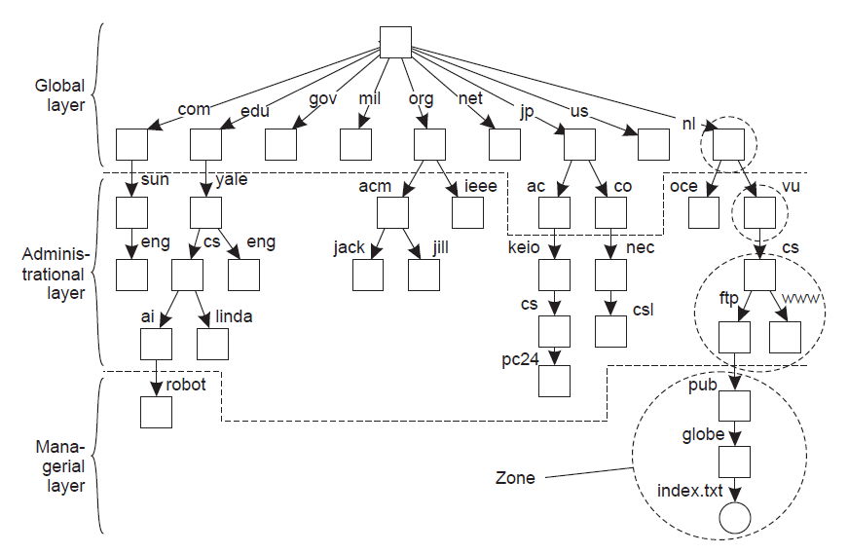
Distributed Name Spaces – An Example

Slide 38
Comparison of Name Servers at Different Layers
 | Global | Administrational | Managerial
Geographical scale of the network
Total number of nodes
Number of replicas
Update propagation
Is client side caching applied?
Responsiveness to lookups
Worldwide
Organization
Department
Few
Many
Vast numbers
Many
None or few
None
Lazy
Immediate
Immediate
Yes
Yes
Sometimes
Seconds
Milliseconds
Immediate

Slide 39
Distributed Name Resolution
Distributed Name Resolution is responsible for mapping names to address in a system where:
  Name servers are distributed among participating nodes
  Each name server has a local name resolver
We will study two distributed name resolution algorithms:
  Iterative Name Resolution
  Recursive Name Resolution

Slide 40
1. Iterative Name Resolution
Client hands over the complete name to root name server
Root name server resolves the name as far as it can, and returns the result to the client
  The root name server returns the address of the next-level name server (say, NLNS) if address is not completely resolved
Client passes the unresolved part of the name to the NLNS
NLNS resolves the name as far as it can, and returns the result to the client (and probably its next-level name server)
The process continues till the full name is resolved

Slide 41
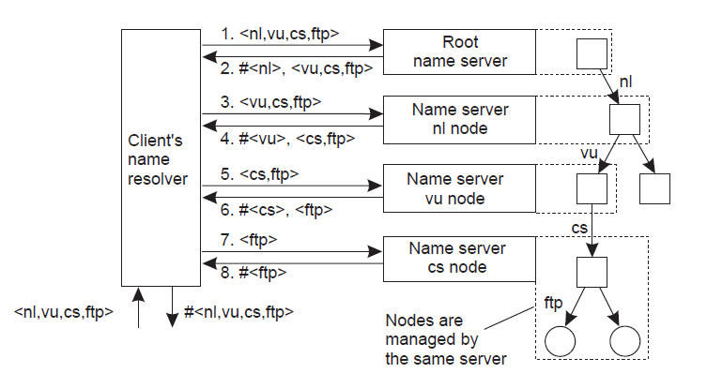
1. Iterative Name Resolution – An Example
<a,b,c> = structured name in a sequence
#<a> = address of node with name “a”
Resolving the name “ftp.cs.vu.nl”

Slide 42
2. Recursive Name Resolution
Approach
  Client provides the name to the root name server
  The root name server passes the result to the next name server it finds
  The process continues till the name is fully resolved
Drawback:
  Large overhead at name servers (especially, at the high-level name servers)

Slide 43
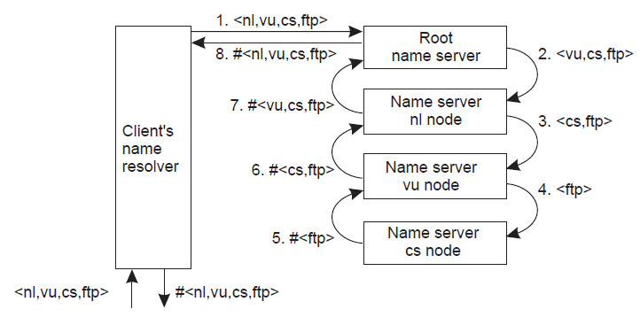
2. Recursive Name Resolution – An Example
<a,b,c> = structured name in a sequence
#<a> = address of node with name “a”
Resolving the name “ftp.cs.vu.nl”

Slide 44
Classes of Naming
Flat naming
Structured naming
Attribute-based naming

Slide 45
Attribute-based Naming
In many cases, it is much more convenient to name, and look up entities by means of their attributes
  Similar to traditional directory services (e.g., yellow pages)
However, the lookup operations can be extremely expensive
  They require to match requested attribute values, against actual attribute values, which needs to inspect all entities
Solution: Implement basic directory service as database, and combine with traditional structured naming system
We will study Light-weight Directory Access Protocol (LDAP); an example system that uses attribute-based naming

Slide 46
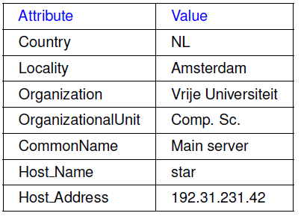
Light-weight Directory Access Protocol (LDAP)
LDAP Directory Service consists of a number of records called “directory entries”
  Each record is made of (attribute, value) pair
  LDAP Standard specifies five attributes for each record
Directory Information Base (DIB) is a collection of all directory entries
  Each record in a DIB is unique
  Each record is represented by a
  distinguished name
  e.g., /C=NL/O=Vrije Universiteit/OU=Comp. Sc.

Slide 47
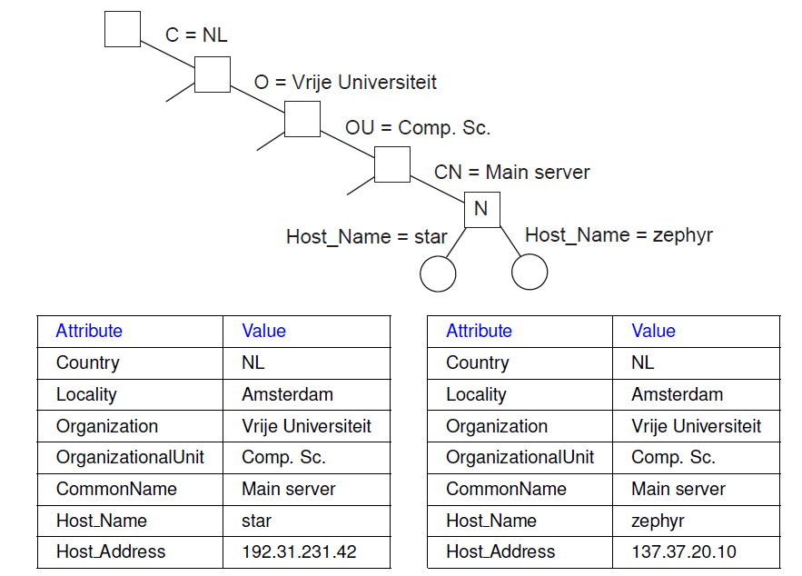
Directory Information Tree in LDAP
All the records in the DIB can be organized into a hierarchical tree called Directory Information Tree (DIT)
LDAP provides advanced search mechanisms based on attributes by traversing the DIT
Example syntax for searching all Main_Servers in Vrije Universiteit:
search("&(C = NL) (O = Vrije Universiteit) (OU = *) (CN = Main server)")

Slide 48
Summary
Naming and name resolutions enable accessing entities in a Distributed System
Three types of naming
  Flat Naming
    Home-based approaches, Distributed Hash Table
  Structured Naming
    Organizes names into Name Spaces
    Distributed Name Spaces
  Attribute-based Naming
    Entities are looked up using their attributes

Slide 49
Questions?

Slide 50
Based on slides from
  Majd F. Sakr, Vinay Kolar, Mohammad Hammoud from CMU QATAR

