Slide 1
DISTRIBUTED SYSTEMS
Principles and Paradigms
Chapter 9
Security
IN Ezeji

Slide 2
Chapter Outline
Introduction to security
Secure Channels
Access Control

Slide 3
Introduction to security
Security in Distributed Systems can be roughly divided into two parts:
  Secure Channels
    This deals with the communication between users and processes
    This entails authentication of users, message integrity, and confidentiality
  Authorisation
    Authorisation deals with ensuring that processes get access to only those resources they are entitled to.
    It is also loosely referred to access control
Secure channel and access control requires mechanisms to distribute cryptographic keys, and adding and removing users form systems
These issues are addressed by what is known as Security Management

Slide 4
Security Threats
One way of looking at security in DS is to view it from the point of protecting the services and data it offers against security threats.
Types of security threats to consider:
  Interception
    An unauthorized party gains access to a service or data
  Interruption
    is a situation in which services/data become unavailable, unusable or destroyed
  Modification
    Unauthorized tampering with the data/services so that it no longer adheres to its original specification
  Fabrication
    Is when additional data/activity will be generated that would normally not exist

Slide 5
Dependability
A dependable system provides availability, reliability, safety, maintainability, confidentiality, and integrity.
  Confidentiality
    refers to the property that information is disclosed only to authorized parties.
  Integrity
    alterations to a system’s assets can be made only in an authorized way, ensuring accuracy and completeness.
  Availability
    Services are usable when needed
MAP to threats
  Interception → confidentiality,
  Modification/fabrication → integrity,
  Interruption → availability.

Slide 6
Security policy
Simply getting what security threats exist is not enough to build a secure system;
A description of the security requirement is needed. A specification of the security requirements is known as the security policy;
A security policy describes precisely which actions the entities in a system are allowed to take and which ones are prohibited
A security policy specifies who may perform which actions on which resources, under what conditions, and what must be audited.
To enforce a security policy, a security mechanisms is required

Slide 7
Key Point
Online Exam System
Exam Access By Student
Policy = who / action / resource / conditions / audit
Policy example: “Only enrolled students may start and submit Exam X within the scheduled window from an approved device and location, with at most one active session; all attempts and submissions must be logged with user, device ID, IP, times, and upload hashes.
Publishing Marks?
Immediate Mark viewing?

Slide 8
Security Mechanisms
Following are some important security mechanisms:
  Encryption
    Transforms the data into a form the attacker can not understand
    It also helps to check whether data has been modified
  Authentication
    Used to verify the claimed identity of the user, client, server, host or any other entity
  Authorisation
    Checks whether the client is authorised to perform the action requested
  Monitoring and Auditing
    Used to trace which clients accessed what and in which way.

Slide 9
Authentication
Verifying the claimed identity of a person, a software component, a device, and so on.
Means of authentication
  Based on what a client knows, such as a password or a personal identification number.
  Based on what a client has, such as an ID card, cell phone, or software token.
  Based on what a client is, i.e., static biometrics such as a fingerprint or facial characteristics.
  Based on what a client does, i.e., dynamic biometrics such as voice patterns or typing patterns.
  Based on Location, Examples: IP addresses or geographical location data, though this is less reliable for direct authentication.

Slide 10
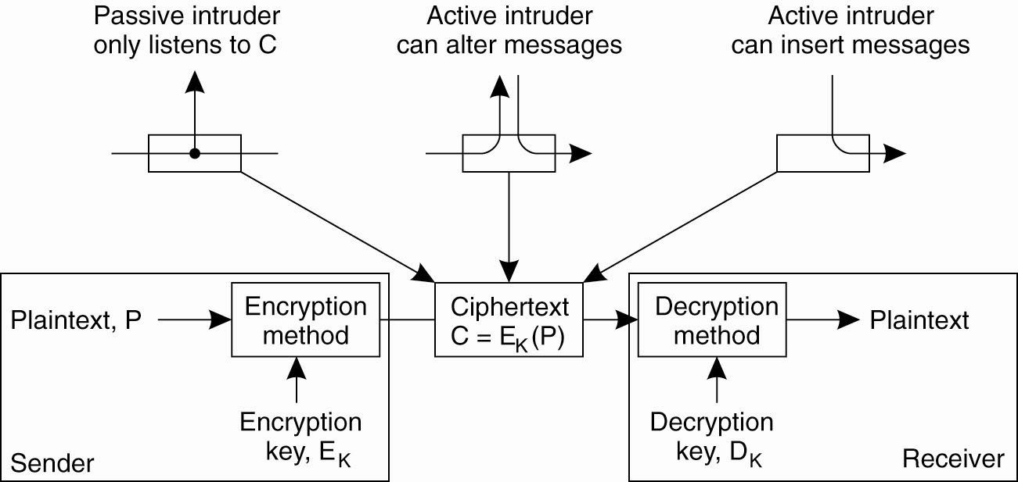
Cryptography (1)
Intruders and eavesdroppers in communication.

Slide 11
Cryptography(2)
In cryptography the aim is protection against the following 3 attacks:
  Message interception
    Without a proper key the intruder will see only unintelligable data
  Message modification
    Without first decrypting the message the intruder cannot meaningfully modify the message
  Insertion of encrypted message
    If an intruder cannot meaningfully modify the message he also cannot meanigfully insert messages

Slide 12
Cryptography (3)
There are two different types of Cryptography
  Symmetric Cryptography
    The same key is used to encrypt and decrypt a message
  Asymmetric Cryptography (Public-key systems)
    Separate keys are used for encryption and decryption
    The following notation is used:
      K⁺_{A}: public key belonging to A
      K⁻_{A}: private key belonging to A

Slide 13
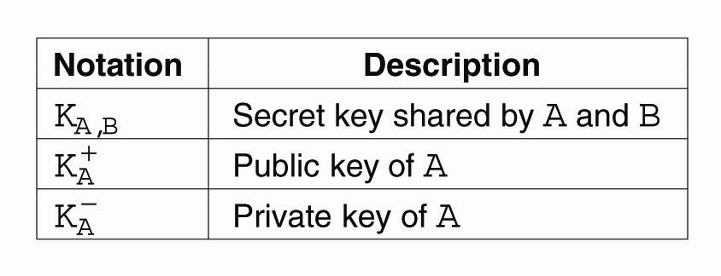
Cryptography (4)
Notation used in this chapter.

Slide 14
Chapter Outline
Introduction to security
Secure Channels
Access Control

Slide 15
Secure Channels
Concentrate on the following two issues:
  Authentication
  Message Integrity and Confidentiality
Authentication and message integrity cannot do without each other;
Before two parties can communicate a channel is first established through authentication
After authentication data integrity and confidentiality come into play. They are achieved through the use of session keys;
A session key is a shared (secret) key that is used to encrypt messages for a given session;
A session key is only valid as long as the channel exists

Slide 16
Authentication
Authentication Based on a Shared Secret Key
Authentication using a Key Distribution Center
Authentication using Public-Key Cryptography

Slide 17
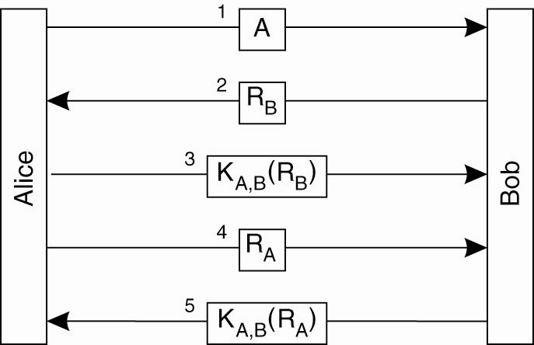
Authentication Based on a Shared Secret Key (1)
Authentication based on a shared secret key: Challenge-response protocol

Slide 18
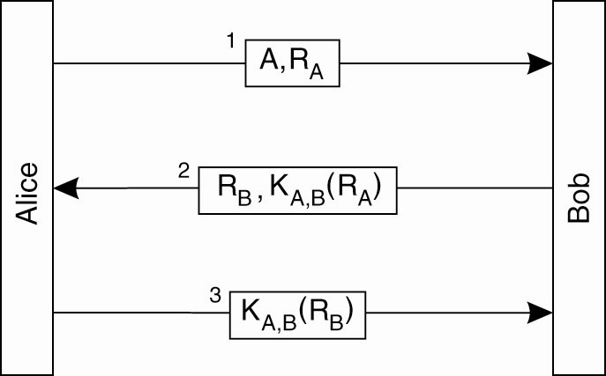
Authentication Based on a Shared Secret Key (2)
Authentication based on a shared
secret key, but using three instead of five messages.

Slide 19
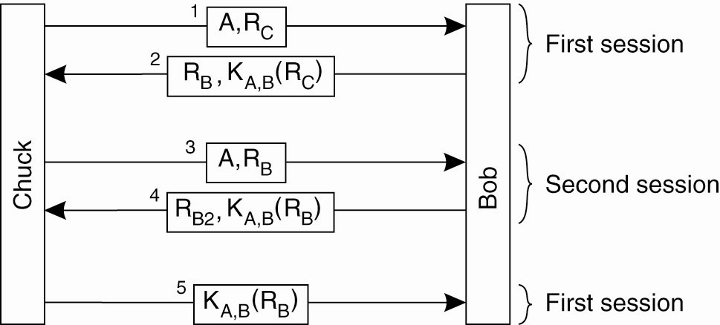
Authentication Based on a Shared Secret Key (3)
The reflection attack: Chuck wants Bob to think he is Alice, so he starts up a second session to trick Bob.

Slide 20
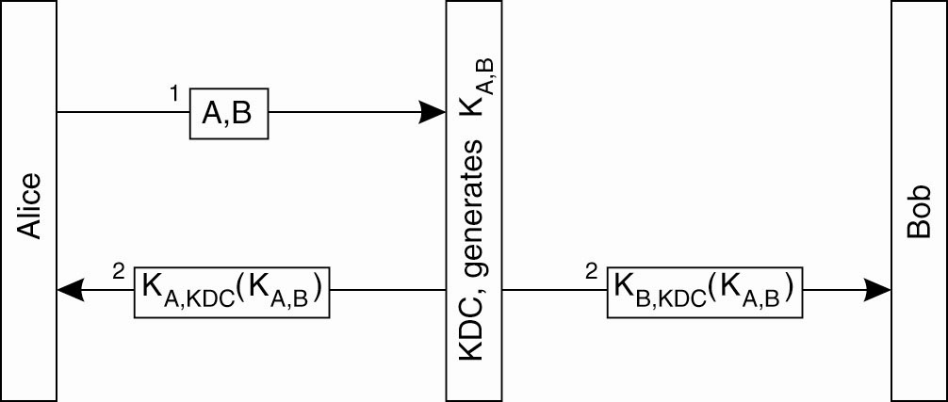
Authentication Using a Key Distribution Center (1)
The principle of using a KDC.
The main challenge with this protocol is Alice may want to start setting up a secure channel with Bob even before Bob had received the shared key from the KDC.
One solution to this problem is to let Alice make a connection to Bob by herself

Slide 21
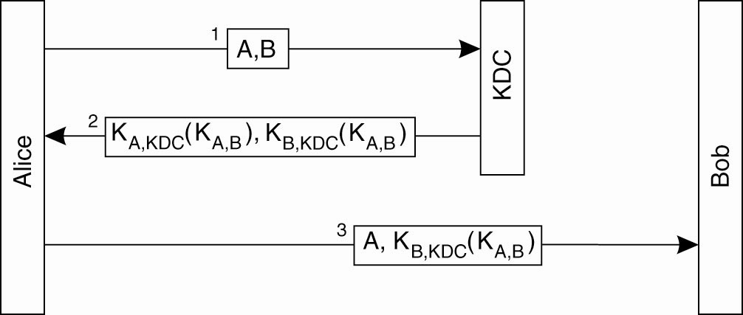
Authentication Using a Key Distribution Center (2)
Using a ticket and letting Alice set up a connection to Bob.
This protocol is a variant to the well-known example of an authentication protocol using KDC, the Needham-Schroeder authentication protocol.

Slide 22
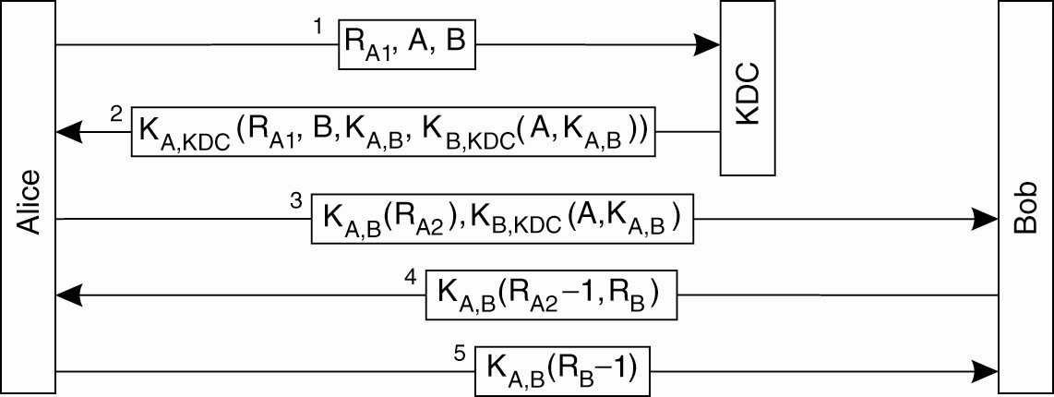
Authentication Using a Key Distribution Center (3)
The Needham-Schroeder authentication protocol.
The concept of a nonce is introduced to uniquely relate request and response messages to each other
Messages 1 and 2 are protected, but an intruder can replay message 3 and get Bob to think he communicating with Alice

Slide 23
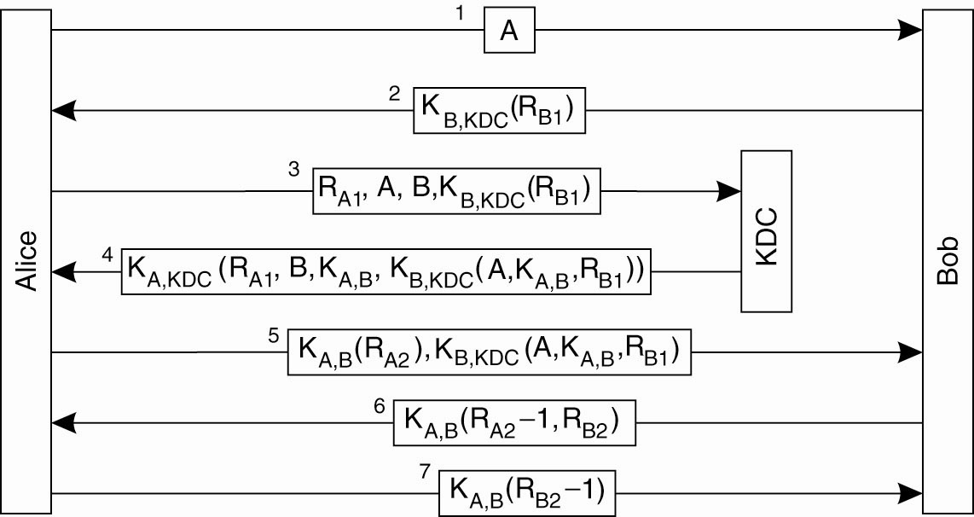
Authentication Using a Key Distribution Center (4)
Protection against malicious reuse of a previously generated key in the Needham-Schroeder protocol.

Slide 24
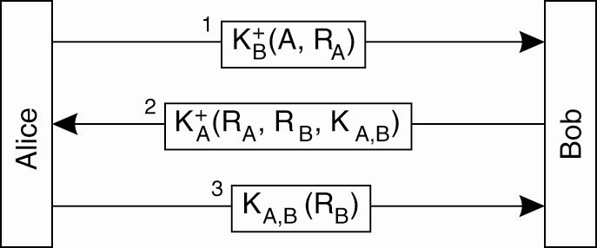
Authentication Using Public Key Cryptography
Mutual authentication in a public-key cryptosystem.

Slide 25
Message Integrity and Confidentiality
Besides authentication a secure channel should also provide guarantees for message integrity and confidentiality
Confidentiality is easily established through encryption
However, protecting messages against modifications is more complicated
Digital signatures are used to ensure integrity of messages exchanged
There are several ways of placing digital signatures on messages, which include:
  Public Key Cryptography
  Use of message digests
  Use of session keys

Slide 26
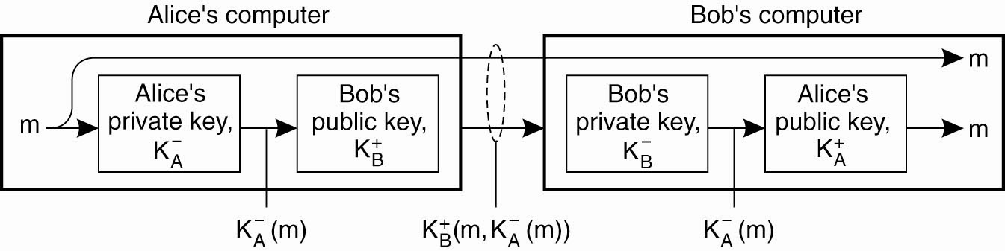
Digital Signatures (1)
Digitally signing a message using public-key cryptography.

Slide 27
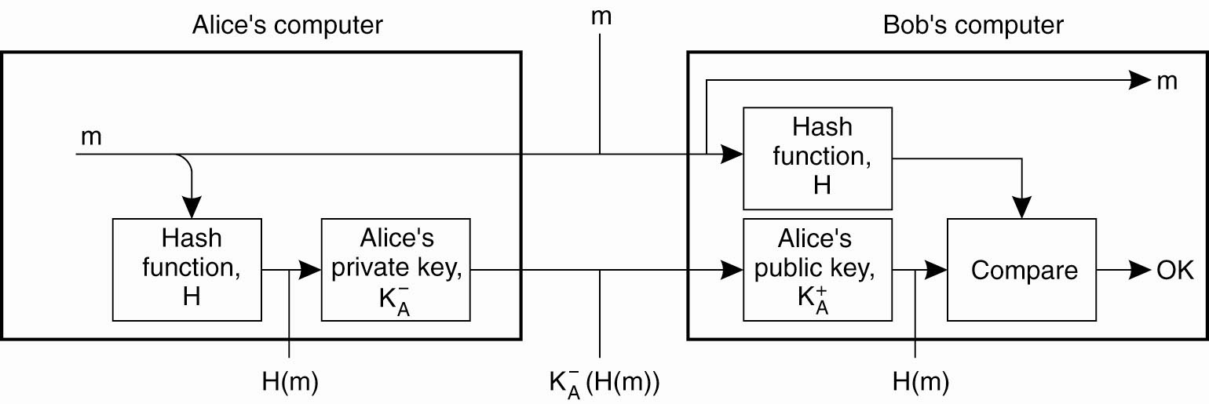
Digital Signatures (2)
Digitally signing a message using a message digest.

Slide 28
Session Keys
After the authentication phase the communicating parties generally use a unique shared session key for confidentiality
The session key is safely discarded when the channel is no longer in use.
An alternative to session keys is to use the key allocated during authentication, but the use of session keys has a lot of important advantages:
  When a key is used often it becomes easier to reveal it.
  Provides protection against replay attacks
  If such a key is compromised damage is limited to only that session

Slide 29
Chapter Outline
Introduction to security
Secure Channels
Access Control

Slide 30
Access Control
Requests involve carrying operations on resources that are controlled by the server;
These operations can only be carried out if the client has sufficient access rights for invoking them;
Verifying access rights is referred as access control;
Granting these access rights in referred to as authorisation.

Slide 31
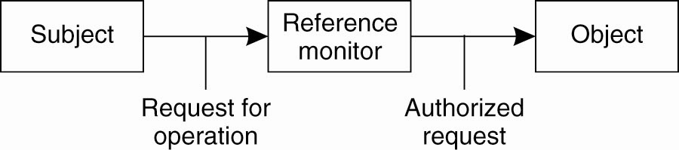
General Issues in Access Control
General model of controlling access to objects.
A reference monitor:
  records which subject may do what;
  decides whether a subject is allowed to invoke a specific operation.
  Is called each time an object is invoked
It is therefore important that the reference monitor be tamperproof

Slide 32
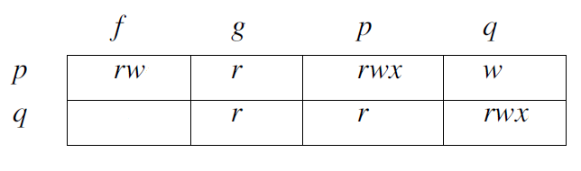
Access Control Matrix
Access Control Matrix is a common approach to modelling the access rights of subjects with respect to objects
It is not economical implement a big matrix with thousands of users and millions of objects
Many entries in the matrix will be empty.
More efficient ways of implementing these matrices are needed

Slide 33
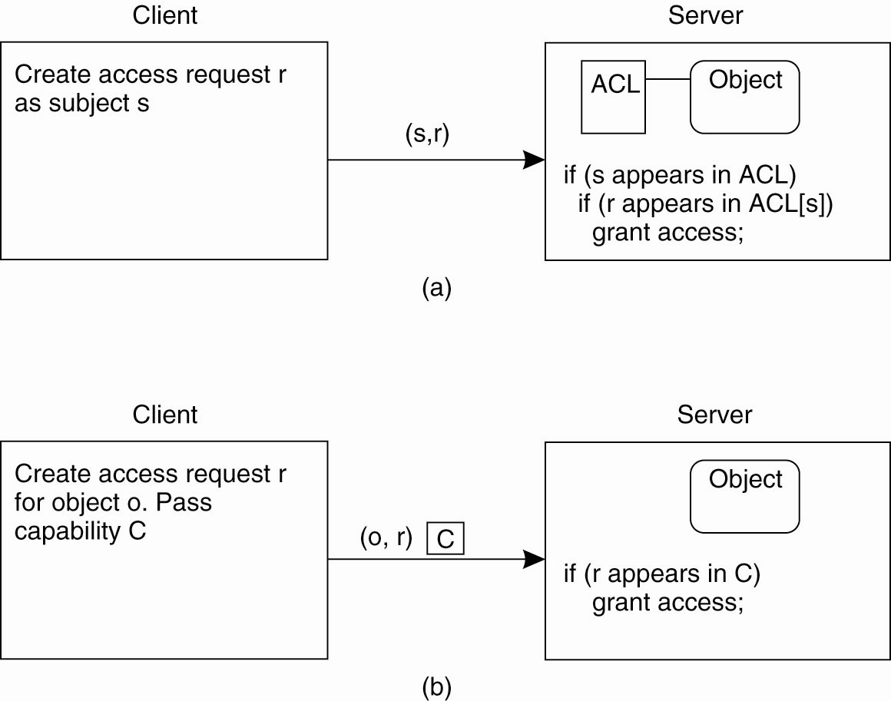
Access Control Matrix (1)
Comparison between ACLs and capabilities for protecting objects. (a) Using an ACL.

Slide 34
Access Control Matrix (2)
Comparison between ACLs and capabilities for protecting objects. (b) Using capabilities.
ACL or capability lists can still become too large that further measures need to be taken.
One general way is to make use of protection domains

Slide 35
Access Control Policies
Mandatory access control: A central administration defines who gets access to what.
Discretionary access control: The owner of an object can change access rights, but also who may have access to that object.
Role-based access control: Users are not authorized based on their identity, but based on the role they have within an organization.
Attribute-based access control: Attributes of users and of objects they want to access are considered for deciding on a specific access rule.

Slide 36
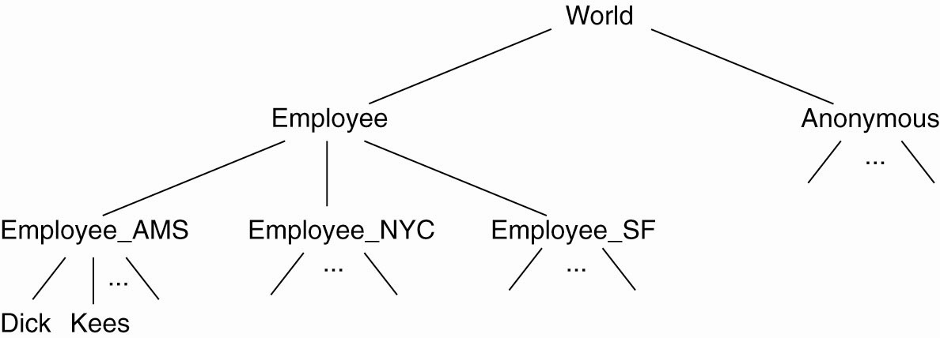
Protection Domains
The hierarchical organization of
protection domains as groups of users.

Slide 37
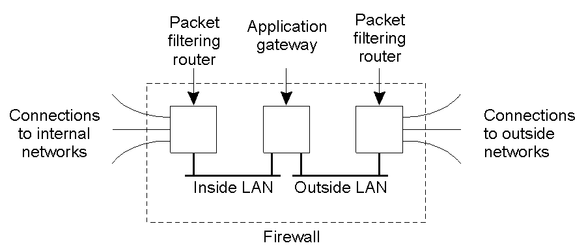
Firewalls
A common implementation of a firewall, which come in one of three types: packet-filtering, application-level (proxy) or circuit-level.

