Slide 1
CO₂ hunters!
The CO₂ reduction game to learn Chemistry!
Dr. Federico Dattila
CREST Group, DISAT, Politecnico di Torino

Slide 2
Introduction to
your research / field
(to your own taste!)

Slide 3
Now it's your turn to be entrepreneurs!
Split into teams…
You have a limited time to convert CO₂…
The team with best products wins!

Slide 4
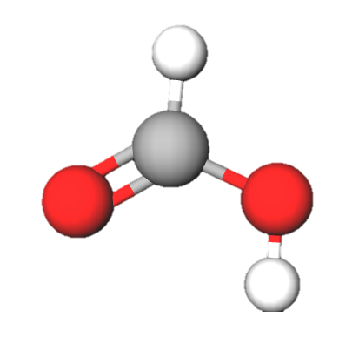
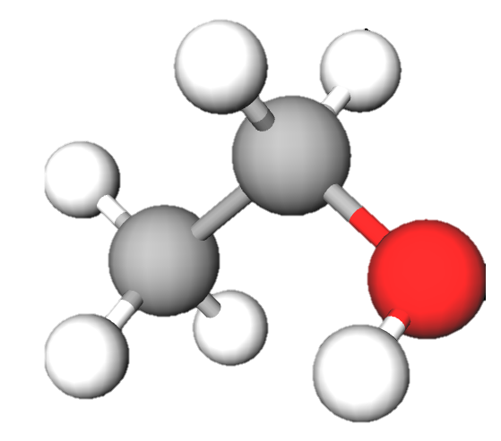
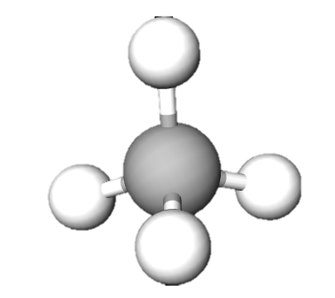
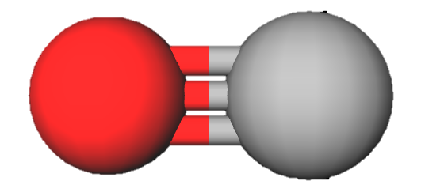
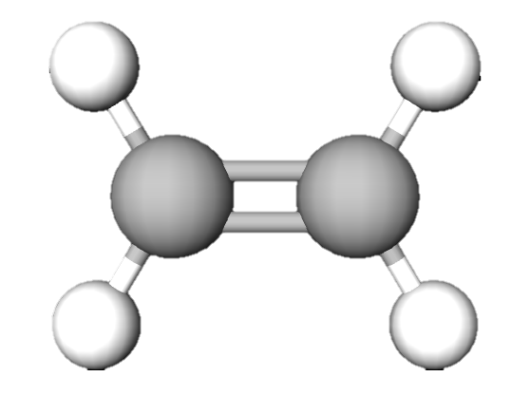
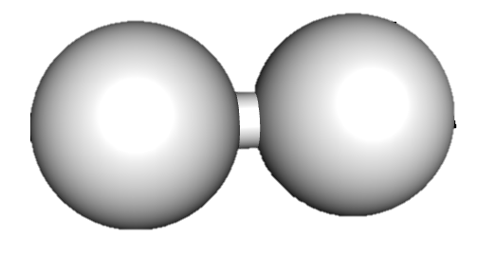
Score
+1
+4
+2
+6
+7
+3
methane
1 C, 4 H
formic acid
1 C, 2 H, 2O
carbon monoxide
1 C, 1O
hydrogen 2H
ethanol
2 C, 6 H, 1O
ethylene
2 C, 4 H
Bonus: +10 if you use the most carbon;
        +5 if you use the most hydrogen.

Slide 5
Score (Ongoing energetic crisis!)
+9
+4
+2
+8
+3
+3
methane
1 C, 4 H
formic acid
1 C, 2 H, 2O
carbon monoxide
1 C, 1O
hydrogen 2H
ethanol
2 C, 6 H, 1O
ethylene
2 C, 4 H
Bonus: +10 if you use the most carbon;
        +5 if you use the most hydrogen.

Slide 6
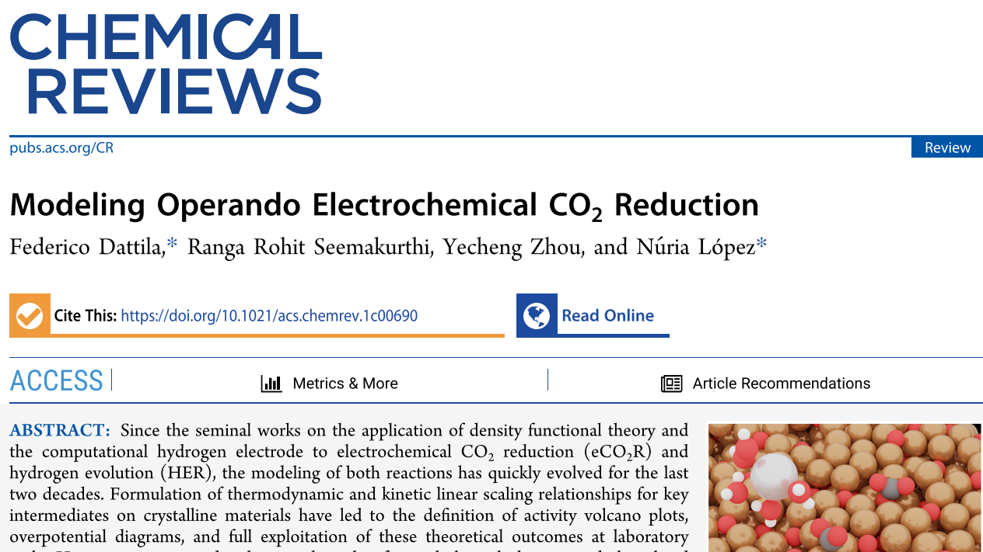
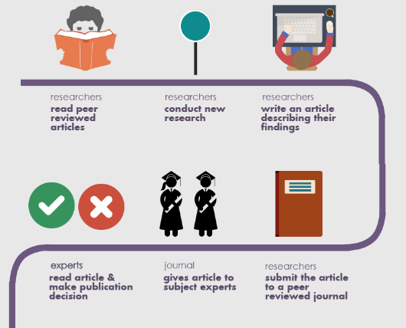
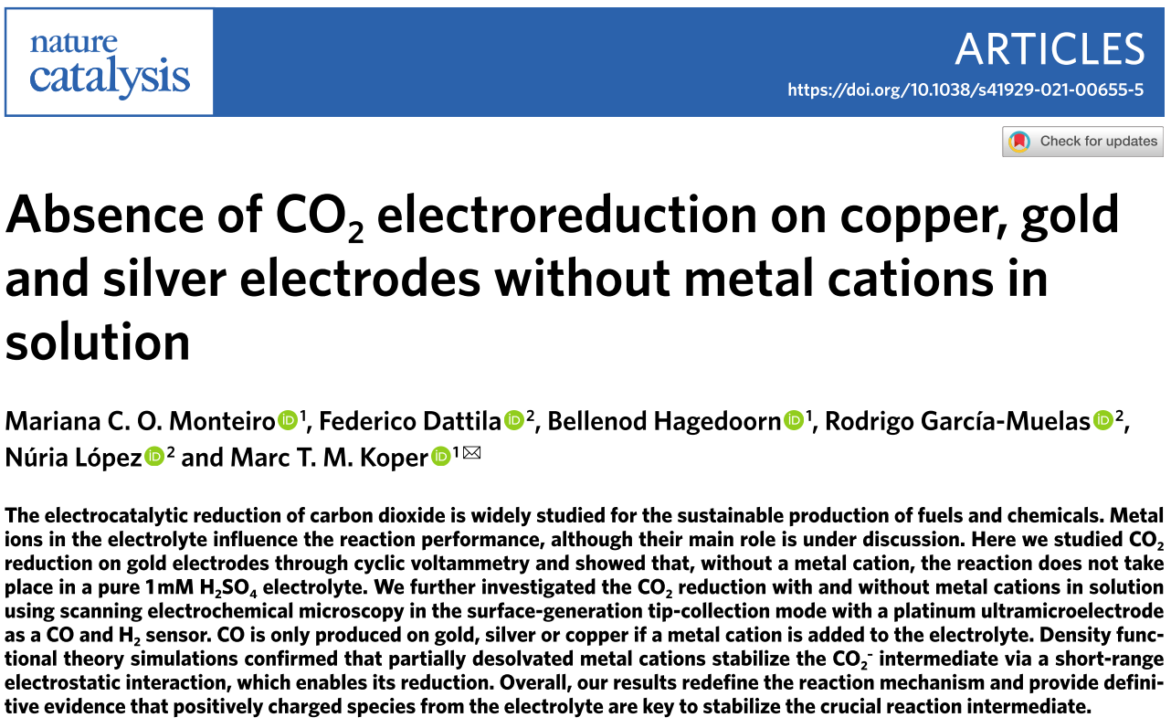
The peer review mechanism
Researchers
Read peer-reviewed articles
Researchers
Conduct new research
Researchers
Write an article describing their findings
Selected experts
Read the article & make publication decision
Researchers
Submit their article to a peer-reviewed journal

