Slide 1
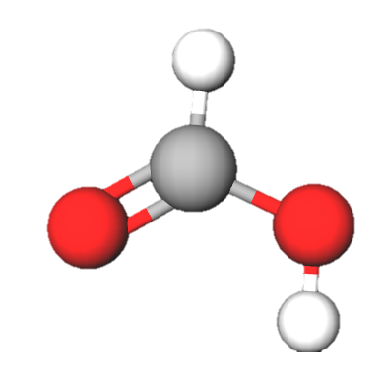
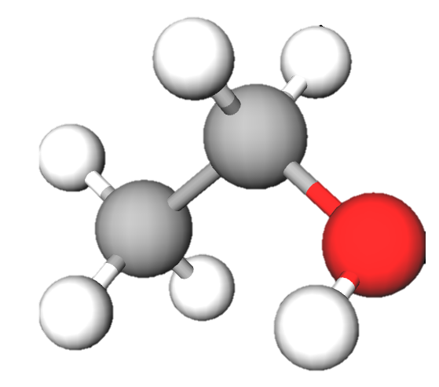
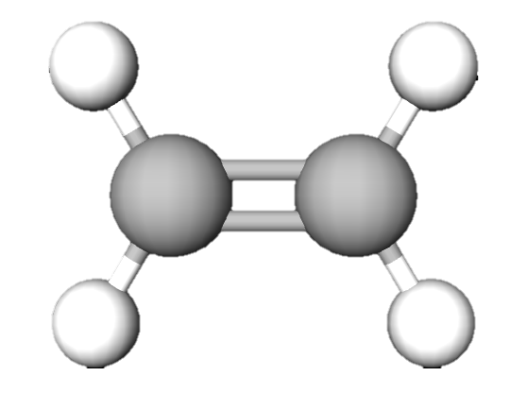
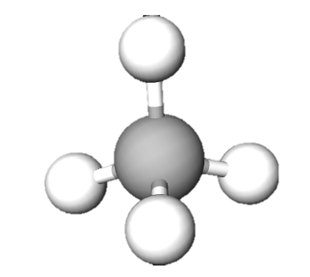
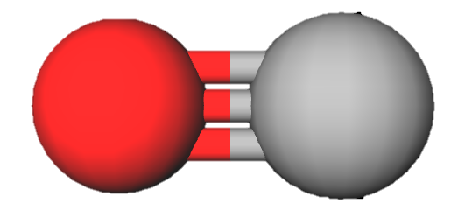
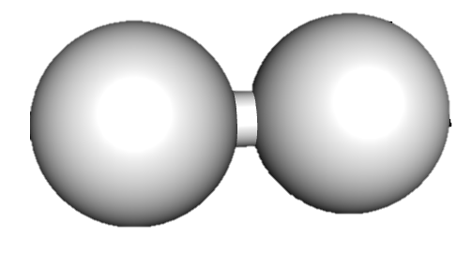
 | Team name | methane | formic acid | carbon monoxide | ethanol | ethylene | C left | H left | TOTAL score
Game
Peer-review
Score
+1
+4
+2
+3
+6
+7
carbon monoxide
1 C, 1O
hydrogen
2H
methane
1 C, 4 H
formic acid
1 C, 2 H, 2O
ethanol
2 C, 6 H, 1O
ethylene
2 C, 4 H
Bonus: +10 for the team with least carbon atoms left on the table;
+5 for the team with least hydrogen atoms left on the table.

