Slide 1
Idealized numerical simulations of a 2D flow over a bell-shaped hill
Tutor: Simona Rinaldi
simona.rinaldi7@unibo.it
Laboratory of Complex Terrain Meteorology course
Prof. L.S. Leo
Bologna, 11/12/2025

Slide 2
Objectives
The aim of this laboratory experience is to study the behavior of flows over complex terrain.
We focus on the case of a 2D flow with constant wind over a small ridge, in different configurations of the atmospheric stability, and varying wind velocity and hill height.
We will do that performing idealized numerical simulations using the Weather Research and Forecasting (WRF) model.
Notes:
L’obiettivo di questo laboratorio è studiare il caso di un flusso bidimensionale che incontra un ostacolo, in particolare una collina isolata. Vedremo come vari fattori quali la stabilità atmosferica, la velocità del vento di background, e la forma di una collina, influenzano il comportamento del flusso.

Slide 3
Objectives
By the end of this laboratory, you will be able to:
Familiarize with the main physical mechanisms controlling flow over orography;
Gain practical experience in configuring, compiling, and running idealized WRF cases;
Visualize and interpret model outputs.

Slide 4
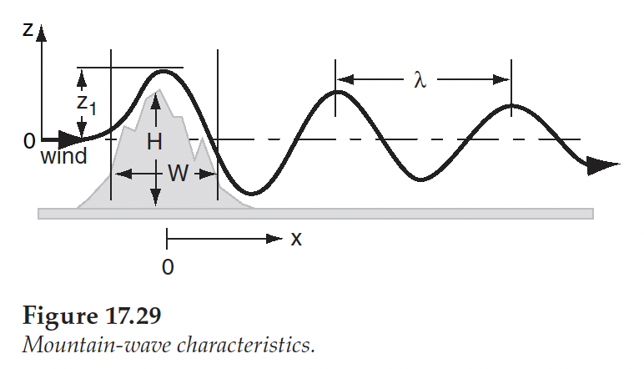
Objectives
When statically stable air flows with speed U over a hill (3D) or ridge (2D), it is set into oscillation at the Brunt-Väisälä frequency, N.
For individual hills, some air can flow around the hill rather than over the top. When less air flows over the top, shallower waves form.
How, and wether, the flow propagates downstream depends both on the geometric aspects of the barrier, and the characteristics of the flow, and it can be studied defining some parameters.

Slide 5

Introduction • Flow over a hill • WRF Model
Weather Research and Forecasting (WRF) model
​A state-of-the-art mesoscale numerical weather prediction system designed for both atmospheric research and operational forecasting applications.​
The model serves a wide range of meteorological applications across scales from tens of meters to thousands of kilometers. ​
For researchers, WRF can produce simulations based on actual atmospheric conditions (i.e., from observations and analyses) or idealized conditions.​
​
Current version is 4.6

Slide 6
Introduction • Flow over a hill • WRF Model
Weather Research and Forecasting (WRF) model
What can WRF be used for?
Atmospheric physics/parameterization research
Case study research
Real-time NWP and forecast system research
Regional climate and seasonal time-scale research
Coupled chemistry applications
Global simulations
Idealized simulations at various scales (convection, baroclinic waves, LES)
@ Atmoz

Slide 7
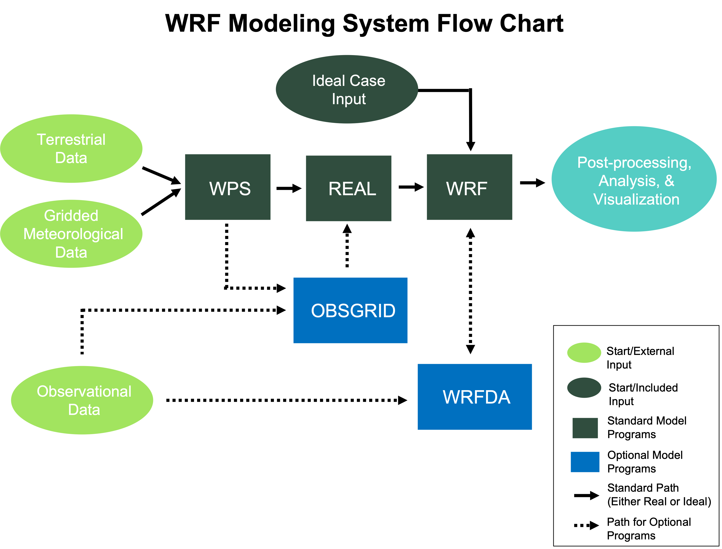
Introduction • Flow over a hill • WRF Model
From WRF User Guide
Notes:
Flowchart che mostra come funziona il modello.

Slide 8
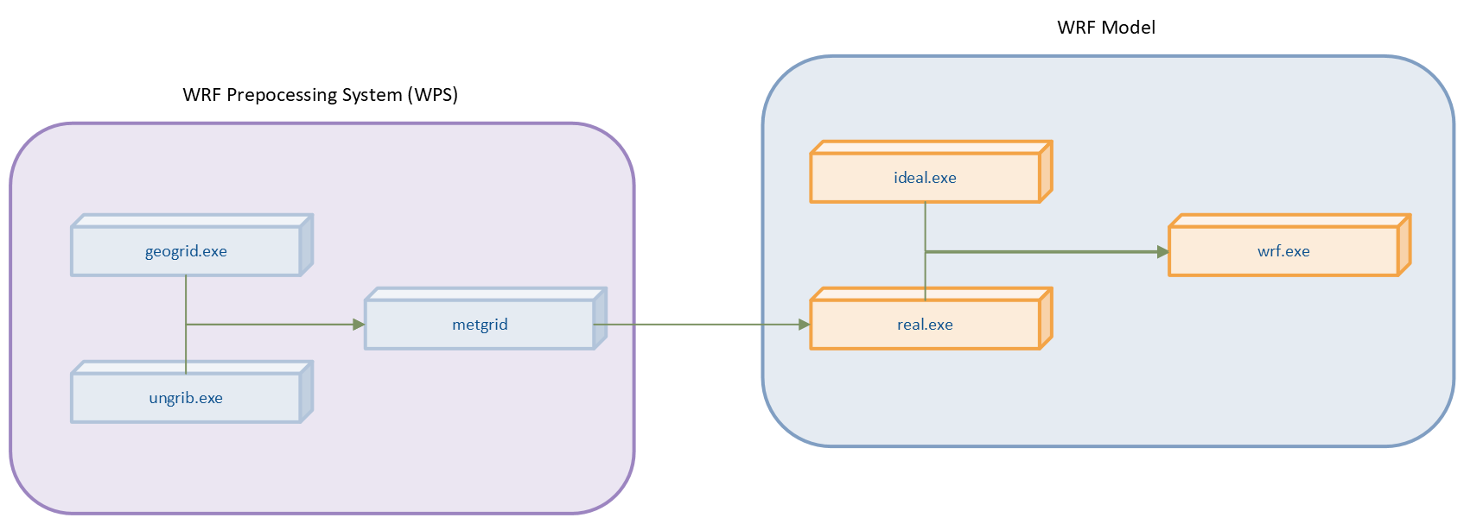
Introduction • Flow over a hill • WRF Model
WPS and WRF Program Flow
Notes:
The WRF model is capable of simulating both real- and ideal-data cases. ideal.exe is a program that simulates in a controlled environment. Idealized simulations are initiated from an included initial condition file from an existing sounding, and assumes a simplified orography.

Slide 9
Introduction • Flow over a hill • WRF Model
The equation set for ARW is fully compressible, Eulerian and nonhydrostatic with a run-time hydrostatic option.
It is conservative for scalar variables.
The model uses terrain-following, hybrid sigma-pressure vertical coordinate with the top of the model being a constant pressure surface.
The horizontal grid is the Arakawa-C grid.
The time integration scheme in the model uses the third-order Runge-Kutta scheme, and the spatial discretization employs 2nd to 6th order schemes.
The model supports both idealized and real-data applications with various lateral boundary condition options.
The model also supports one-way, two-way and moving nest options.

Slide 10
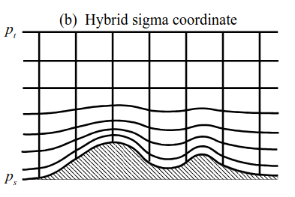
Introduction • Flow over a hill • WRF Model: Vertical coordinates
The ARW v4 uses hybrid sigma-pressure vertical coordinate defined as
p₀: reference sea-level pressure.
B(η): defines the relative weighting between the terrain-following sigma coordinate and a pure pressure coordinate, such that η corresponds to the sigma coordinate for B(η) = η and reverts to a hydrostatic pressure coordinate for B(η) = 0.
To smoothly transition from a sigma coordinate near the surface to a pressure coordinate at upper levels, B(η) is defined by a third order polynomial.
ARW coordinate
Notes:
The ARW equations are formulated using a terrain-following hydrostatic-pressure vertical coordinate denoted by η, which is also referred to a mass vertical coordinate.
In previous versions of the ARW the traditional sigma coordinate (Laprise, 1992) were used. In V4, the vertical coordinate has been generalized to allow the influence of the terrain on the coordinate surfaces to be removed more rapidly with increasing height above the surface.

Slide 11
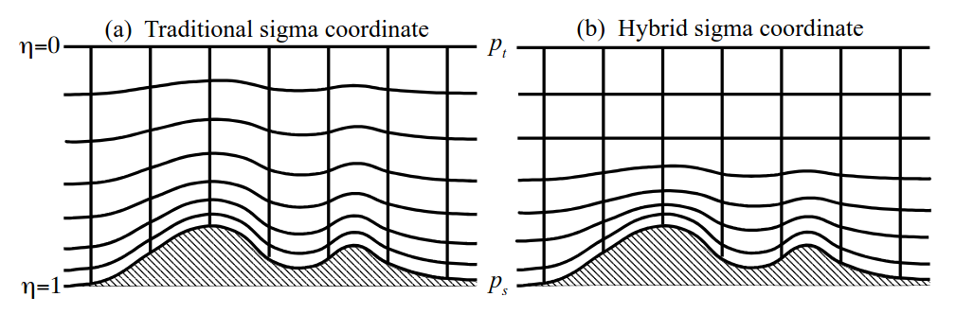
Introduction • Flow over a hill • WRF Model: Vertical coordinates
The ARW v4 uses hybrid sigma-pressure vertical coordinate.
Fig. 2.1 of WRFv4 Technical notes (see references)
Notes:
in un sistema ibrido sigma-pressione i livelli vicini alla superficie seguono il terreno, mentre nell’alta troposfera si trasformano in coordinate di pressione.

Slide 12


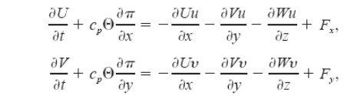


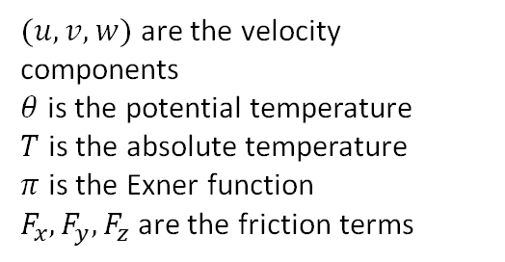
Introduction • Flow over a hill • WRF Model: Equations
WRF ARW solves the fully compressible, non-hydrostatic equations of motion with a terrain-following hydrostatic pressure coordinate system, written in flux form. For simplicity, using Cartesian coordinates and neglecting the Coriolis effect, the WRF model solve the followings:
Equation of state
$(u,v,w)$ are the velocity components
$θ$ is the potential temperature
$T$ is the absolute temperature
$π$ is the Exner function
$F_{x},F_{y},F_{z}$ are the friction terms
Mass conservation
Conservation of momentum
Conservation of energy
A more detail description in WRFv4 Technical notes
Notes:
Le equazioni sono scritte nella forma di flusso

Slide 13
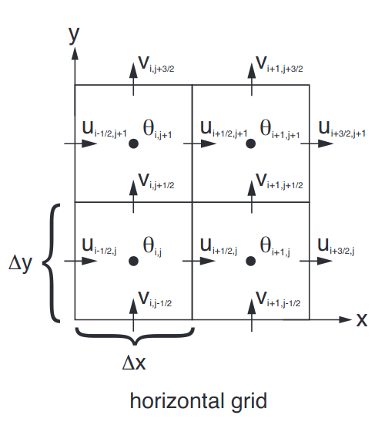
Introduction • Flow over a hill • WRF Model: Spatial discretization
The spatial discretization in the ARW solver uses a C grid staggering for the variables.
Normal velocities are staggered one-half grid length from the thermo-dynamic variables.​
The variable indices, (i, j, k) indicate variable locations with (x, y, η) = (i∆x, j∆y, k∆η).​
​
u, v, and w are defined as u points, v points, and w points, respectively, while points where θ is located as mass point.​
​
Moisture variables q_{i} and the coordinate metric μ are defined at the mass points on the discrete grid, while the geopotential φ that is defined at the w points.
Mass points
Fig. 3.2 of WRFv4 Technical notes
Notes:
Griglia staggerata: griglia in cui le variabili prognostiche sono definite in punti diversi rispetto alle variabili termodinamiche

Slide 14
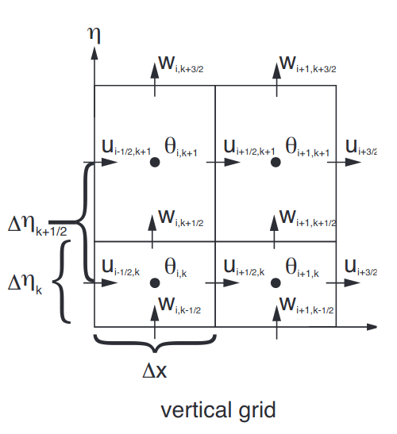
Introduction • Flow over a hill • WRF Model: Spatial discretization
The spatial discretization in the ARW solver uses a C grid staggering for the variables.
The vertical grid length ∆η is not a fixed constant, it is specified in the initialization. The user is free to specify the η values of the model levels subject to the constraint that η = 1 at the surface, η = 0 at the model top, and η decreases monotonically between the surface and model top.
Fig. 3.2 of WRFv4 Technical notes
Notes:
Vertical spacing determined by the number of eta levels and another factor in the initialization module

Slide 15
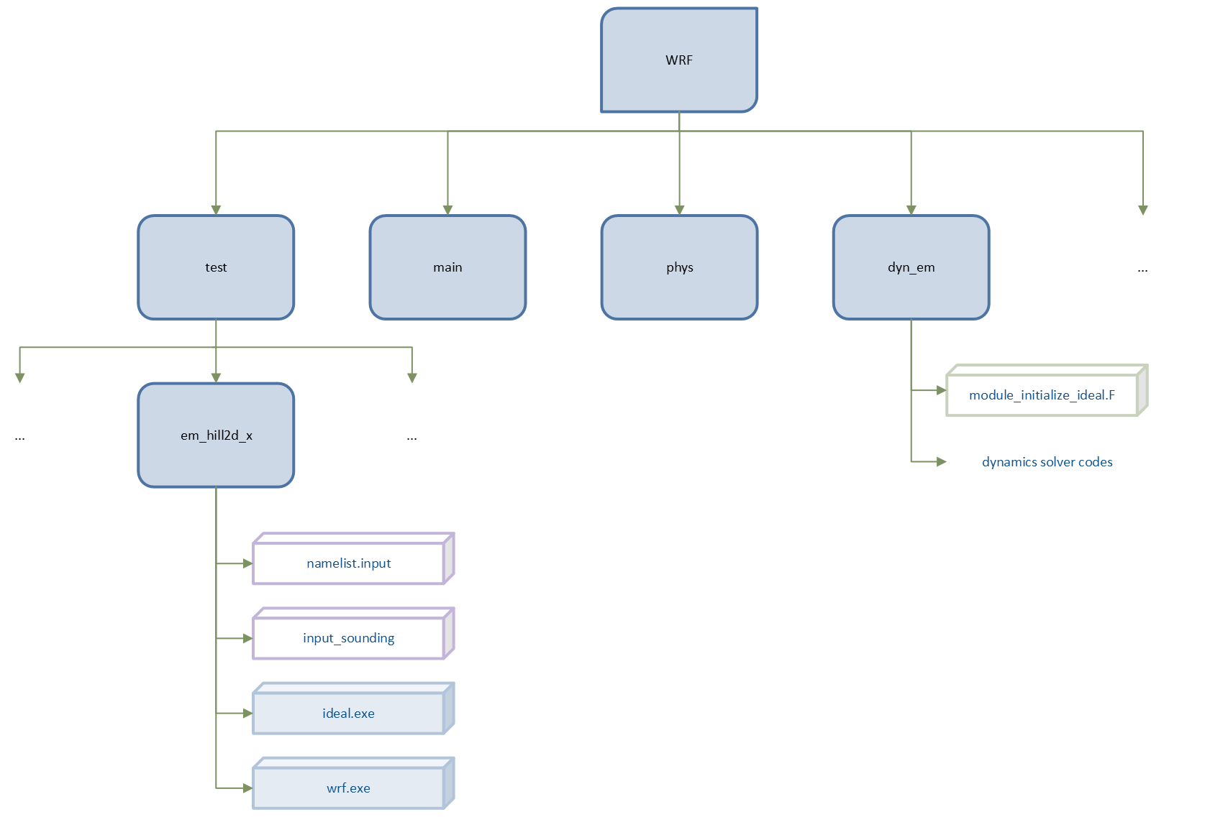
Introduction • Flow over a hill • WRF Model: 2D hill simulation
Case directory
Initialization module
Notes:
Adesso vediamo il caso che andiamo a simulare. Come detto, WRF può simulare anche casi idealizzati in cui le condizioni iniziali sono date da un file rappresentante il sounding di input, e viene assunta un'orografia semplificata.
Il caso che andiamo a simulare si trova nella cartella test/em_hill2d_x, mentre il codice di inizializzazione si trova nella cartella dyn_em, la quale contiene anche gli script di inizializzazione degli altri casi. Questo è lo script che contiene la configurazione del dominio (la forma della collina).
The test suite allows an ARW user to easily reproduce these known solutions. The test suite is also the starting point for constructing personalized idealized flow simulations by modifying the existing initializations that closely resemble a desired initialization.
The folder case contains 4 files: two are the input files and two are the executables for the simulation.

Slide 16
Introduction • Flow over a hill • WRF Model
Let's now see the case we will work on.
Steps:
Access the cluster
Set the environment: create a conda environment and install Ncview to view wrf outputs
Configure and compile WRF
Run the case

Slide 17
Introduction • Flow over a hill • WRF Model
Access the cluster:
ssh -X -J nome.cognome@137.204.165.34 nome.cognome@137.204.165.41
Download WRF:
git clone --recurse-submodules https://github.com/wrf-model/WRF
To compile WRF use an interactive job:
salloc -N 1 --cpus-per-task=4 --time=00:30:00 --mem=32G --constraint=blade --partition=b1
srun --pty --overlap --jobid $JOBID bash
Then, set the environment:

Slide 18
Introduction • Flow over a hill • WRF Model
WRF User’s guide
Steps to run a WRF simulation:
Build WRF Code
Configure WRF (./configure)
Compile WRF (./compile case_name >& compile.log)
Run the simulation
Run ideal.exe (real.exe for real cases)
Run wrf.exe

Slide 19
Introduction • Flow over a hill • WRF Model: Configuration and Compiling
tcsh
setenv DIR /home/software/atmos/WRFv4/Build_WRF/LIBRARIES
setenv CC gcc
setenv CXX g++
setenv FC gfortran
setenv FCFLAGS -m64
setenv F77 gfortran
setenv FFLAGS -m64
setenv JASPERLIB $DIR/grib2/lib
setenv JASPERINC $DIR/grib2/include
setenv LDFLAGS -L$DIR/grib2/lib
setenv CPPFLAGS -I$DIR/grib2/include
setenv PATH $DIR/netcdf/bin:$PATH
setenv NETCDF $DIR/netcdf
setenv LD_LIBRARY_PATH /home/software/atmos/WRFv4/Build_WRF/LIBRARIES/grib2/lib
setenv LD_LIBRARY_PATH $DIR/grib2/include:$LD_LIBRARY_PATH
module load mpi/openmpi/4.1.4

Slide 20
Introduction • Flow over a hill • WRF Model: Configuration and Compiling
In the WRF main directory type:
./configure
For idealized simulations, choose option 32 with no nesting (0)
Open configure.wrf file and modify line 137:
vi configure.wrf
type :137 and press enter. Press i to go in INSERT MODE and delete “time”.
To exit press esc and save (:wq).
Now you can compile:
./compile em_hill2d_x >& compile.log
Call at the end:
scancel $JOBID
If compilation is successful, you should see executables in the main directory. In WRF folder, type:
ls main/
These commands refers to Vim text editor, but you can choose whatever you prefer (e.g. GNU nano)!

Slide 21
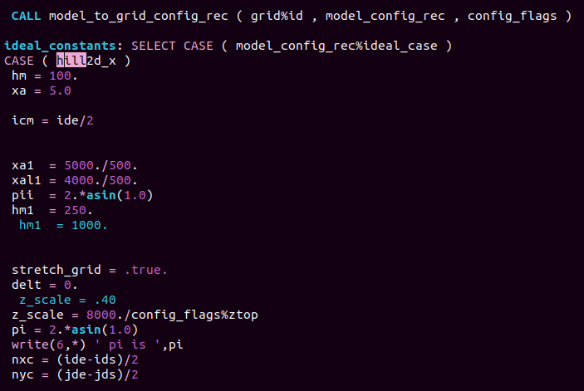
Introduction • Flow over a hill • WRF Model: 2D hill simulation
dyn_em/module_initialize_ideal.F
In vim:
Type /hill
Press n (N) to move forward (back) in the search
hill height (m) and half-width (grid points)
hill position in domain (center gridpoint in x)

Slide 22
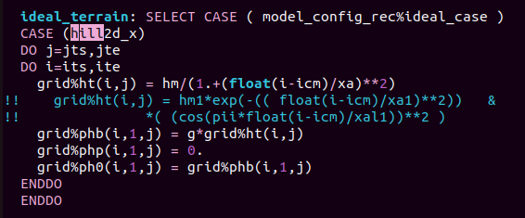


Introduction • Flow over a hill • WRF Model: 2D hill simulation
dyn_em/module_initialize_ideal.F
In vim:
Type /hill
Press n (N) to move forward (back) in the search
$$h$$
Witch of Agnesi
$$h\left(x\right)=\frac{h_{m}}{{(x/b)}^{2}+1}$$
hill shape
Gaussian
shape
lower bc

Slide 23
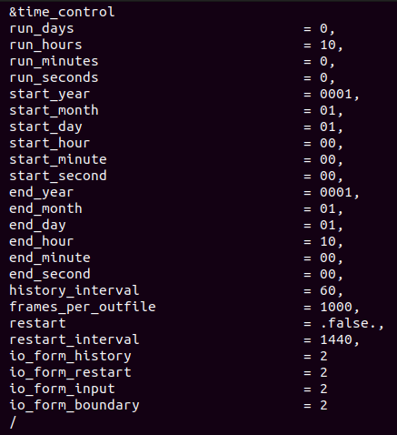
Introduction • Flow over a hill • WRF Model: 2D hill simulation
namelist.input
Section (&)
Simulation time
Frequency (in min) that data are written in the wrfout* file
number of history output times in each wrfout* file
More on namelist variables in WRF UG section on Namelist variables

Slide 24
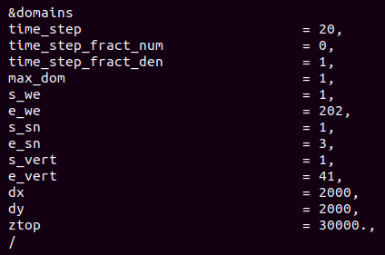
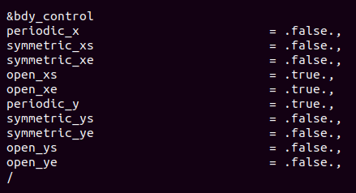
Introduction • Flow over a hill • WRF Model: 2D hill simulation
namelist.input
Time step (s)
Number of grid points
s: start
e: end
Number of vertical levels
Resolution in metres
Open boundaries (x)
Height of the top in metres
Periodic bc in y

Slide 25
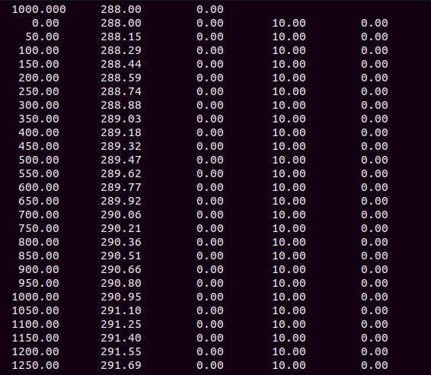
Introduction • Flow over a hill • WRF Model: 2D hill simulation
surface potential temperature (K)
surface vapor mixing ratio (g/kg)
surface pressure (mb)
Each successive line is a point in the sounding
V (south-north) velocity (m/s)
height (m)
potential temperature (K)
U (west-east) velocity (m/s)
input_sounding

Slide 26
Introduction • Flow over a hill • WRF Model: Initialization of ideal case
During initialization:
Idealize test specifics are enabled in the code using the Fortran CASE construct.
SELECT CASE ( model_config_rec%ideal_case )
CASE ( hill2d_x )
Model levels are set within the initialization to produce a stretched η coordinate (close to equally spaced z), or equally spaced η coordinate.
Terrain is set in the initialization code
A single sounding (z, q, Q_{v}, u and v) is read in from
WRF/test/em_hill2d_x/input_sounding
Sounding is interpolated to the ARW grid, equation of state and hydrostatic balance used to compute the full thermodynamics state.
Wind fields are interpolated to model η levels.

Slide 27
Introduction • Flow over a hill • WRF Model
Note:
3D meshes are always used, even in 2D (x,z; y,z) cases. The third dimension contains only 5 planes, the boundary conditions in that dimension are periodic, and the solutions on the planes are identical in the initial state and remain so during the integration.

Slide 28
Introduction • Flow over a hill • WRF Model: 2D hill simulation
After compiling, we are ready to run the case. First, copy the bash scripts to your folder:
cp /scratch/atmos/simona.rinaldi7/complex_terrain_lab/run_* .
Set initial condition by running ideal.exe:
sbatch run_ideal.sh
Check ideal.log file:
wrf: SUCCESS COMPLETE IDEAL INIT
Then run wrf via run_wrf.sh
sbatch run_wrf.sh
After simulation has finished you should see a wrfout* file. Check wrf.log file
wrf: SUCCESS COMPLETE WRF
To open the output file with ncview activate conda environment:
conda activate env_name
ncview wrfout*
To visualize all the variables available in a netcdf file
ncdump -h wrfout
Here it is required to have installed miniconda, created a conda environment and installed necessary packages (ncl, ncview). If this is not the case, go to the end of this presentation to see how to do that.

Slide 29
Introduction • Flow over a hill • WRF Model
Weather phenomena related to flow over orography include:
Mountain waves
Lee waves and clouds
Rotors and rotor clouds
Severe downslope windstorms
The phenomena are induced by air flowing over varying terrain.
Basic wave behavior can be understood using linear theory.
Nonlinear effects arise when the barrier becomes very high, the basic flow very slow, or stratification increases. Nonlinear processes include upstream blocking, wave breaking, and severe downslope winds.

Slide 30
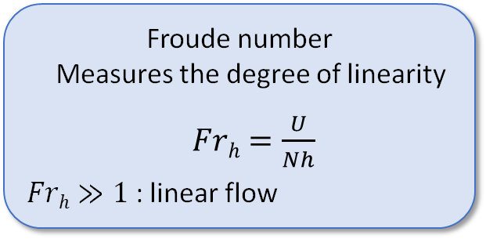
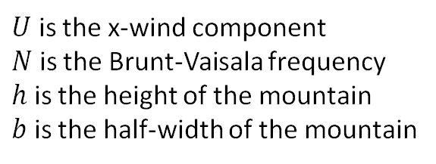
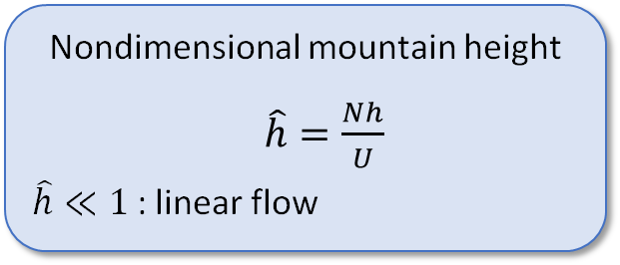
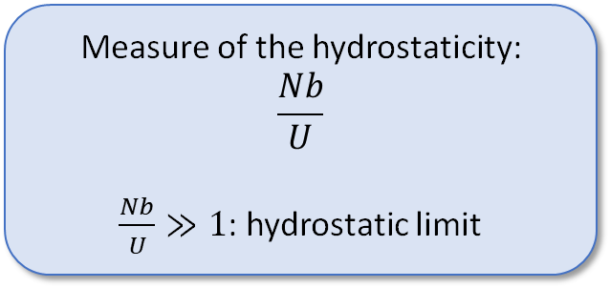
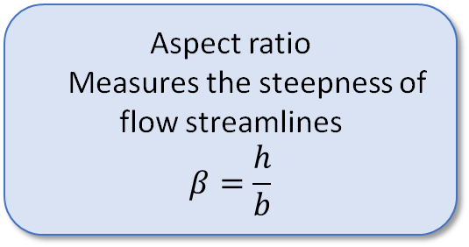
Introduction • Flow over a hill • WRF Model
Froude number
Measures the degree of linearity
$Frh=\frac{U}{Nh}$
$Frh≫1$ : linear flow
Aspect ratio
Measures the steepness of flow streamlines
$$β=\frac{h}{b}$$
Measure of the hydrostaticity:
$$\frac{Nb}{U}$$
$\frac{Nb}{U}≫1$: hydrostatic limit
Nondimensional mountain height
$\hat{h}=\frac{Nh}{U}$
$\hat{h}≪1$ : linear flow
$U$ is the x-wind component
$N$ is the Brunt-Vaisala frequency
$h$ is the height of the mountain
$b$ is the half-width of the mountain
Notes:
The ratio Na/U​ compares the stability of the atmosphere (through N) and the hill’s horizontal scale (via a) to the horizontal wind speed (U)
For high Na/U​ ​, vertical accelerations are negligible, and the flow can be considered hydrostatic (strong stability or broad obstacles).

Slide 31
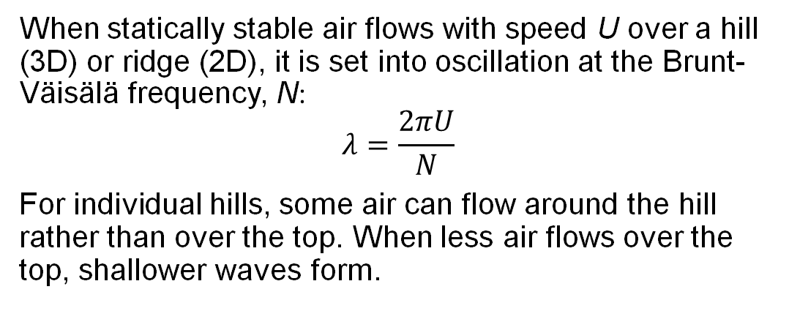
Introduction • Flow over a hill • WRF Model
When statically stable air flows with speed U over a hill (3D) or ridge (2D), it is set into oscillation at the Brunt-Väisälä frequency, N:
$$λ=\frac{2πU}{N}$$
For individual hills, some air can flow around the hill rather than over the top. When less air flows over the top, shallower waves form.
b

Slide 32
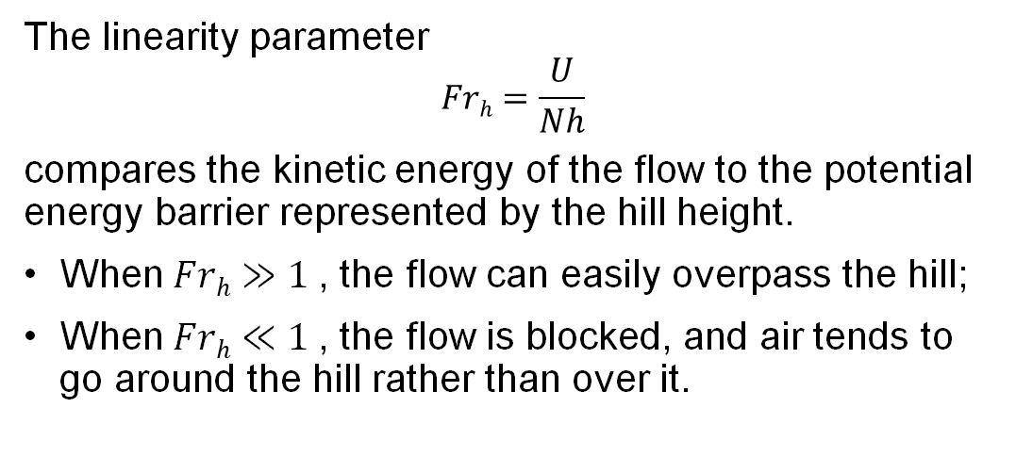
Introduction • Flow over a hill • WRF Model
The linearity parameter
$$Frh=\frac{U}{Nh}$$
compares the kinetic energy of the flow to the potential energy barrier represented by the hill height.
When $Frh≫1$ , the flow can easily overpass the hill;
When $Frh≪1$ , the flow is blocked, and air tends to go around the hill rather than over it.
b

Slide 33
Calendar
Giovedì 11/12 | 9 – 11 14 – 16 | Theoretical remarks flow over a ridge / WRF model Part 0 – Test case em_hill2d_x
Martedì 16/12 | 16 – 18 | Part 0.1 – Analysis of output basic case Part 1.1 – Flow over a hill with two-layer atmosphere
Giovedì 18/12 | 9 – 11 14 – 16 | Part 1.2 – Linear vs non-linear effects Part 2 – Flow over a hill with three-layer atmosphere
Venerdì 19/12 | 11 – 18 | Continuazione analisi outputs parte 1/2 Parte 3 – fires and downslope winds
Lunedì 22/12 | 11 – 13 14 – 16
Cluster in manutenzione

Slide 34
Part 0 – test case em_hill2d_x
Objective:
Become familiar with the base-case input files and simulation output;
Run the base case and interpret the results (calculate the parameters shown on Slide 29).

Slide 35

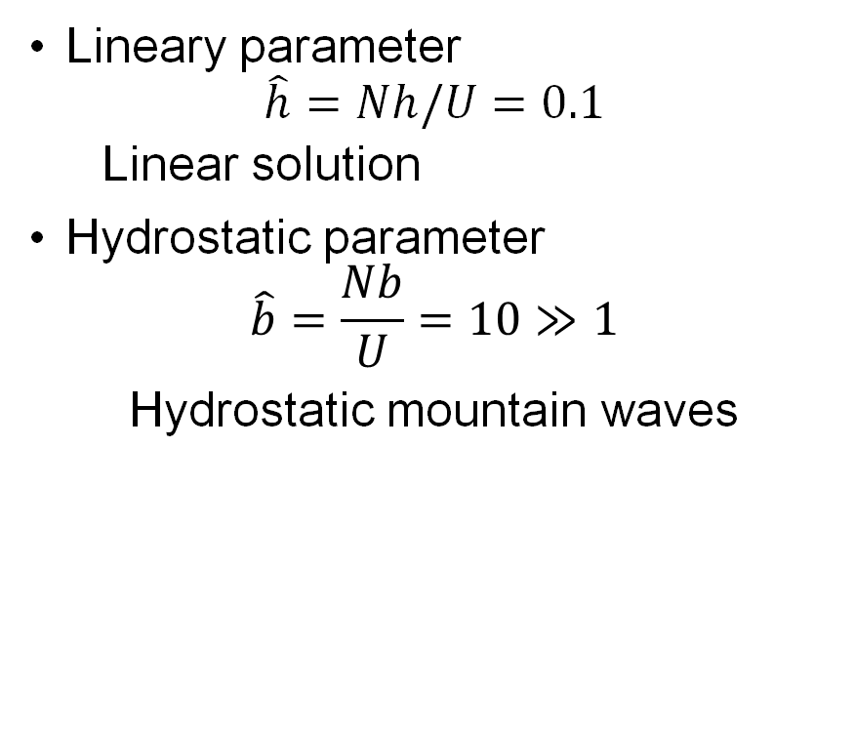
Part 0 – test case em_hill2d_x
Domain setup
$$L_{x}=402 km$$
$$∆x=∆y=2 km$$
41 vertical levels
$$U=10 m/s$$
$$N=0.01 1/s$$
$$h=100 m$$
$$2b=20 km$$
Lineary parameter
$$\hat{h}=Nh/U=0.1$$
Linear solution
Hydrostatic parameter
$$\hat{b}=\frac{Nb}{U}=10≫1$$
Hydrostatic mountain waves

Slide 36
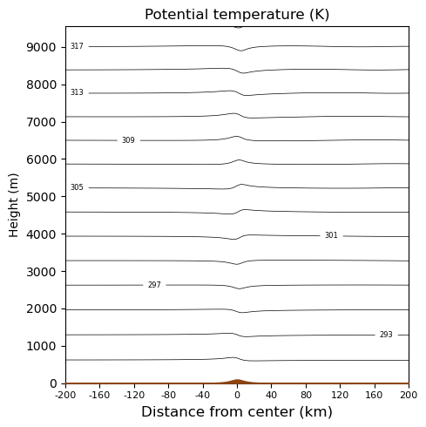
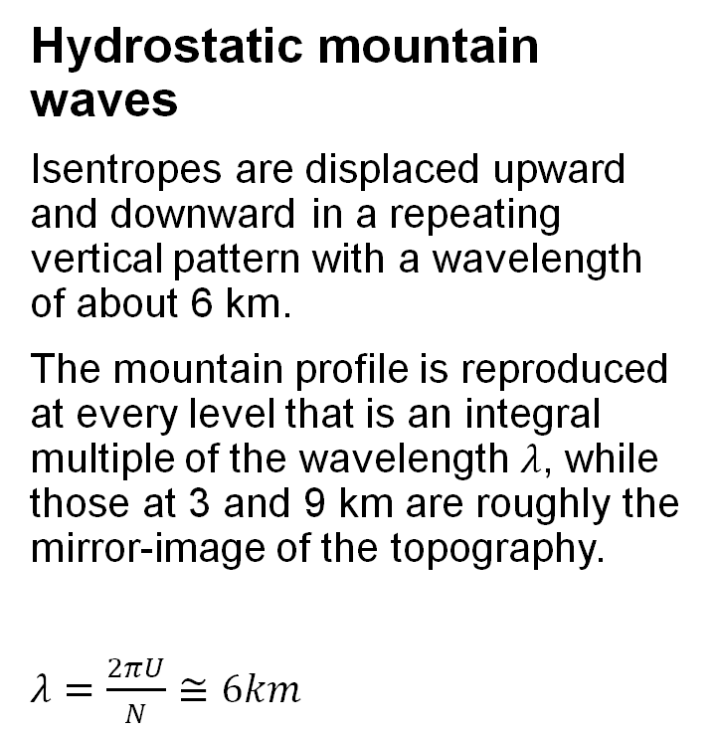

Part 0 – test case em_hill2d_x
$$Nh/U=0.1$$
Hydrostatic mountain waves
Isentropes are displaced upward and downward in a repeating vertical pattern with a wavelength of about 6 km.
The mountain profile is reproduced at every level that is an integral multiple of the wavelength $λ$, while those at 3 and 9 km are roughly the mirror-image of the topography.
$λ=\frac{2πU}{N}≅6km$

Slide 37
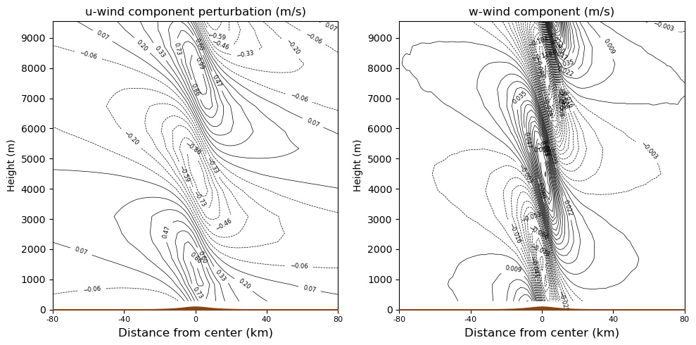
Part 0 – test case em_hill2d_x
$$Nh/U=0.1$$
Hydrostatic mountain waves
Notes:
Vertically propagating wave confined above mountain.
Downward motion starts before the mountain top, on the upwind side.

Slide 38
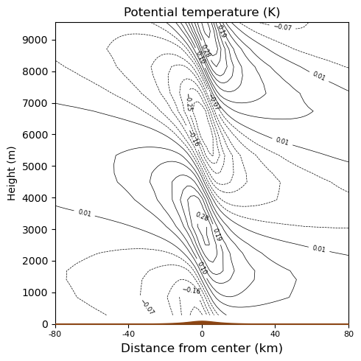
Part 0 – test case em_hill2d_x
$$Nh/U=0.1$$
Hydrostatic mountain waves
The hill forces rising and sinking motions in a stably stratified flow, generating stationary gravity waves.
The disturbance is confined in the horizontal above the mountain, but repeats itself in vertical.

Slide 39
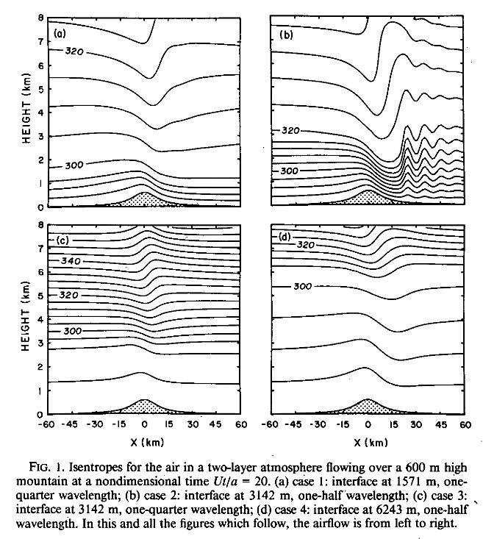
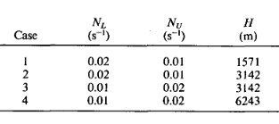
Part 1.1 – 2-layer atmosphere
Objective: investigation of the development of trapped lee waves.
In this case, the atmosphere has two layers, with the upper layer being less stable than the bottom one.
(Durran, 1986)

Slide 40
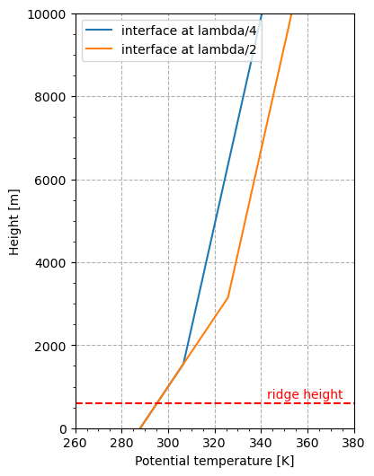
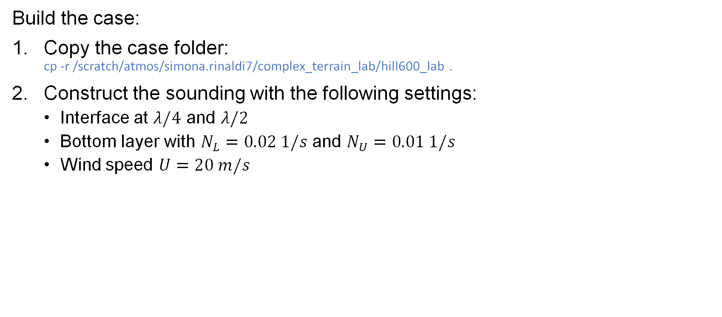

Part 1.1 – 2-layer atmosphere
Build the case:
Copy the case folder: cp -r /scratch/atmos/simona.rinaldi7/complex_terrain_lab/hill600_lab .
Construct the sounding with the following settings:
Interface at $λ/4$ and $λ/2$
Bottom layer with $N_{L}=0.02 1/s$ and $N_{U}=0.01 1/s$
Wind speed $U=20 m/s$
$$λ=\frac{2πU}{N_{L}}$$
Notes:
Compilare WRF
Costruire primo sounding
Lanciare simulazione
Fare lo stesso per secondo sounding

Slide 41
Part 1.1 – 2-layer atmosphere
To construct the sounding, use the excel worksheet.
Change U and T to match the settings in the previous slide.
Then, go into the test case folder in the cluster, and make a copy of the sounding file: cp input_sounding input_sounding_twoL_z1
Now, copy and paste the sounding created in the excel file into input_sounding_twoL_z1. Using vim:
Open the file: vi input_sounding_twoL_z1
Skip the first row, and go to the second one (where the five column table starts)
Press shift+v to select the whole row. You should see --VISUAL LINE -- at the bottom left corner of the window;
Press shift+g to go to the final row;
Press d to delete the whole selection.
Notes:
Compilare WRF
Costruire primo sounding
Lanciare simulazione
Fare lo stesso per secondo sounding

Slide 42
Part 1.1 – 2-layer atmosphere
To construct the sounding, use the excel worksheet.
Change U and T to match the settings in the previous slide.
Then, go into the test case folder in the cluster, and make a copy of the sounding file: cp input_sounding input_sounding_twoL_z1
Now, copy and paste the sounding created in the excel file into input_sounding_twoL_z1. Using vim:
Open the file: vi input_sounding_twoL_z1
Skip the first row, and go to the second one (where the five column table starts)
Press shift+v to select the whole row. You should see --VISUAL LINE -- at the bottom left corner of the window;
Press shift+g to go to the final row;
Press d to delete the whole selection.
Copy the sounding from the excel file using ctrl+c
Go back to input_sounding_twoL_z1 and press i to go in Insert mode. You should see -- INSERT -- at the bottom left corner of the window.
At the second row, press ctrl+v to copy the table from the excel file.
Press esc to exit Insert mode.
Save the file and exit using :wq.
Rename the original input_sounding: mv input_sounding input_sounding_basic
Soft link the new input sounding: ln -sf input_sounding_twoL_z1 input_sounding
Now you can run the simulation: sbatch run_ideal.sh sbatch run_wrf.sh
Notes:
Compilare WRF
Costruire primo sounding
Lanciare simulazione
Fare lo stesso per secondo sounding

Slide 43
Part 1.1 – 2-layer atmosphere
Remember, every sounding file should have:
First line as surface values of pressure, potential temperature (K) mixing ratio
Following lines values of level height (m), potential temperature (K) mixing ratio (g/kg), u (m/s) and v (m/s)
Notes:
Compilare WRF
Costruire primo sounding
Lanciare simulazione
Fare lo stesso per secondo sounding

Slide 44
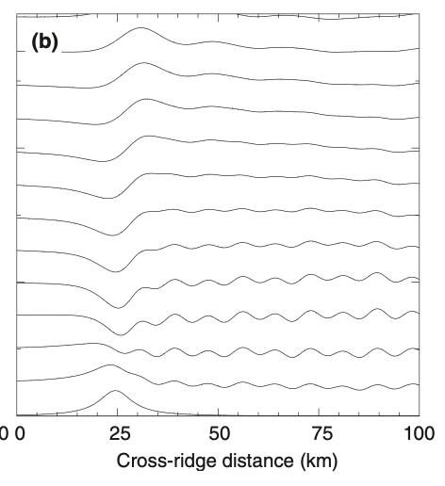
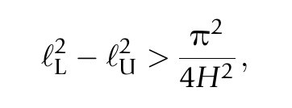
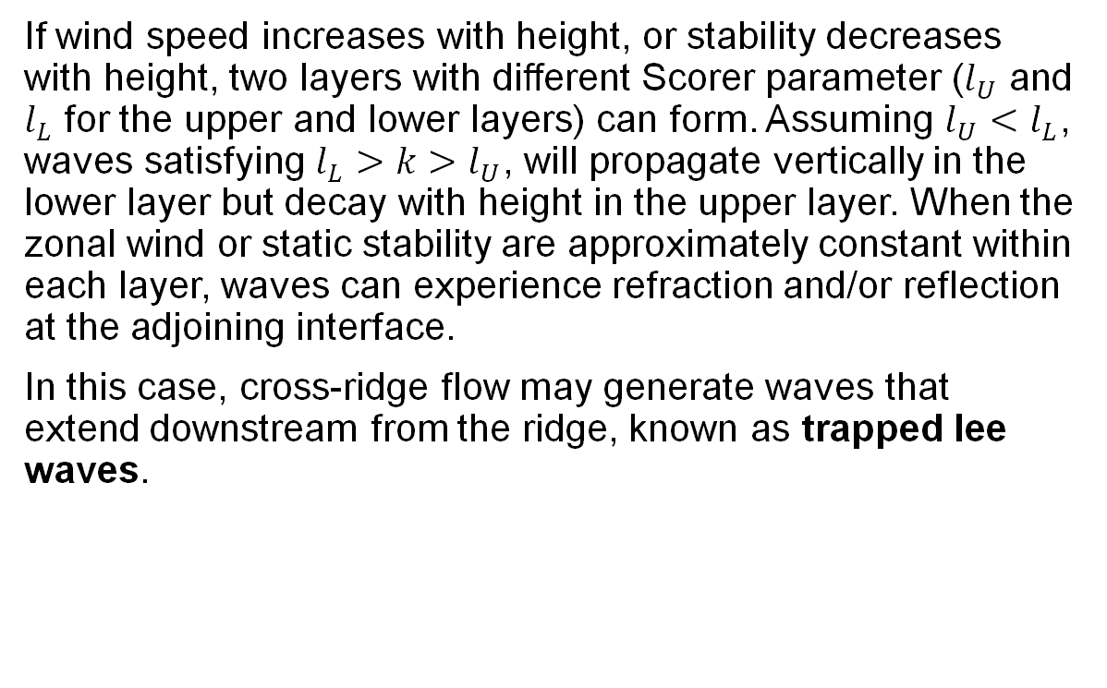
Part 1.1 – 2-layer atmosphere
If wind speed increases with height, or stability decreases with height, two layers with diﬀerent Scorer parameter ($l_{U}$ and $l_{L}$ for the upper and lower layers) can form. Assuming $l_{U}<l_{L}$, waves satisfying $l_{L}>k>l_{U}$, will propagate vertically in the lower layer but decay with height in the upper layer. When the zonal wind or static stability are approximately constant within each layer, waves can experience refraction and/or reflection at the adjoining interface.
In this case, cross-ridge flow may generate waves that extend downstream from the ridge, known as trapped lee waves.
Streamlines in steady air flow over an isolated mountain as predicted by linear theory (Durran, 2015).

Slide 45
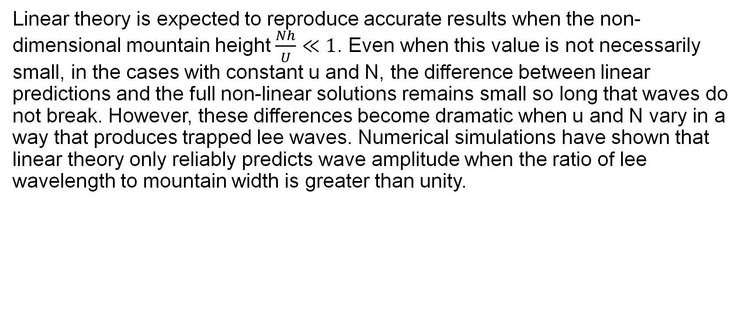
Part 1.1 – 2-layer atmosphere
Linear theory is expected to reproduce accurate results when the non-dimensional mountain height $\frac{Nh}{U}≪1$. Even when this value is not necessarily small, in the cases with constant u and N, the diﬀerence between linear predictions and the full non-linear solutions remains small so long that waves do not break. However, these diﬀerences become dramatic when u and N vary in a way that produces trapped lee waves. Numerical simulations have shown that linear theory only reliably predicts wave amplitude when the ratio of lee wavelength to mountain width is greater than unity.

Slide 46
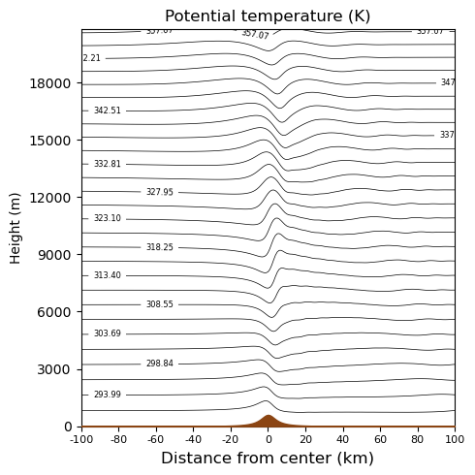
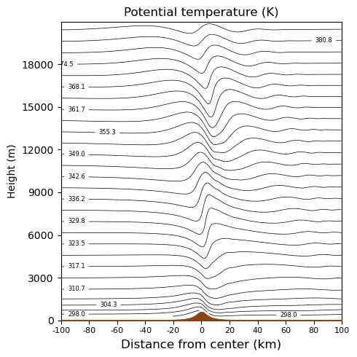



Part 1.1 – 2-layer atmosphere
Difference between one layer (a) and two-layer (b) atmosphere, where the one layer case has the same stability of the upper layer of case (b).
(a)
(b)
$$\hat{h_{U}}=Nh/U=0.3$$
$$\hat{h_{L}}=Nh/U=0.6$$
$$\hat{h}=Nh/U=0.3$$
Notes:
Nel primo caso ho un solo strato con stabilità uguale a quella dello strato più alto. La lambda è circa pari a 12.

Slide 47
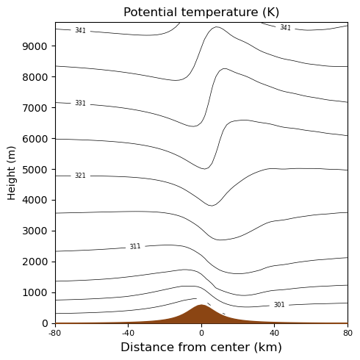

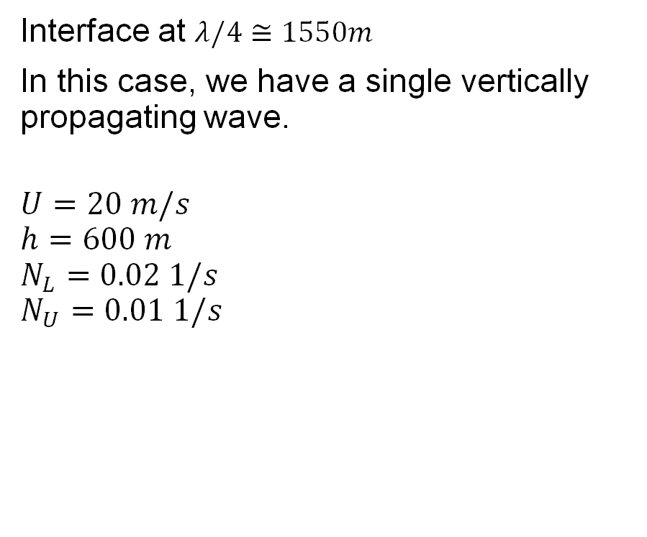
Part 1.1 – 2-layer atmosphere
Interface at $λ/4≅1550m$
In this case, we have a single vertically propagating wave.
$$U=20 m/s$$
$$h=600 m$$
$$N_{L}=0.02 1/s$$
$$N_{U}=0.01 1/s$$
Solution at $\frac{Ut}{a}=20$
Notes:
Stabilità del layer più in basso maggiore rispetto a quella del layer più alto. La struttura verticale è tale da far sì che l’onda posso passare allo strato superiore, e quindi si vede un’onda che si propaga verso l’alto.

Slide 48
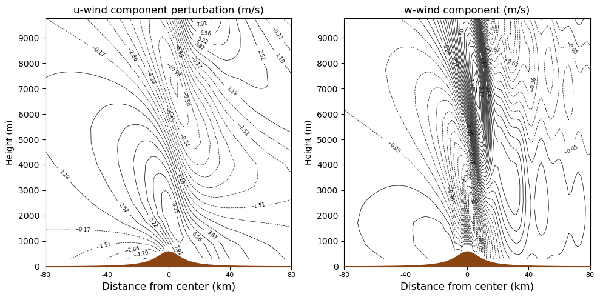

Part 1.1 – 2-layer atmosphere
Interface at $λ/4≅1550m$
Notes:
The flow slows before the mountain top up to. Right after that, the wind increases on the downwind side and the maximum is reached above the mountain (from approximately 1km height).
From the w, the downslope extends from the mountain top to almost the base of the ridge (15 km).

Slide 49
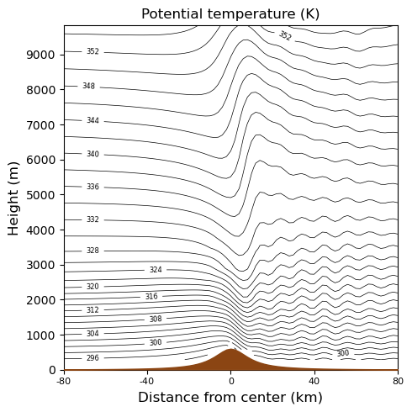
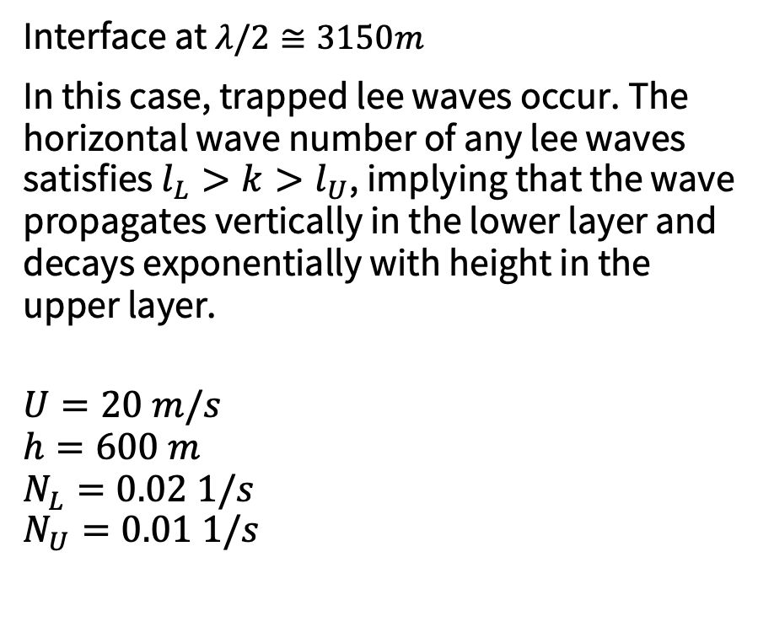
Part 1.1 – 2-layer atmosphere
Interface at $λ/2≅3150m$
In this case, trapped lee waves occur. The horizontal wave number of any lee waves satisfies $l_{L}>k>l_{U}$, implying that the wave propagates vertically in the lower layer and decays exponentially with height in the upper layer.
$$U=20 m/s$$
$$h=600 m$$
$$N_{L}=0.02 1/s$$
$$N_{U}=0.01 1/s$$
Solution at $\frac{Ut}{a}=20$

Slide 50
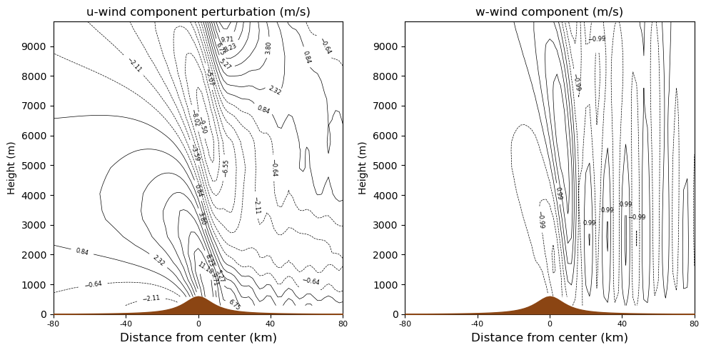

Part 1.1 – 2-layer atmosphere
Interface at $λ/2≅3150m$
Notes:
La zona di decelerazione si ferma più in basso rispetto al caso precedente, con l’accelerazione che parte già da prima del picco del ridge. La zona di massima velocità si ha subito dopo il picco.
Dalla w si vedono i moti upward e downward nella parte downwind.

Slide 51
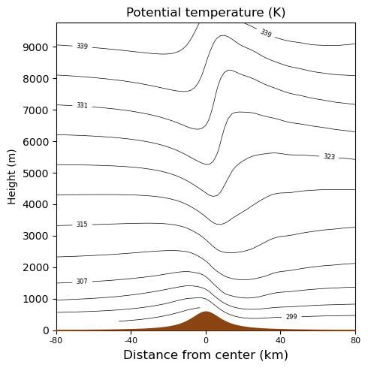
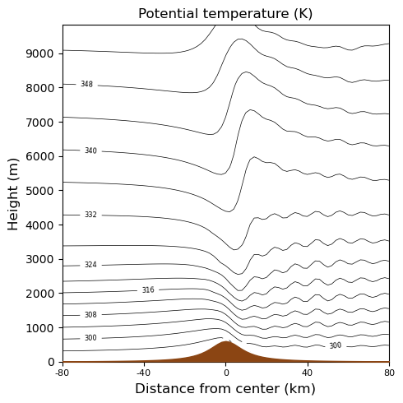


Part 1.1 – 2-layer atmosphere
Difference between the different position of the interface
$$z_{i}=λ/4≅1550m$$
$$z_{i}=λ/2≅3150m$$

Slide 52
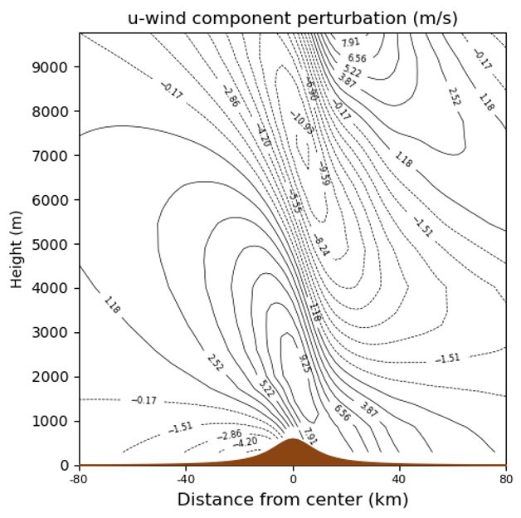


Part 1.1 – 2-layer atmosphere
Difference between the different position of the interface
$$z_{i}=λ/4≅1550m$$
$$z_{i}=λ/2≅3150m$$
Notes:
Il secondo caso, in cui si formano le trapped lee waves, fa sì che si generi un downslope wind più forte rispetto a prima e più vicino alla superficie.

Slide 53


Part 1.1 – 2-layer atmosphere
Difference between the different position of the interface
$$z_{i}=λ/4≅1550m$$
$$z_{i}=λ/2≅3150m$$
Notes:
Il secondo caso, in cui si formano le trapped lee waves, fa sì che si generi un downslope wind più forte rispetto a prima e più vicino alla superficie.

Slide 54
Part 1.2 – non-linear effects
Copy the WRF folder pre-compiled with hill height at 1000m: cp -r /scratch/atmos/simona.rinaldi7/complex_terrain_lab/WRF_hill1000 .
Hill height is different now, how does this affect the adimensional parameters (slide 29)? What changes?

Slide 55





Part 1.2 – non-linear effects
$$h=100 m$$
$$U=10 m/s$$
$$N=0.01 1/s$$
$$h=1000 m$$
$$U=10 m/s$$
$$N=0.01 1/s$$
$$\hat{h}=0.1$$
$$\hat{b}=10$$
$$\hat{h}=1$$
$$\hat{b}=10$$
Linear case
Non-linear case

Slide 56


Part 1.2 – non-linear effects
Domain setup
$$L_{x}=402 km$$
$$2b=20 km$$
$$∆x=∆y=2 km$$
41 vertical levels
$$U=10 m/s$$
$$N=0.01 1/s$$
$$h=1000 m$$
$$\hat{h}=\frac{Nh}{U}=1$$
Wave breaking

Slide 57



Part 1.2 – non-linear effects
Ut/a
10.8
18
25.2
32.4
Notes:
Sequenza temporale del caso non lineare. Le piccole lee waves che si vedono nell’ultimo timestep compaiono dopo la rottura dell’onda (a 18 non le vediamo).

Slide 58

Part 1.2 – non-linear effects
h=1000m, U=10 m/s

Slide 59

Part 2 – 3-layer atmosphere
Objective: investigate the development of topographic blocking and downslope windstorms.
Which of the following two soundings produce the strongest downslope windstorm?
Inversion below mountain top (blue line);
Inversion at mountain top (orange line).

Slide 60

Part 2 – 3-layer atmosphere
First, build the cases:
$$h=1000 m$$
$$U=10 m/s$$
$$N_{L}=0.002 1/s$$
$$N_{U}=0.01 1/s$$
$$N_{inv}=0.025 1/s$$
Thickness of the inversion layer:
$$h_{inv}=1/4h$$
Inversion below mountain top (blue line): $z_{inv}=5/8h$
Inversion at mountain top (orange line): $z_{inv}=7/8h$
with $z_{inv}$ being the center of the inversion.

Slide 61

Part 2 – 3-layer atmosphere
Case (a): inversion below mountain top.

Slide 62

Part 2 – 3-layer atmosphere
Case (b): inversion at mountain top.

Slide 63


Part 2 – 3-layer atmosphere
Difference between the inversion layer position respect to mountain peak: (a) below mountain top, (b) at mountain top.
(a)
(b)
Below MT
At MT
Notes:
Nel primo caso si vede che il dow

Slide 64
Part 2 – 3-layer atmosphere
Difference between the inversion layer position respect to mountain peak: (a) below mountain top, (b) at mountain top.
(a)
(b)
Below MT
At MT
Notes:
Nel primo caso si vede che il dow

Slide 65


Part 2 – 3-layer atmosphere
Difference between the inversion layer position respect to mountain peak: (a) below mountain top, (b) at mountain top.
(a)
(b)
Below MT
At MT
Notes:
Vedere l'evoluzione per capire se ci sono lee waves prima del breaking
Aggiungere plot U totale con linee+colori (anche per gli altri tests)
Aggiungere in hidden mode la griglia
Quanto è la velocita in input? - OK

Slide 66

Part 0.1 - Atmosphere with uniform stability
Objective:
Investigates flow regimes under different settings.
You can vary:
U component of the wind (input_sounding)
Potential temperature profile (input_sounding)
Height of the hill (module_initialize_ideal.F)
[Lin and Wang (1996)]
Notes:
Which features can you see (wave breaking, downslope winds, etc)?
How stronger is the downslope wind compared to the background wind?

Slide 67



Part 0.1 - Atmosphere with uniform stability
Firstly, calculate/take note of essential parameters:
Hill height h;
Half-mountain width a;
U-wind velocity u;
Brunt-Vaisala frequency N;
F or $\hat{h}$.
Then, try to identify flow regimes.
Nondimensional mountain height
$\hat{h}=\frac{Nh}{U}$
$\hat{h}≪1$ : linear flow
u (m/s)
$$\hat{h}$$
Regime

Slide 68



Part 0.1 - Atmosphere with uniform stability
h (m) | 1000
N | 0.01 1/s
u (m/s) | 8
$$\hat{h}$$ | 1.25 (F=0.8)
Regime | Wave breaking

Slide 69

Part 0.1 - Atmosphere with uniform stability
h (m) | 1000
N | 0.01 1/s
u (m/s) | 10
$$\hat{h}$$ | 1 (F=1)
Regime | Wave breaking – no upstream blocking

Slide 70
Soundings and Plotting
Sounding: excel worksheet.
For plotting we can use wrf-python.
In VSCode, follow this guide to see how to create a new Jupyter notebook:
> Create a new Jupyter Notebook: ctrl+shift+p (or creating a .ipynb file)
> Select a kernel (top right)
> Create a conda environment (with a python version <= 3.11)
> Install libraries (In a code cell type: %conda install metpy)

Slide 71
Terminal commands
Access the cluster ssh -Y -J nome.cognome#@137.204.165.34 nome.cognome#@137.204.165.41
Request an interactive job (frontend)
salloc -N 1 --cpus-per-task=4 --time=00:30:00 --mem=32G --constraint=blade --partition=b1
srun --pty --overlap --jobid $JOBID bash
Submit job via sbatch
sbatch script_name.sh
Control job queue
squeue –u nome.cognome#
or
slurmtop
In here remember to modify the bash script and insert your email
To exit from slurmtop press ctrl+c

Slide 72
Terminal commands
Soft link a file
To access the cluster open another terminal window and insert:
To download a file from the cluster, go into the local folder and insert:
To upload a file in the cluster, go into the folder containing the file and type:
ln –sf name_of_the_file softlink_name
ssh -Y -J nome.cognome#@137.204.165.34 nome.cognome#@137.204.165.41
scp -J nome.cognomen#@137.204.165.34 nome.cognome#@137.204.165.41:path/of/the/file/ .
scp –J nome.cognomen#@137.204.165.34 filename nome.cognome#@137.204.165.41:pathofthefinalfolder

Slide 73
Terminal commands
To mount remote filesystem, firstly install sshfs:
Then, create a local mount point (where you want to have the cluster folder):
Now you can mount the remote directory:
To unmount the folder, type in the directory of the mount point:
If unmounting is unsuccessfull, force it:
sudo apt-get install sshfs
mkdir ~/folder_name
sshfs -o ProxyJump=nome.cognome#@137.204.165.34 nome.cognome#@137.204.165.41:/path/of/clusterfolder ~/folder_name
umount -f folder_name
diskutil unmount force folder_name

Slide 74
Create a conda environment in the cluster
In the cluster
Firstly, install miniconda. Go into main folder and type:
Then, you can create a conda environment:
To activate the environment:
To install packages, activate conda environment first and then install:
Install ncl and ncview.
mkdir -p ~/miniconda3​
wget https://repo.anaconda.com/miniconda/Miniconda3-latest-Linux-x86_64.sh -O ~/miniconda3/miniconda.sh​
bash ~/miniconda3/miniconda.sh -b -u -p ~/miniconda3​
rm ~/miniconda3/miniconda.sh
conda create –n env_name python=3.8
conda activate env_name
conda install -c conda-forge package_name

Slide 75
Create a conda environment in the cluster
For macOS (locally):
brew install --cask miniconda
Firstly, install miniconda. Go into main folder and type:
Then, you can create a conda environment:
To activate the environment:
To install packages, activate conda environment first and then install:
Install ncl and ncview.
mkdir -p ~/miniconda3​
wget https://repo.anaconda.com/miniconda/Miniconda3-latest-Linux-x86_64.sh -O ~/miniconda3/miniconda.sh​
bash ~/miniconda3/miniconda.sh -b -u -p ~/miniconda3​
rm ~/miniconda3/miniconda.sh
conda create –n env_name python=3.8
conda activate env_name
conda install -c conda-forge package_name

Slide 76
References
Lin, Y., and T. Wang, 1996: Flow Regimes and Transient Dynamics of Two-Dimensional Stratified Flow over an Isolated Mountain Ridge. J. Atmos. Sci., 53, 139–158, https://doi.org/10.1175/1520-0469(1996)053<0139:FRATDO>2.0.CO;2
Durran, D.R., 2015. Lee Waves and Mountain Waves. In: Gerald R. North (editor-in-chief), John Pyle and Fuqing Zhang (editors). Encyclopedia of Atmospheric Sciences, 2nd edition, Vol 4, pp. 95–102.
Durran, D. R., 1986: Another Look at Downslope Windstorms. Part I: The Development of Analogs to Supercritical Flow in an Infinitely Deep, Continuously Stratified Fluid. J. Atmos. Sci., 43, 2527–2543, https://doi.org/10.1175/1520-0469(1986)043<2527:ALADWP>2.0.CO;2.
Reinecke, P. A., and D. R. Durran, 2008: Estimating Topographic Blocking Using a Froude Number When the Static Stability Is Nonuniform. J. Atmos. Sci., 65, 1035–1048, https://doi.org/10.1175/2007JAS2100.1.
Stull, R., 2017: "Practical Meteorology: An Algebra-based Survey of Atmospheric Science" -version 1.02b. Univ. of British Columbia. 940 pages. isbn 978-0-88865-283-6.

Slide 77
References
WRF-related:
WRF Technical notes (v4)
WRF User Guide
WRF ARW User's Page
WRF GitHub Repository
Ncview features
NCL installation
Other useful stuff:
Vim cheatsheet
OPH Guide
Lab folder

Slide 78
Introduction • Flow over a hill • WRF Model
If needed WRF folder can be copied from:
cp -r /scratch/atmos/simona.rinaldi7/complex_terrain_lab/WRFv4.6/WRF .

Slide 79





Introduction • Flow over a hill • WRF Model
a) $Frb≪1$ Strong static stability or weak winds The natural wavelength of air is much shorter than the width of the mountain, resulting in only a little air flowing over the top of the hill, with small waves. Most of the air is blocked in front of the ridge, or flows around the hill.
b) $Frb≅1$ For moderate stabilities and wavelenghts of the order of the hill width, the air resonates with the terrain, causing very intense waves. Extremely fast near-surface winds on the downwind (lee) side of the mountains cause downslope wind storms
$Frw=\frac{U}{Nb}$

Slide 80


Introduction • Flow over a hill • WRF Model
c) $Frb≫1$
For weak static stability and strong winds, the natural wavelength is much greater than the hill width. Wave amplitude is weak, $z1≫H/2$. A turbulent wake will form downwind of the mountain, sometimes with a cavity of reverse flow near the ground.
d) $Frb=∞$
In case of statically neutral conditions, a large turbulent wake occurs.

