Slide 1
Tests of the GenWQE/PCIe
Accelerator for the European XFEL
IT & Data Management Group
European XFEL
23.11.2016

Slide 2
Test data files
Raw data files from LCLS detectors:
  eXtended Tagged Container - (.xtc) format
    XTC streams from LCLS experiments
“Data files” / diffraction pattern - (.cxi) format
  HDF5, NeXus-inspired and ~compatible
Data available from http://cxidb.org
  kindly provided by Dr. Adrian Mancuso (SPB/SFX)
LCLS: SLAC Linac Coherent Light Source
CXIDB: Coherent X-ray Imaging Data Bank

Slide 3
Types of experimental data
Sequential crystallography: idb22
  beamline CXI @LCLS
Not-so-weakly scattering: idb30
  beamline AMO @LCLS
Weakly scattering – TODO

Slide 4
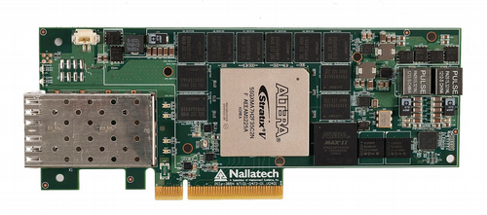
Compression rates with FPGA
FPGA = GenWQE/PCIe GZIP Accelerator @p8.desy.de
Comparison criteria:
space saving = 1 – 1/comp_ratio
    comp_ratio = uncompressed_size / compressed_size
data compression rate (speed)
  I/O from/to 3 alternatives: disk / memory / null
  Disk: home@p8.desy.de

Slide 5
Compression rates with FPGA
Sequential crystallography, idb22, ~175GB of 16 TB
  Space saving [41-51%], depends on run #
  Data rate (single thread):
    Disk: 0.95 GB/s RAM: 1.05 GB/s RAM/null O: 1.12 GB/s
Not-so-weakly scattering, idb30, ~210 GB of 4 TB
  Space saving [32-42%], depends on run #
  Data rate (single thread):
    Disk: 0.85 GB/s RAM: 0.89 GB/s RAM/null O: 1.00 GB/s

Slide 6
Comparison against software
Speed / data rate
  FPGA: ~1GB/s. ~100x faster than software:
    id22: [8.6, 8.8] MB/s
    id30: [8.7, 9.9] MB/s
Storage saved:
  FPGA: [32, 51]% raw data storage save
  Software could save more, [41, 57]%:
    id22: [48, 57]% => ~[12,17]% (relative) higher space saving
    id30: [41,50]% => ~[17,27]% (relative) higher space saving
Other software implementations (gzip, custom ‘gzip’) can be 6-7% faster
+ on different machines (exflpclXXnY), up to [19, 21]% faster.

Slide 7
Other remarks
Acceleration works well with our technologies:
  HDF5 format compression
  Karabo framework
    Karabo HDF5 API
    Devices
Multi-thread/process:
  Could do 1.7 GB/s (2 threads)
    Recommended? Stable? How does it work?

Slide 8
Headlines
Work in progress
  Format XTC / HDF5
  Disk I/O setup: GPFS
Storage saving:
  Raw data: ~32-51% Other files:potential ≥85%?
Compression data rate:
  FPGA rates “close to” 1 GB/s.
  Faster than software by x[93, 128] (RAM I/O)

Slide 9
Qs
Ideal rate of 1.7-1.8 GB/s?
  Buffer sizes - 1.4 GB/s single threaded?
  Multi-process/threading? - 1.7 GB/s - stable?
GenWQE -- CAPI

