Slide 1
Discover Driven Data Augmentation

Slide 2
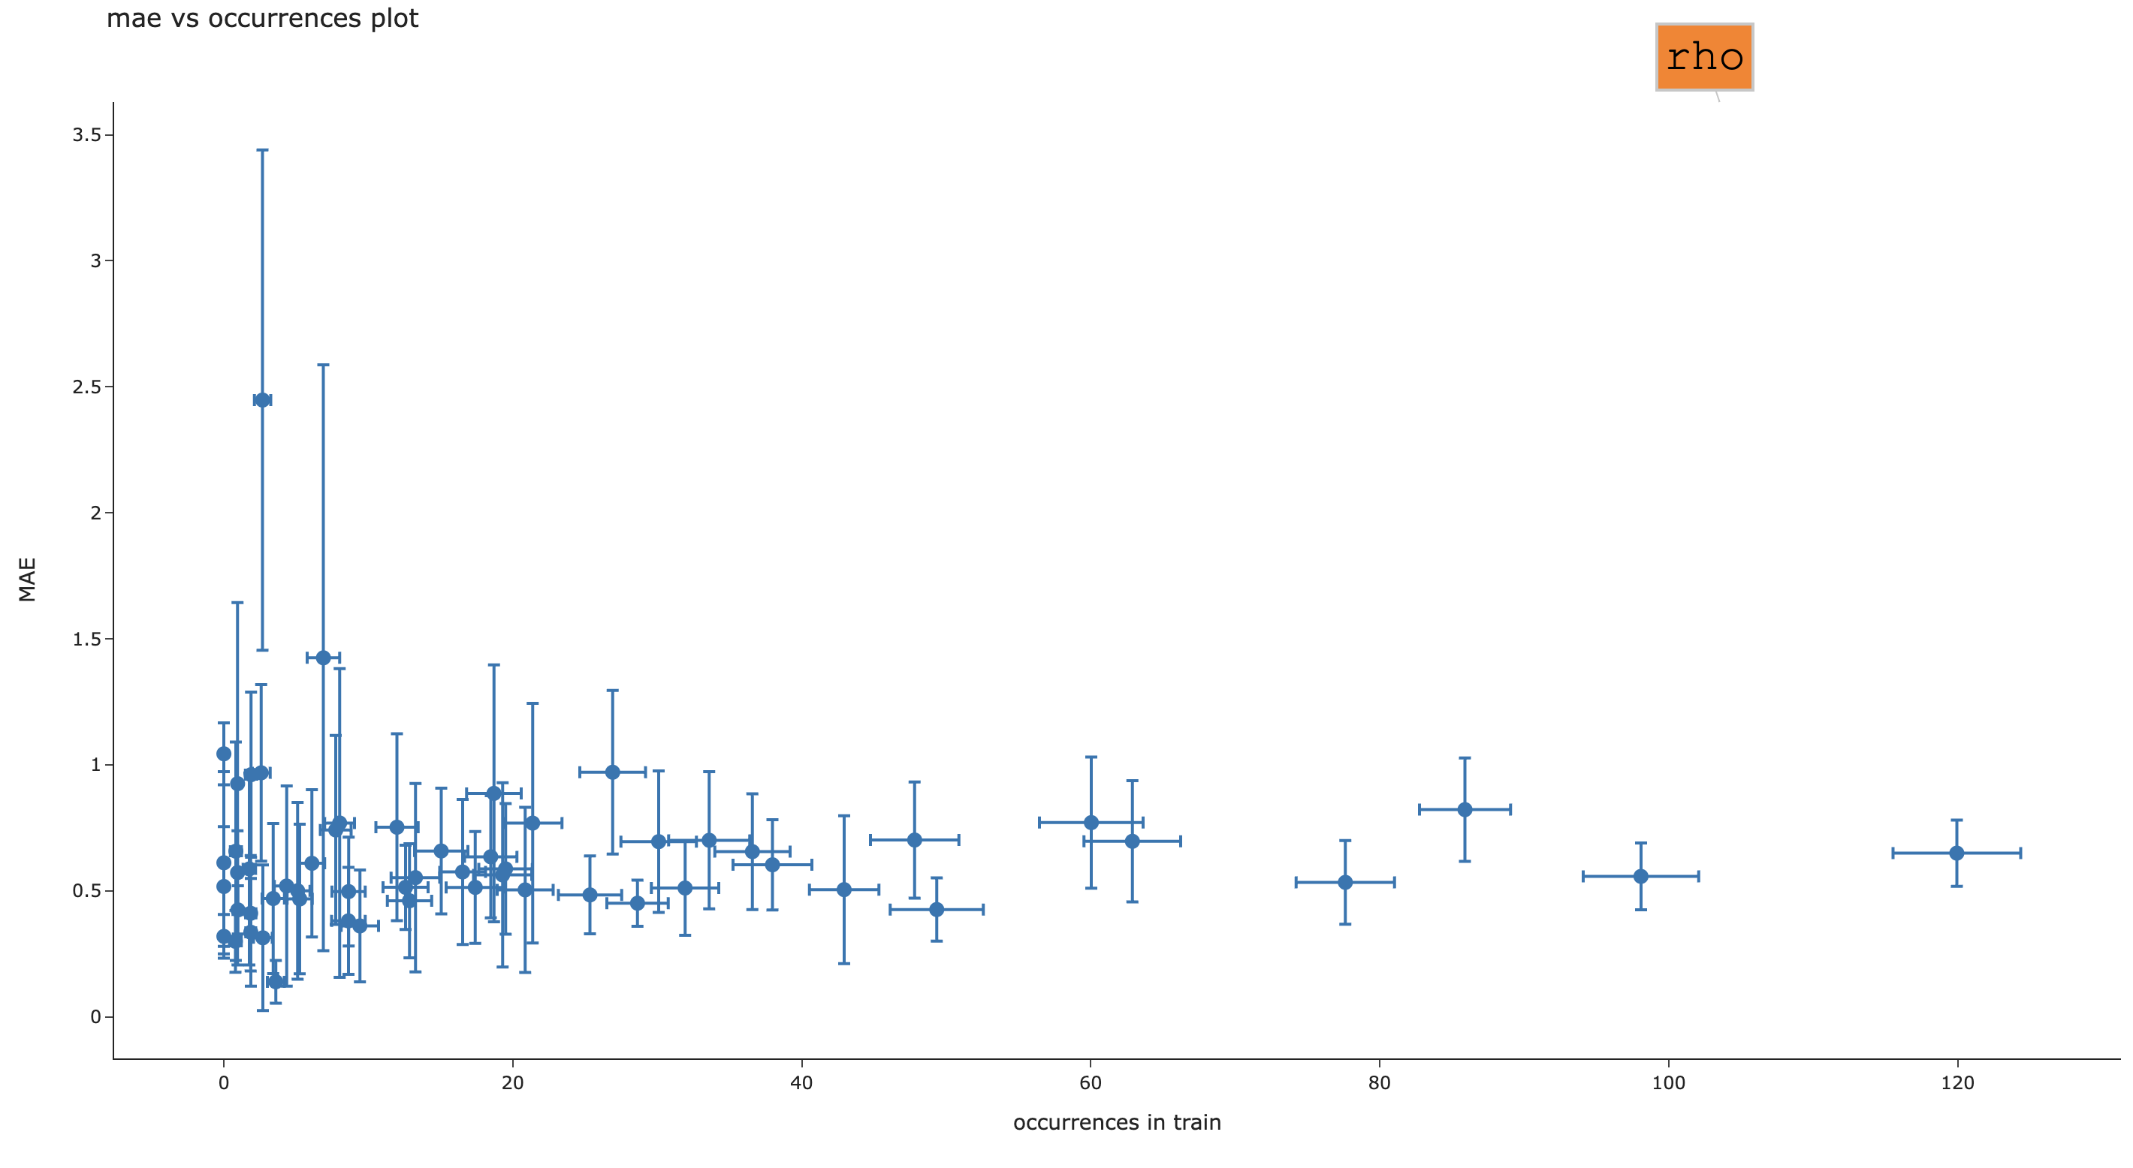
FIGURE 1
occurrences vs MAE
high occ -> low MAE
low occ -> high MAE
high occ -> high occ bars
low occ -> low occ bars
high occ -> low MAE bars
low occ -> high MAE bars
W
Tl
Rh
Cu
Sb
O
Occurrences of a specific element in the train set plotted against the corresponding error when the same formula appear in the test set.
With that we want to show that the error is likely to increase as less representative data become available in the training.

Slide 3
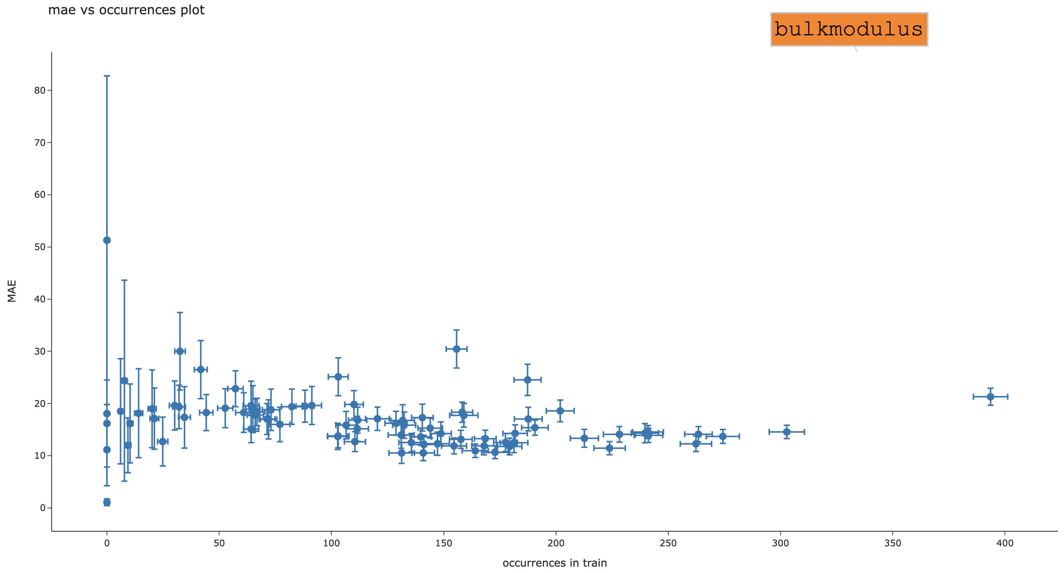
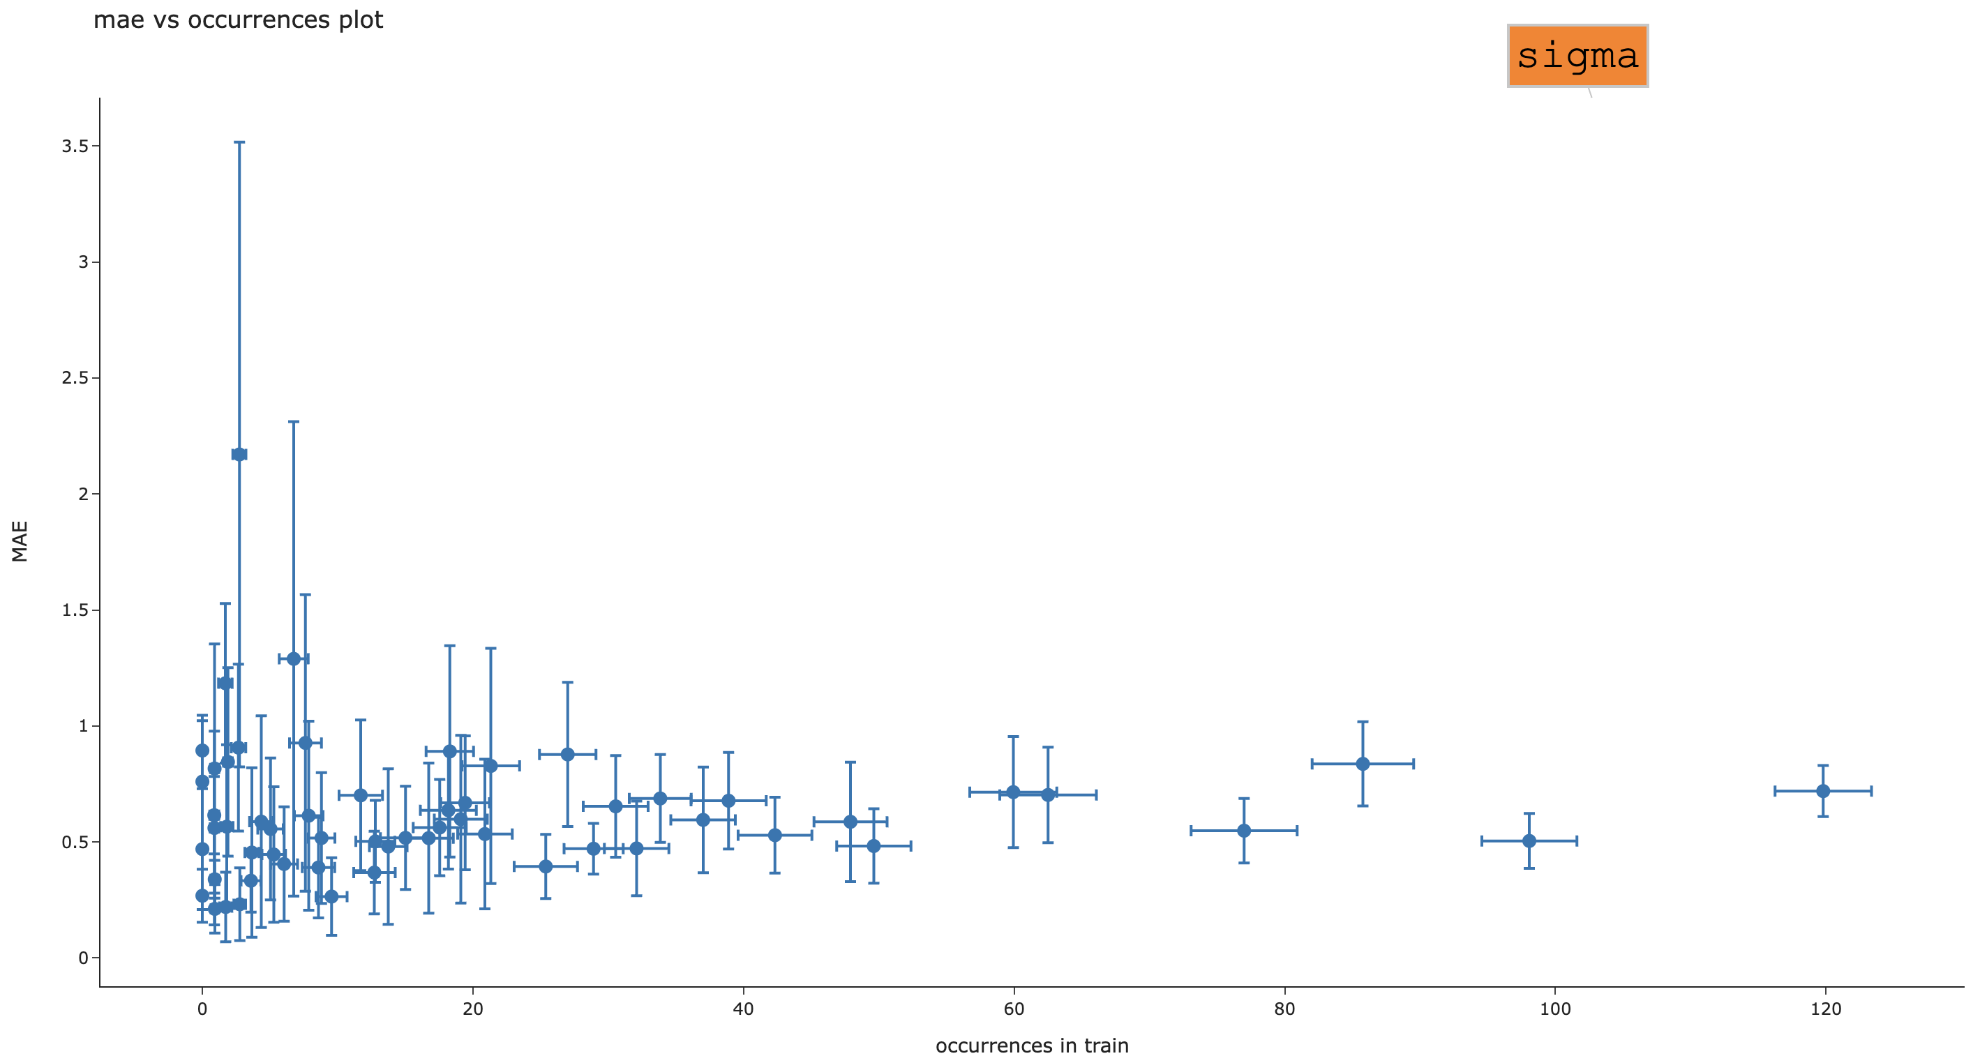
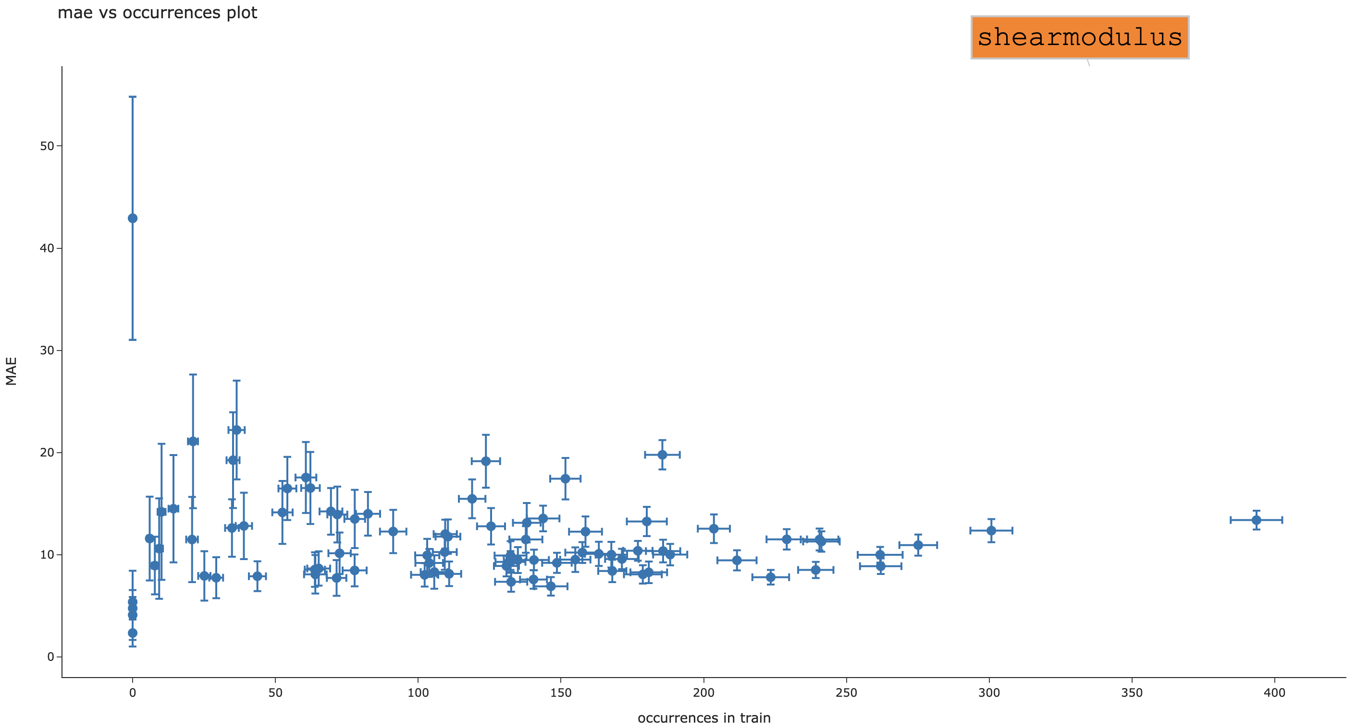
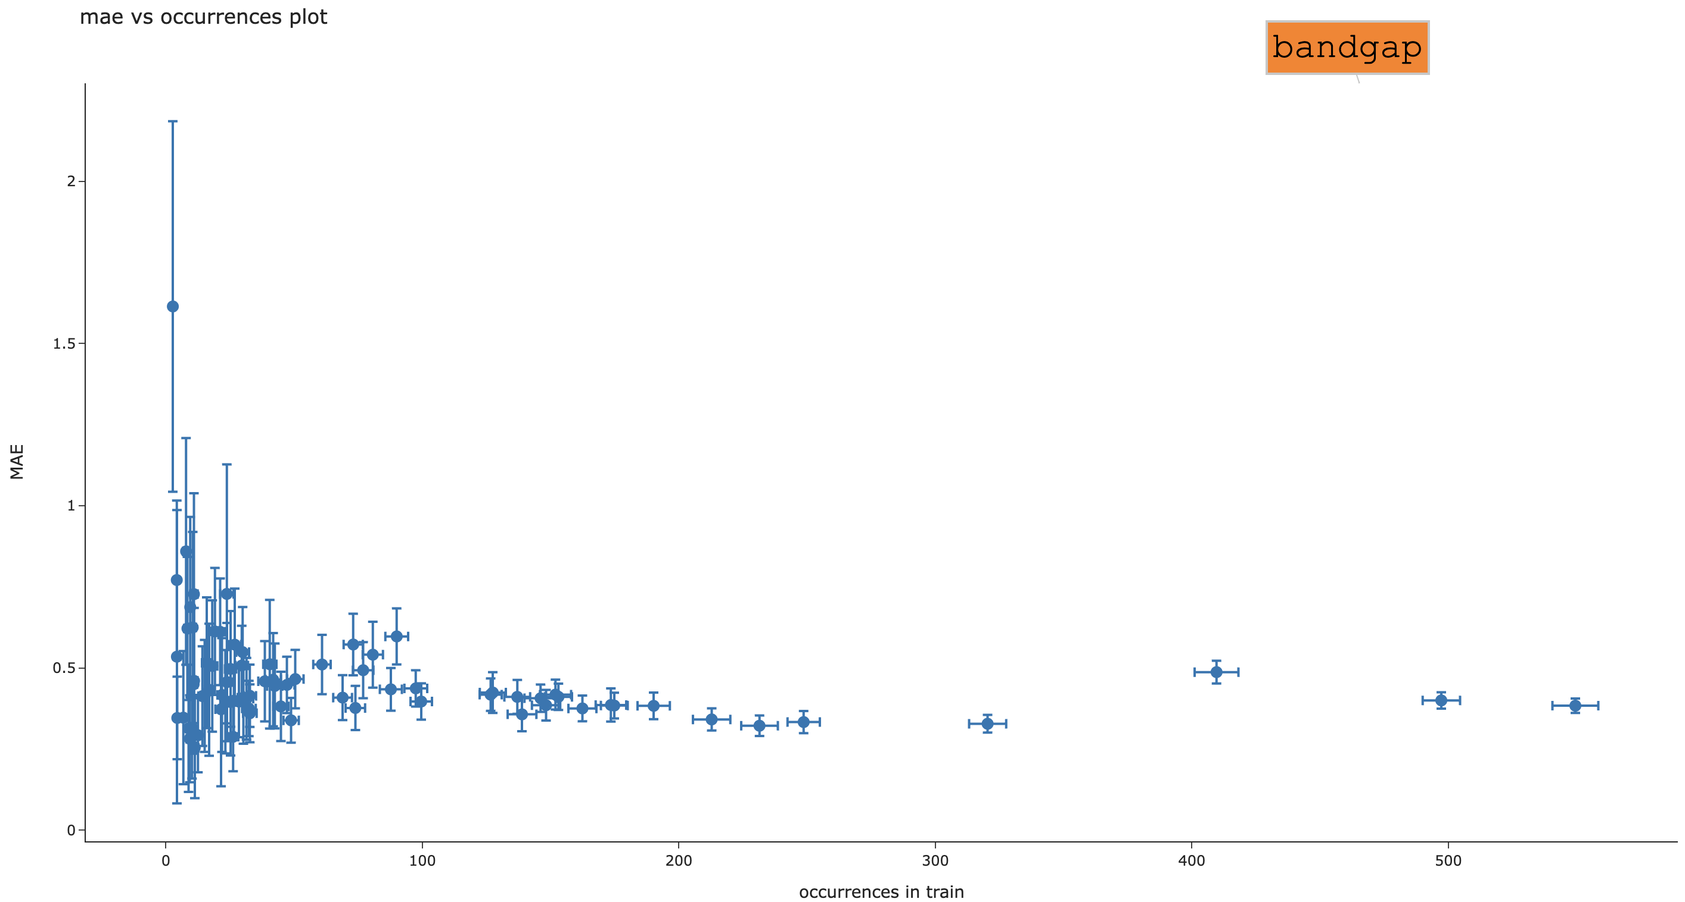
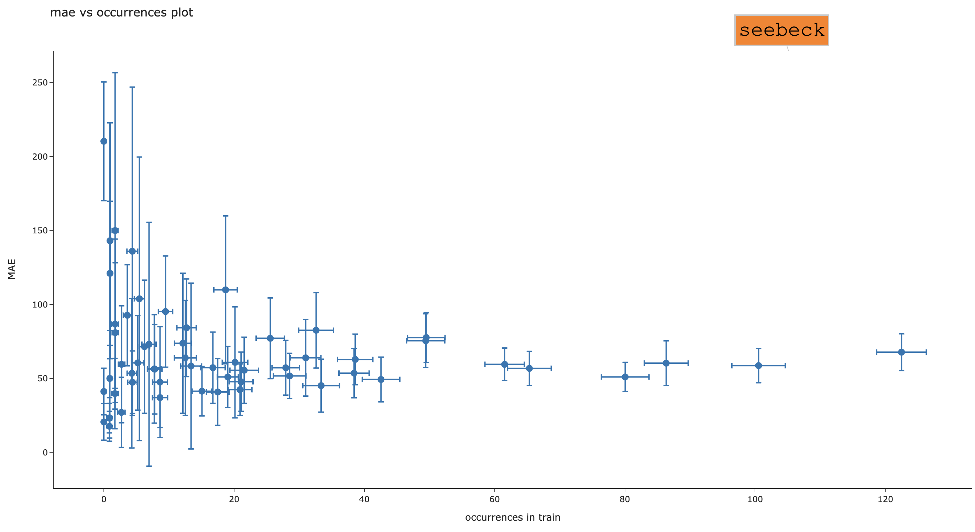
FIGURE 1
occurrences vs MAE

Slide 4
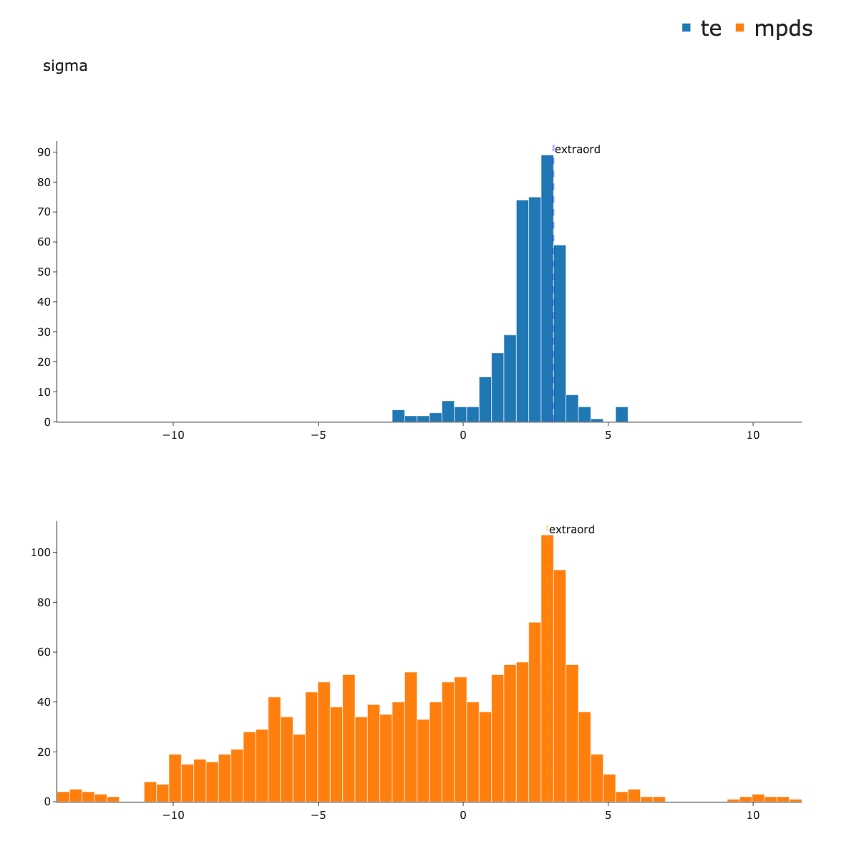
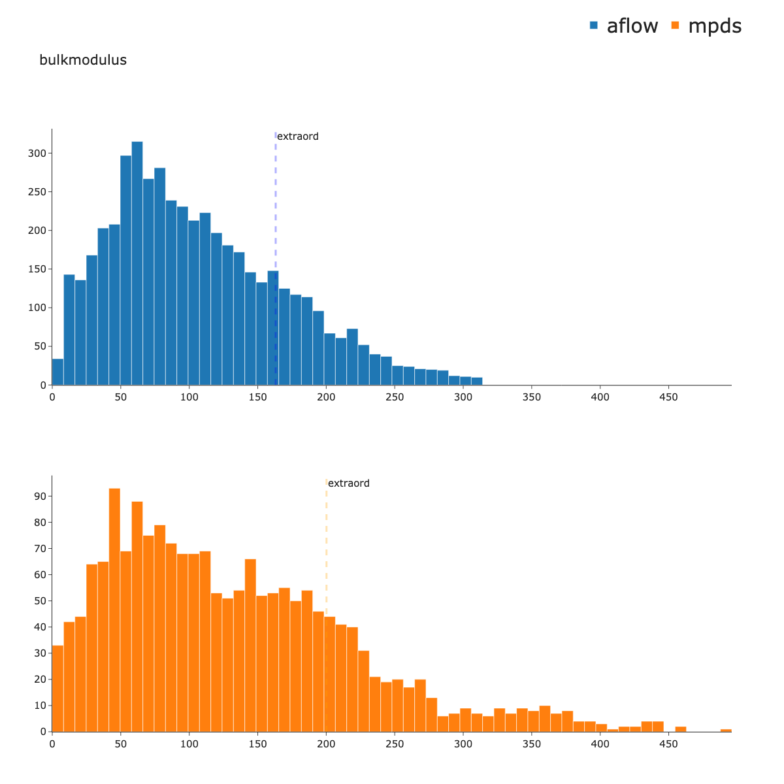
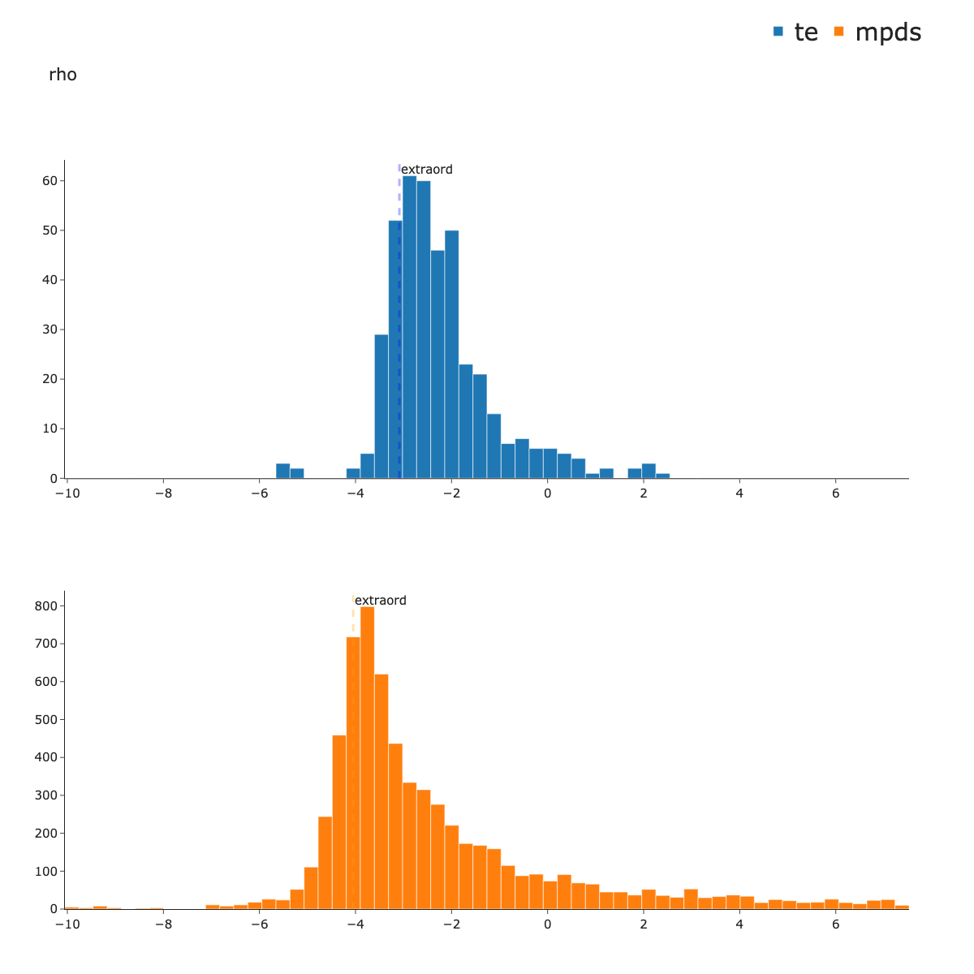
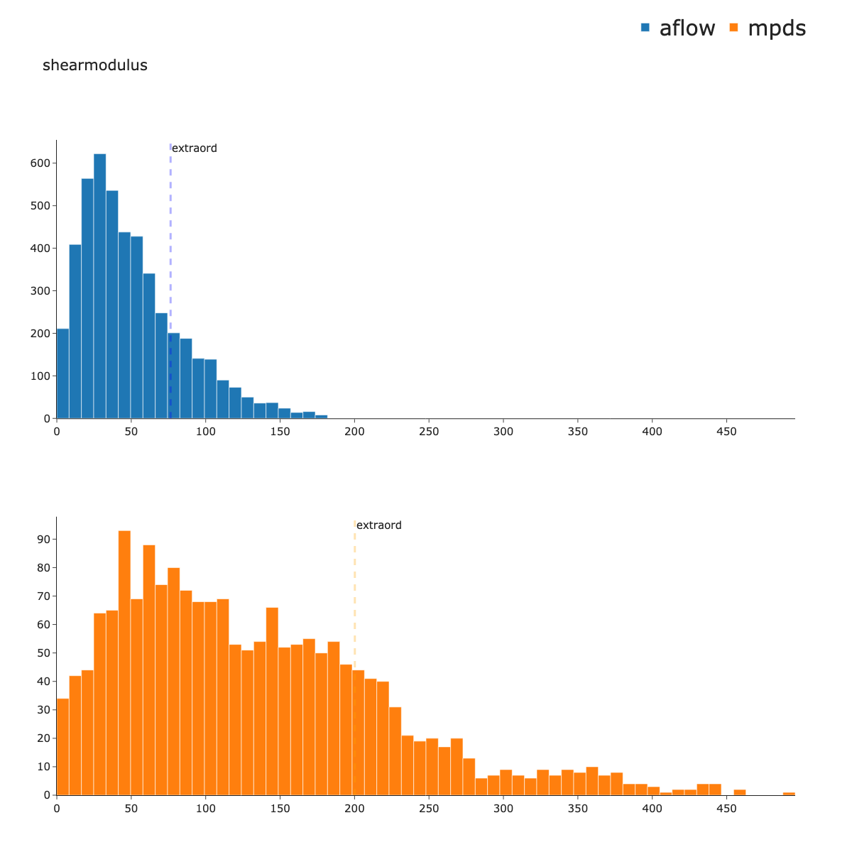
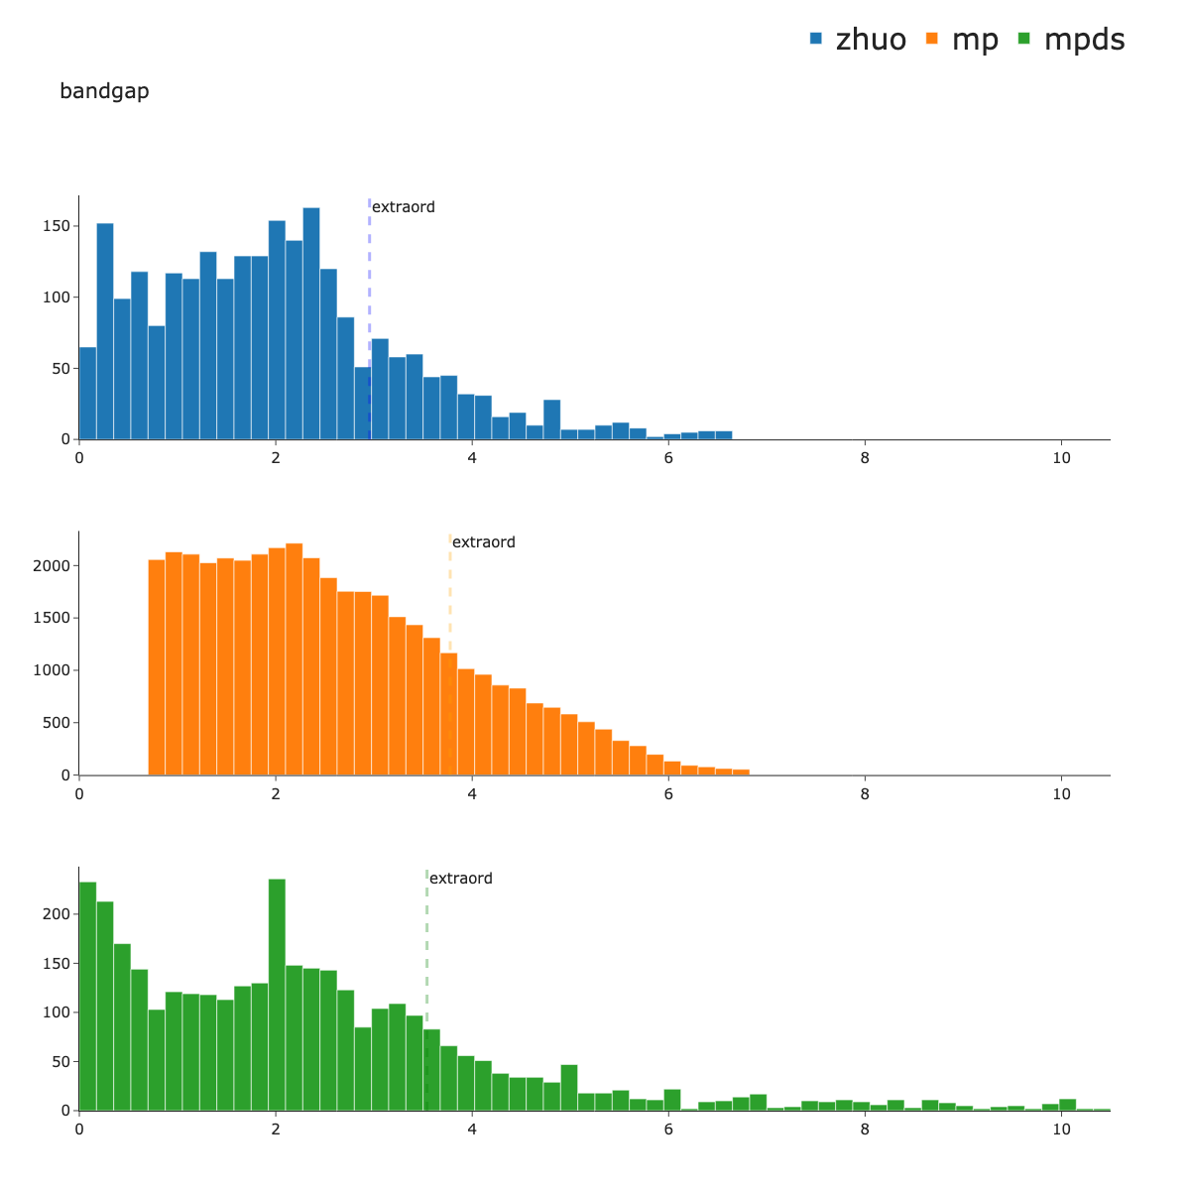
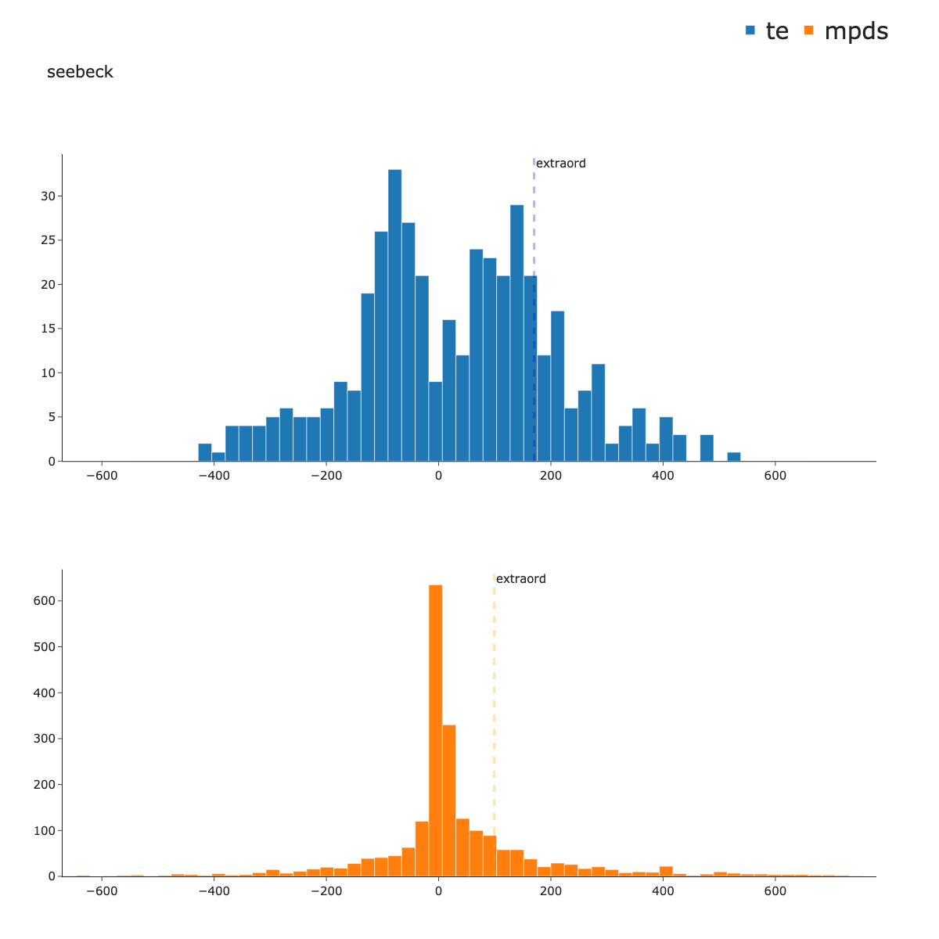
FIGURE 2

Slide 6
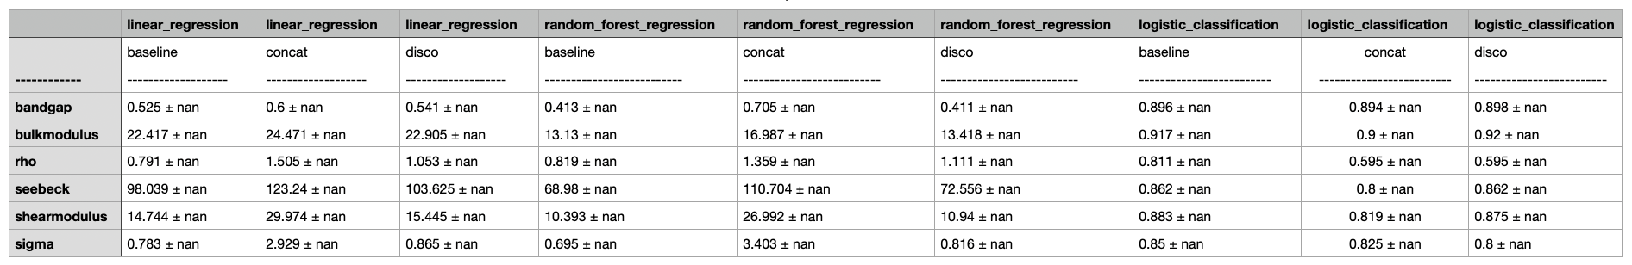
FIGURE 3
The table contains the changes in accuracy when different configurations are considered.
For each original dataset and model, three numbers are reported: the accuracy on a test set without augmentation, accuracy after concatenation with the mpds, accuracy after concatenating with most novel points in the mpds (according to Discover).
No augmentation shows better accuracies consistently.

Slide 7
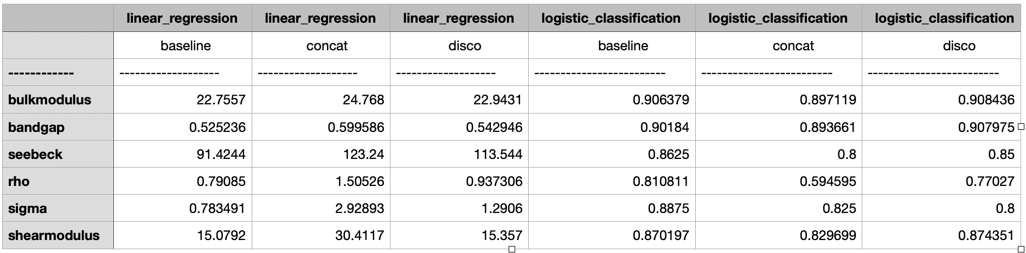
old table

Slide 8
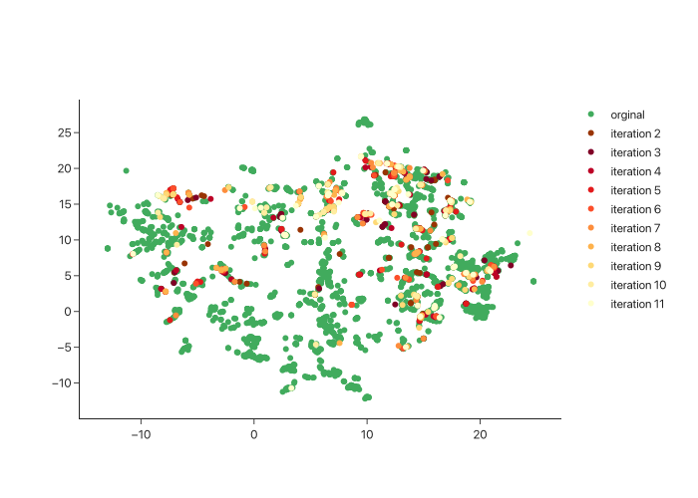
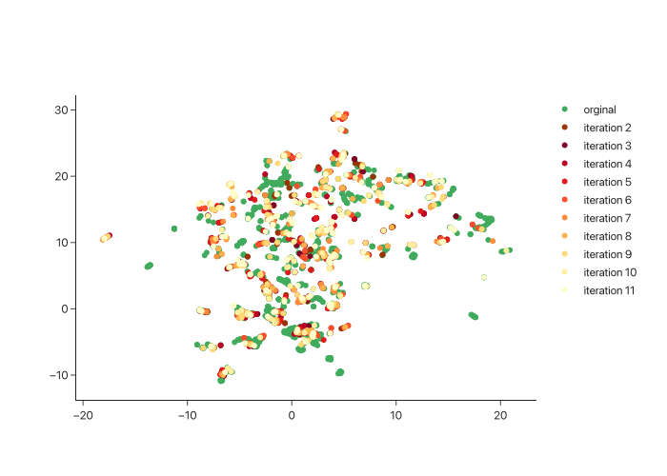
Bulkmodulus
Bandgap
Discover augmentation. The plot shows the umap embedding of the most novel points added by discover. Novel regions are hardly populated.

Slide 9
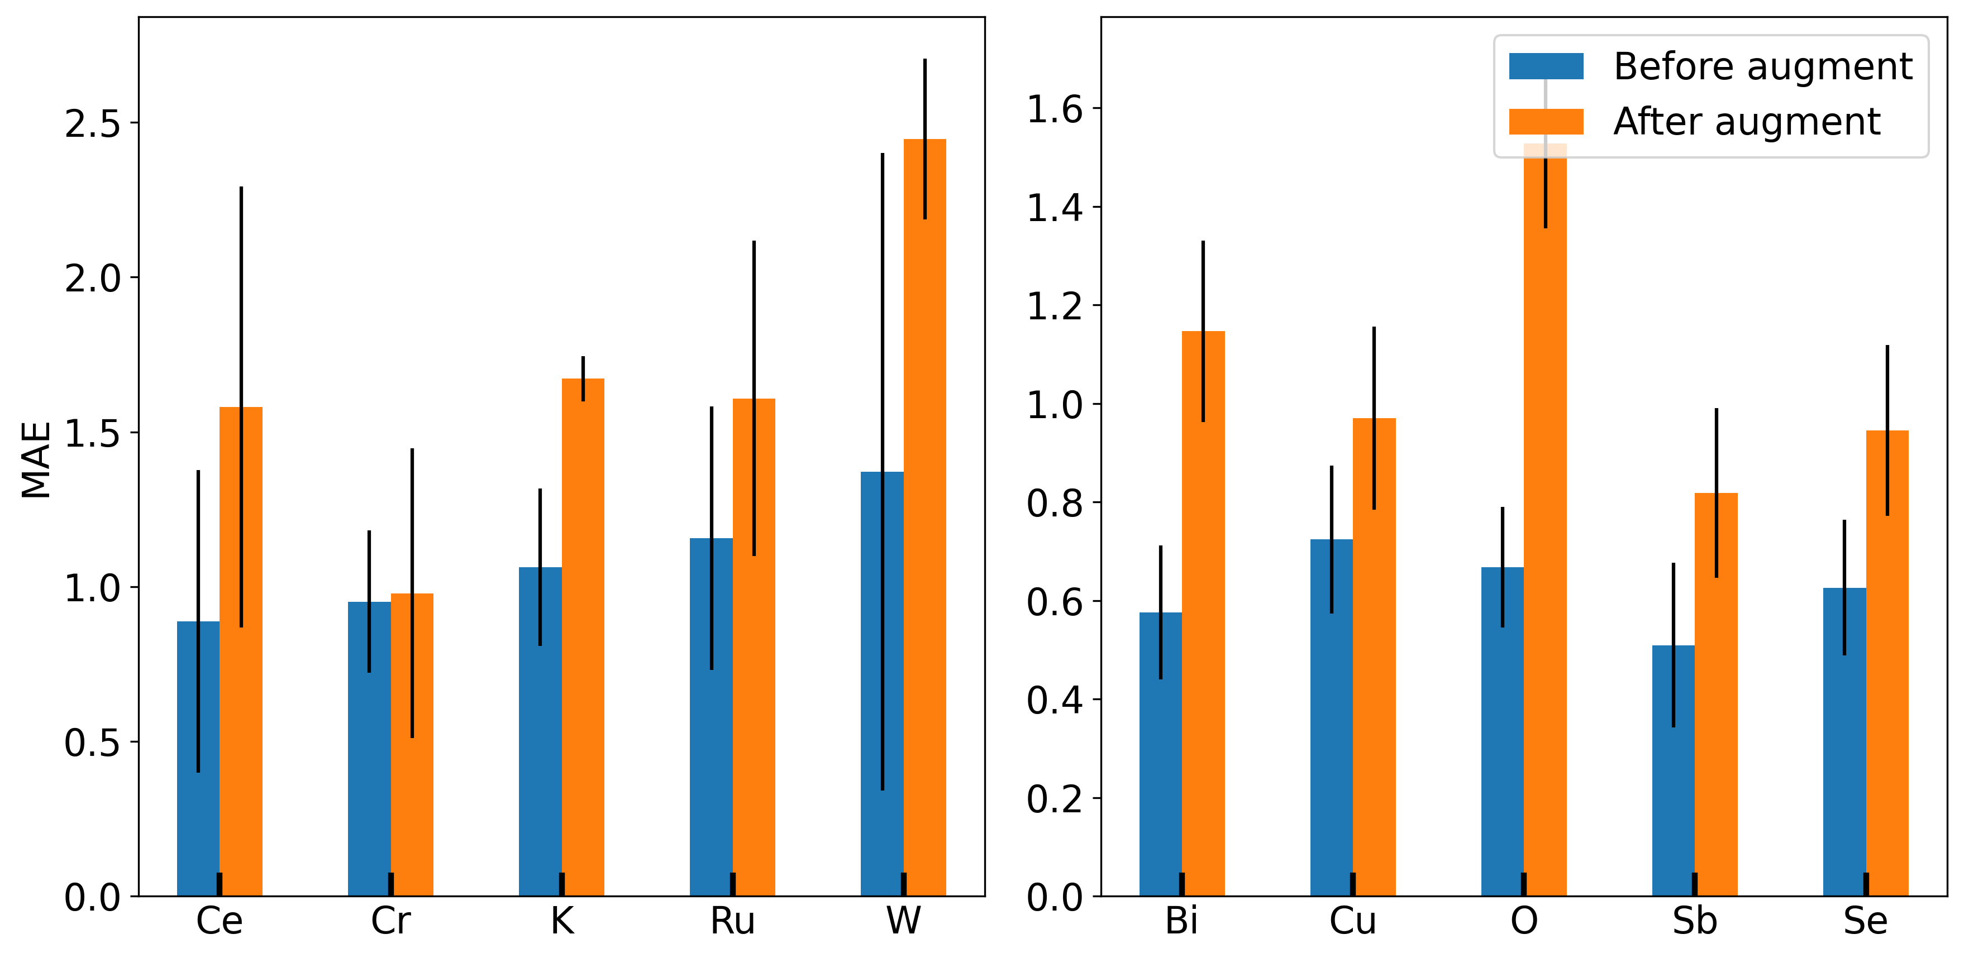
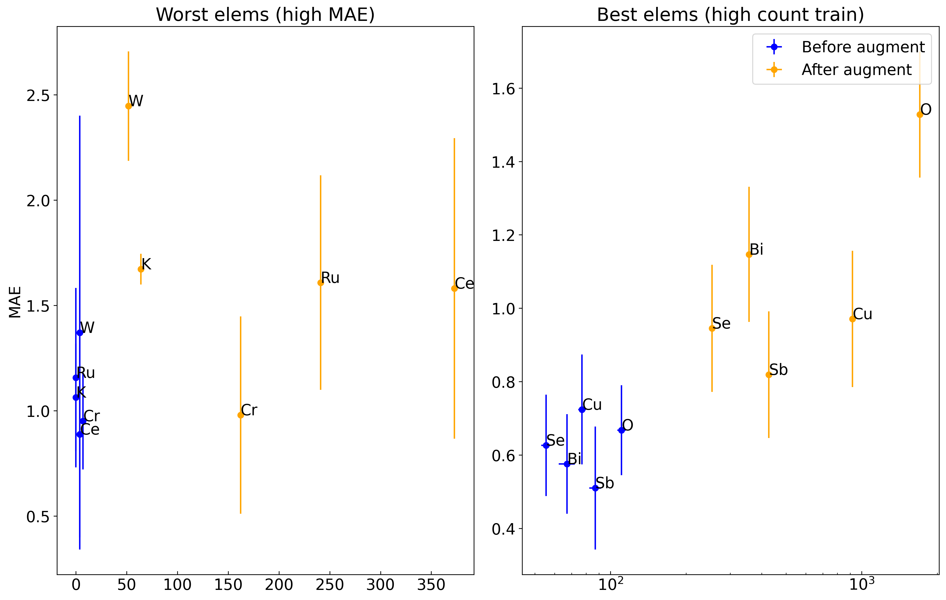
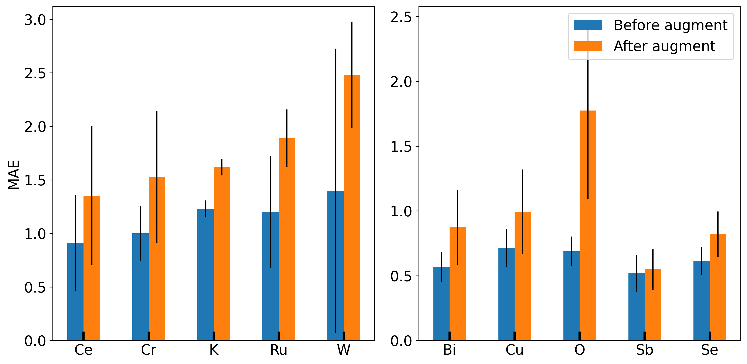
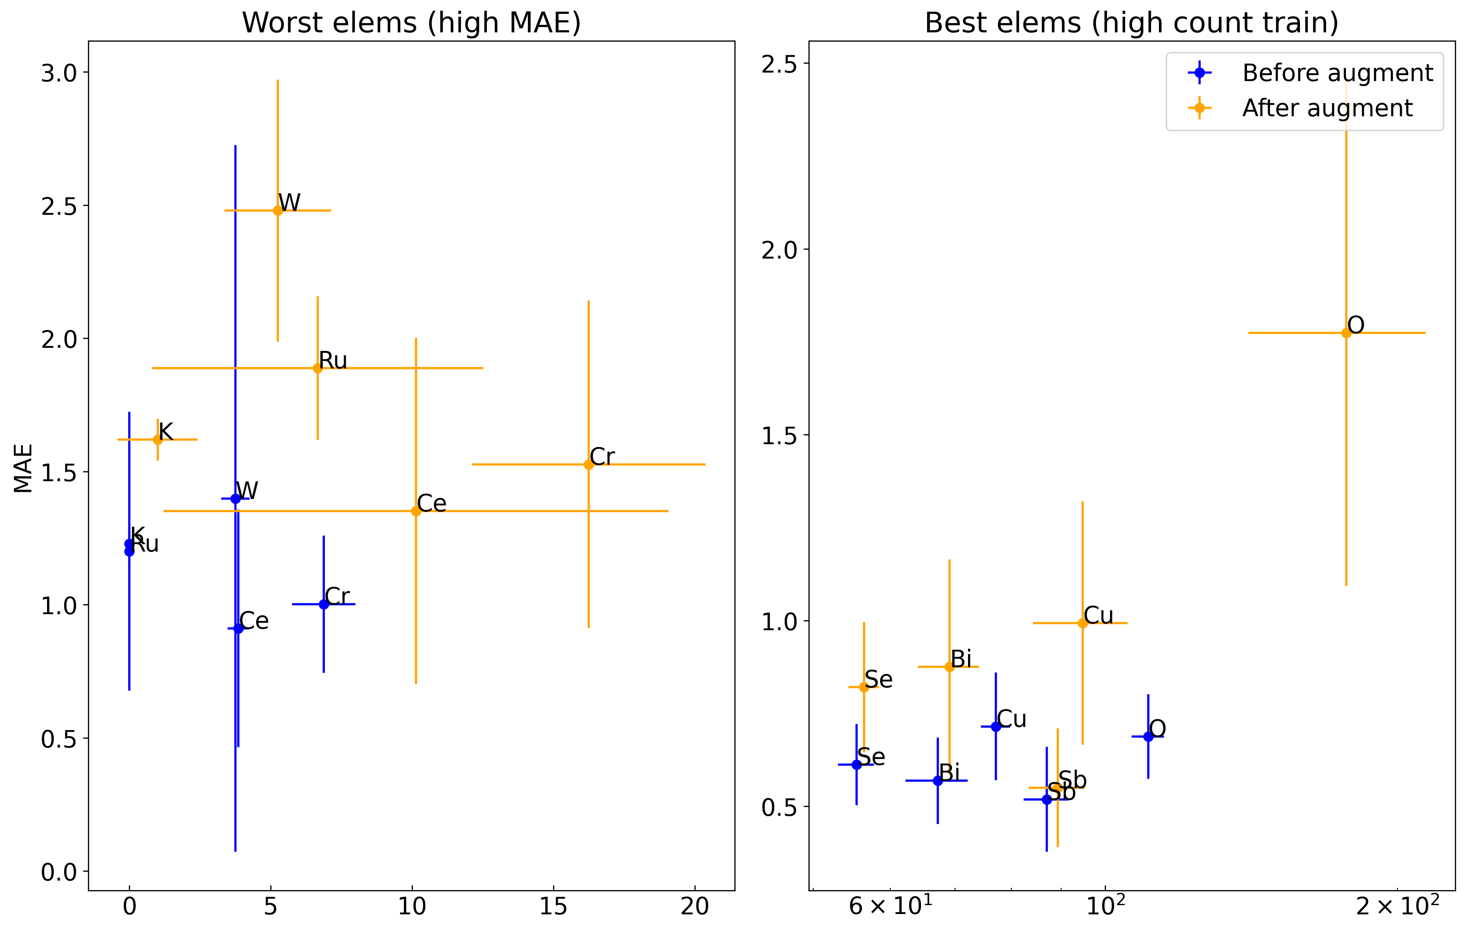
CONCAT
DISCO

Slide 11
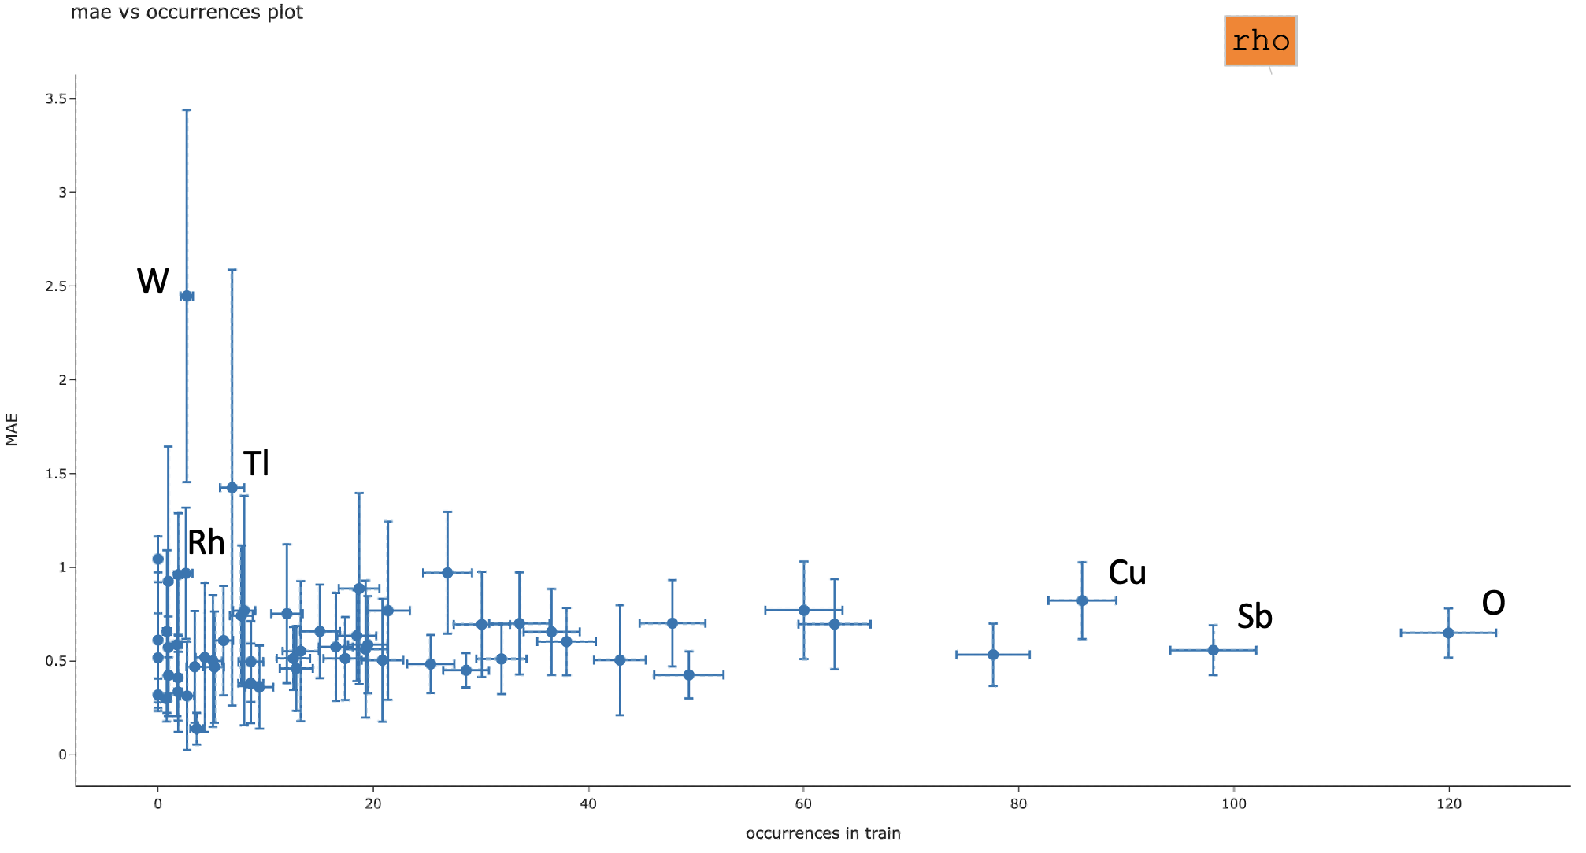
RECAP
Figure 1 (imbalance)
Figure 2 (datasets)
Figure 3 (DA from mpds)
Figure 4 (accuracy vs mat class)
Figure 5 (metric vs dataset similarity?)
Figure 6 (DA from itself)

Slide 12
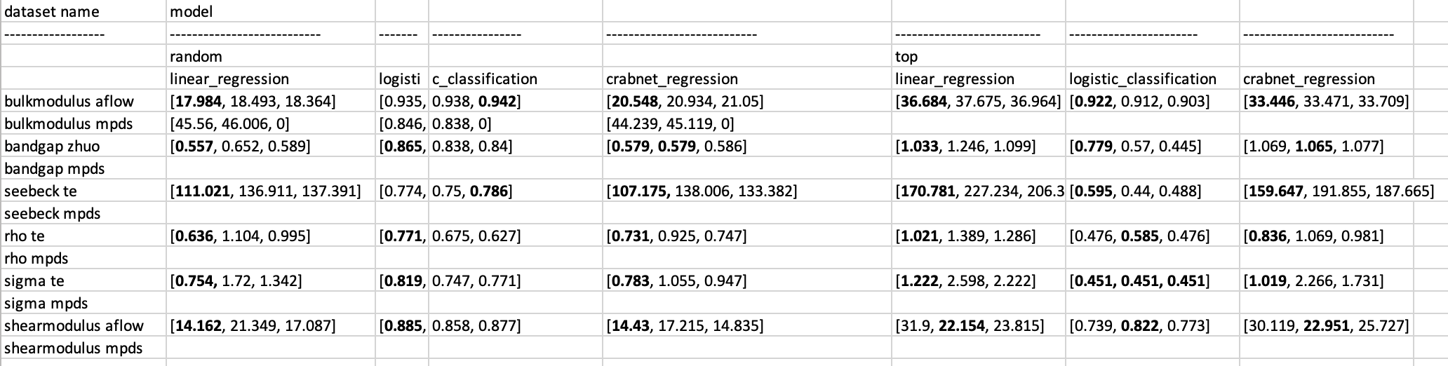
backup
old table

